Slide 1
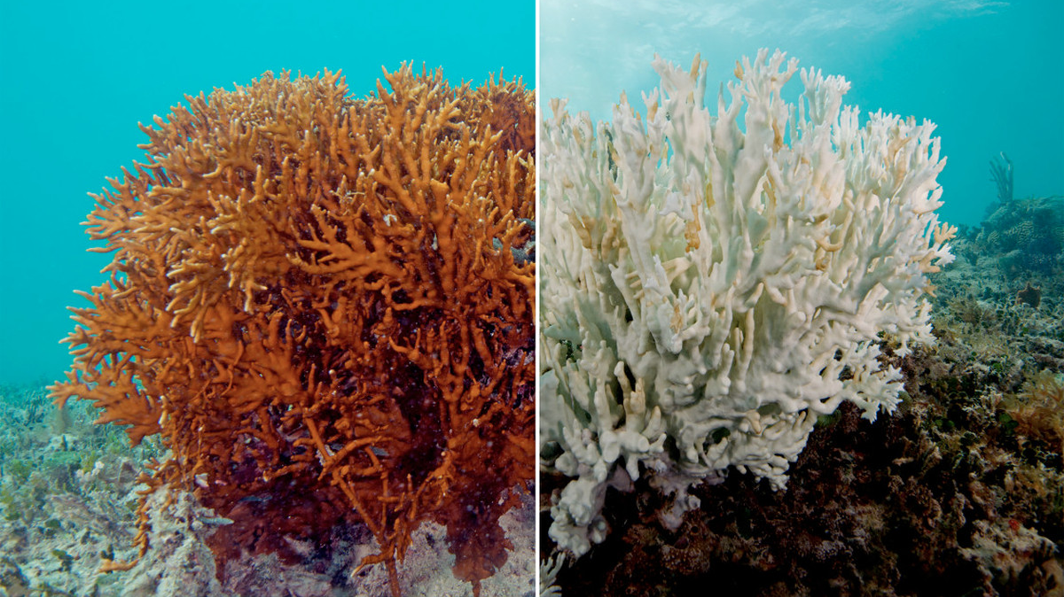
Coral Bleaching
Sam Rosen

Slide 2
Time to KaHOOT!!
Let’s test your knowledge on Coral Bleaching!
2

Slide 3
Suggested Conservation Efforts
Observe boating regulations
No mooring in shallow areas with coral
Using biofuels instead of natural gas – curbs emissions, too!
Emissions can mix with sea water to create a toxic environment for marine species
Education and Awareness
General public: be mindful about waste and pollution
Divers: stay off the reef!
Building artificial reefs using concrete structures, sunk ships, etc.
Unless plastic, not completely ideal because can still be affected by increasing ocean temp and acidity from emissions
Coral farming
Decent from a regeneration perspective & protection from marine habitat loss
Lowering greenhouse gas emissions & sea surface temperatures
Helping curb carbon dioxide emissions to 350-450 ppm!
Eliminating runoff pollution and (organic*) garbage
Probably one of the best things to do at this point
*Organic: when it decomposes, carbon dioxide and methane gas is released -> compost better than landfill!

Slide 4
Government Influence: EPA
Executive Order 13089: Coral Reef Protection
Calls for organizations whose activities may affect coral reefs to identify their actions, operate in a way to protect and enhance the coral reef ecosystems and ensure that any action they authorize or fund won’t degrade the integrity of the reef systems
Important because without regulation, little-to-no way of protecting the reefs
Clean Water Act – a few examples
Provides funding and technical assistance to coral monitoring and assessment programs (CWA 106)
Implements water quality improvement projects in places from which water discharge originate (CWA 319)
Works to reduce trash from entering coastal waters through the Trash-Free Waters Program

Slide 5
Government Influence: Paris Climate Talks
Coral Reef experts educating Paris scientists about the imperativeness of limiting global carbon emissions
Ideally, commit to limiting carbon dioxide concentrations to no more than 450 ppm (short term) and 350 ppm (long term)

Slide 6
Interesting Topic: Sunscreen
Sunscreen poses another threat to coral reefs.
Sunscreens contain chemicals such as UV filters, which protect the skin against sunburn and skin cancer. However, some of those chemicals, like oxybenzone (benzophenone-3) and octinoxate, are harmful to corals, and have even been shown, toxicopathologically, to play a role in coral viral infection. Specifically, these chemicals cause bleaching, as well as DNA and endocrine disruption to corals (Miller et. al., 2019).
The U.S.F.D.A. is a very lazy agency and has yet to approve of modern UV filters for the U.S. Market – not enough research has been done, and so efficacy and safety is still a question.
Solution: sunscreen-infused swim/dive shirt! Even though you might think it’d still be bad, sunscreen is actually retained more in fabric (polyester) than on skin. Thus, it doesn’t harm corals as much. In some areas, like in the Caribbean, certain governments impose fines if tourists wear sunscreen on bare skin, but not if they wear a sunscreen-infused swim/dive shirt.

Slide 7
Discussion Questions
Question 1
Question 2
Question 3
If you had direct access to the President, stakeholder, or other authoritative figure, what area of coral conservation would you recommend they tackle first as part of a top-down approach?
Are there any ways you can think of for revitalizing lost coral populations within the next decade or so, or do you think it’ll take much longer?
Do you see there being a point where natural populations become so decimated that the only way of revitalization is to do so artificially (e.g. artificial reefs)?
The cycle of coral bleaching is very positive: sea water traps more CO2, temperatures heat up, Zooxanthellae die out, and coral turns the color chalk. Are there any points where this feedback loop can “neutralize” or any solutions that can solve more than one problem in this cycle?

Slide 8
Discussion Questions
Question 4
Question 5
Question 6
Partly based on our discussion of corals from earlier in the semester, do you think the EPA is doing enough to protect coral reefs?
If anything, what else should be done
Regarding the Paris Climate talks, do you think it’s still possible that, with international partnerships and cooperation, we can reduce emissions to between 350-450 ppm in the future?
Thought: we’ll have to work to lower by doing many things to reduce carbon emissions
What do you think you (yes, each of you) can personally do to help coral reefs (e.g. by supporting eco-friendly, sustainable businesses that don’t pump their sewage into reefs, that dredge reefs, and that work with local stakeholders to manage reefs and natural resources)?

Slide 9
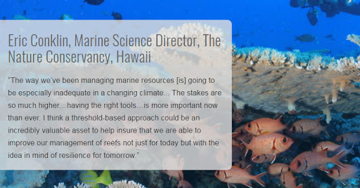
Quote and Image Slide
“
9

Slide 10
THANK YOU!
Insert Image

Slide 11
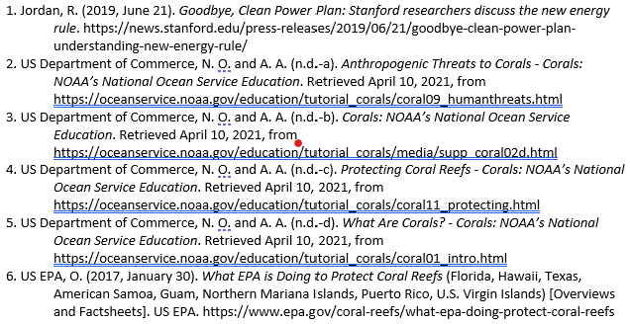
References
Is Your Sunscreen Harming Coral Reefs? A single study was the main catalyst for recent sunscreen ingredient bans, yet the science community is still debating those ingredients' effects on coral reefs--and even on sunscreen users. (2019, April 22). Miller-McCune.com. https://link.gale.com/apps/doc/A593892268/ITOF?u=coloboulder&sid =ITOF&xid=1654b988

