Slide 1
Policy Implications of Climate : Critical Issues in Climate and the Environment,
ATOC4800/ATOC5000/ENVS5830:
Prof. Weiqing Han
University of Colorado Boulder
Boulder, CO
23 March 2021
The role of the Montreal Protocol in protecting present and future climate:
A scientific perspective
by
Outline
• Ozone basics
• The Montreal Protocol
• Ozone Depletion Assessment
• CFC-11 rogue emissions
• HFCs and Kigali Amendment
• Climate Change Building
• Summary remarks
Dr. David W. Fahey, Director
NOAA Chemical Sciences Laboratory
Boulder, Colorado USA

Slide 2
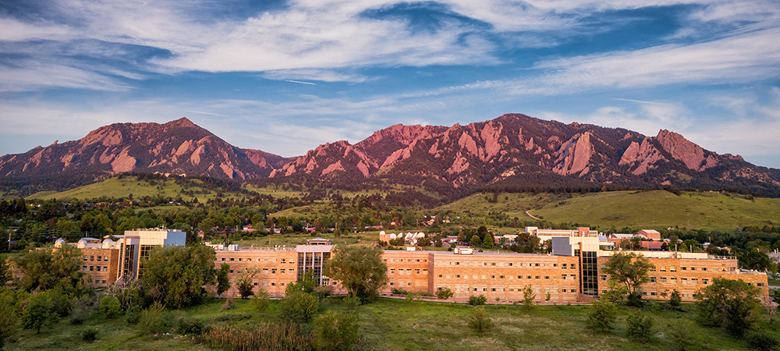
David Skaggs Research Center
CSL Mission:
To advance scientific understanding of the chemical and physical processes that affect Earth’s atmospheric composition.
NOAA Chemical Sciences Laboratory: https://csl.noaa.gov/
2021 Laboratory Review: https://csl.noaa.gov/reviews/2021/

Slide 3
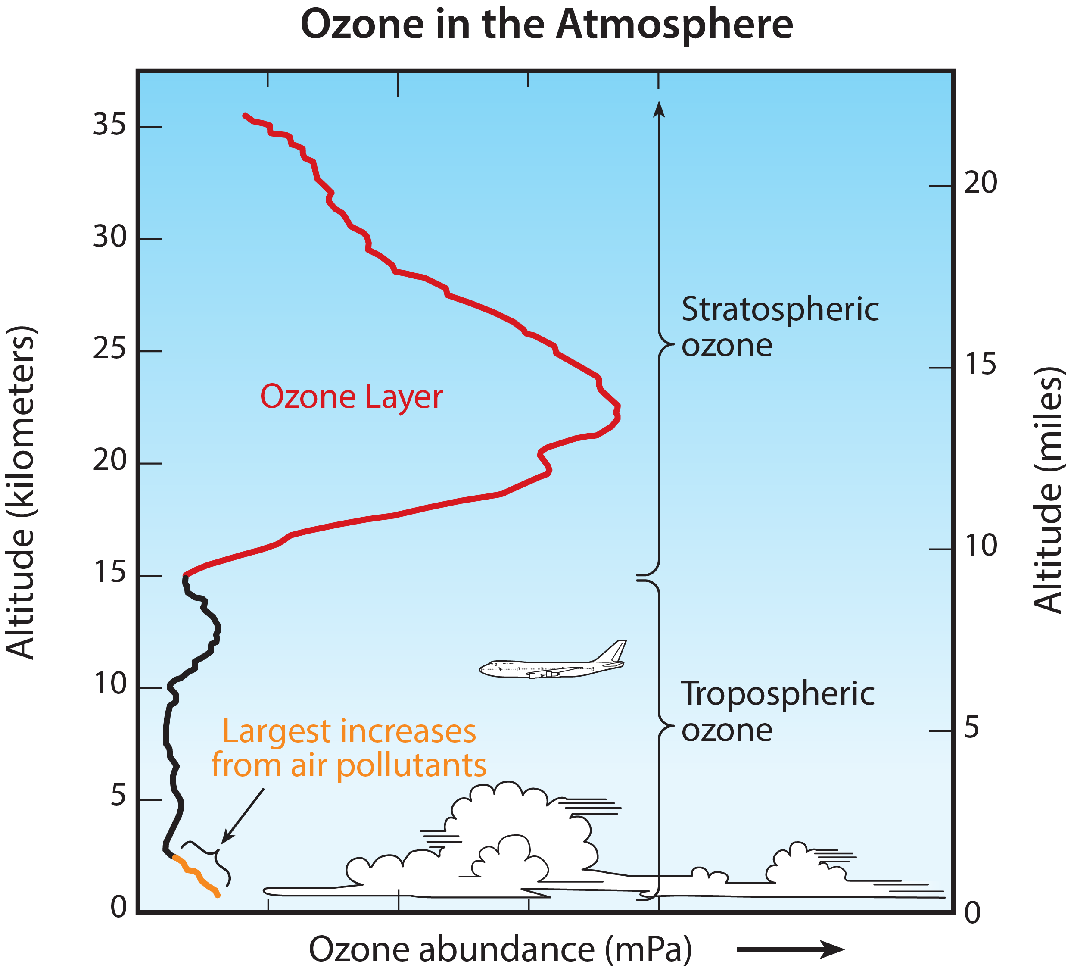
The Ozone Layer
• The ozone layer resides in the stratosphere and surrounds the entire Earth.
• UV-B radiation (280- to 315-nanometer (nm) wavelength) from the Sun is strongly absorbed in this layer.
• UV-A (315- to 400-nm wavelength), visible light, and other solar radiation are not strongly absorbed by the ozone layer.
Good ozone
• Human exposure to UV-B radiation increases the risks of skin cancer, cataracts, and a suppressed immune system. UV-B radiation exposure can also damage terrestrial plant life, single-cell organisms, and aquatic ecosystems.
Bad ozone
The stratospheric ozone is good ozone and excess ozone in the troposphere is bad ozone.
UNEP/WMO Ozone Assessment, 2018

Slide 4
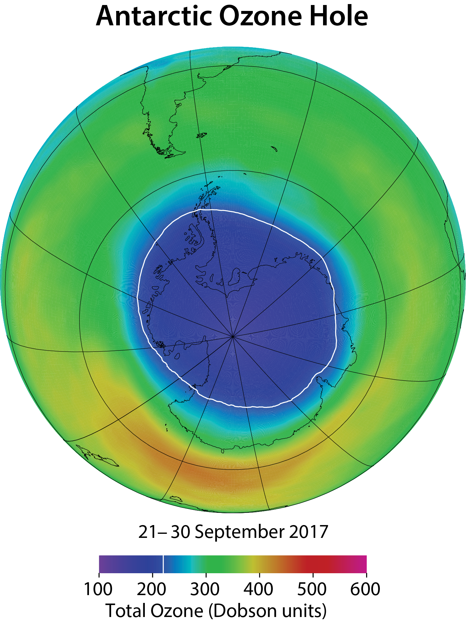
The Montreal Protocol on Substances that
Deplete the Ozone Layer – 16 September 1987
The Parties to this Protocol,
Being Parties to the
Vienna Convention for the Protection of the Ozone Layer,
Mindful of their obligation under that Convention to take appropriate measures to protect human health and the environment against adverse effects resulting or likely to result from human activities which modify or are likely to modify the ozone layer,
Recognizing that world-wide emissions of certain substances can significantly deplete and otherwise modify the ozone layer in a manner that is likely to result in adverse effects on human health and the environment,
Conscious of the potential climatic effects of emissions of these substances, ……
Universal ratification in September 2009 by 197 members of the United Nations.
→ The world’s most successful environmental treaty
www.unep.org/OZONE/pdfs/Montreal-Protocol2000.pdf

Slide 5
Aspects of the Montreal Protocol
The Montreal Protocol has imposed legally binding controls on the global consumption and production of ozone depleting substances (ODSs) and introduced short-term and long-term substitute gases.
- chlorofluorocarbons (CFCs)
- halons
- hydrochloroflurocarbons (HCFCs)
ODSs are used to meet application demand for refrigeration, air conditioning, insulating foams, fire suppression, and many other society needs.
The Montreal Protocol addresses the governance, technical, economic and scientific aspects of its regulations and distinguishes between the developed and developing world.
The Montreal Protocol has imposed legally binding controls on the global consumption and production of hydrofluorocarbons (HFCs)

Slide 6
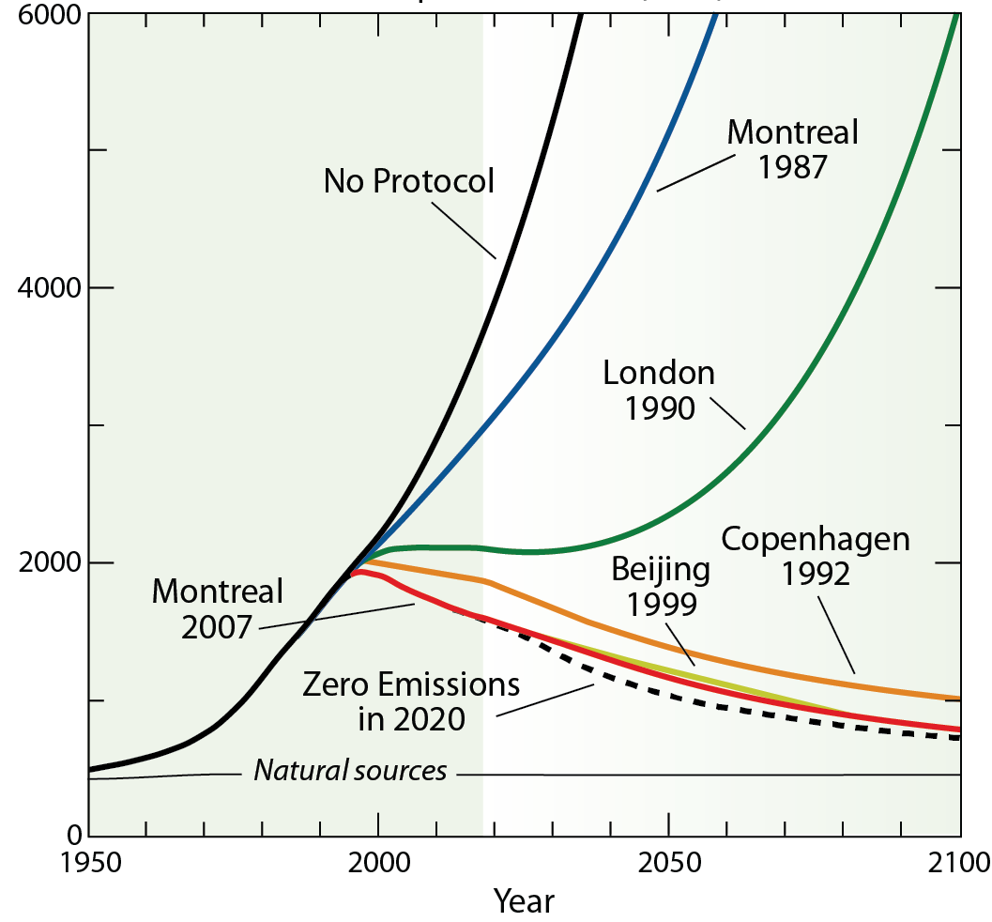
The Montreal Protocol & Amendments
The Ozone Hole Movie
Chlorine and bromine from ozone depleting substances (ODSs) destroys ozone.
(World avoided)
The Montreal Protocol has been very successful in reducing chlorine and bromine in the atmosphere.
Atmospheric chlorine and bromine
Strategy: Start and strengthen.
City names are locations
of the meetings of the parties
UNEP/WMO, Ozone Assessment, 2018

Slide 7
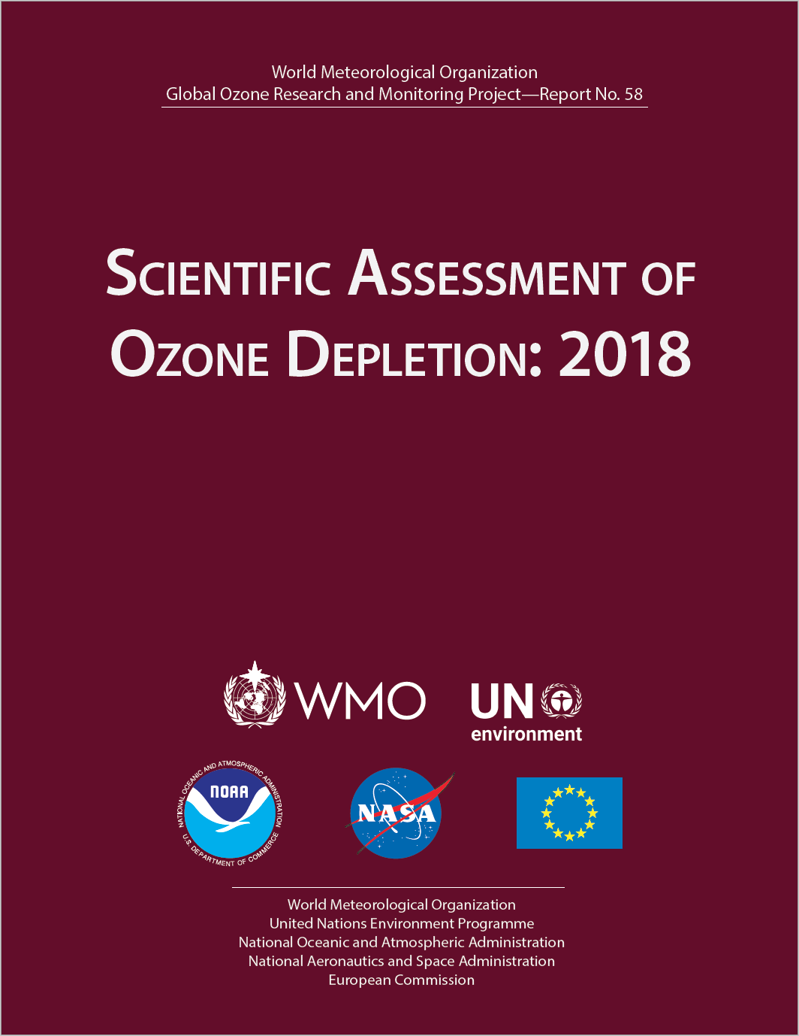
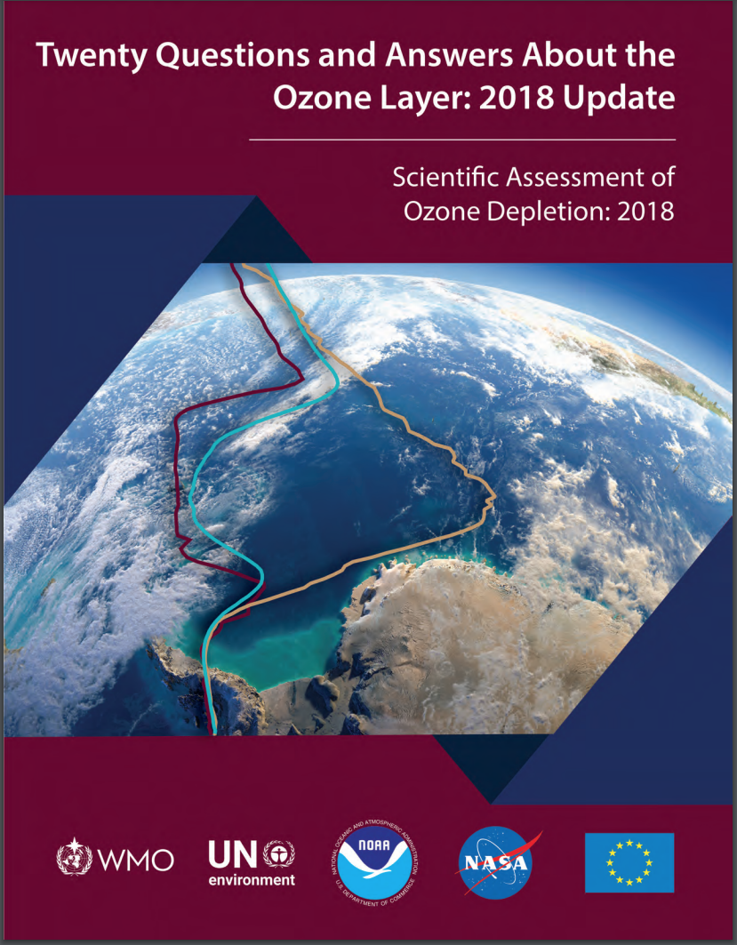
• The 2018 Ozone Depletion Assessment was released to the 197 Montreal Protocol parties and the public in February 2018 (590 pgs)
https://csl.noaa.gov/assessments/ozone/2018/

Slide 8
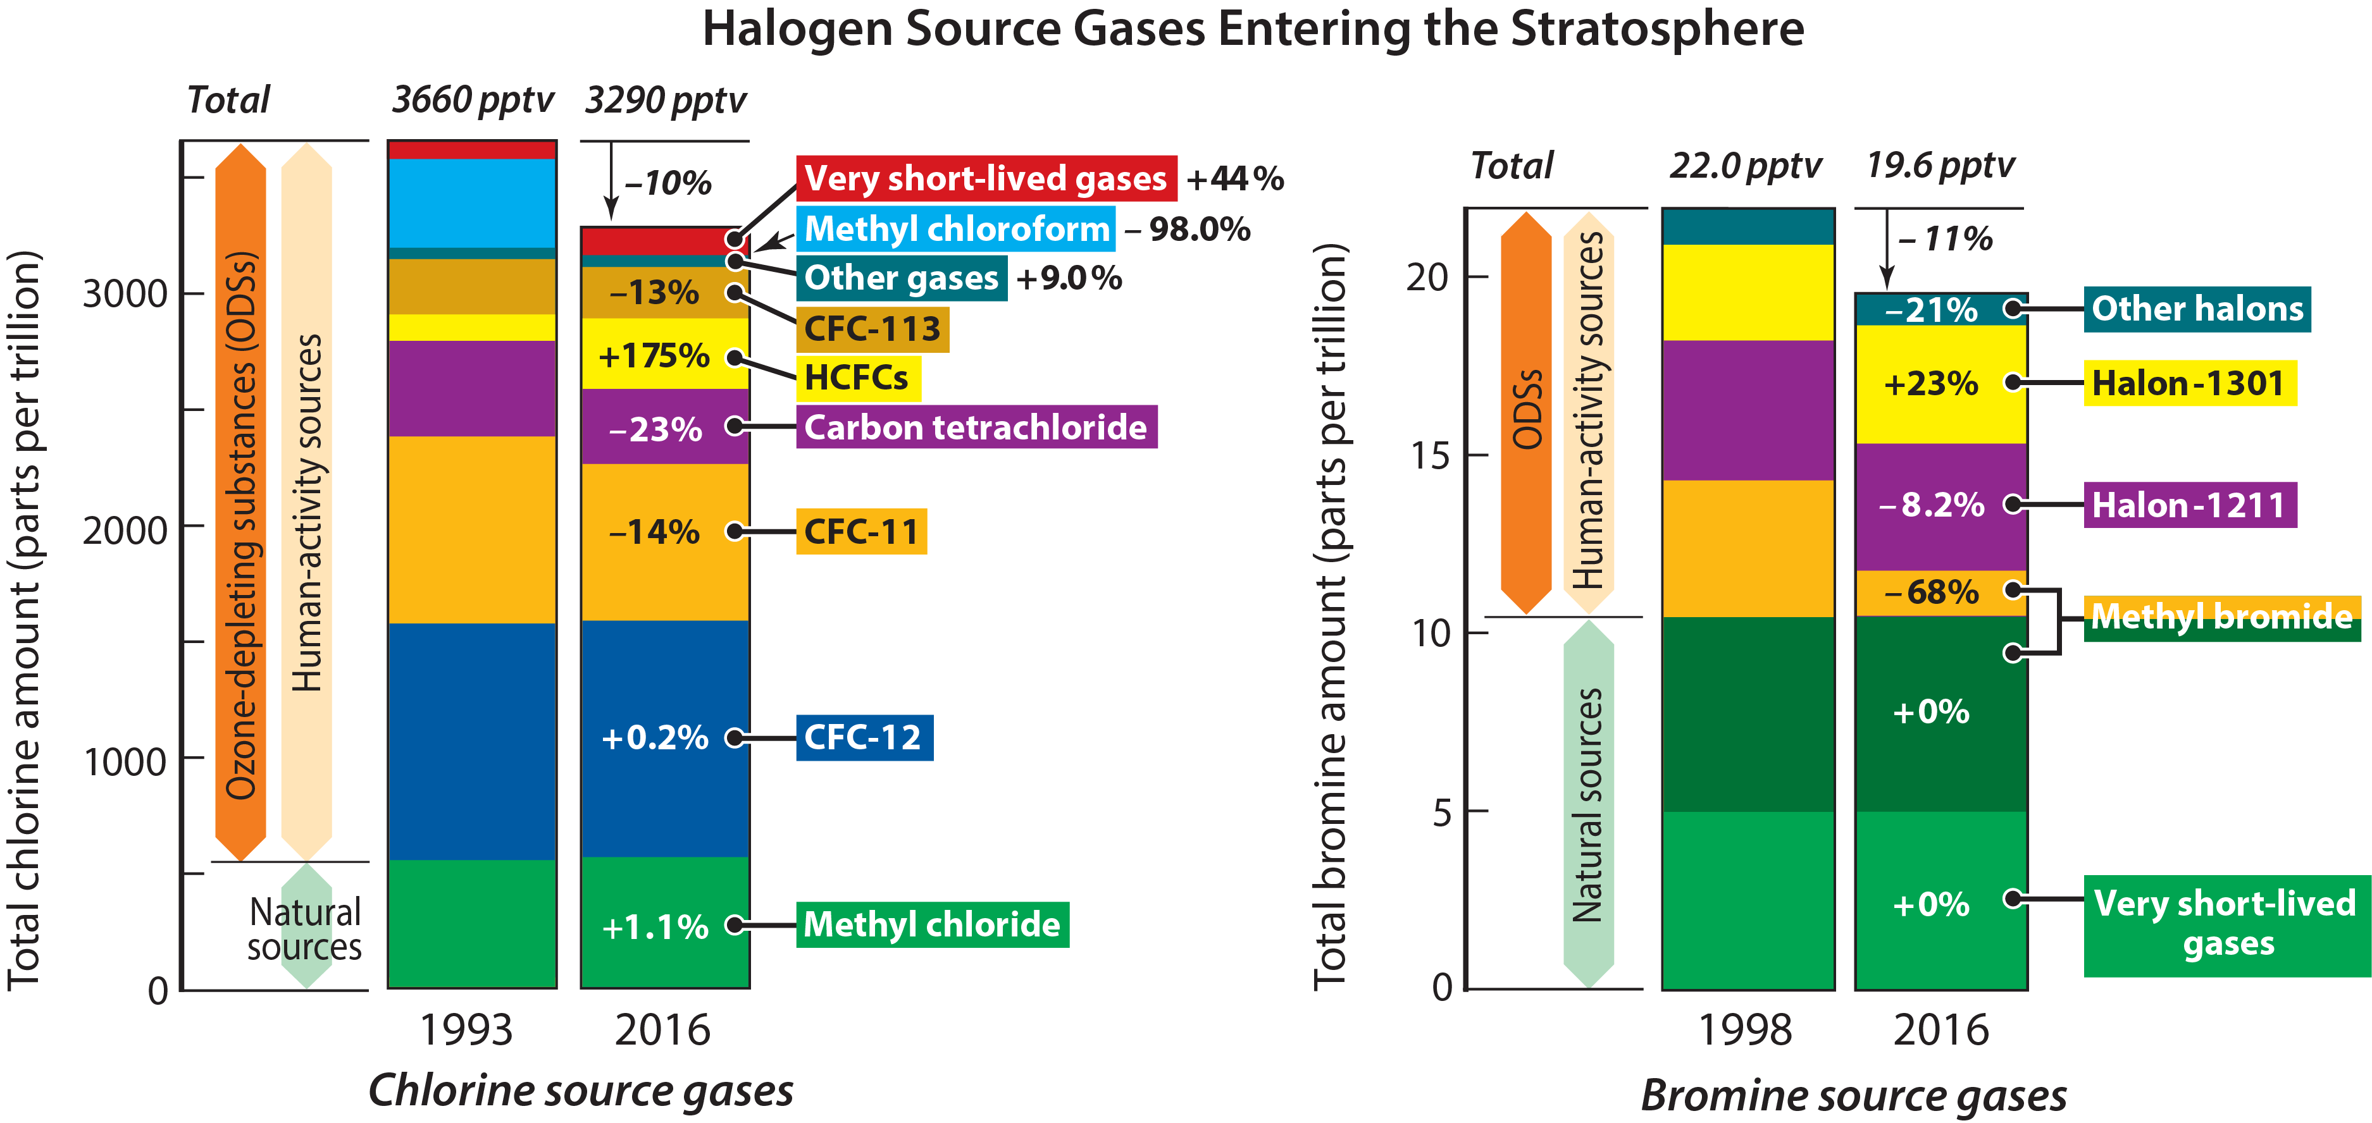
Ozone-depleting substances (ODSs) entering the stratosphere in 1993 and 2016: an inventory
Human uses of synthetic chemicals have significantly increased their abundance in the stratosphere.
Most synthetic gases have no significant loss processes in the troposphere, i.e., very unreactive.
Chlorine ~3290 ppt; Bromine ~19.6 ppt; Bromine ~60x more effective
UNEP/WMO, Ozone Assessment, 2018

Slide 9
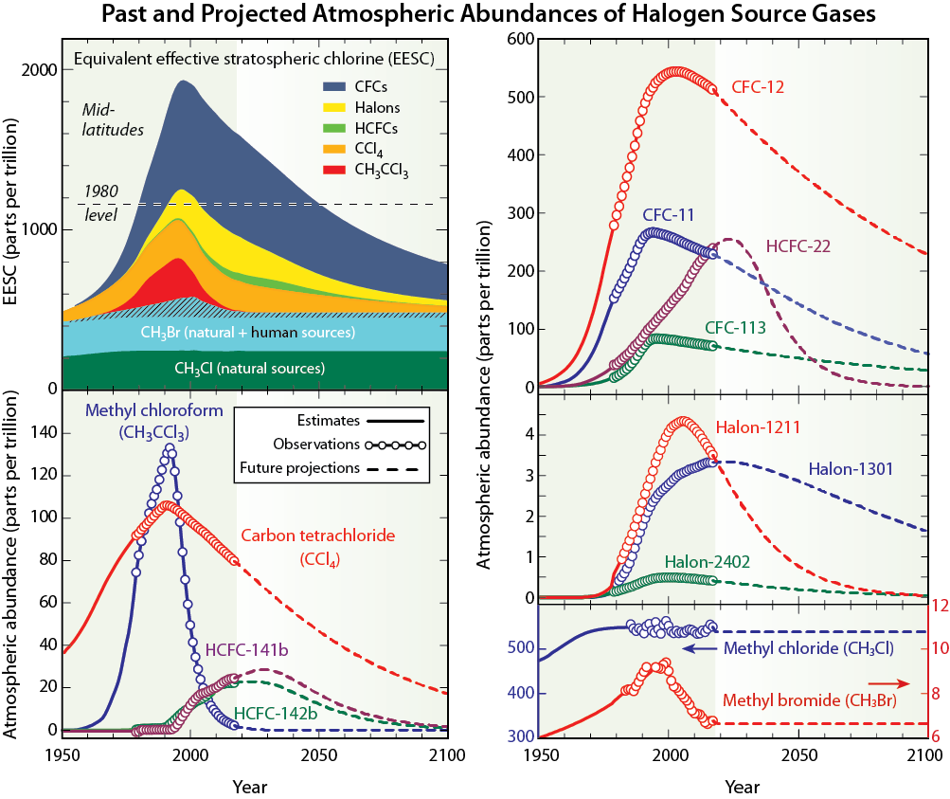
Timelines of ozone-depleting substances (ODSs)
Peak halogens (chlorine + bromine) occurred in the late 1990s
Atmospheric abundances of most synthetic gases are in slow decline
UNEP/WMO, Ozone Assessment, 2018

Slide 10
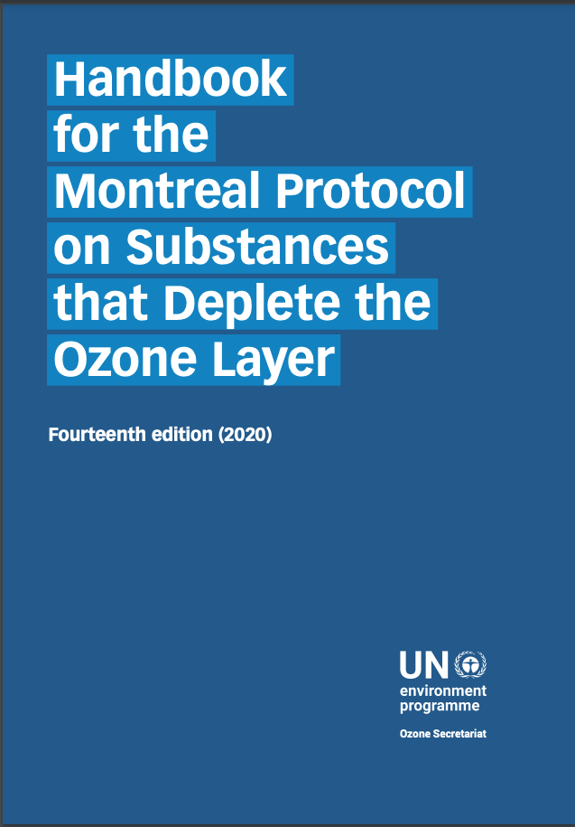
https://ozone.unep.org/sites/default/files/Handbooks/MP-Handbook-2020-English.pdf

Slide 11
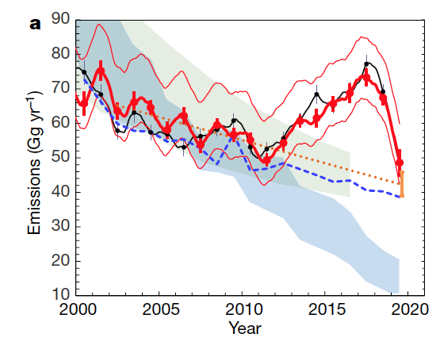
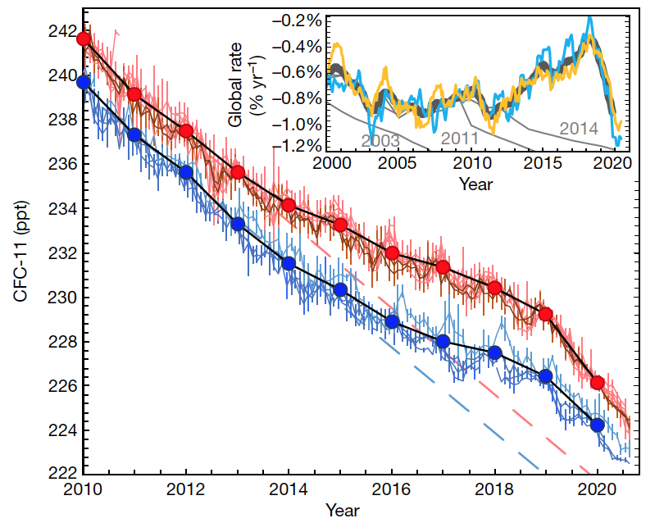
Unreported emissions of CFC-11
Global surface concentrations
Annual global emissions
Northern Hemisphere
Southern Hemisphere
Expected concentrations
Expected emissions
• The slowing of the decline in CFC-11 emissions are due to new emissions from unreported production of CFC-11
• The annual emissions have peaked and are substantially reduced in 2019.
• Detection of new emissions demonstrates the value of vigilant monitoring of the atmosphere.
Montzka et al., Nature, 2021
Note CFC-11 global phaseout in 2010

Slide 12
Unreported regional emissions of CFC-11
Korea
2008 - 2012
2014 - 2017
2019
CFC-11 annual emissions
• A large fraction of emissions originate in eastern China based on surface measurements made downwind in Korea.
• The annual emissions have peaked and are substantially reduced in 2019.
Park et al., Nature, 2021

Slide 13
The dual benefit of the Montreal Protocol
High ODP
Low ODP
Zero ODP
CFCs
& halons
HCFCs
HFCs
High GWP
Range of high to low GWPs
• By reducing the use and emissions of ozone depleting substances, the Montreal Protocol has provided to date the dual benefit of protecting ozone and climate.
• All synthetic substances are evaluated for their ODP and GWP if they are to be emitted in substantial quantities to the atmosphere.
Metrics for ODSs and substitutes:
ODP = ozone depletion potential
GWP = global warming potential

Slide 14
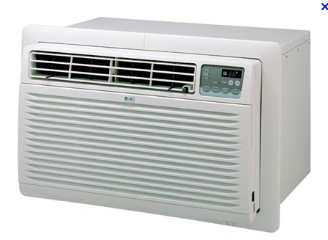
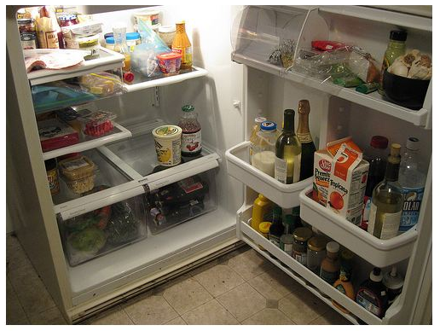
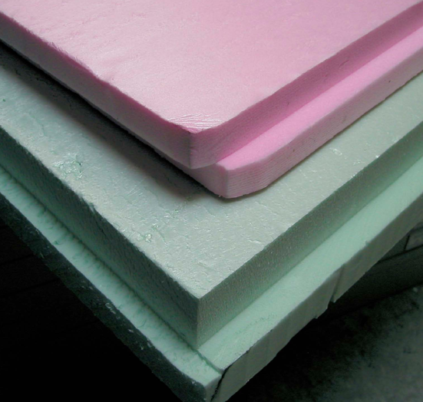
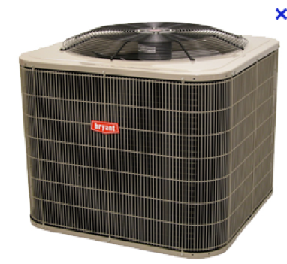
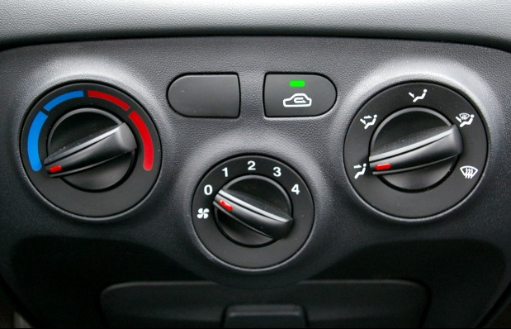
The dual benefit of the Montreal Protocol
High ODP
Low ODP
Zero ODP
CFCs
& halons
HCFCs
HFCs
High GWP
Range of high to low GWPs
Large expected growth of HFC use in the developing world
Ultimately, the climate impact of future HFC use depends on choosing HFC substitutes that have low-GWPs.
Residential
Air conditioning
Refrigeration
Insulating
foams
Mobile air conditioning

Slide 15
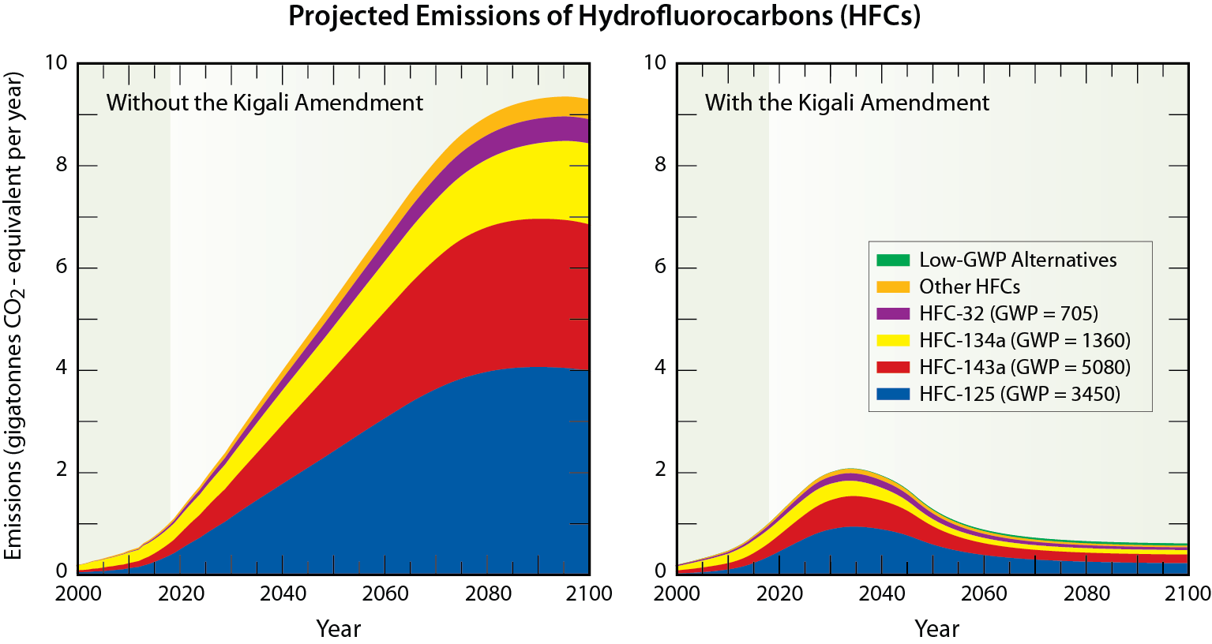
The Kigali Amendment to the Montreal Protocol:
Avoiding the large projected growth in HFC use
Global HFC consumption
HFCs will be the primary choice for future applications of refrigeration, air conditioning, and foams.
Pre-Kigali scenarios based on GDP and population growth projections.
Pre-Kigali scenario assumes HCFC phaseout schedule and business-as-usual replacement schedule from developed nations.
UNEP/WMO, Ozone Assessment, 2018
Velders et al., PNAS, 2009
Velders et al., Atmos. Environ. 2015

Slide 16
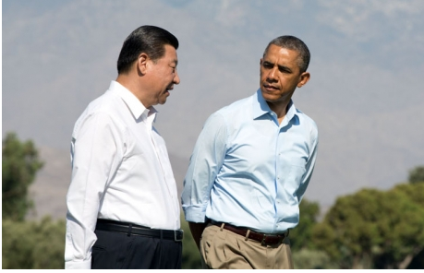
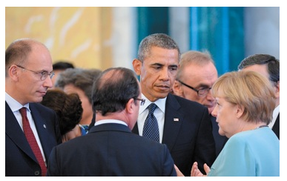
Initiatives for global phase down of HFCs in 2013
Meeting of Chinese President Xi Jinping and US President Barack Obama at Rancho Mirage, California on 8 June 2013.
Will work together and with other countries to use the expertise and institutions of the Montreal Protocol to phasedown the production and consumption of HFCs.
6 September 2013: G-20 leaders expanded the support for using the expertise and institutions of the Montreal Protocol to phase down the production and consumption of HFCs, while retaining HFCs within the scope of the UNFCCC and its Kyoto Protocol for accounting and reporting of emissions.
This was agreed by the following countries: Argentina, Australia, Brazil, Canada, China, France, Germany, India, Indonesia, Italy, Japan, Korea, Mexico, Russia, Saudi Arabia, South Africa, Turkey, the United Kingdom, the United States, and the European Union, as well as Ethiopia, Spain, Senegal, Brunei, Kazakhstan, and Singapore.
G20 Summit, St. Petersburg
September 2013
http://www.whitehouse.gov/

Slide 17
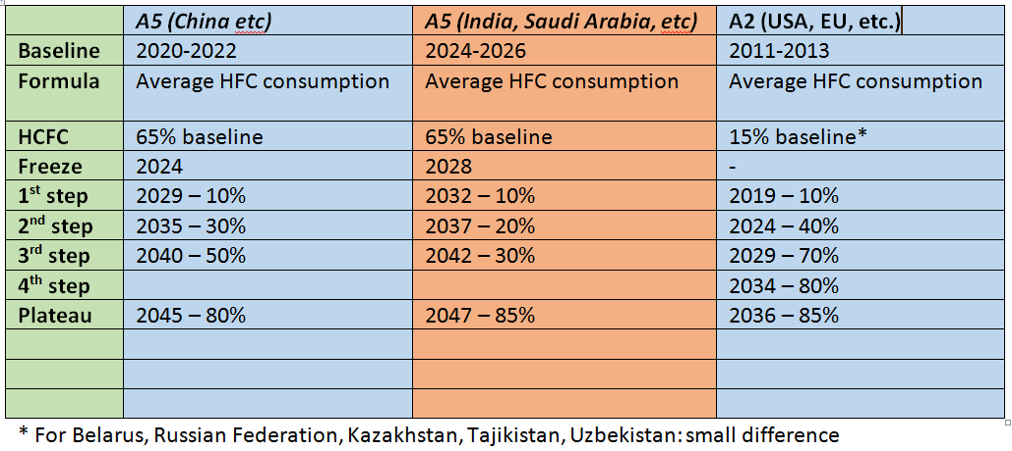
Montreal Protocol Kigali Amendment
to control HFC production and consumption
Kigali, Rwanda, 15 October 2016
Agreed upon baselines and phasedown schedules

Slide 18
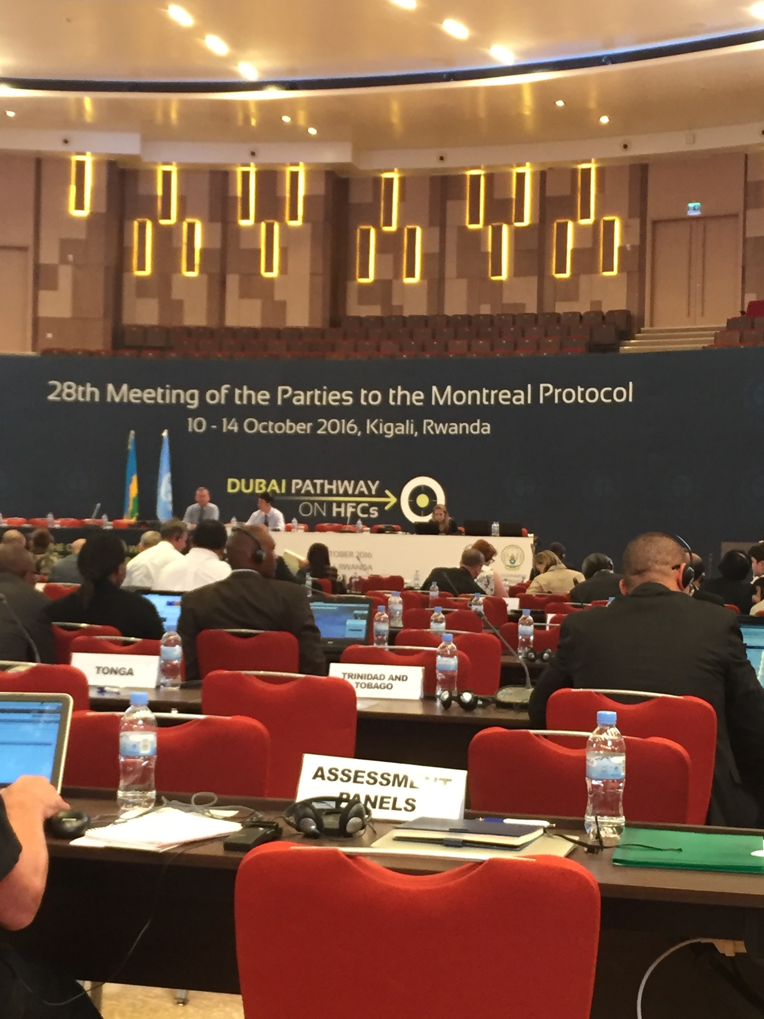
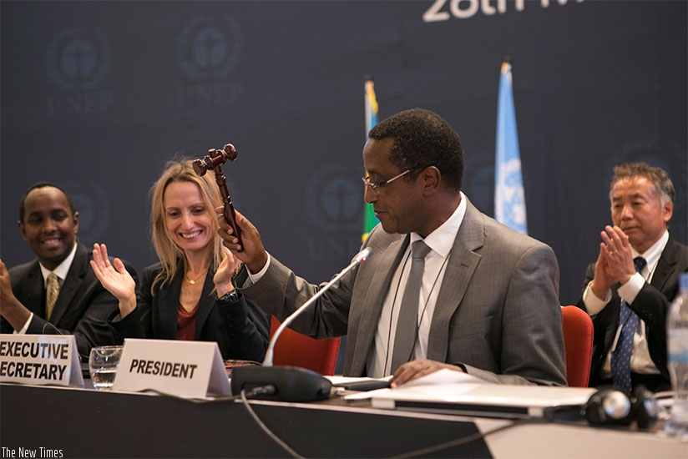
Montreal Protocol HFC amendment
Kigali, Rwanda, 15 October 2016
Dr. Tina Birmpili, Executive Secretary of the Montreal Protocol

Slide 19
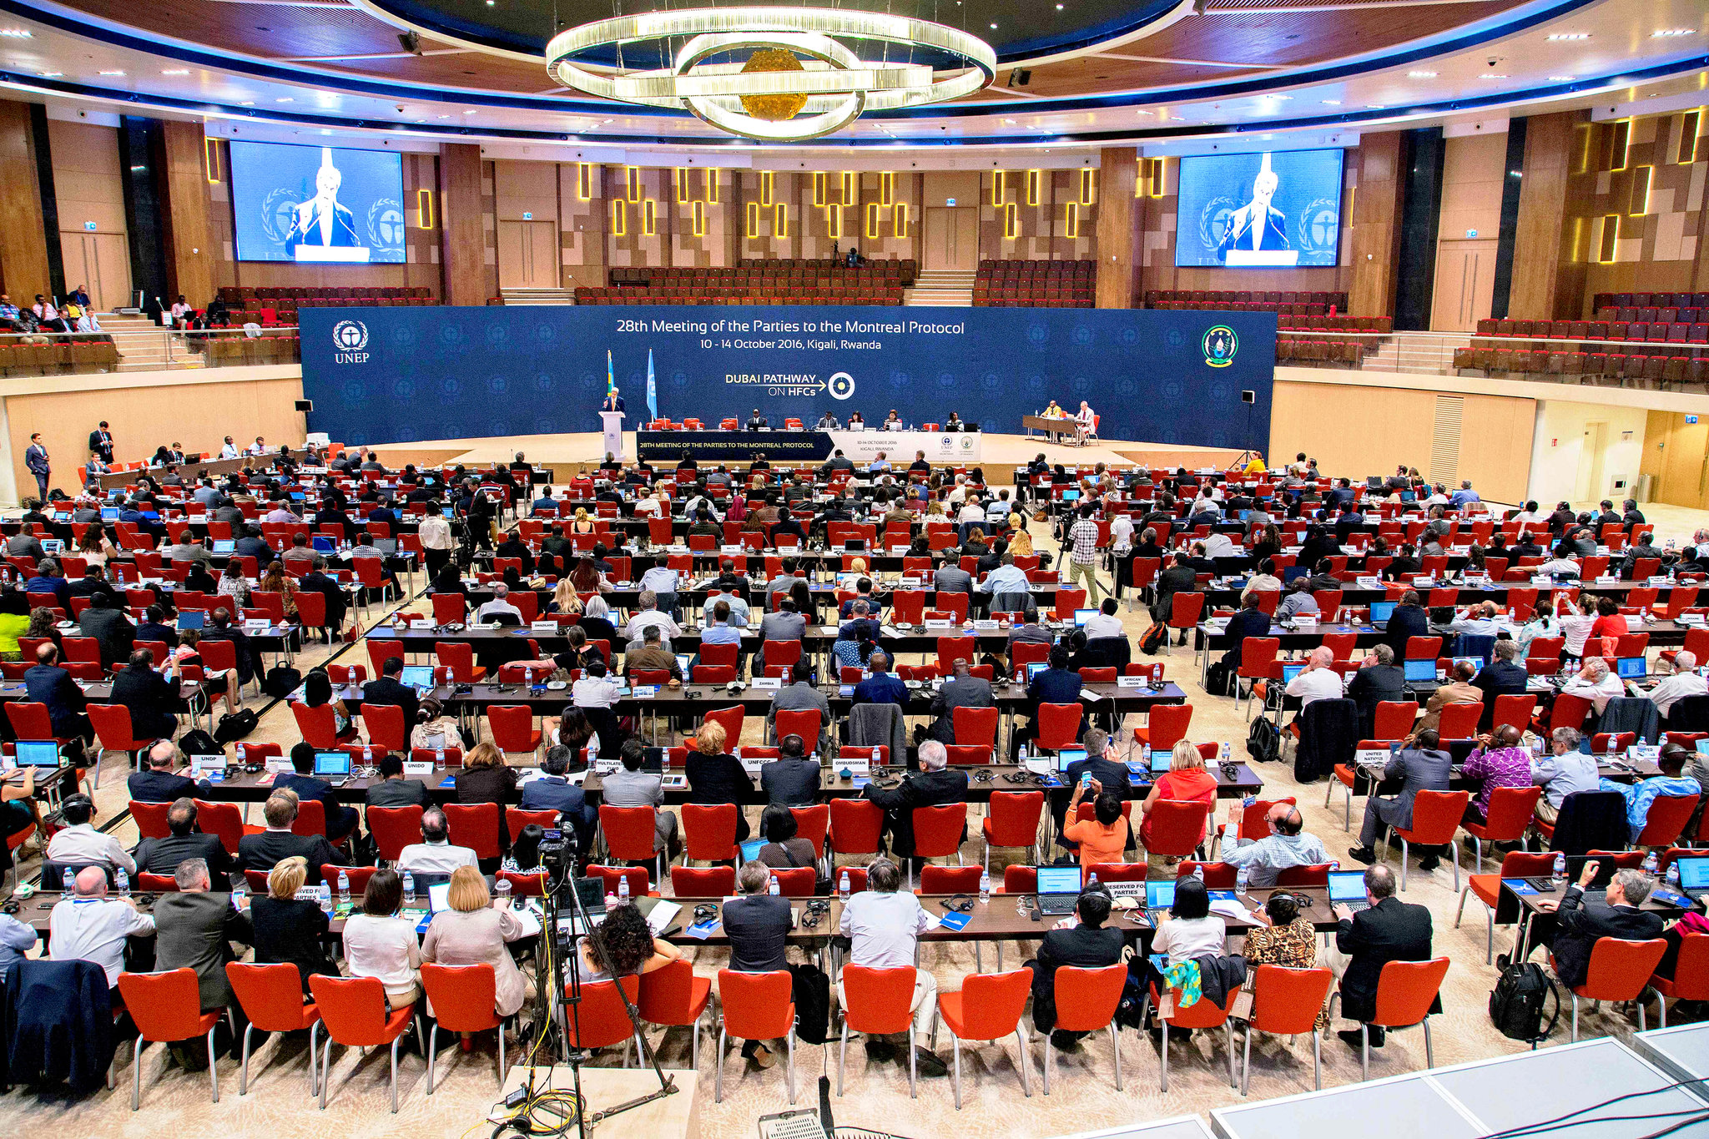
Annual Montreal Protocol Meeting, October 2016, Kigali, Rwanda
Address by US Secretary of State John Kerry

Slide 20
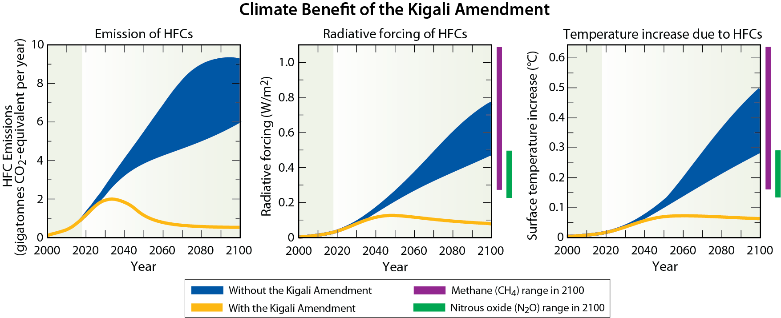
Impact of the Kigali Amendment to reduce HFC use
• Global temperature projections for 2100 reduced by up to 0.4°C
• Kigali Amendment is the first multilateral, fully funded, legally binding action to avoid climate change
UNEP/WMO, 2018 Ozone Assessment

Slide 21
http://www.diplomacy.edu/

Slide 22
http://www.diplomacy.edu/

Slide 23
Summary Remarks
The Montreal Protocol is the most successful environmental treaty in history. It has the dual benefit: protecting ozone and climate. Strategy: Start and strengthen.
Chlorine and bromine compounds (ODSs) are largely phased out and most are in decline in the atmosphere.
CFC-11 emissions have increased due to unreported production and have recently declined back towards expected levels.
Projected HFC use in the developing world as a result of Montreal Protocol regulations would lead to substantial climate forcing contributions by 2050.
The Kigali HFC amendment avoids HFC growth and limits temperature increases to <0.06 ºC in 2100 representing the first multilateral, fully funded, legally binding action to avoid climate change.
Grand challenge: The Montreal Protocol and Kyoto Protocol parties continue working together to minimize the climate impact in meeting the global application demand for synthetic gases in the developing world.
Ongoing challenge: Identifying scientific contributions that provide the needed foundation for the climate change building.

Slide 24
Science has the first word on everything, but the last word on nothing."
Victor Hugo
Thank you for your attention.

