Slide 1
Climate Change and Extremes
Michael Alexander
NOAA/Earth System Research Laboratory
Physical Science Division

Slide 2
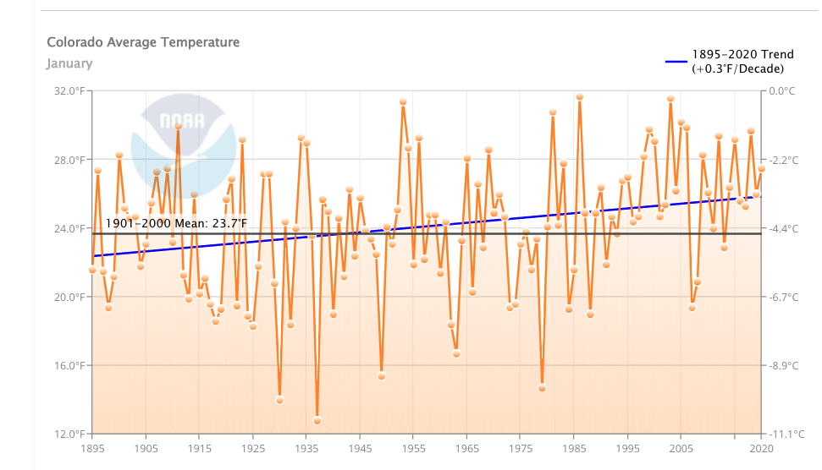
Ways to represent variability including extremes
Time Series
2017
2016
Colorado Average temperature in January

Slide 3
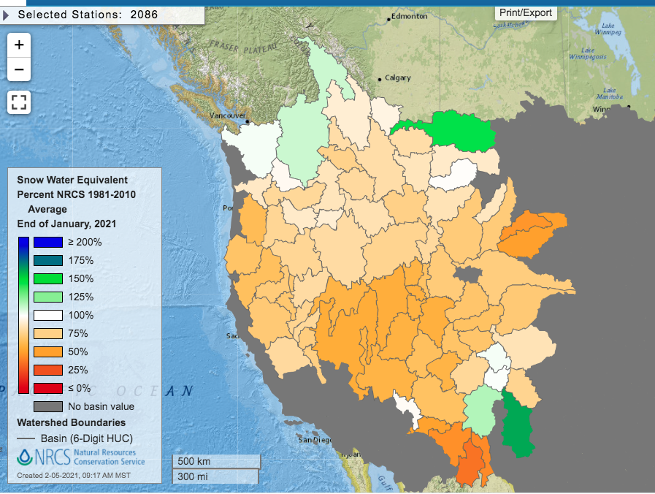
Maps: Percent of Normal Snow Water Equivalent
South Platte
Upper Colorado
watershed

Slide 4
Comparison of years
Upper Colorado River Snow Pack Snow Water Equivalent (SWE)
2019
2020
2018
Median, mean
2021
How do we put this variability including extremes into context?

Slide 5
What is an extreme?
Rare event- Somewhat subjective and depends on application
Sometimes statistically examined:
As a percentile (%)
95%
as a “return period”
e.g. once every 20 years
For dams can be a one in “500 year event”
Temperature based
Record highs and lows, heat waves, cold air out breaks (polar vortex), date of first/last frost etc.
Precipitation based
Heavy rain events, floods, snow storms
Drought both temperature & precipitation
Other:
Sea level related
Storm surges, “dry day flooding” (Miami)
Wind related
Ocean waves

Slide 6
What makes changes in extremes hard to determine?
By definition extremes are rare events
Are the people/instruments in place to observe the event
As observers/instruments increase may falsely give the impression that extremes are increasing
Instruments and/or their location change (non-homogeneous, or a heterogeneous record)
Many comprehensive observations were not available until the were satellites starting in the mid to late 1970s
A high degree of inherent variability in the climate system that can occur on long time scales (decades), which can appear to be a trend, especially when data records are short
Can be hard to make an “attribution” to climate change

Slide 7
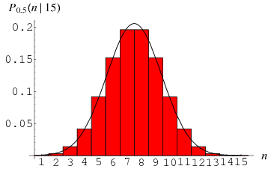
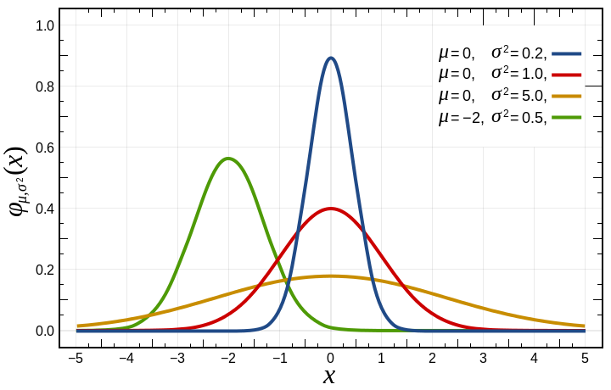
Distributions
Discrete
Empirical, often estimated by a histogram
Continuous/function
Gaussian or normal
f(x)= exp[−(x−μ)²/(2σ²)] /σ(2π)^{1/2}
For Gaussuan know entire distribution just from 2 variables:
μ mean; anomalies μ=0
σ standard deviation
Including most extreme
Temperatures, especially monthly values often (nearly) Gaussian
Return period based on percentile:
95%, return period of 20 years
Many other types of distributions
Some variables like precipitation and wind speed are always positive and can be skewed (long tail)
“realistic” (blue)
histogram
Exact (red)
Histogram & Normal distribution
(black line)
5% of values
1 in 20,
2 σ

Slide 8
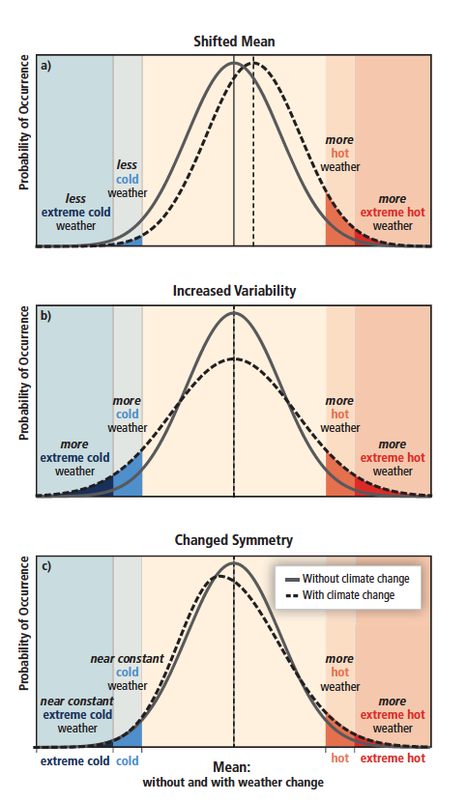
Change in Distributions and Extremes
These changes could happen in combination
For example increased mean and increased variance (σ²)
subtract out mean change (anomalies)
If variance of anomalies increases some still might consider “extremes getting more extreme”

Slide 9
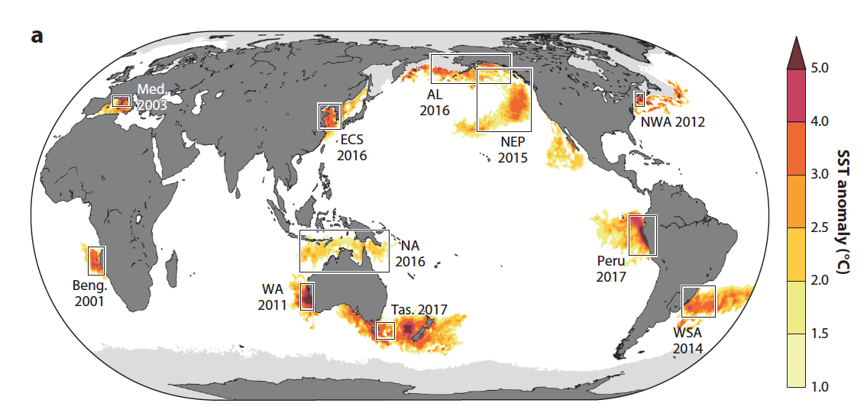
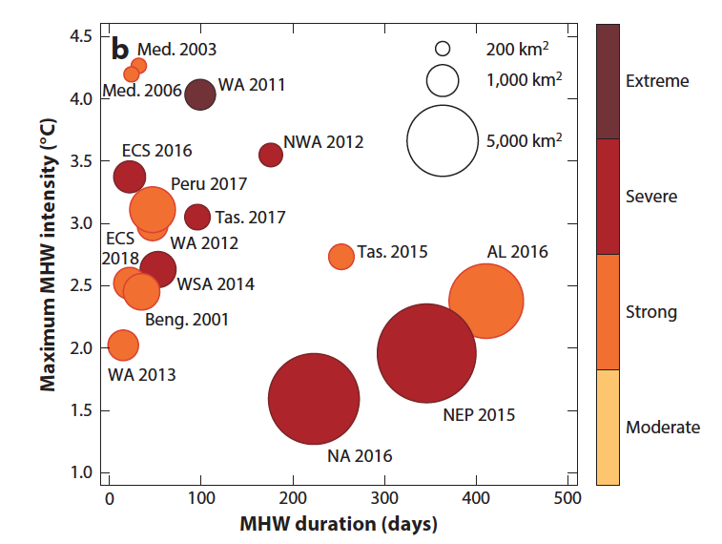
Marine Heat Waves (MHWs)
A MHW is a discrete period of prolonged anomalously warm water at a particular location. Quantitative definitions are based on ocean temperatures exceeding a fixed, seasonally
varying or cumulative (e.g. heating degree days) threshold.
Intensity, Area, Duration, (Frequency)
Notes:
Key historical MHWs. (a) SST anomalies on the day of peak MHW intensity.MHW intensity was defined based on the time series of
SST averaged over the regions indicated by the black boxes. Light gray indicates areas of sea ice influence. (b) MHW properties for key
historical events. The MHW intensity (y axis),MHW duration (x axis), and category (color; see Hobday et al. 2018a) were determined
from the spatially averaged time series, as in panel a. TheMHWarea (circle size) is the total contiguous area reaching at least category 2
(strong). All events shown in panel b are referenced in Section 2. Abbreviations: AL, Gulf of Alaska and Bering Sea; Beng., Benguela;
ECS, East China Sea; Med., Mediterranean; NA, northern Australia; MHW, marine heatwave; NEP, northeast Pacific; NWA,
northwest Atlantic; SST, sea surface temperature; Tas., Tasman Sea;WA,Western Australia; WSA, western South Atlantic. Panel a
inspired by a schematic from Frölicher & Laufkötter (2018).

Slide 10
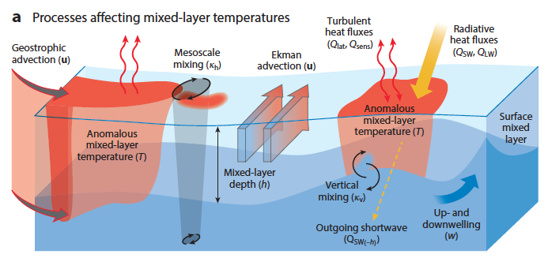
Processes that affect T_{mix} and thus MHWs
(T_{mix})
Temperature is (nearly) uniform in the surface mixed layer, T_{mix} ≈ SST

Slide 11
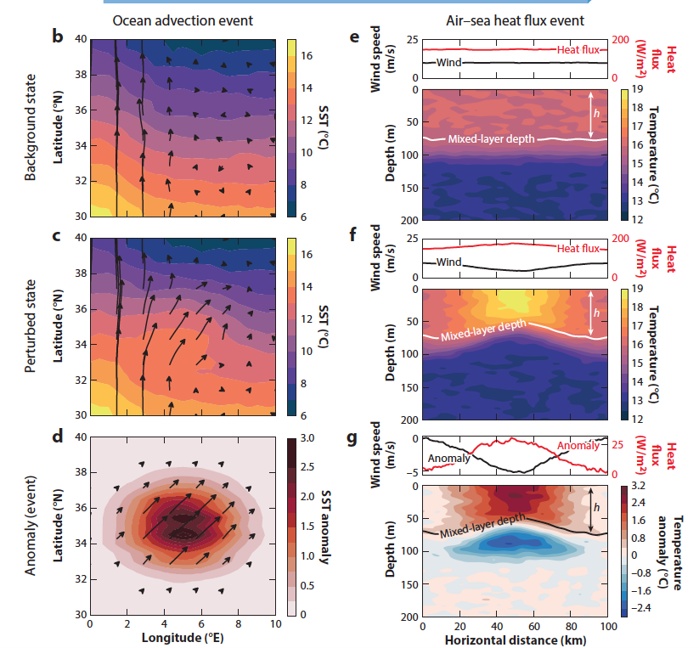
Processes that can cause MHWs
Ocean Advection
Air-sea Heat Flux
Notes:
Idealized examples of MHW events where the budget is dominated by (b–d) horizontal advection and (e–g) air–sea heat flux. For
the advection event, we have (b) a background state consisting of a poleward ocean current u (arrows) across a temperature gradient T
(colors; e.g., a western boundary current), which is (c) perturbed by an anomalous flow to the northeast, resulting in (d) anomalously high
SSTs. For the air–sea heat flux event, we have (e) a background state consisting of stratification with a constant mixed-layer depth (h),
wind forcing, and air–sea heat flux (Q). This state is ( f ) perturbed by an atmospheric event that acts to weaken the surface winds,
increase the air–sea heat flux, and shoal the mixed-layer depth, resulting in (g) anomalously high temperatures in the mixed layer (and
anomalously low temperatures immediately below the mixed layer

Slide 12
How can we use models to help us to understand & quantify changes in extremes
Conduct very long model simulations (e.g., 2000 years) with fixed greenhouse gasses (“control runs”) to get reliable statistical estimates of natural climate variability including extremes.
Compare control runs with increasing greenhouse gasses to runs with fixed greenhouse gasses at higher levels (“equilibrium runs”, e.g. “double CO₂”)
Save daily temperatures (and/or max/min) and precipitation
Conduct a large ensemble of runs with increasing greenhouse gasses but different initial conditions. See how extremes evolve over time
e.g. NCAR Large ensemble 40 runs, 1920-2100 (RCP8.5 after 2005)
Kay et al. 2015, BAMS
Event based attribution.
Annual BAMS issue since 2011
Use to understand of what could cause changes in extremes
For example, isolate changes in decreasing sea ice.

Slide 13
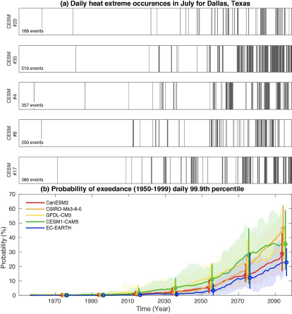
Changes in a land heat wave in a large ensemble (LE)
Changes in probability if a heat wave
multi-model large ensemble (LE)
Probability of exceeding the historical (1950-1999) 99.9th percentile of daily temperature in July at Dallas, Texas for 5 model LEs. Thick colored lines show the probability in each LE calculated across all ensemble members, and color shading shows the 5-95th percentile when the probability is calculated for each ensemble member separately. Open circles and vertical bars show those same values for every other decade from 1970 onwards, with models plotted in a staggered fashion centered on year 5 of a given decade.
Vertical bars mark the occurrence of July days which meet or exceed the historical (1950-1999) 99.9th temperature percentile for the grid box containing Dallas, Texas in five members of the CESM1-LE under historical and future (RCP8.5) radiative forcing. The 99.9th percentile is defined as the average of the 99.9th percentile values calculated for each ensemble member.

Slide 14
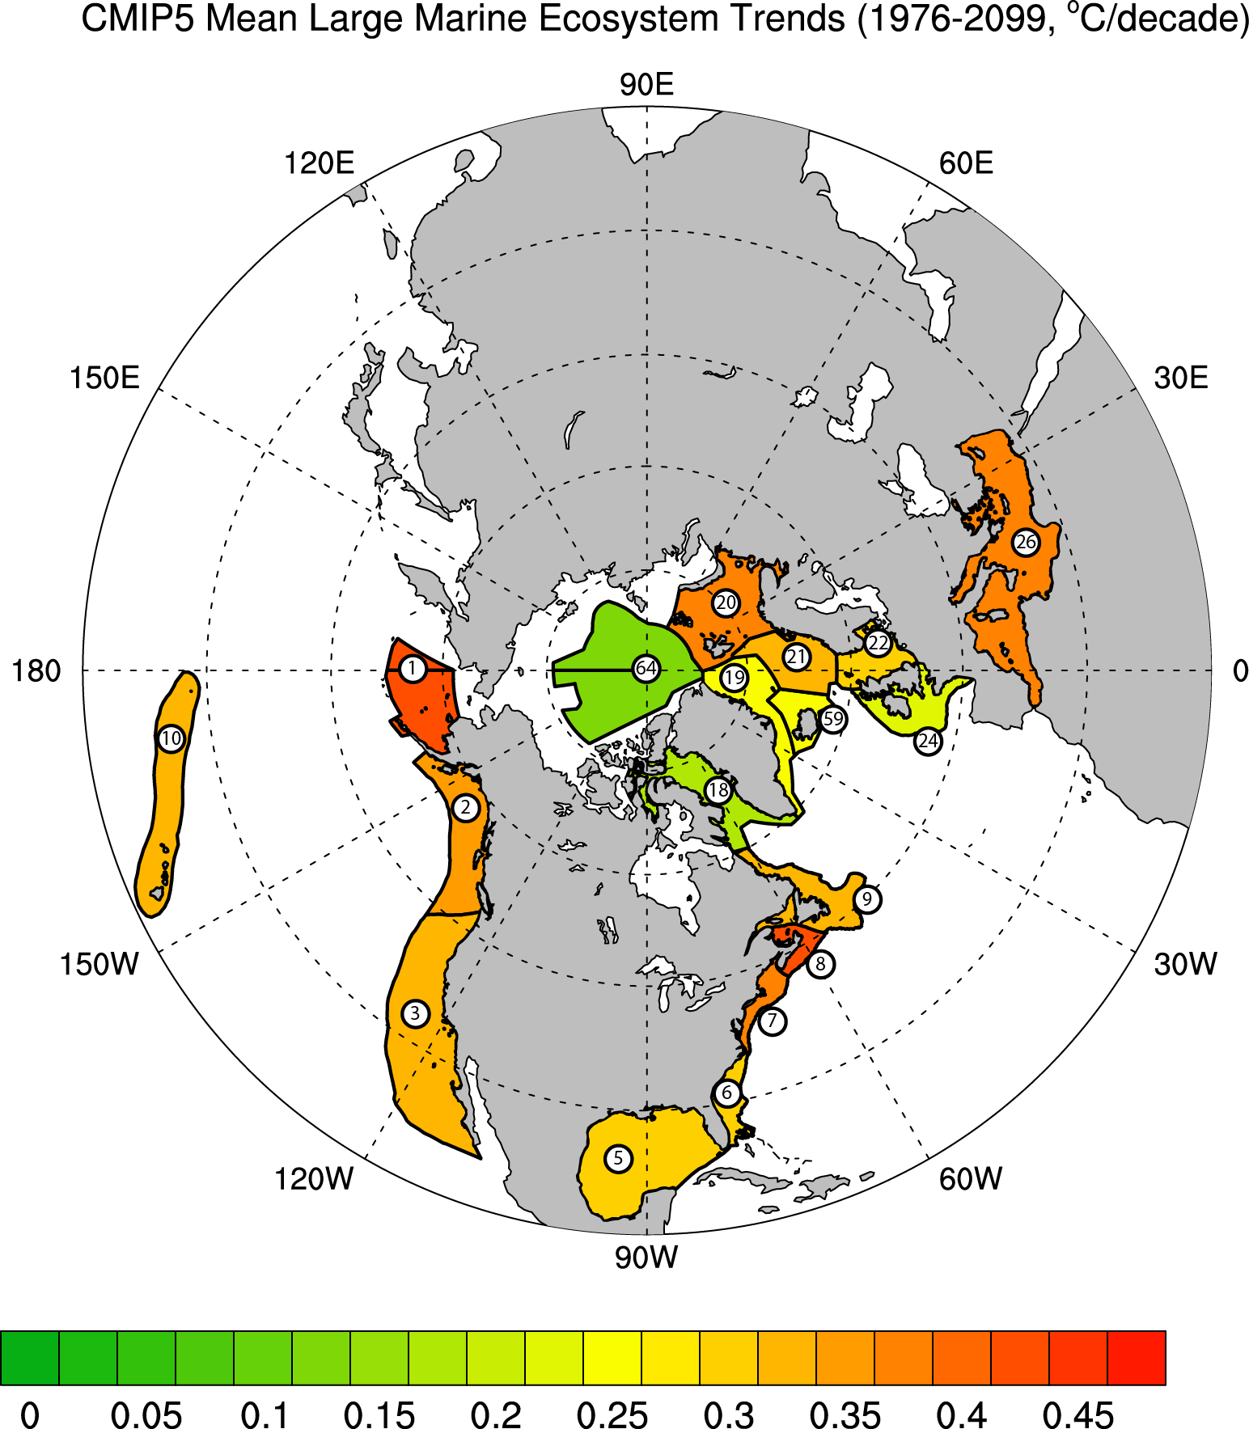
SST trends estimated from models
Examined changes in Sea Surface Temperature (SST) in historical/RCP8.5 simulations (“business as usual”) from 1976-2099
Focus on Large marine ecosystems (LMEs) around North America and Europe
7) NE US includes Gulf of Maine
8) Scotian Shelf
Alexander et al., 2018
Elementa, Science of the Anthropocene
Multi-model estimate of SST trends in LMEs

Slide 15
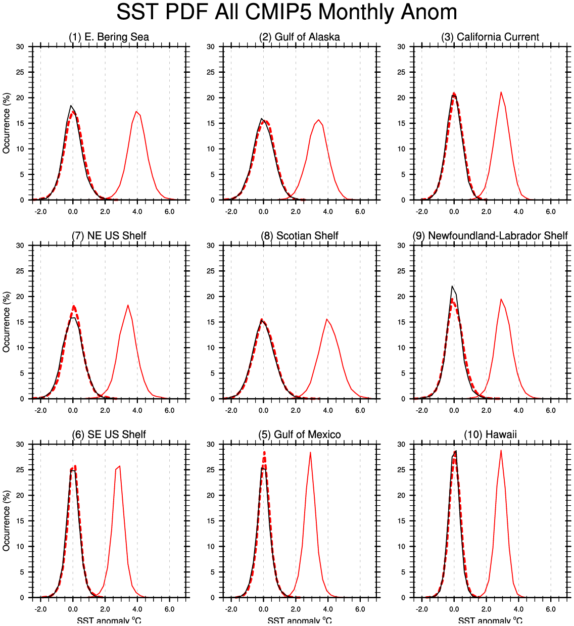
SST Distribution and it changes
Histogram: example Scotian shelf LME
Black line: years 1976-2005
Solid red line: years 2070-2099
Dashed red line years 2070-2099 but with the mean change removed
SSTs are first detrended within each period
2070-2099
without mean change
2070-2099 With mean
change
1976-2005
Notes:
Probability distributions given by histograms of CMIP5 monthly SST anomalies averaged over the LMEs around North America for the historical (black line, 1976-2005) and future (red lines, 2070-2099) periods. The SST distributions are presented without trends. The future distribution is shown with the mean change (red solid line) and without the mean change (red dashed lines) to make it easier to compare the shapes of the future and historical distributions. Changes in de-trended variance are significant (at 95% confidence) for the Newfoundland-Labrador Shelf.

Slide 16
SST Distribution and it changes
Shown for LMEs around North America
Black line: years 1976-2005
Solid red line: years 2070-2099
Dashed red line years 2070-2099 but with the mean change removed
SSTs are first detrended within each period
Notes:
Probability distributions given by histograms of CMIP5 monthly SST anomalies averaged over the LMEs around North America for the historical (black line, 1976-2005) and future (red lines, 2070-2099) periods. The SST distributions are presented without trends. The future distribution is shown with the mean change (red solid line) and without the mean change (red dashed lines) to make it easier to compare the shapes of the future and historical distributions. Changes in de-trended variance are significant (at 95% confidence) for the Newfoundland-Labrador Shelf.

Slide 17
2012 ocean heat wave
Largest, most intense warm event in Northwest Atlantic in last 30 years from Mills et al. 2013, Oceanography
Scotian
Shelf

Slide 18
2012 ocean heat wave
Pronounced warming in Gulf of Maine

Slide 19
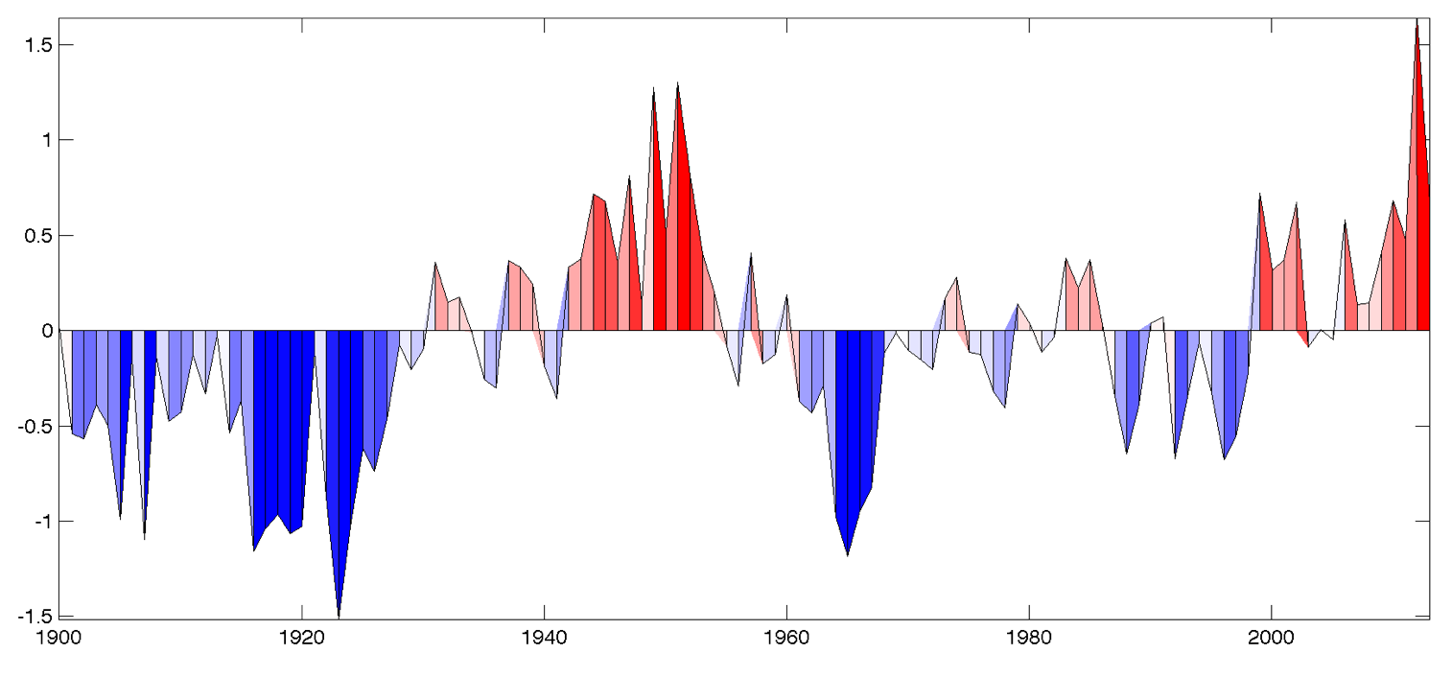
A longer perspective
Tem
1.5
1
0.5
Temperature anomaly
0
-0.5
-1
-1.5
1900
1920
1940
1960
1980
2000

Slide 20
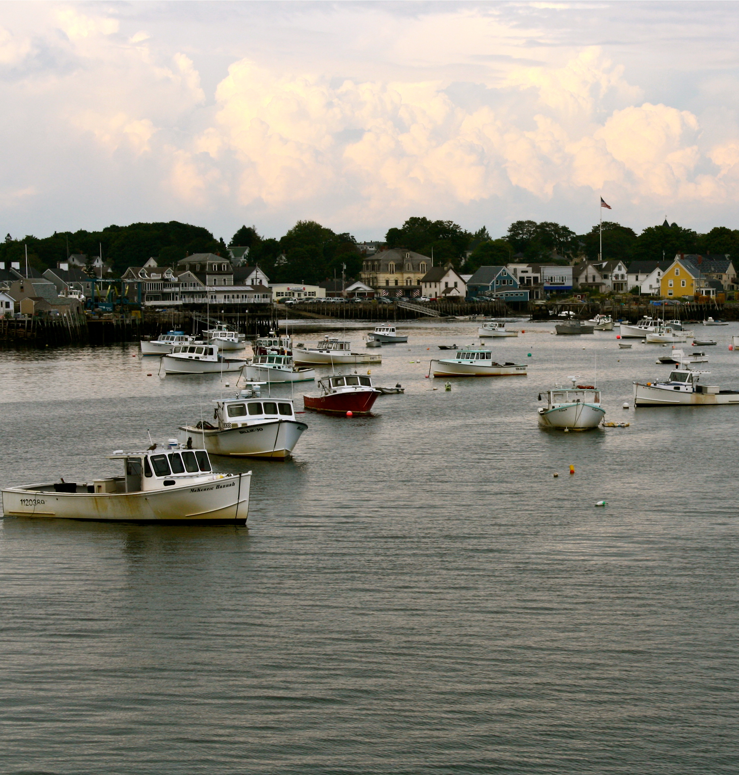
Lobster fishery
Valued over $429M in 2012
Second most valuable species fished in US
Accounts for over 75% of Maine’s landed value

Slide 21
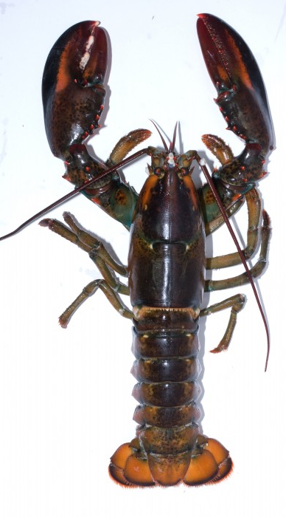
Lobsters
Phenology closely tied to temperature
Migration
Molting
(discarding shell to grow)
Fishery closely tied to lobster phenology
Over 75% of landed lobsters in ME are newly molted into legal size class
Phenology - the study of cyclic and seasonal natural phenomena,
especially in relation to climate and plant and animal life.

Slide 22
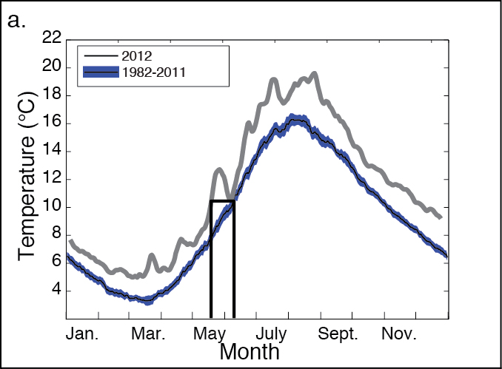
2012 temperature patterns

Slide 23
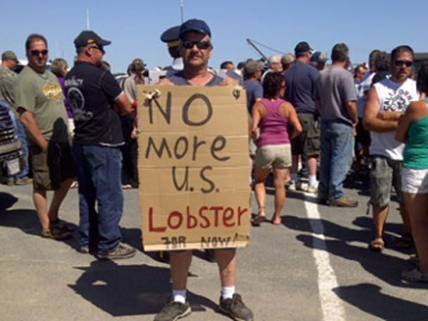
Prices to less than $3/lb
Maine lobstermen reeling from low prices, seeking cooperation from dealers
Protests over Maine lobster continue in New Brunswick
“We can’t say we’re striking or anything; that’s against the law. I’m just taking a few days off and enjoying the sun.”
- Richard Alley

Slide 24
Thermal Displacement as a Fisheries-Relevant Metric for Characterizing Marine Heatwaves
Marine Heatwave Intensity
Thermal displacement is the distance that must be travelled to maintain constant SST, a simple proxy for habitat displacement.
Thermal displacements vary from 10s to 1000s of kilometers.
On a global scale, thermal displacement is not significantly correlated with heatwave intensity.
Depending on the regional SST patterns, a given location can be characterized by, for example:
Intense heatwaves and large displacements
Intense heatwaves and small displacements
Thermal Displacement
Jacox, Alexander, Bograd, and Scott Nature (2020)

Slide 25
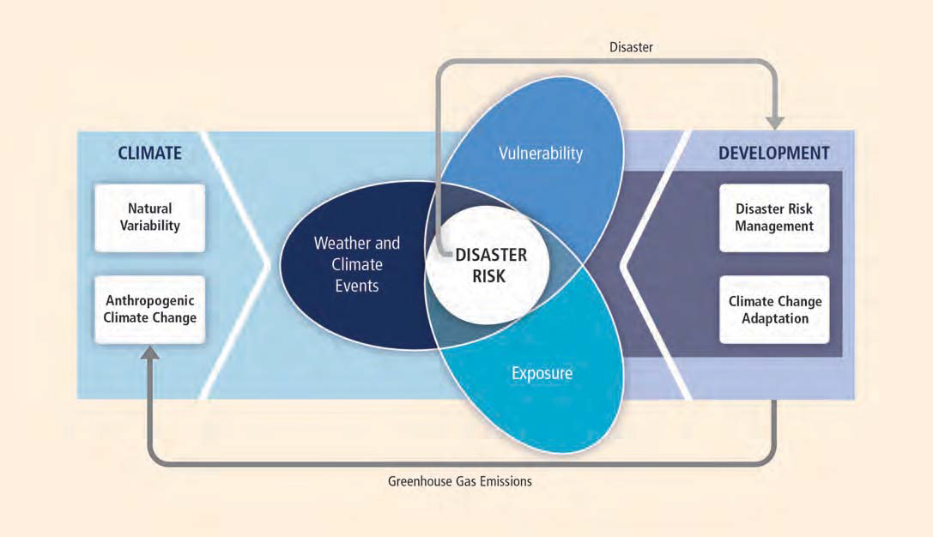
Extreme Events and their Repercussions
Climate Extreme: The occurrence of a weather or climate variable above (or below) a threshold value near the upper (or lower) ends of the range of observed values of the variable
Exposure: The presence of people; plants & animals; infrastructure; etc. that could be adversely affected.
Vulnerability: The propensity or predisposition to be adversely affected.
Disaster management (or emergency management): the creation of plans through which communities reduce vulnerability to hazards and cope with disasters.
Adaptation: Adjustment to actual or expected climate and its effects, in order to moderate harm or exploit beneficial opportunities.
IPCC, 2012: Special Report on Managing the Risks of Extreme Events and Disasters to Advance Climate Change Adaptation (SREX) [Field, C.B., et al. (eds.)].
https://www.ipcc.ch/pdf/special-reports/srex/SREX_Full_Report.pdf

Slide 26
Components of Climate-Ready Fisheries Management
What is changing?
Why is it changing?
What is vulnerable to change?
How will it change?
How to deliver and use key information/advice?
How to prepare and respond to changes?
Karp et al. 2019, ICES J. Mar. Sci., doi:10.1093/icesjms/fsz048

Slide 27
Fishery Policy Issues, Examples
Improve climate ecological data, forecast models and management tools
Ecocast (https://coastwatch.pfeg.noaa.gov/ecocast/)
Mange fisheries
Catch limits (number, size, etc.)
Closed regions
New species that move into a region
Many species along the US east coast are shifting north
Change ship routes and/or speeds to reduce whale strikes
Renegotiate International agreements
Change ship path
Remove/Reduce other stressors
Reduce local pollution
No-line crab and lobster pots
Reduce entanglements of whales

Slide 28
Additional Slides

Slide 29
Other Distributions
Gaussian distribution not always a good fit
Some variables like precipitation and wind speed are always positive and can be skewed (long tail)
Other distributions
Gamma, Weibull
Generalized extreme value
often fit to just the tail values, e.g. maximum temperature in July
Stochastically Generated Skewed
(SGS, Sardeshmukh et al., 2015, J. Climate)
For a comparable change (e.g. the same change in 𝛔) in two different distributions can give different changes in the probability of extreme
<=see example on the left
Notes:
An illustration of how changes in the probabilities of extreme values associated with a mean climate shift depend strongly on the shape of the PDF. Results are shown for (a) a Gaussian PDF and (b) a non-Gaussian SGS PDF (see text) with skewness S = 1 and excess kurtosis K = 5. In both panels the PDFs for the current climate (black curves) have zero mean and unit standard deviation, and are shifted by one standard deviation to the right (red curves) to illustrate a future climate scenario. This identical mean shift in the two cases implies very different changes in the probability P(x > 2) of exceeding 2 standard deviations, from 2.3% to 15.8% in (a) and from 3.4% to 13.3% in (b). The changes in the probability P(x > 4) of exceeding 4 standard deviations are even more striking, increasing by a large factor of 43 from 0.003% to 0.135% in (a) and by a relatively modest factor of 3 from 0.34% to 1.01% in (b).

Slide 30
Event based attribution
Many recent studies that try to assess to what extent an individual extreme event is influenced (if at all) by climate change
Frontier of the science that is evolving.
Difficult as natural variability is a very prominent component in individual events
Often strong disagreements among scientists about how much is attributable to climate change
Example: Russian heat wave in 2012
Often use a large set of climate model runs to estimate what percentage of the event was due to climate change over natural variability
still viewed in a statistical or probability sense
Since 2011 BAMS has published a supplemental every year on “Explaining extreme events from a climate perspective : An example overview paper:
Herring, S. C., M. P. Hoerling, J. P. Kossin, T. C. Peterson, and P. A. Stott, 2015: Explaining extreme events of 2014 from a climate perspective. Bull. Amer. Meteor. Soc., 96 (12), S1–S172, doi:10.1175/BAMS-ExplainingExtremeEvents2014.1.
Events both seasonal (drought) and individual, e.g. heavy precipitation
Temperature events are generally easier to attribute than precipitation

Slide 31
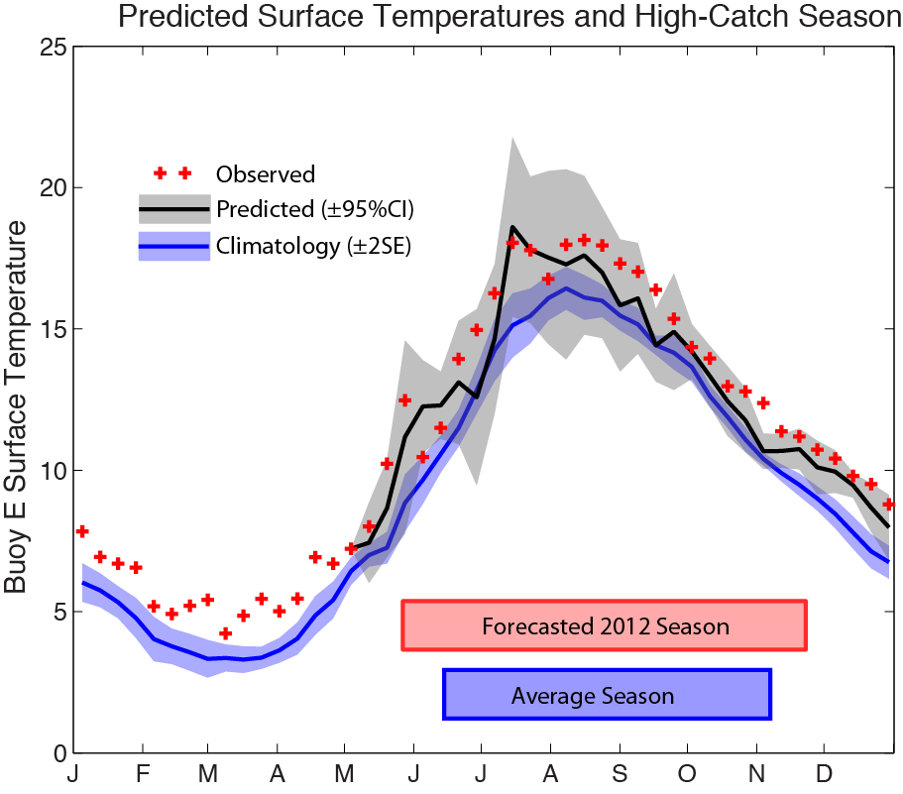
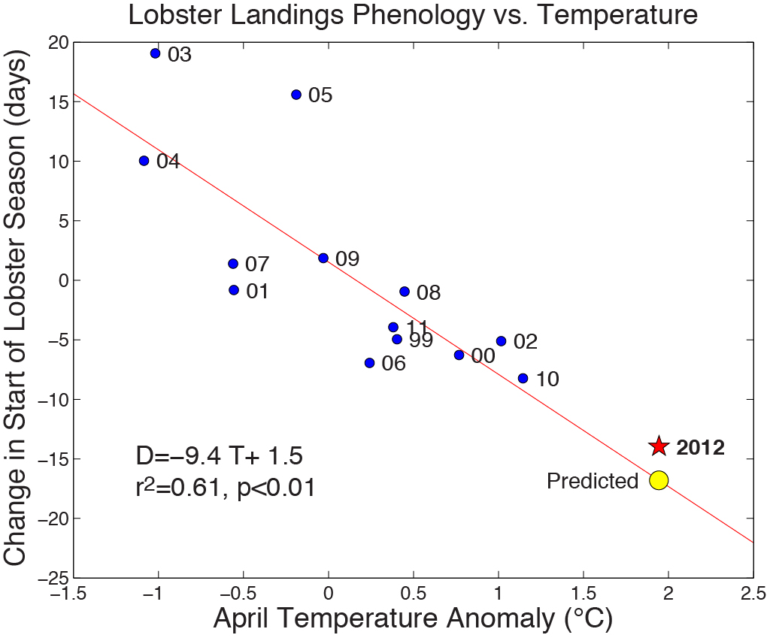
Could the lobster season of 2012
been predicted?

Slide 32
Climate impacts on coupled social-ecological systems
Climate
Ecosystem
Fishery
Communities
Economy
Management

Slide 33
Moving towards a climate adaptation framework for fisheries
Vulnerability
Ecosystem
Resilience
Fishery
Adaptive capacity
Management
Scales:
Individual
Fishery
Community
Maine
Gulf of Maine
NE US
Seasonal
Interannual
Decadal

Slide 34
Lessons for climate adaptation
Improved capacities to assess risk of climate impacts
Climate-ecosystem models
Fishery-specific predictive models
2. Protect resilience in natural and social systems
Population age structure
Access to emerging fisheries
3. Management preparation for species shifts
Management jurisdictions
Management tools

Slide 35
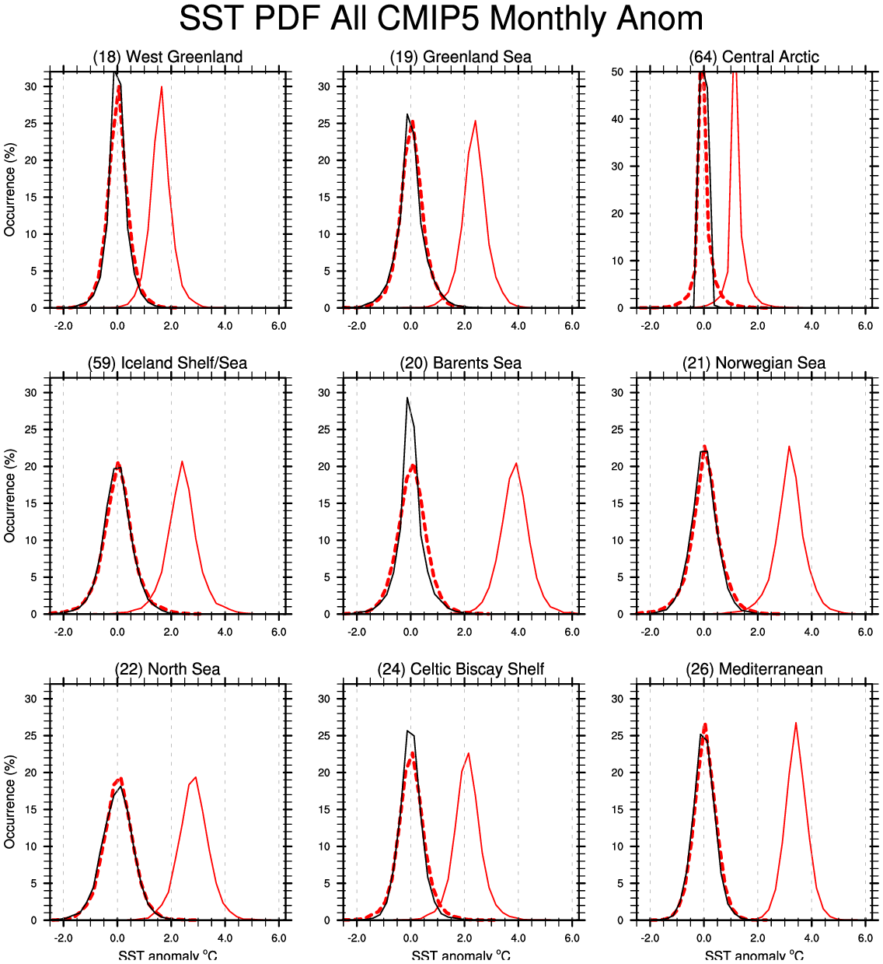
SST Anomaly Distribution and its change
Shown for LMES in the Arctic and surrounding Seas
Black line: years 1976-2005
Solid red line: years 2070-2099
Dashed red line years 2070-2099 but with the mean change removed
SSTs are first detrended within each period
Notes:
Probability distributions given by histograms of CMIP5 monthly SST anomalies averaged over the LMEs in the Artic and surrounding seas for the historical (black line, 1976-2005) and future (red lines, 2070-2099) periods. The SST distributions are presented without trends. The future distribution is shown with the mean change (red solid line) and without the mean change (red dashed lines) to make it easier to compare the shapes of the future and historical distributions. Changes in de-trended variance are significant (at 95% confidence) for the Newfoundland-Labrador Shelf.

Slide 36
Extremes: Change in US Tornados?
Tornados measured on Fujita (F) scale based on damage
mainly from wind <estimated speed>, tornado width and duration on ground
Scale from:
0 very weak
To 5 strongest observed
6 exists in theory
Very weak tornados (F0)
Weak to very strong tornados
(F1+)
Why is there a difference in the two time series?
Do you think the trend in F0 tornados is real?
Kunkel et al. 2013, BAMS

Slide 37
Discussion Questions
In many ways changes in extremes may be more critical to people and the environment than changes in the mean
Describe how you might respond to the following
“All extremes are getting more extreme”
“There have always been extremes, including before the burning of fossil fuels was a major factor”
“We can only predict the weather out about two weeks how can we say whether temperatures will get more extreme or not”
“Even if extremes might increase, the uncertainty is very large, so why or how should we plan for potential changes in them?”

Slide 38
Evaluation criteria for extremes (and other aspects of science)
Is it in peer reviewed published literature
(doesn’t insure it will be correct in the long run)
Is a similar result found in multiple studies, using different methods, data and models?
Can it be explained by physically consistent reasoning?
Careful of “all or nothing” thinking.

