Slide 1





Ocean Ecosystem Model Parameter Estimation in a
Bayesian Hierarchical Model (BHM)
Ralph F. Milliff; CIRES, University of Colorado
Jerome Fiechter, Ocean Sciences, UC Santa Cruz
Christopher K. Wikle, Statistics, University of Missouri
Radu Herbei, Statistics, Ohio State Univ.
Bill Leeds, Statistics, Univ. Chicago
Andrew M. Moore, Ocean Sciences, UC Santa Cruz
Zack Powell, Biology, UC Berkeley
Mevin Hooten, Wildlife Ecology, Colorado State Univ.
L. Mark Berliner, Statistics, Ohio State Univ.
Jeremiah Brown, Principal Scientific
ATOC Ocean Seminar and Boulder Fluid Dynamics Seminar Sep-Oct 2013

Slide 2
Goal: differentiate and identify ocean ecosystem model parameters that can “learn” from data
Challenges: model is a significant abstraction of ocean ecosystem dynamics
large number of correlated parameters
disproportionate parameter amplitudes (gain)
very few data; obs for (at most) 2 state variables, 0 parameters
Methods: BHM in large state-space, geophysical fluid systems
Adaptive Metropolis-Hastings sampling MCMC
“pseudo-data” from ensemble, coupled, forward model calculations
Outline
what is a BHM?
the NPZDFe BHM for the CGOA
failure in a straight-forward application
(crudely) incorporate upper ocean physics
guide experimental design and model validation with ROMS-NPZDFe
(limited) success
summary

Slide 4
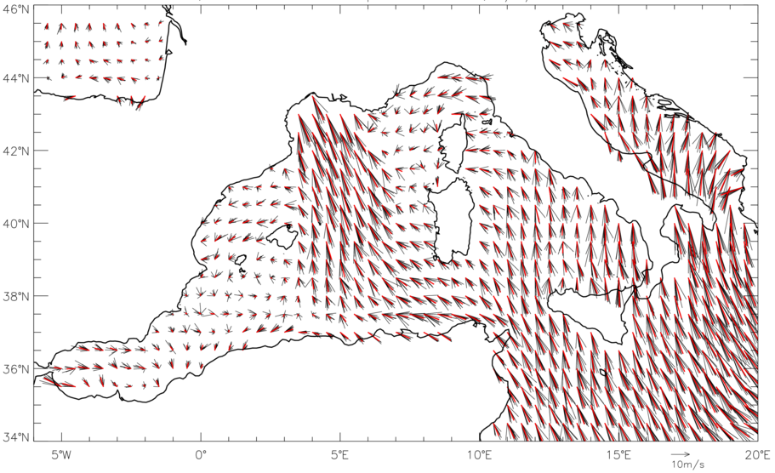
Ensemble surface winds in the Mediterranean Sea from a BHM
data stage: ECMWF surface winds and SLP, QuikSCAT winds
process model: Rayleigh Friction Equations (leading order terms)
Posterior Distribution: Snapshot depicts posterior mean and 10 realizations
(x,t) variability in distributions
Wind-Stress Curl (WSC) implications for ocean forcing
Milliff, R.F., A. Bonazzi, C.K. Wikle, N.Pinardi and L.M. Berliner, 2011: Ocean Ensemble Forecasting, Part 1: Ensemble Mediterranean Winds from a Bayesian Hierarchical Model. Quarterly Journal of the Royal Meteorological Society, 137, Part B, 858-878, doi: 10.1002/qj.767
Pinardi, N., A. Bonazzi, S. Dobricic, R.F. Milliff, C.K. Wikle and L.M. Berliner, 2011: Ocean Ensemble Forecasting, Part 2: Mediterranean Forecast System Response. Quarterly Journal of the Royal Meteorological Society, 137, Part B, 879-893, doi: 10.1002/qj.816.

Slide 6
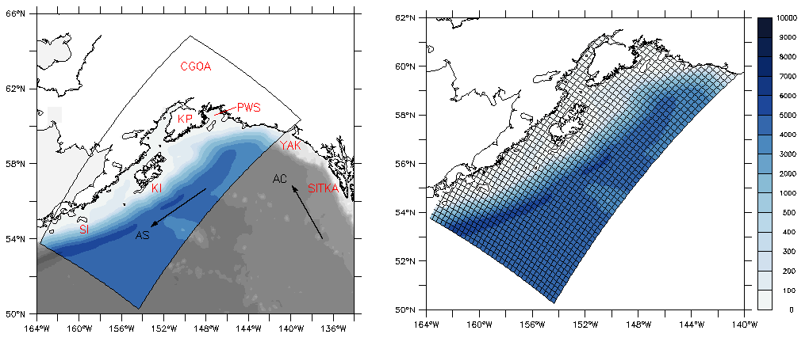
NPZD Parameter Estimation BHM in the Coastal Gulf of Alaska
O
O
O
O
Seward Line
O
O
O
Kodiak Line
O
O
Shumagin Line
Data Stage Inputs
Seward Line: IS, OS, offshore Observations: GLOBEC + SeaWiFS
Kodiak Line: IS, OS, offshore Observations: SeaWiFS only
Shumagin Line: IS, OS, offsh. Observations: SeaWiFS only

Slide 7
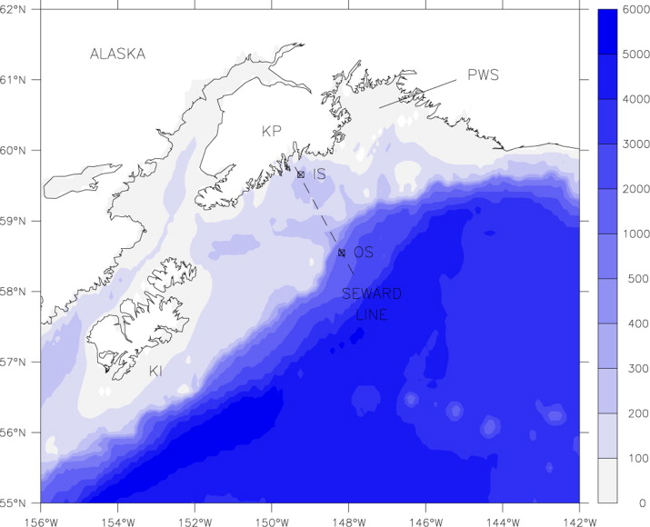
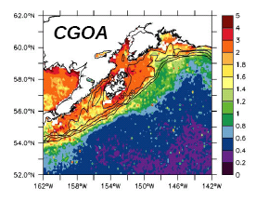
Seward Line (GLOBEC station) in the Coastal Gulf of Alaska
Fiechter, J., R. Herbei, W. Leeds, J. Brown, R. Milliff, C. Wikle, A. Moore and T. Powell, 2013: A Bayesian parameter estimation method applied to a marine ecosystem model for the coastal Gulf of Alaska., Ecological Modelling, 258, 122‐133.
Fiechter, J., 2012: Assessing marine ecosystem model properties from ensemble calculations., Ecological Modelling, 242, 164‐179.
Milliff, R.F., J. Fiechter, W.B. Leeds, R. Herbei, C.K. Wikle, M.B. Hooten, A.M. Moore, T.M. Powell and J.L. Brown, 2013: Uncertainty management in coupled physical-biological lower-trophic level ocean ecosystem models., Oceanography (GLOBEC Special Issue in preparation).

Slide 8
NPZDFe (prior):
N
P
Z
D
Fe

Slide 9
NPZDFe Parameters (random and fixed)
PhyIS
VmNO3
KNO3
KFeC
ZooGR
DetRR
FeRR

Slide 10
Gibbs-Sampler Algorithm: embedded M-H step
straight-forward, 7 parameter BHM failed
add discrete vertical process analog to prior, reduce to 2 key parameters
validate with synthetic data

Slide 11
“Perfect” data experiments to validate the NPZDFe BHM:
data stage inputs from ROMS assimilation run at Seward inner shelf location (2001)
BHM includes a model error term but no dynamical terms
ROMS state variable data not sufficient to set seasonal bloom clock
N (t,z)
P (t,z)
level
level
10
10
20
20
30
Model
30
Model
day
day
Model Error
Model Error
Sum
Sum
Data
Data
μmol N m⁻³
μmol N m⁻³

Slide 12
“Perfect” data experiments to validate the NPZDFe BHM:
data stage inputs from ROMS assimilation run at Seward inner shelf location (2001)
BHM includes a model error term but no dynamical terms
ROMS state variable data not sufficient to set seasonal bloom clock
N (t,z)
P (t,z)
level
level
10
10
20
20
30
Model
30
Model
day
day
Model Error
Model Error
Sum
Sum
Data
Data
μmol N m⁻³
μmol N m⁻³

Slide 13
NPZDFe (prior):
N
P
Z
D
Fe

Slide 14
NPZDFe with Vertical Mixing (prior):
N
P
Z
D
Fe

Slide 15
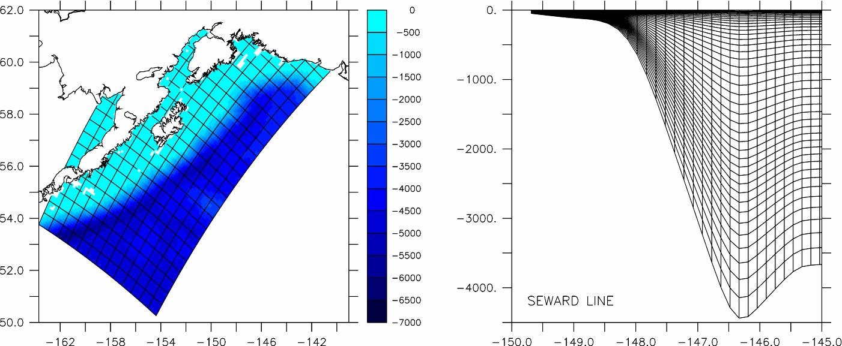
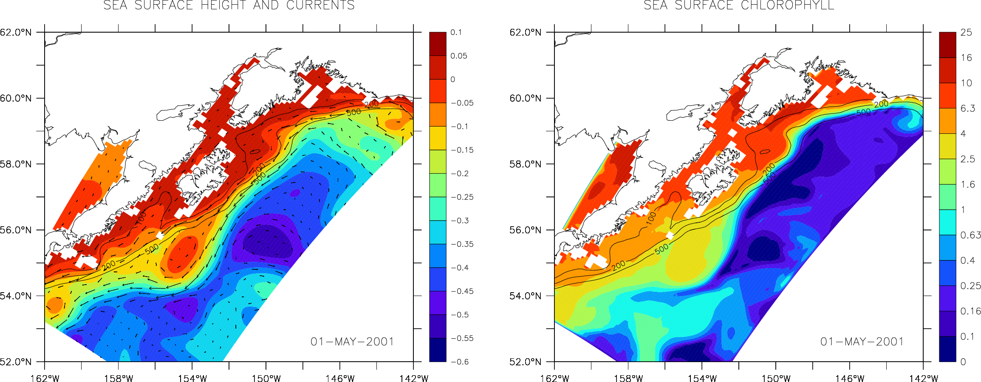
Simulated Data from Hi-Fidelity, Data Assimilative, Deterministic Model
ROMS-NPZDFe
Fiechter, J., A.M. Moore, 2012 Iron limitation impact on eddy-induced ecosystem variability in the coastal Gulf of Alaska
Journal Marine Systems, 92, pp. 1–15 http://dx.doi.org/10.1016/j.jmarsys.2011.09.012
SSH and Currents
Surface Chlorophyll

Slide 16
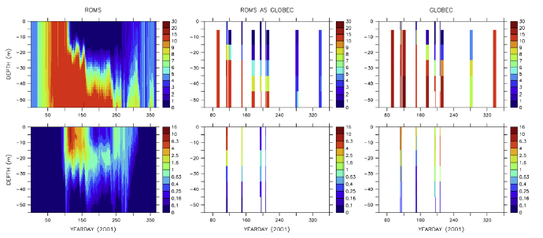
“Perfect” data experiment repeat with MLD dependent mixing term in prior
Seward line; inner shelf
ROMS
μmol N m⁻³
ROMS as GLOBEC
GLOBEC
N(t,z)
P(t,z)
YEARDAY (2001)

Slide 17
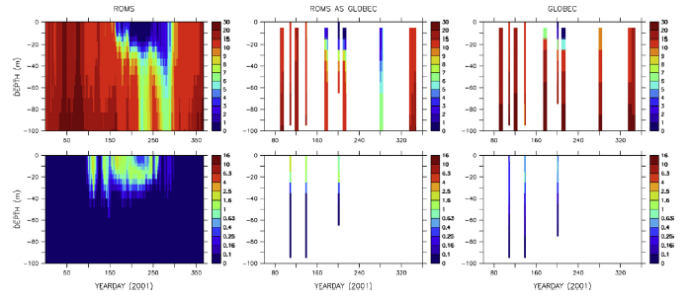
“Perfect” data experiment repeat with MLD dependent mixing term in prior
Seward line; outer shelf
ROMS
μmol N m⁻³
ROMS as GLOBEC
GLOBEC
N(t,z)
P(t,z)
YEARDAY (2001)

Slide 18
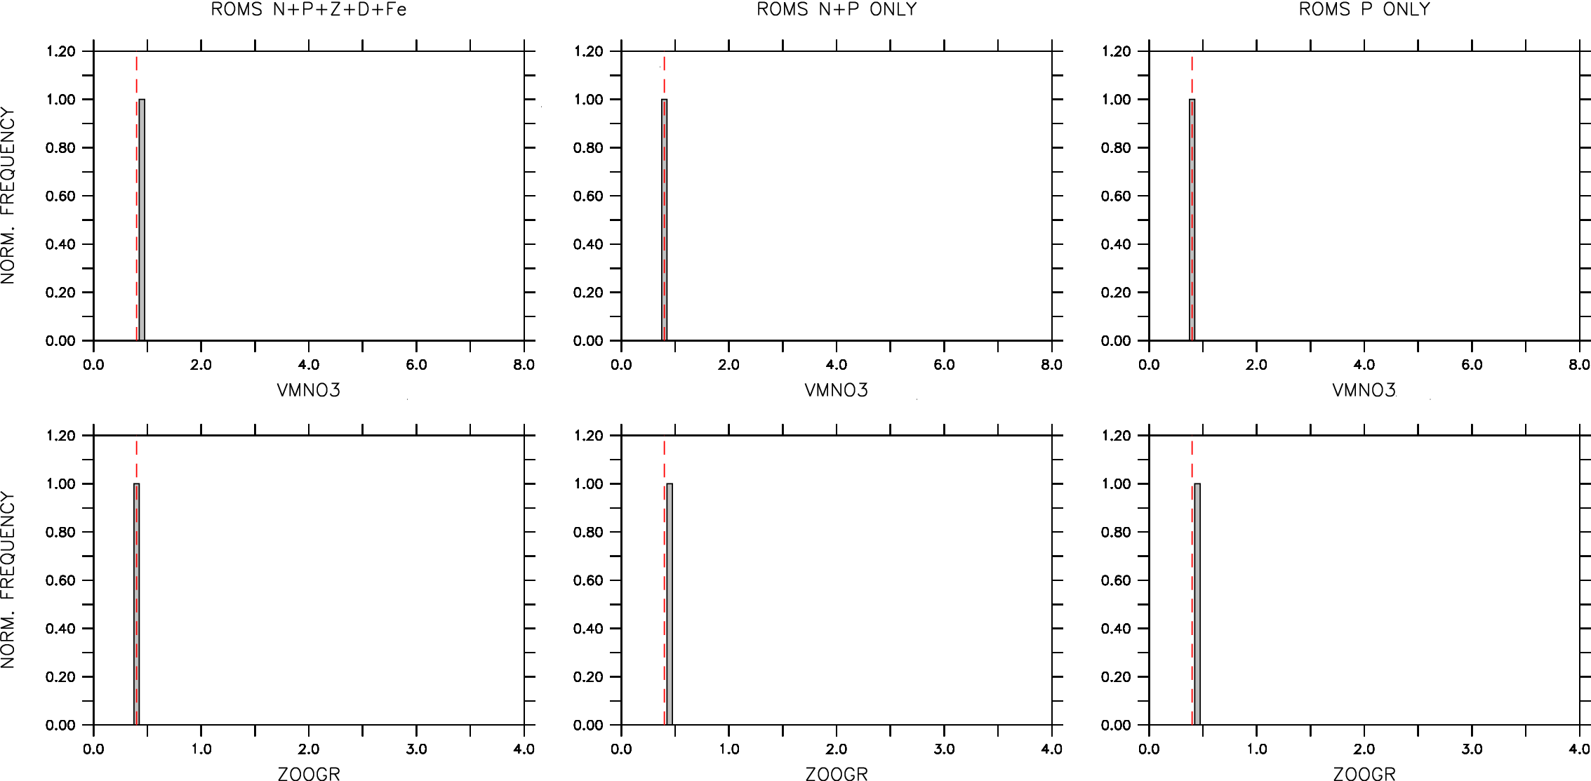
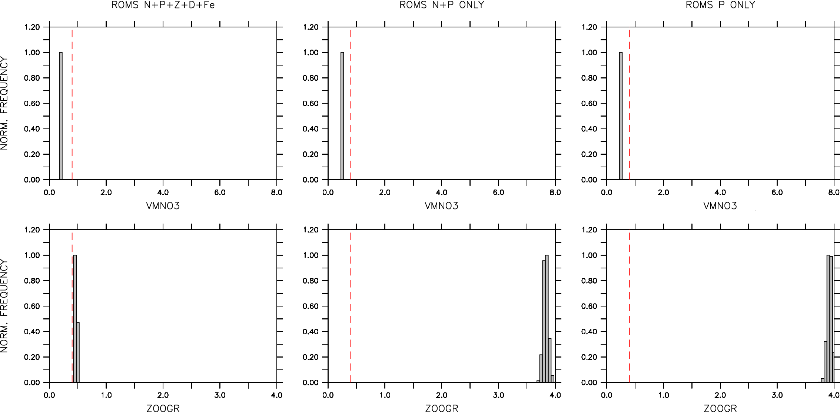
ROMS data (subsets thereof)
VmNO3
inner
shelf
ZooGR
VmNO3
outer
shelf
ZooGR

Slide 19
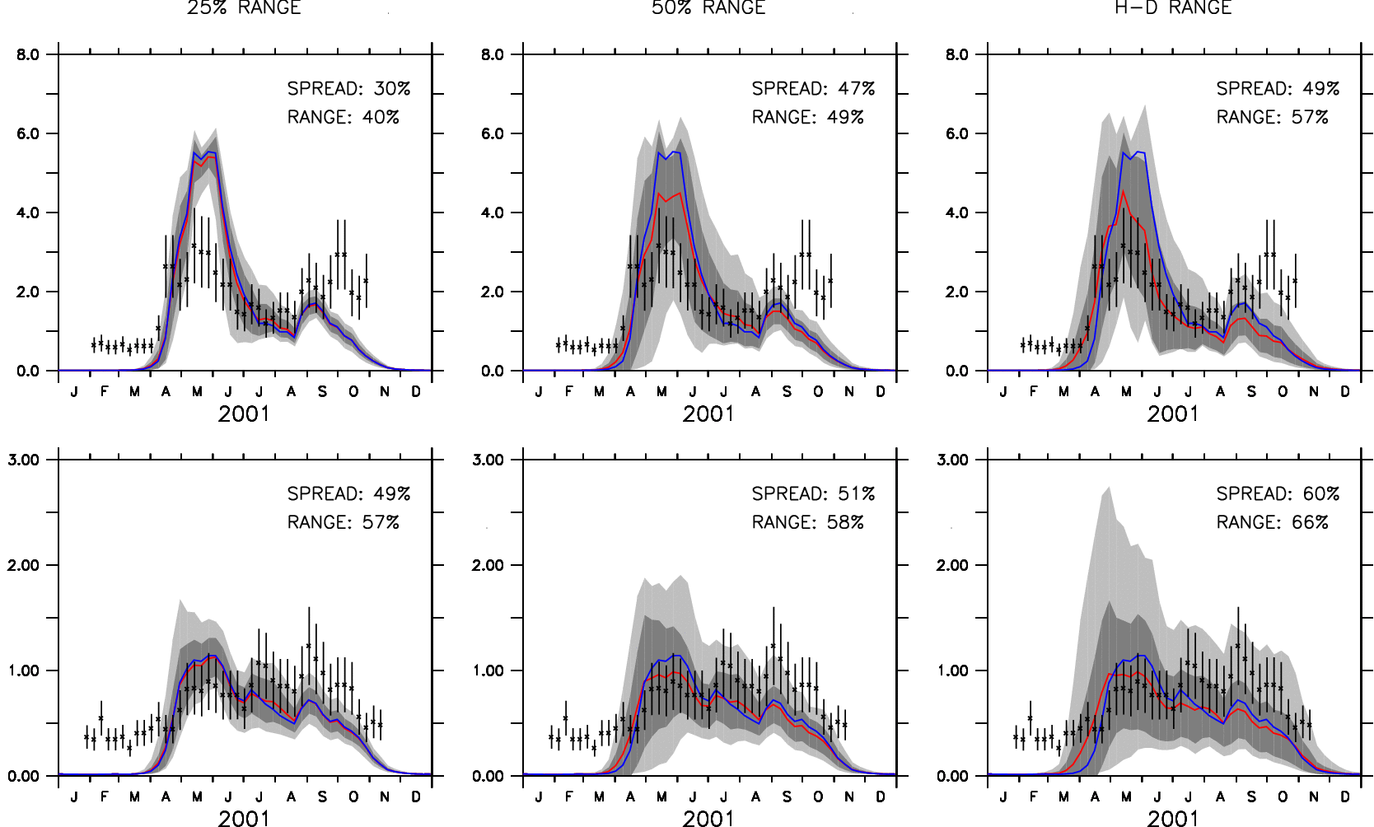
ROMS-NPZD Ensembles for shelf and basin (±50% range)
CONTROL ENSEMBLE MEAN SEAWIFS
Notes:
25 member shelf (top row) and basin (bottom row) averages P(t)
left col: +/- 25$ on 7 params; mid col: +/- 50%; right col: half and double range
SeaWiFS obs, control(blue) and ensemble mean(red)
Latin Hypercube, simultaneous parameter selections.

Slide 20
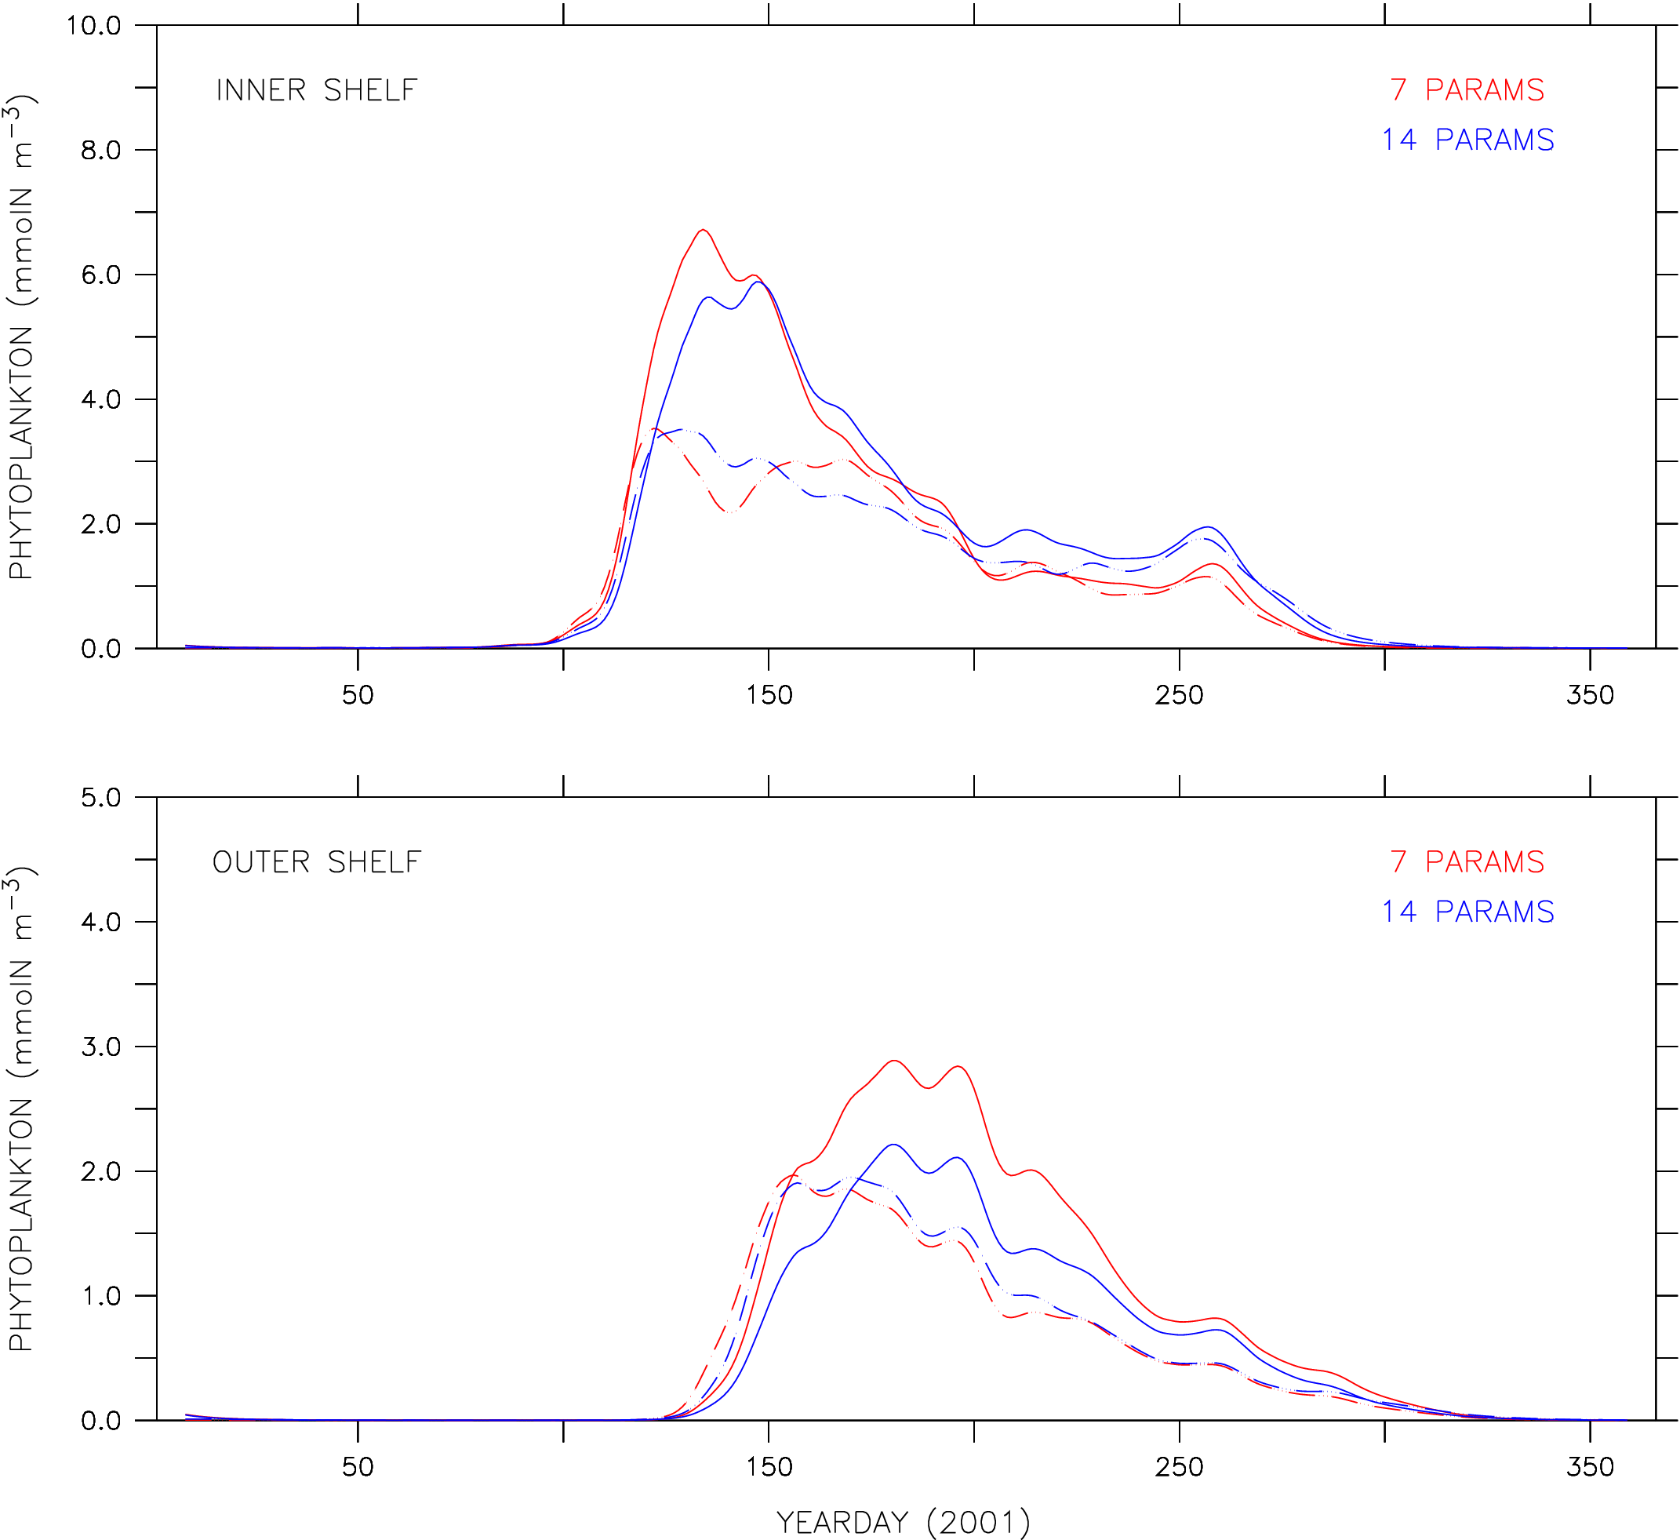
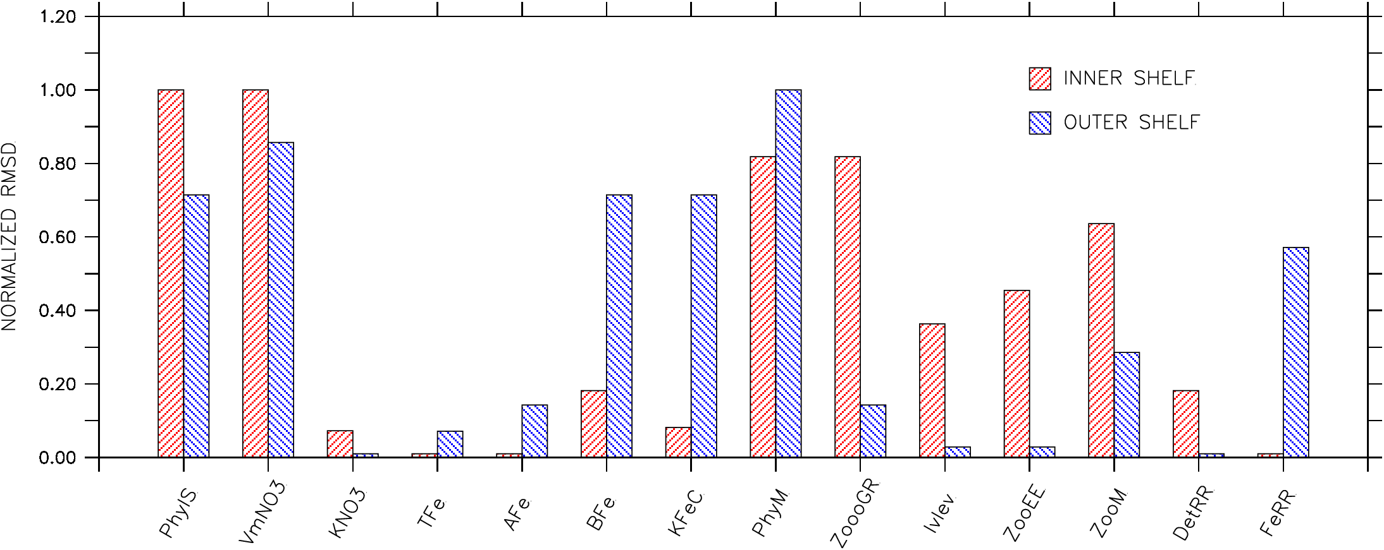
1-D NPZD Ensembles for Seward IS and OS (±50% range)
Notes:
Top 2 Panels: Inner Outer Shelf P(t) for 7 parameter ensemble (Red) and 14 parameter ensemble (Blue)
Ensemble means are solid lines, ensemble spread is dashed.
I think they are 25-member ensembles with Latin-Hypercube selection (simultaneous) of parameters within +/- 50%
Shows that varying 7 parameters captures most of signal and spread on inner shelf, most of spread on outer shelf/
Bottom Bar graphs: Normalized difference with respect to [P]; i.e. sensitivity of solution to parameter variation
nb: some parameters are part of an exponential, some are just additive or in denominators … exponential
impacts are treated same as others (i.e. +/- 50%).

Slide 21
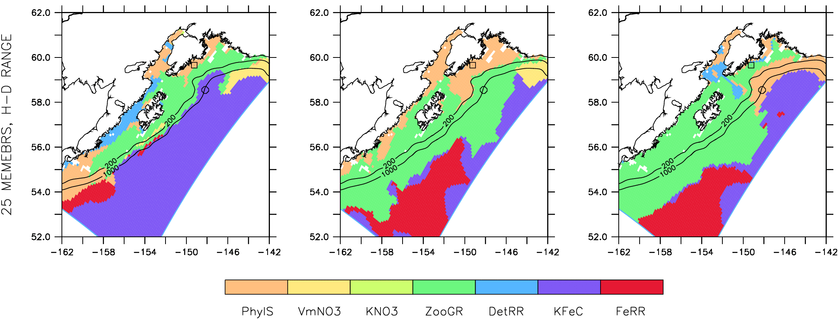
ROMS-NPZD Ensembles: Parameter Control
May
Jul
Sep
Regress (normalized) model parameters on monthly-average surface chlorophyll
from SeaWiFS at each point in the ROMS-NPZDFe CGOA domain. Determine relative
importance, in space and time, of each parameter on surface P abundance.
P_{n} = a₁θ₁ + a₂θ₂ + a₃θ₃ + a₄θ₄ + a₅θ₅ + a₆θ₆ + a₇θ₇, n=1,…,N
where the θ_{p}, p=1,…,7; are the parameters to be treated as random variables in
the BHM, and N is the ensemble size (~50 members).
Notes:
Top Panels: Inner, Outer shelf normalized regression slopes for [P] regressed against 7 parameters as function of month at 2 locations (circle and square off Kenai Penn.)
Overall regression R^2 at top of each monthly column
PhyIS inner shelf dominates positive early season when light is affecting growth, negative summer when growth slows
ZooGR negative impact in Jun, Sep to limit P blooms inner shelf; all summer to limit outer shelf (see tongue of green advected across shelf)
KFeC negative reduces Iron limitation early season off shore.
Bottom Panels, leading regression variable; grid point by grid point average over all ensemble members, each month.

Slide 22
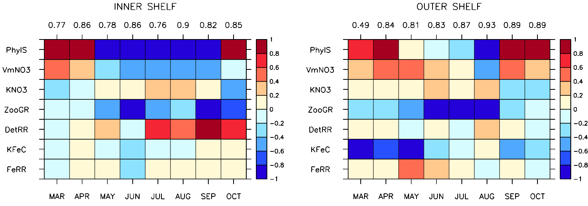
ROMS-NPZD Ensembles: Parameter Control
temporal (monthly average) regression coefficients
Notes:
Top Panels: Inner, Outer shelf normalized regression slopes for [P] regressed against 7 parameters as function of month at 2 locations (circle and square off Kenai Penn.)
Overall regression R^2 at top of each monthly column
PhyIS inner shelf dominates positive early season when light is affecting growth, negative summer when growth slows
ZooGR negative impact in Jun, Sep to limit P blooms inner shelf; all summer to limit outer shelf (see tongue of green advected across shelf)
KFeC negative reduces Iron limitation early season off shore.
Bottom Panels, leading regression variable; grid point by grid point average over all ensemble members, each month.

Slide 23
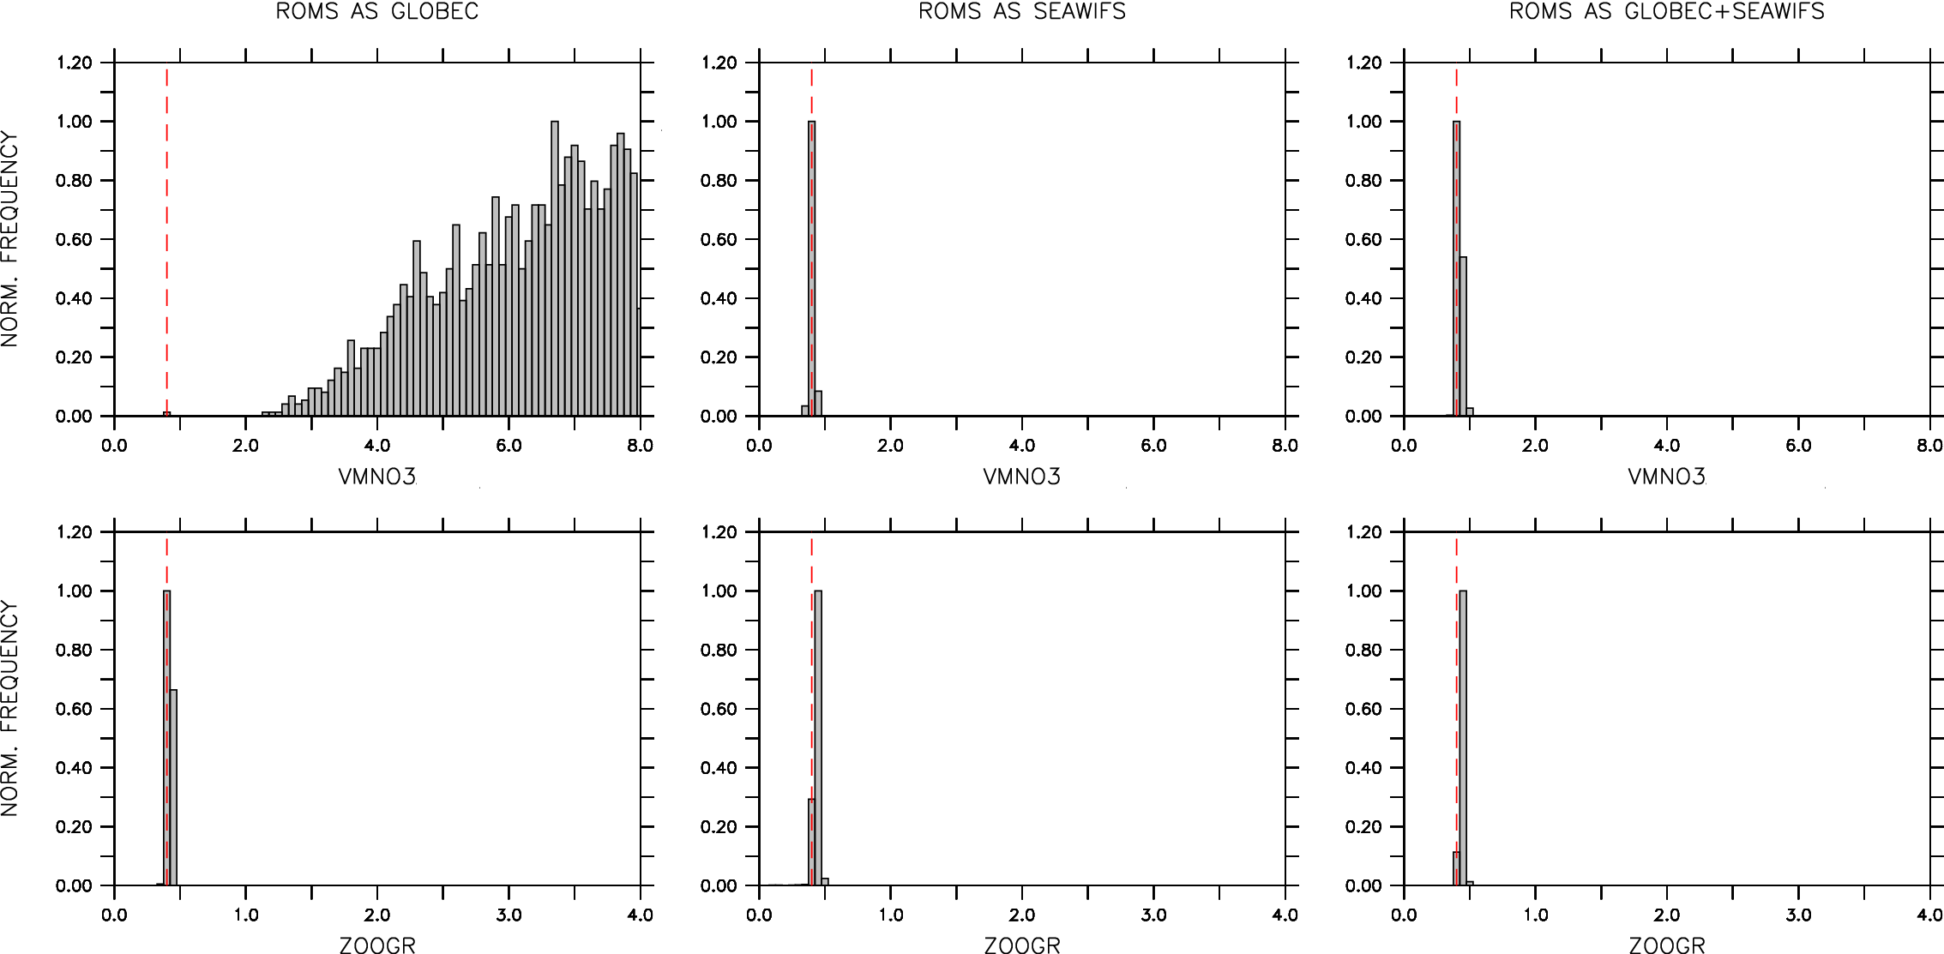
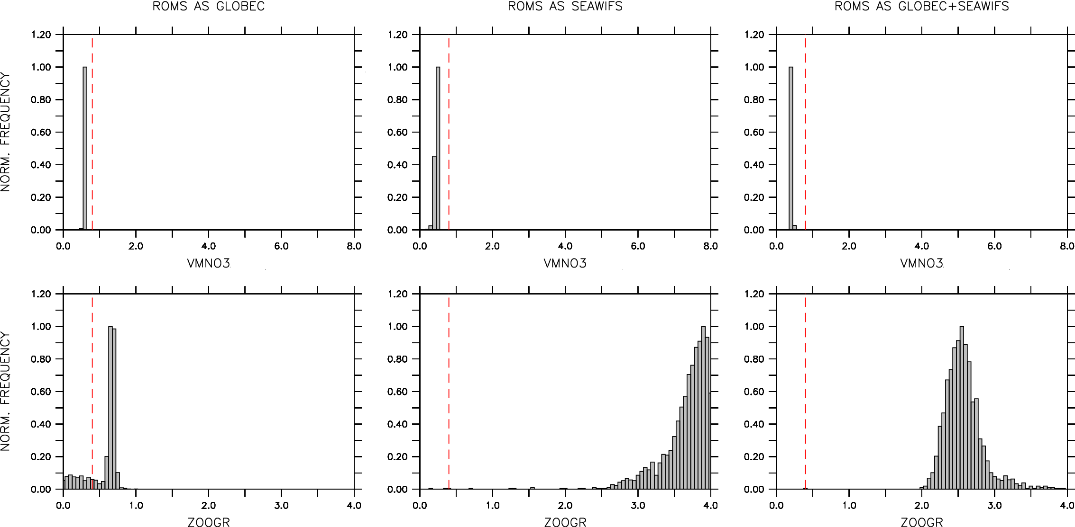
ROMS inserted at Globec and SeaWiFS locations
VmNO3
inner
shelf
ZooGR
VmNO3
outer
shelf
ZooGR

Slide 24
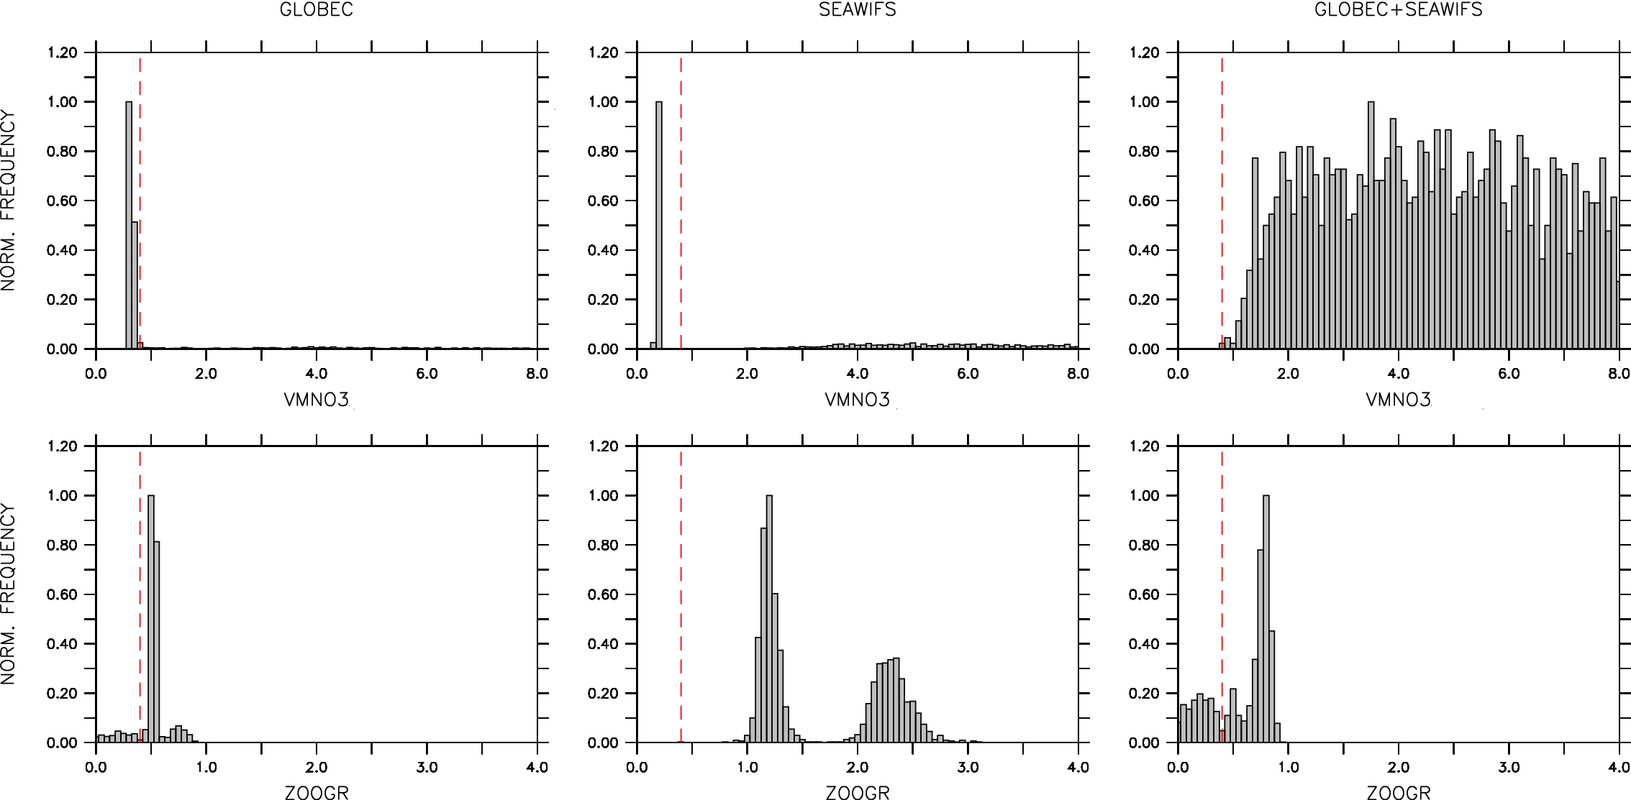
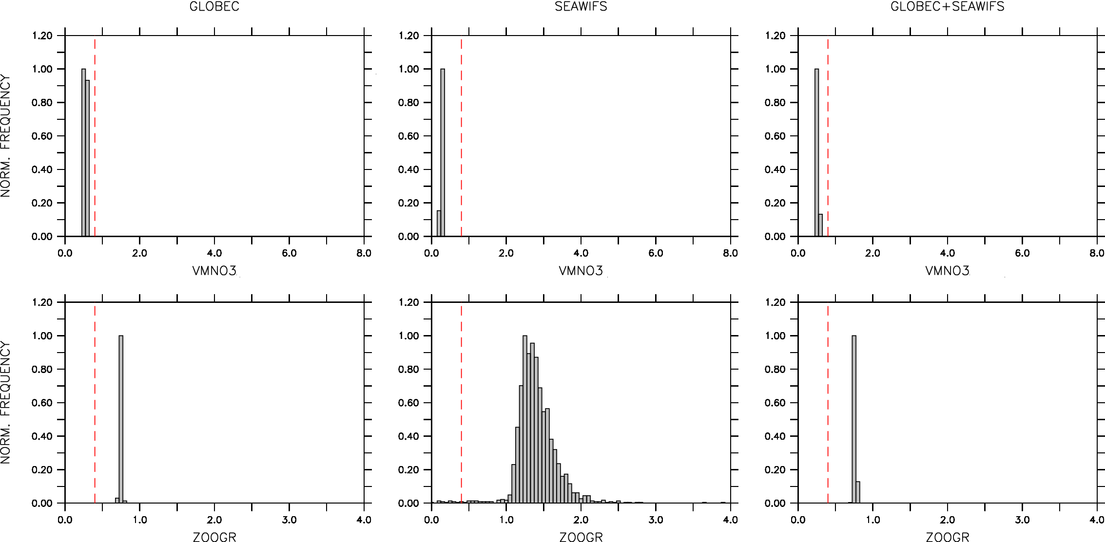
estimating 2 parameters from
in-situ Globec stations and SeaWiFS (8d avg) data
VmNO3
inner
shelf
ZooGR
VmNO3
outer
shelf
ZooGR

Slide 25
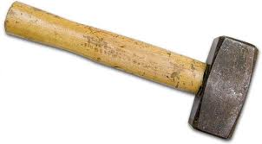
Lessons Learned
Realistic ecosystem solution for 1D NPZDFe BHM in CGOA requires vertical mixing
  nutrient replenishment in Winter
  stratification sets timing of Spring bloom
Under-determination addressed with mixed probabilistic-deterministic approach
  BHM validation
  re-scope parameter identification experiment
  separate sampling from model limitations
BHM

Slide 26
EXTRAS

Slide 27
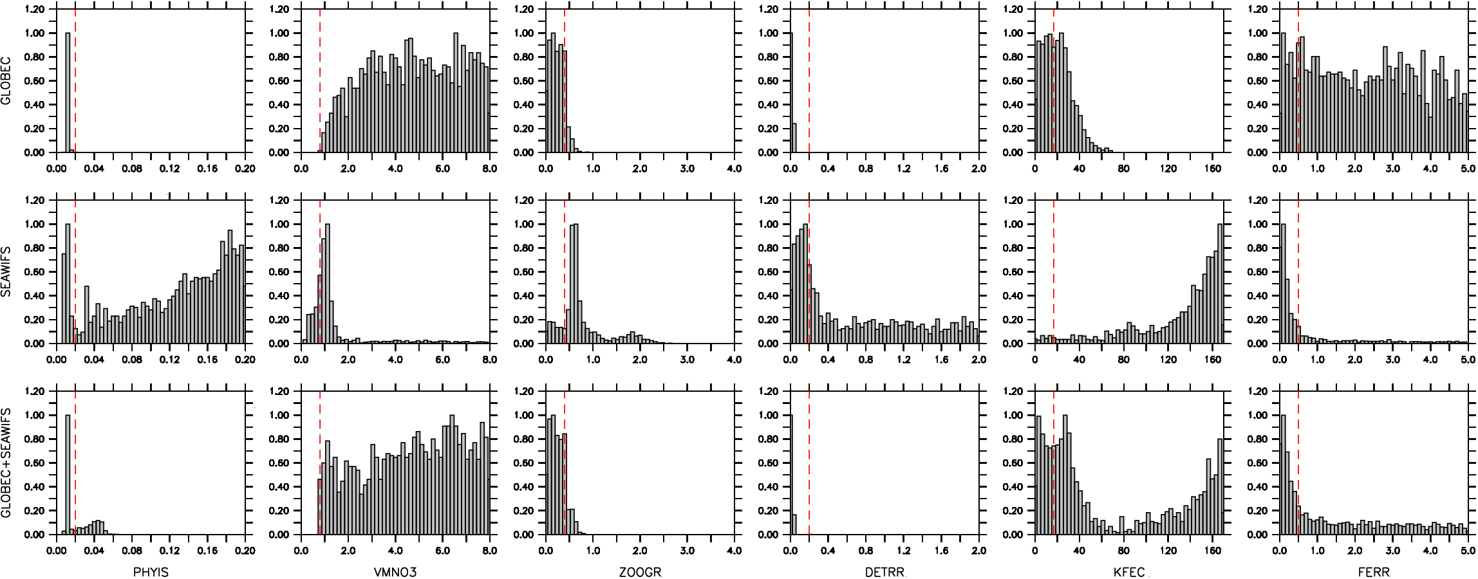
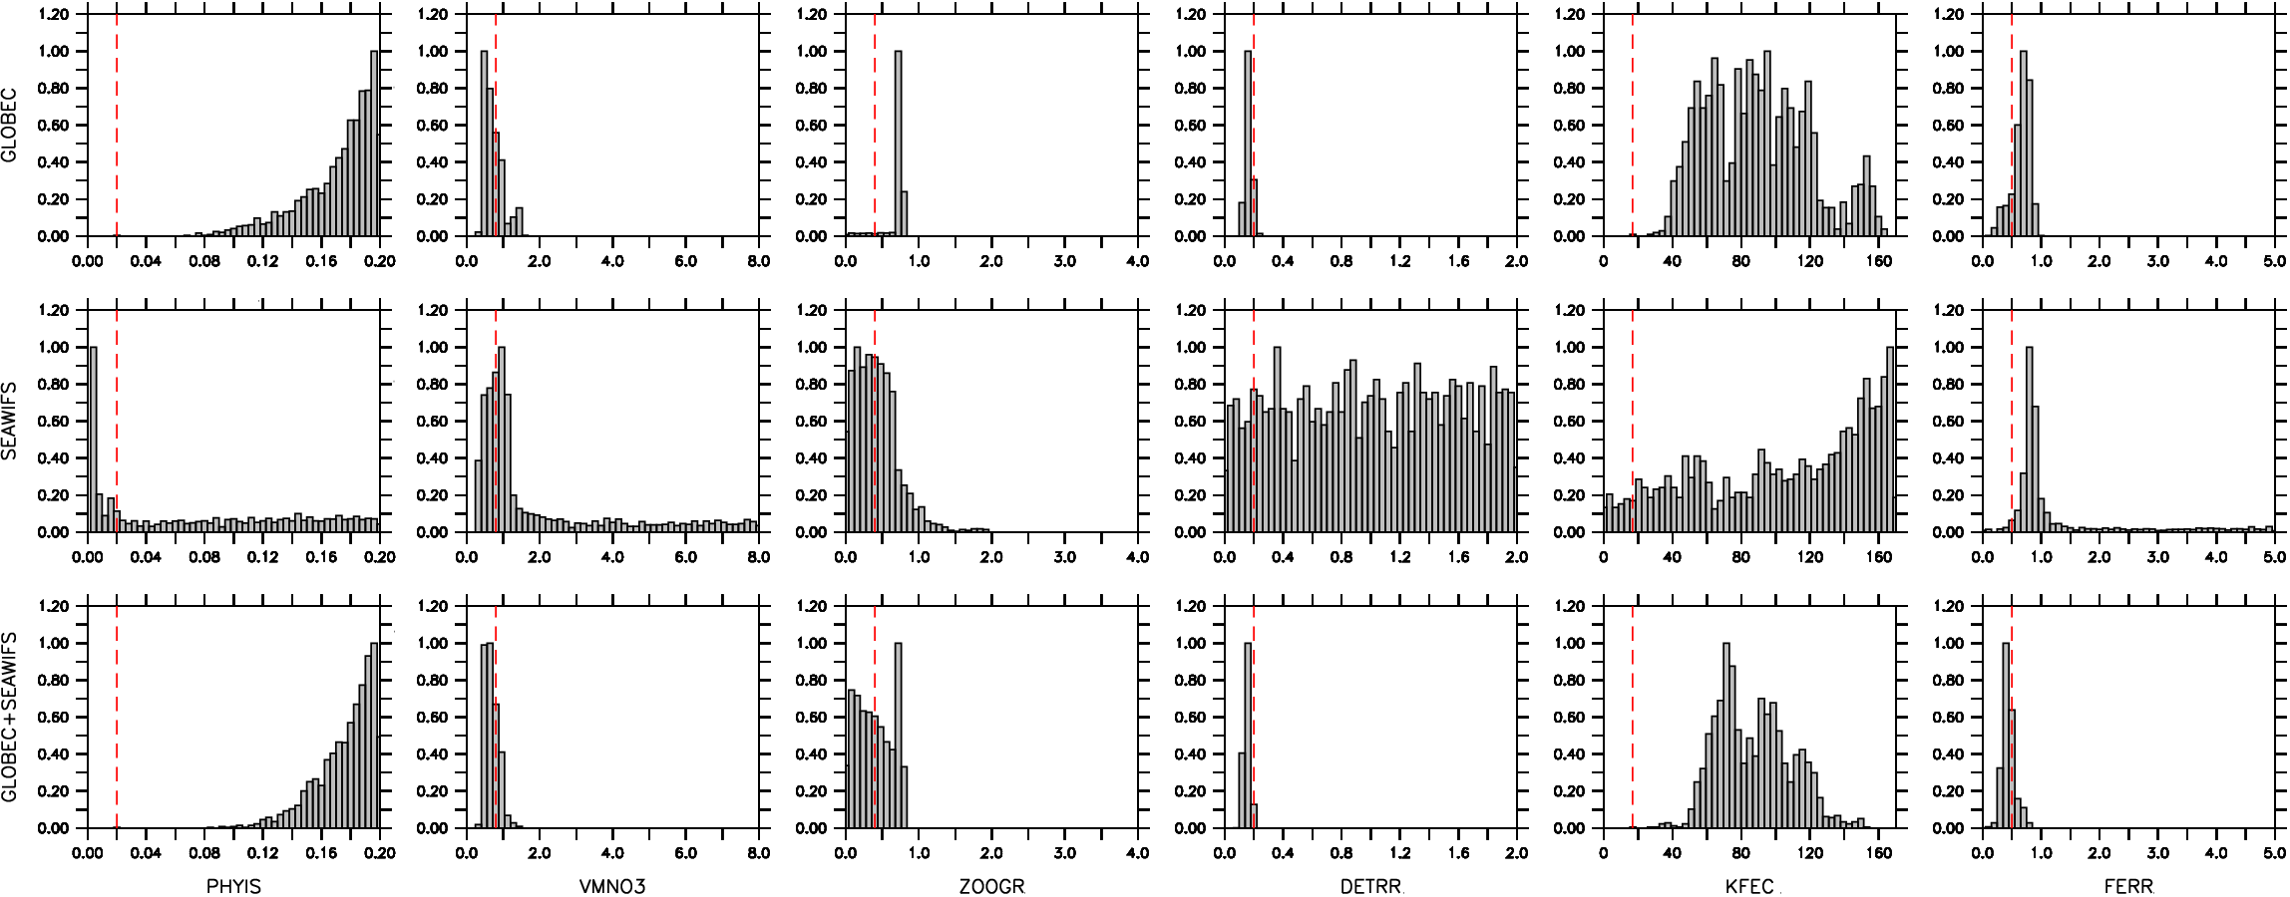
estimating 6 parameters; PhyIS, VmNO3, ZooGR, DetRR, KFeC, FeRR
(ROMS)
inner
shelf
outer
shelf

Slide 28
Ocean Ecosystem Model Parameter Estimation BHM Summary:
Science Perspective:
new approach to under-determination in biogeochem models
trade uncertainty for number of identifiable parameters
value-added for forward model ensemble
elucidate parameter correlations, space-time dependence
Zooplankton grazing and Nutrient uptake are identifiable in CGOA
given station data and Chl retrievals from ocean color sat obs
BHM Perspective:
sparse data
in-situ station data (biased by season)
ocean color/Chl data (biased by cloud cover)
too many (correlated) parameters (identifiability)
Metropolis-Hastings step required in Gibbs Sampler
low acceptance
synthetic Data from deterministic system
ROMS-NPZD+Fe to improve proposals
validate model and physical interpretations
EXPENSIVE

Slide 29
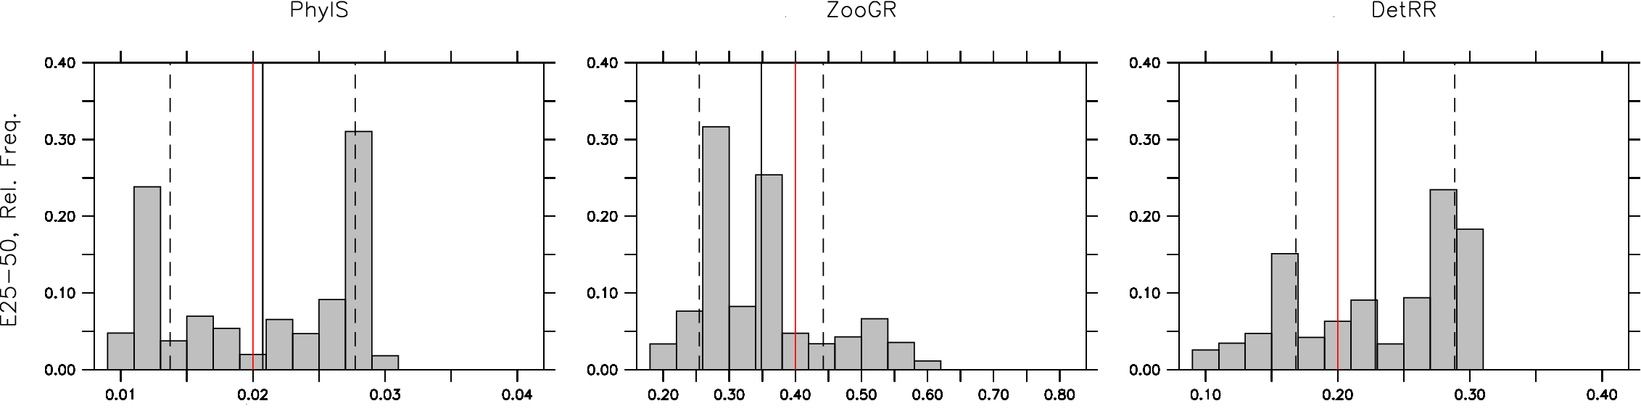
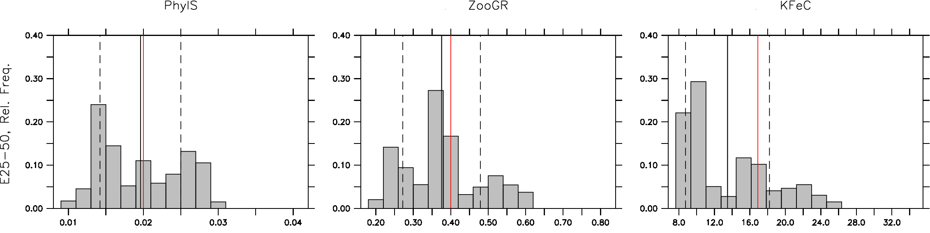
ROMS-NPZD Ensembles: Parameter Estimation
Experiment | PhyIS | VmNO3 | KNO3 | ZooGR | DetRR | KFeC | FeRR
Control Shelf best Basin best Domain best | 0.02 0.029 0.029 0.029 | 0.8 0.55 0.66 0.73 | 1.0 0.81 1.32 0.92 | 0.4 0.42 0.28 0.34 | 0.2 0.12 0.24 0.16 | 16.9 24.79 22.40 21.76 | 0.5 0.61 0.71 0.67
Notes:
Ad hoc means of parameter estimations given ensembles of forward runs.
Top: grid-by-grid, select best agreement vs obs in P at each t and record param value; do so for shelf, basin and whole domain
Bottom: build distribution by recording params for best agreement grid-by-grid on shelf (top row), and basin (bottom row)
red is default value, black solid is ensemble mean and dashed is 1 std.
Naïve parameter estimation from random mixing of parameter values and a posteriori comparison with P obs

Slide 30
Review: Bayesian Hierarchical Models (BHM)
Probability Models:
Conditional thinking; [A,B,C] = [A | B,C] [B | C] [C], easier to specify conditional vs joint
Use what we know/willing to assume to simplify; e.g. [A | B,C] ∼ [A|B]
BHM Building Blocks:
Data Stage Distribution (likelihood) quantifies uncertainty in relevant observations,
e.g. measurement errors, quantifiable biases, etc. .... [D | X, θ_{d} ]
Process Model Stage Distribution (prior) quantifies uncertainty in (perhaps incomplete)
physics of process; e.g., [X_{t+1} | X_{t} , θ_{p} ]
Parameter Distributions from Data Stage and Process Models (i.e. [θ_{d}], [θ_{p}] )‏
issues of identifiability, uncertainty, model validation
Bayes Theorem relates Data and Process Model Stages to the Posterior Distribution
[X,θ_{p},θ_{d}|D] ∝ [ D|X,θ_{d} ] [X|θ_{p}] [θ_{p}] [θ_{d}]
BHM Posterior Distribution:
Obtained via Gibbs Sampler Algorithm, Markov Chain Monte Carlo
Distributional estimates of process (and parameters) given data e.g. [X,θ_{d},θ_{p}|D]
Posterior mean is expected value
Standard deviation of posterior is an estimate of the spread
Cressie, N.A. and C.K. Wikle, 2011: Statistics for Spatio-Temoral Data, Wiley Series in Probability and Statistics, John Wiley and Sons, 588pgs
Notes:
30
30
30
So this is the one-slide review of BHM.
The approach is fundamentally distinct from deterministic approaches to models of geophysical systems with which many of us were raised. BHM is based in probability theory, and is an application of Bayes Theorem. The fundamental input and output entities in BHM are probability distributions. We use a common, square-bracket notation to indicate probability distributions, << identify joint, conditional>>
In BHM, there is a divide and conquer strategy that starts with the realization that it is easier to specify the conditional distribution factors of a joint distribution, than it is to specify a complicated joint distribution directly. Moreover, given our knowledge of the processes of interest, and/or our willingness to accept assumptions regarding some of the conditional distribution factors, we can simplify even the specification of the component conditional distributions. I will try to point out some of this as we dive into details of the BHM to be described here.
It has become convenient in our applications of BHM to atmosphere/ocean problems to identify 3 stages of the BHM hierarchy of distributions, that in turn lead to estimates of the posterior distribution of interest. The distributions are: 1) a data stage distribution or likelihood function, wherein measurement errors in relevant observations are taken into account; 2) a process model distribution or prior where our best description of the physical processes of interest are posed, i.e. either as discrete equations or as summations of structure functions arising from systems of equations describing the process; and 3) distributions on parameters that arise in both the data stage and process model distributions. Again, we will see examples of these distributions and their interactions in the BHM developments to follow.
The data stage, process model and parameter distributions are convolved according to Bayes Theorem to obtain a posterior distribution for the process of interest and the parameters of the system, given the data. In very-large state space systems of interest here, Bayes Thm cannot be implemented analytically, and we resort instead to estimates of the posterior via so-called MCMC methods that are the numerical methods equivalents in probabilistic modelling. It is the advent of efficient MCMC methods that brought BHM to bear on large state-space problems. This breakthrough occurred in the late 1980's in the modern statistics literature.
We will use estimated modes of the posterior distributions to be our best estimates of the processes and parameters in our modelling. Second moments of the posterior, i.e. standard deviations, will serve as estimates of the spread or uncertainty in the posterior.

Slide 32
MFS-Wind-BHM Summary:
BHM Perspective:
abundant data
satellite data contribute to density functions
far fewer random variables than d.o.f. in deterministic setting
full x,t modelling is more challenging
issues of identifiability
efficient Gibbs Sampler
full conditional distributions
estimating state variables
data stage inputs project directly on process
Science Perspective:
ensemble forecast methods
initial condition perturbations
efficient, balanced perturbations of important dependent variable fields
upper ocean forecast
emphasize uncertain part of forecast (ocean mesoscale)

Slide 33
Bayesian Emulators from Forward Model Ensemble:
Leeds, W.B., C.K. Wikle and J. Fiechter, 2012: Emulator-assisted reduced-rank ecological data assimilation for nonlinear
multivariate dynamical spatio-temporal processes., Statistical Methodology,1, pg. 11 doi:10.1016/j.statmet.2012.11.004.

Slide 34
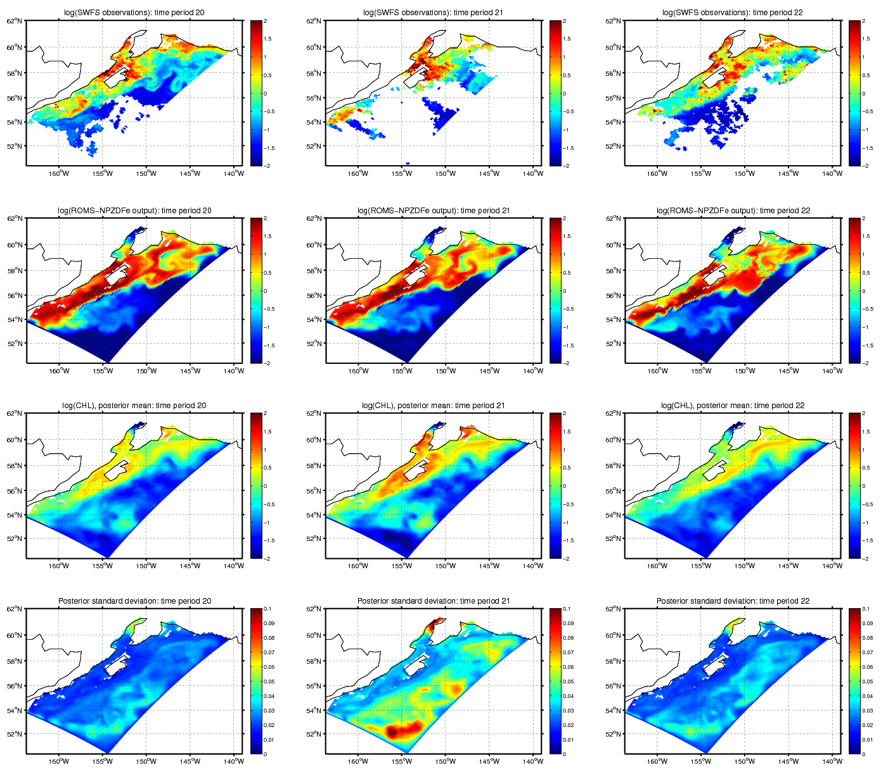
Emulated Phytoplankton: log(Chl)
time (in 8d epochs)
SeaWiFS
ROMS-NPZDFe
Posterior Mean
Uncertainty

