Slide 1
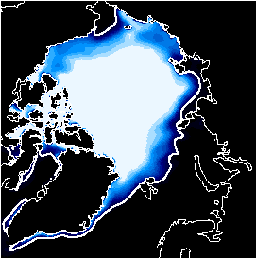
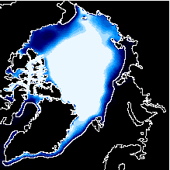
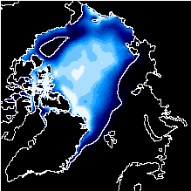
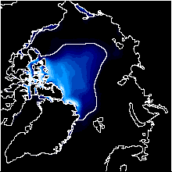
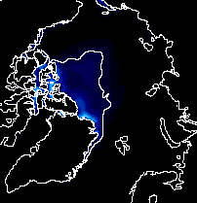
Sea Ice Predictability on Seasonal to Interannual Timescales
Marika Holland
National Center for Atmospheric Research
Collaborators: David Bailey (NCAR), Steve Vavrus (U.WI), Julienne Stroeve (NSIDC), Ed Blanchard-Wrigglesworth (U. WA), Cecilia Bitz (U. WA), Jennifer Kay (NCAR)
University of Toronto
November 2012
NCAR is sponsored by the National Science Foundation

Slide 2
Outline
Background
Arctic sea ice predictability on seasonal to interannual timescales
“predictor” relationships in a changing climate
inherent predictability from climate model studies
Antarctic sea ice predictability

Slide 3
Outline
Background
Arctic sea ice predictability on seasonal to interannual timescales
“predictor” relationships in a changing climate
inherent predictability from climate model studies
Antarctic sea ice predictability

Slide 4
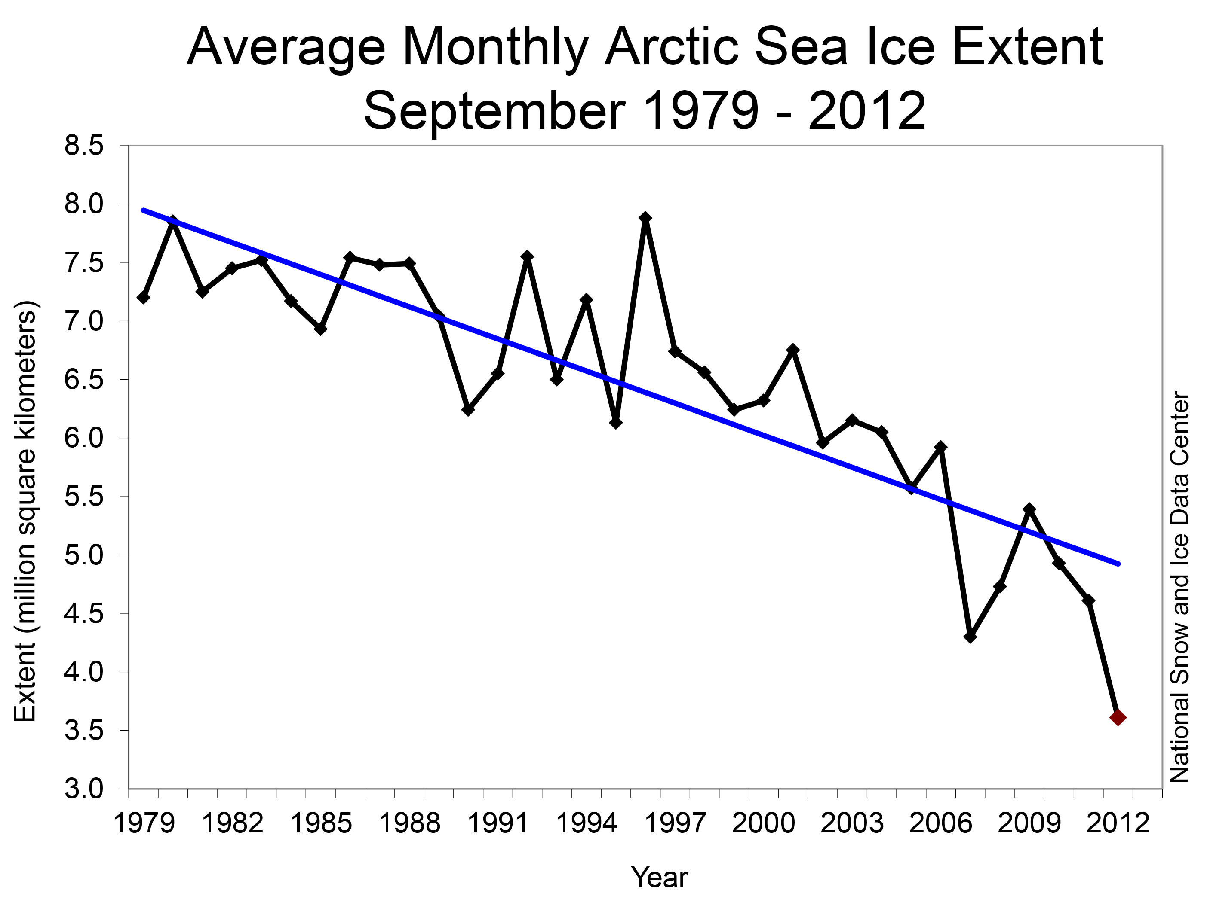
When I received my Ph.D.
6.74 million sq km
Where we were last Sept
3.61 million sq km
~13% per decade linear trend

Slide 5
September Ice Cover
From The Cryosphere Today website
University of Illinois

Slide 6
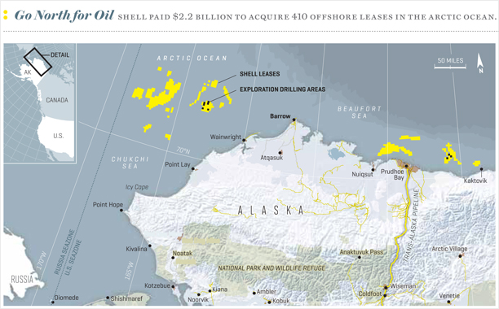
2010 – 4 vessels
2011 – 34 vessels
2012 – 46 vessels
Norwegian Tanker – ‘Marika’
Transported jet fuel from Korea to Finland in Aug

Slide 7
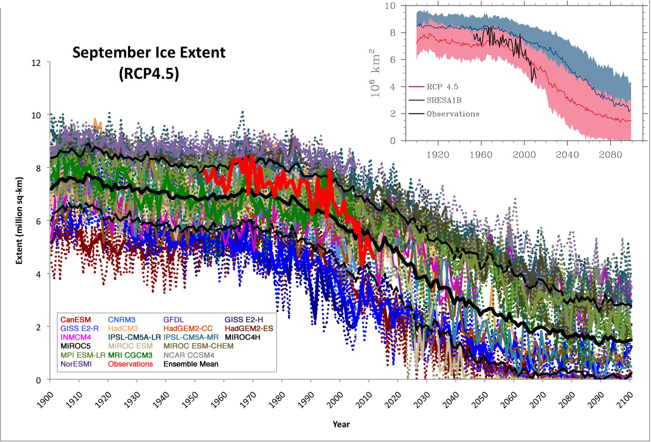
Simulated September Arctic Sea Ice Extent
CMIP3
OBS
CMIP5
Stroeve et al., GRL, 2012

Slide 8
Uncertainty of Arctic sea ice change projections
From CMIP3 Models
Sources of Uncertainty
Internal
Model
Scenario
On <15 years intrinsic variability dominates
On 20+ years, model uncertainty dominates
On 50+ years, future GHG scenario uncertainty becomes important
(Following Hawkins and Sutton, 2009)

Slide 9
Predictability
Of the First Kind:
Initial value problem
Sensitive dependence on initial conditions limits predictability
Timescale depends on system
State
Of the Second Kind:
Boundary value problem
Prediction of statistical properties of the climate system subject to some external forcing
Time
Total: Combination of the two
(Adapted From Brantstator and Teng, 2011)

Slide 10
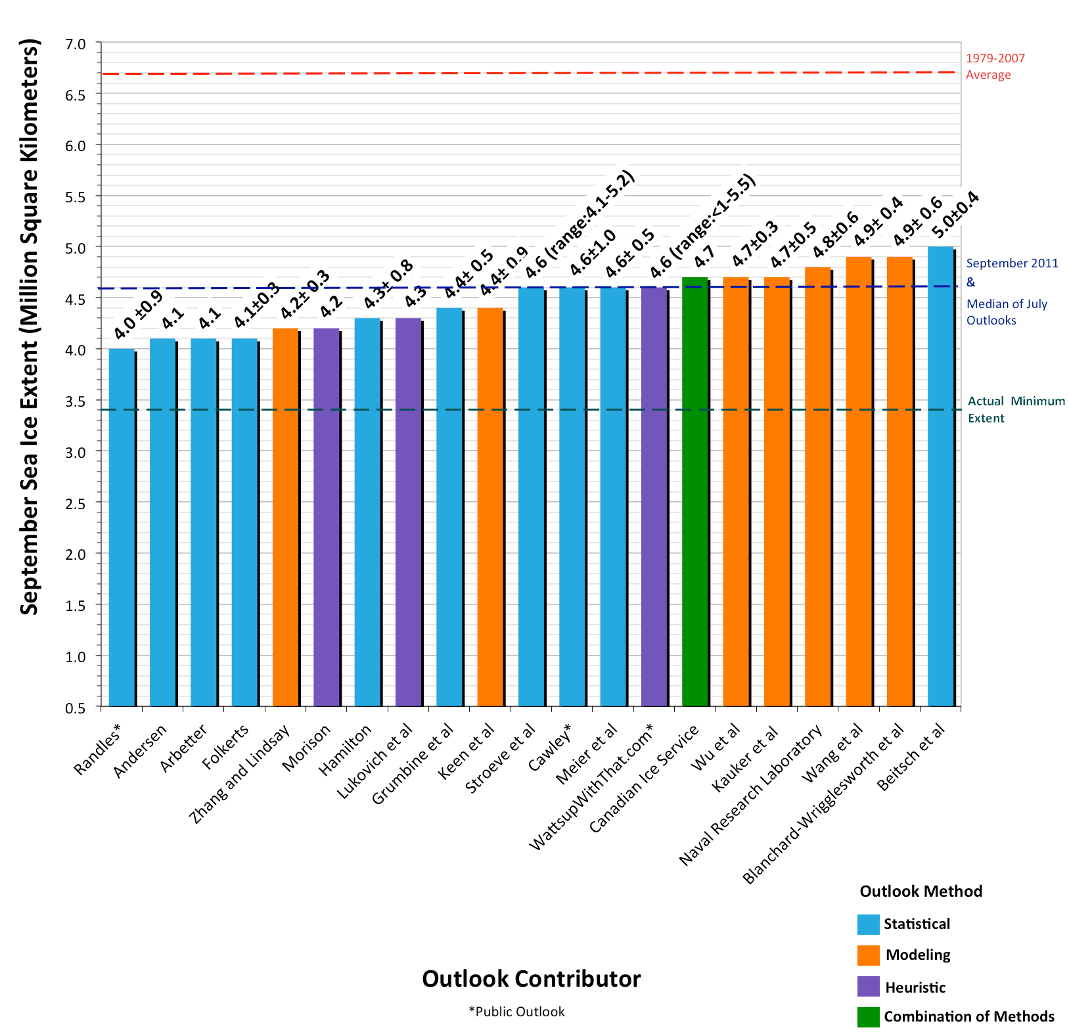
State of Predictability Seasonal Scale: Sea Ice Outlook
1979-2007 average: 6.7 mil km²
Median of July 2012 Outlooks: 4.6 mil km²
2012 minimum:
3.6 mil km²
Sept 2012: All predictions over estimate record minimum

Slide 11
Outline
Background
Arctic sea ice predictability on seasonal to interannual timescales
“predictor” relationships in a changing climate
inherent predictability from climate model studies
Antarctic sea ice predictability

Slide 12
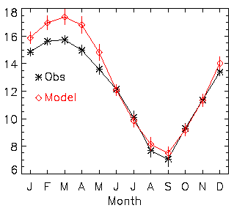
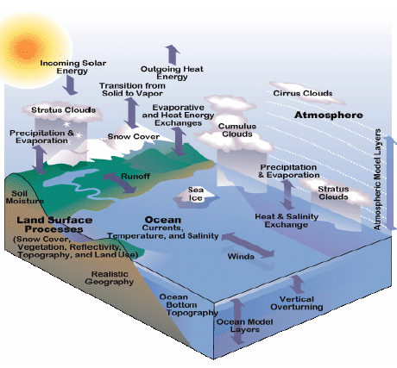
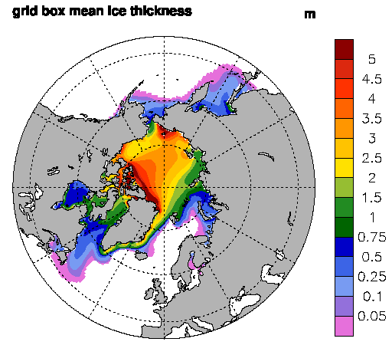
Simulated Arctic ice cover
Coupled climate model
NH Ice Extent
CCSM3 - One of only 2 CMIP3 models that has a late-20th century ice loss consistent with satellite observations
Ice Thickness
1979-1999 climatology

Slide 13
Simulated Arctic ice cover – CCSM3
Sea ice change
Results from a mix of natural & forced change
Sea ice change could modify aspects of predictability
Range in extent
(for 2007)
4.8-7 10⁶ km²
Previous work suggests that ice area variance changes in a warming climate

Slide 14
“Predictor” Relationships for Sept Extent Winter/Spring ice conditions
Observed Correlations
Climate Model Results
1950-1980
Correlation of Jan Ice Thickness and Sept Extent
From 8-members of CCSM3
Detrended March Sfc Temperature and Barents/Kara Sea summer ice cover
Detrended March MY ice concentration and Barents/Kara Sea summer ice cover
Analysis for 1982-2004
(From Drobot, 2007)
(Holland and Stroeve, 2011)

Slide 15
Changing correlation of Jan thickness and Sept extent
Do “predictor” relationships change?
Winter ice conditions and Sept extent
Arctic winter ice thickness more strongly determines Sept extent as ice thins
Weighted Index
Arctic Thickness
Model results: 30-yr running correlation
8 ensemble members
(Holland and Stroeve, 2011)
Correlation of Jan Thickness & Sept Ice Extent
1950-1980
1985-2015
2015-2045

Slide 16
“Predictor” Relationships for Sept Extent Summer Atmospheric Circulation
Observations
Climate Model
1950-1980
Regression:
Summer SLP on Sept ice extent
High SLP leads low ice cover
Ekman transport of sea ice (ice moves to right of wind; net convergence)
Correlation:
August SLP and Sept ice extent
High SLP leads low sea ice
From 8-members of CCSM3
(Data from 1979-2006)
(Ogi and Wallace, 2007)
(Holland and Stroeve, 2011)

Slide 17
Changing relationship of summer circulation and Sept ice cover
Correlation of Aug SLP & Total Sept Extent
1950-1980
1985-2015
2015-2045
Low summer Arctic SLP associated with large Sept extent (as in obs)
Relationship weakens with thinning ice cover
Model results: Using 8 ensemble members and detrended timeseries
(Holland and Stroeve, 2011)

Slide 18
Outline
Background
Arctic sea ice predictability on seasonal to interannual timescales
“predictor” relationships in a changing climate
inherent predictability from climate model studies
Antarctic sea ice predictability

Slide 19
Seasonal Prediction
(Lorenz, 1963)
Because of chaotic nature of system, sensitive dependence on initial conditions limits predictability
The predictability characteristics can be dependent on the initial conditions
Cold, thick ice covered Arctic could be different than a warm, thin ice covered Arctic
(Figure courtesy of Branstator and Teng, 2011)

Slide 20
Seasonal-Interannual Sea Ice Predictability
What is the inherent predictability in Arctic sea ice?
What factors contribute to predictability/influence loss of predictability?
Do predictability characteristics change with a changing mean climate?
Model experiments:
20+ member ensembles of CCSM3 with same initial ice-ocean-land state/slight change in initial atmospheric state
Run for 2 years
Perform 3 sets with initial conditions obtained from 20th-21st century runs
(Holland et al., 2011)

Slide 21
Model Integrations
September Extent
Set 1
Set 2
CCSM3 IPCC-AR4 Run
Set 1
Observations
NSIDC Ice Index
Set 2
Set 3
Initialize runs with identical ice-ocean-land conditions from CCSM3
Use 3 sets of Jan 1 initial conditions
Each ensemble set has ~20 members
Run forward 2-years
Set 3

Slide 22
Preindustrial Control
September Ice Area
Set 1: Initialized in thick (1970) sea ice regime
Present Control
Set 2: Initialized in thinner regime just prior to large ice loss event
Set 3: Initialized in thinner regime just following large ice loss event
Present Control

Slide 23
Assessing Predictability
Examine how ensemble members diverge over time
Compare to the natural variability of the system
When these are indistinguishable, predictability associated with initial state is lost

Slide 24
Ice Area
Potential Predictability
PPP = 1-σ²_{t}(ens)/σ²(cont)
PPP decreases during spring, regained during summer and following winter
Thick initial ice

Slide 25
Ice Area
Potential Predictability
PPP = 1-σ²_{t}(ens)/σ²(cont)
PPP decreases during spring, regained during summer and following winter
Significant winter predictability - memory in ocean heat content
Thick initial ice
January SST PPP
Memory of ice edge location associated with SST predictability
Consistent with results from Blanchard-Wrigglesworth et al., 2011

Slide 26
Ice Area
Potential Predictability
PPP = 1-σ²_{t}(ens)/σ²(cont)
PPP decreases during spring, regained during summer and following winter
Significant winter predictability - memory in ocean heat content
Thick initial ice
January SST PPP

Slide 27
Ice Area
Potential Predictability
PPP = 1-σ²_{t}(ens)/σ²(cont)
PPP decreases during spring, regained during summer and following winter
Significant winter predictability - memory in ocean heat content
Significant summer predictability – memory in ice thickness and strong ice area-thickness coupling
Thick initial ice
Ice Thickness “Memory”
Correlation: Jan Ice Thickness and Sept Ice Thickness
Ice Thickness/Area Coupling
Correlation: Sept Ice Thickness and Sept Ice Concentration

Slide 28
Ice Area
Potential Predictability
PPP = 1-σ²_{t}(ens)/σ²(cont)
PPP decreases during spring, regained during summer and following winter
Significant winter predictability - memory in ocean heat content
Significant summer predictability – memory in ice thickness and strong ice area-thickness coupling
Thick initial ice
Thinner initial ice
Thinnest initial ice

Slide 29
Ice Area
Potential Predictability
PPP = 1-σ²_{t}(ens)/σ²(cont)
PPP decreases during spring, regained during summer and following winter
Significant winter predictability - memory in ocean heat content
Significant summer predictability – memory in ice thickness and strong ice area-thickness coupling
Thick initial ice
Thinner initial ice
Thinnest initial ice

Slide 30
Ice Area
Potential Predictability
PPP = 1-σ²_{t}(ens)/σ²(cont)
PPP decreases during spring, regained during summer and following winter
Significant winter predictability - memory in ocean temperature
Significant summer predictability – memory in ice thickness and strong ice area-thickness coupling
Thick initial ice
Thinner initial ice
Thinnest initial ice
Reduced summer predictability in thin ice conditions

Slide 31
Influence of initial values and climate forcing on predictability
Ice Volume Predictability
Initial values – provide predictability for ~2 yrs
At 5+ years, forcing provides predictability
Limited predictability at 2-3 years
From Blanchard-Wrigglesworth, Bitz and Holland, 2011, GRL

Slide 32
Outline
Background
Arctic sea ice predictability on seasonal to interannual timescales
“predictor” relationships in a changing climate
inherent predictability from climate model studies
Antarctic sea ice predictability

Slide 33
Antarctic Sea Ice Predictability
Ice Retreat
Ice Advance
Ice Advance
Ice Retreat
Ice extent predictability negligible during the ice retreat season
Predictability returns during ice advance
Predictability of ice edge location has an eastward propagating signal
Holland et al., 2013

Slide 34
Antarctic Predictability
Correlation of June SST with temperature at different months/depths
Correlations from control integrations suggest ocean temperature reemergence plays a role in ice predictability
Mechanism does not occur consistently around Antarctica
Holland et al., 2013

Slide 35
Antarctic Predictability
Observational analysis:
Supports the presence of “re-emergence” of predictability
Ice edge location anomalies in June correlated to previous November
Holland et al., 2013

Slide 36
Summary/Conclusions
Predictability of Arctic sea ice important for marine access and planning (on multiple timescales)
Predictor relationships:
Will likely change with long-term ice loss
May affect the skill of statistical models
Ice area inherent predictability in winter and summer for 2 yrs – SST and ice thickness memory
Less predictable in thinner ice regime
Note that the predictability that can actually be realized is shorter and dependent on observational network, etc.
Antarctic sea ice exhibits winter predictability – associated with ocean heat content

Slide 38
Questions?

Slide 39
Extra Slides

Slide 40
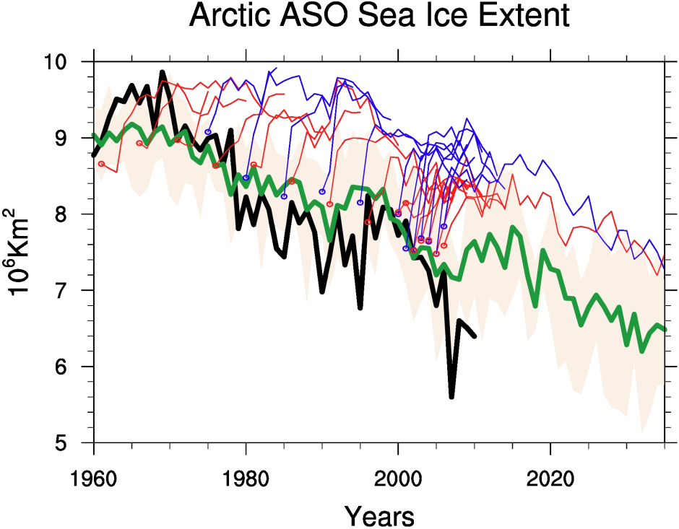
Sea ice extent – Initialized decadal forecasts
Arctic ASO
CCSM4
Considerable drift after initialization
(Courtesy of Haiyan Teng)

