Slide 1

Tsunami Early Detection and Warning Using Satellite Remote Sensing
Ben Hamlington¹, Robert Leben¹, Oleg Godin², Edison Gica³, Vasily Titov³, Bruce Haines⁴, Shailen Desai⁴
CIRES, University of Colorado
NOAA/Earth System Research Laboratory
NOAA Center for Tsunami Research
Jet Propulsion Laboratory
CIRES
University of Colorado at Boulder
October 21st, 2013

Slide 2
Outline
Overview of Tsunami: Generation, Properties, History etc.
Recent Tsunami Events
  2004 Sumatra-Andaman Earthquake and Tsunami
  2010 Chilean Earthquake and Tsunami
  2011 Tohoku Earthquake and Tsunami
Early Warning and Detection
Satellite Remote Sensing of Tsunami
  Detection Using Satellite Altimeters
  Detection in Ocean Surface Roughness Measurements
  Other Satellite Observations of Tsunamis
Conclusion and Summary
CIRES
University of Colorado at Boulder
October 21st, 2013

Slide 3
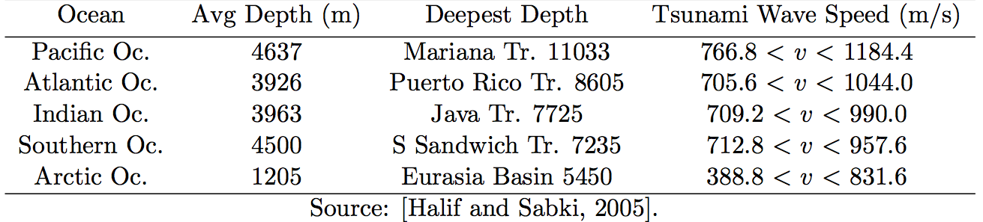
What is a tsunami?
A tsunami is a series of waves caused by the displacement of a large volume of a body of water.
  “Tsunami” is a Japanese word meaning “harbor wave”.
  As it approaches shore, often said to resemble a rapidly rising tide, and has thus been called a “tidal wave”.
  Surface gravity wave with very long wavelengths.
  Travel at speeds proportional to the square-root of the depth of the ocean.
CIRES
University of Colorado at Boulder
October 21st, 2013

Slide 4
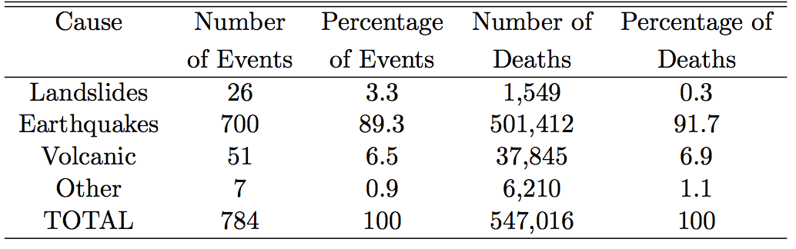
Tsunami Generation
Tsunamis are created in several different ways:
  Earthquakes
  Landslides
  Volcanic Eruptions
  Glacier Calving
  Meteorites
  Nuclear tests
Causes of tsunamis over the past 2000 years (NGD, 2007)
CIRES
University of Colorado at Boulder
October 21st, 2013

Slide 5
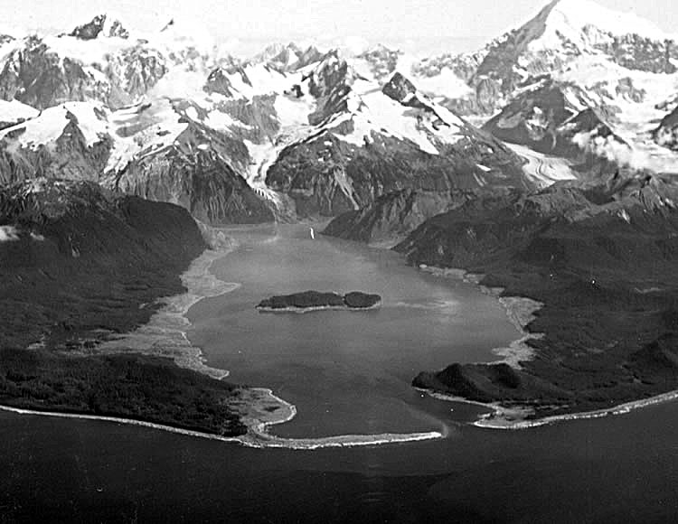
Landslides
Landslides (or large impact events) can lead to the generation of “megatsunami”.
  Refers to a tsunami with initial wave amplitudes measured in several tens or hundreds of meters.
  Landslides next to bodies of water can cause a massive amount of water displacement.
  A relatively minor landslide in a limited body of water can generate an exceedingly large tsunami.
  Lituya Bay (1958) – landslide caused 30 million cubic meters of rock to fall into the bay → led to a 516 meter tsunami.
CIRES
University of Colorado at Boulder
October 21st, 2013

Slide 6
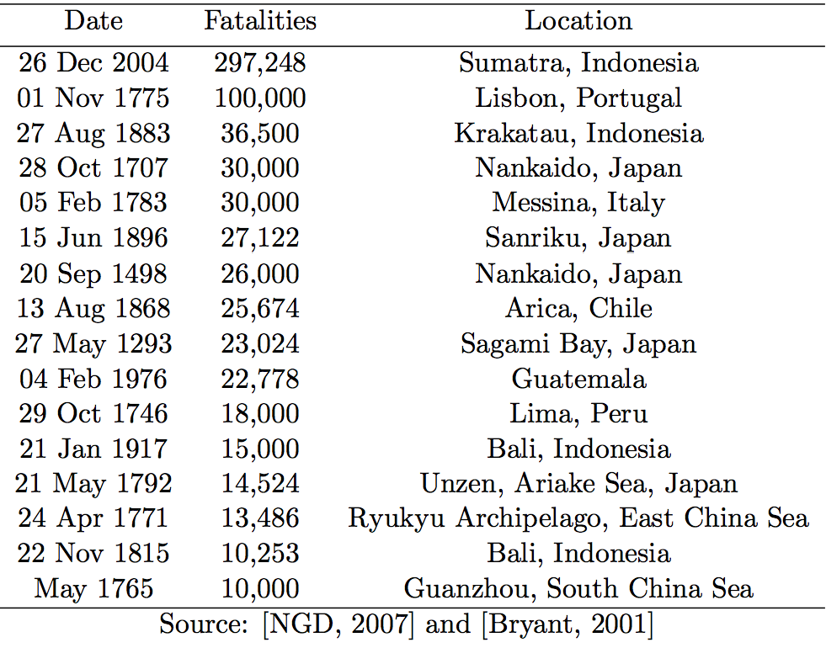
Tsunami History
- 2011 Tohoku/Japan Tsunami resulted in ~19,000 deaths.
CIRES
University of Colorado at Boulder
October 21st, 2013

Slide 7
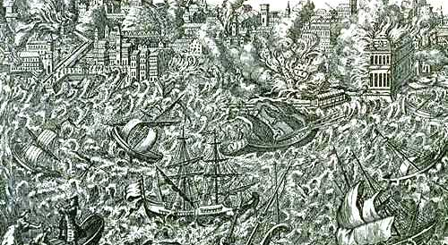
1755 Lisbon Tsunami
CIRES
University of Colorado at Boulder
October 21st, 2013

Slide 8

1755 Lisbon Tsunami
CIRES
University of Colorado at Boulder
October 21st, 2013

Slide 9
Early Warning and Detection of Tsunami
Early warning of an impending tsunami is heavily dependent on the detection of the tsunami away from the shore.
  Wave amplitude in the open ocean is small (generally < 1 meter).
  Difficult to distinguish tsunami signal from other ocean variability until tsunami approaches the shore.
  Detection must occur with enough lead-time to allow coastal populations to move to safety.
Models have generally been used to provide early assessment of an impending tsunami threat.
  Without actual observations in the open ocean, it is difficult to definitively determine the presence of a tsunami in the ocean.
  Open ocean observations could also be used to hone model predictions and improve representation of the earthquake source (Geist et al. 2007; Yamakazi et al. 2011).
CIRES
University of Colorado at Boulder
October 21st, 2013

Slide 10
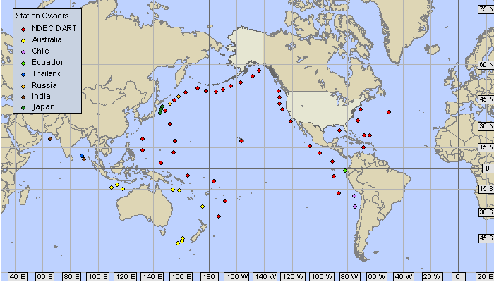
Deep-Ocean Assessment and Reporting of Tsunamis (DART) Buoys
DART measures the change in height of the water column by measuring associated pressure changes.
Very poor coverage in the Indian Ocean.
Located predominantly along coastlines.
Measurement taken at one point – may miss focusing that occurs.
CIRES
University of Colorado at Boulder
October 21st, 2013

Slide 11
Recent Tsunami Events
Here, we will focus on satellite remote sensing of three recent tsunamis:
  2004 Sumatra-Andaman Earthquake and Tsunami
  2010 Chilean Earthquake and Tsunami
  2011 Tohoku Earthquake and Tsunami
The reason for studying these three tsunamis is their strength and scale, in addition to occurring during periods of good satellite altimeter coverage.
CIRES
University of Colorado at Boulder
October 21st, 2013

Slide 12
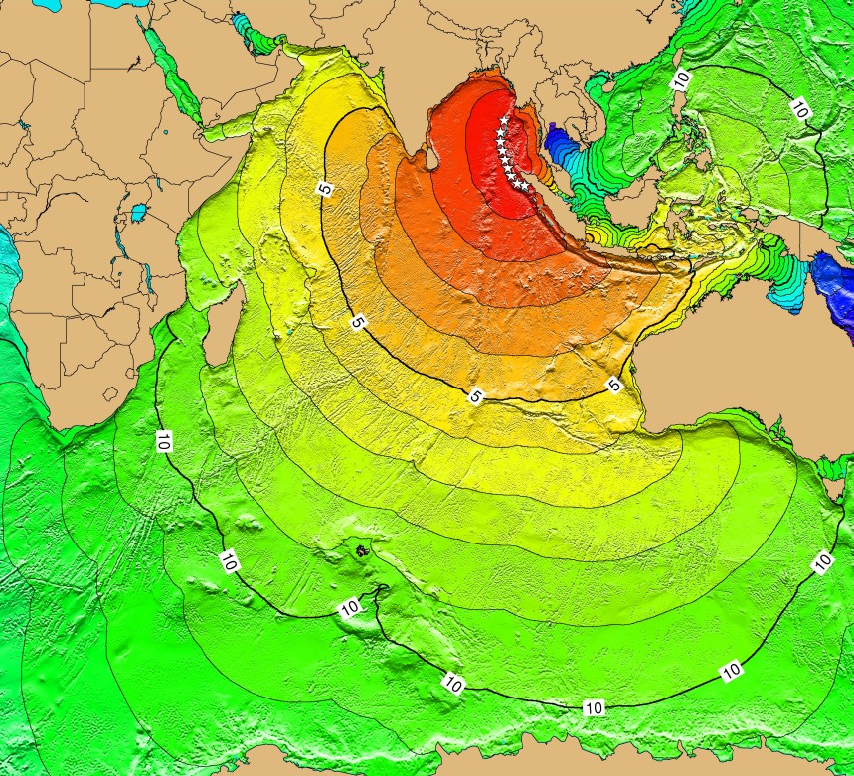
2004 Sumatra-Andaman Tsunami
Generated by an 9.0 earthquake with an epicenter off the west coast of Sumatra, Indonesia on 26 December 2004.
  Despite a lag of up to several hours between the earthquake and impact of tsunami, nearly all of the victims were taken completely by surprise.
  No formal tsunami warning system in the Indian Ocean to detect the presence of a tsunami and issue a warning.
  Resulted in the death of ~230,000 people.
CIRES
University of Colorado at Boulder
October 21st, 2013

Slide 13
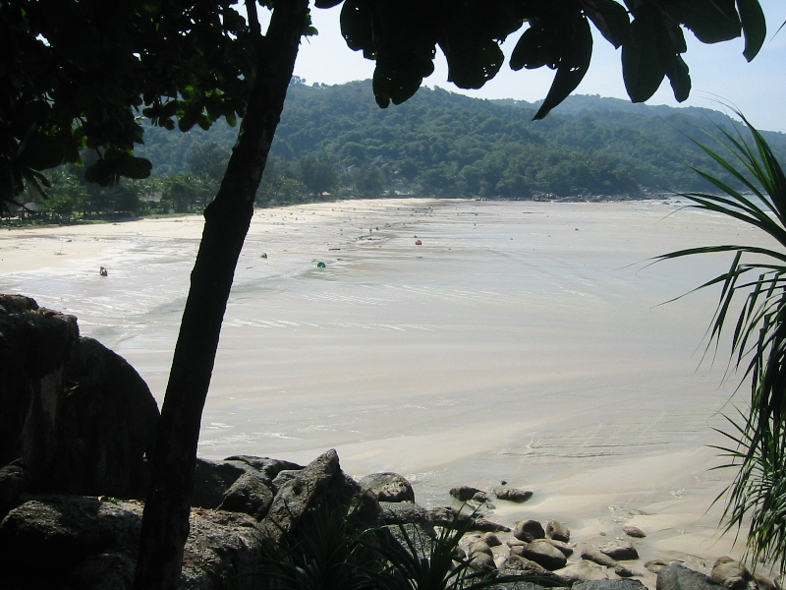
2004 Sumatra-Andaman Tsunami
CIRES
University of Colorado at Boulder
October 21st, 2013

Slide 14
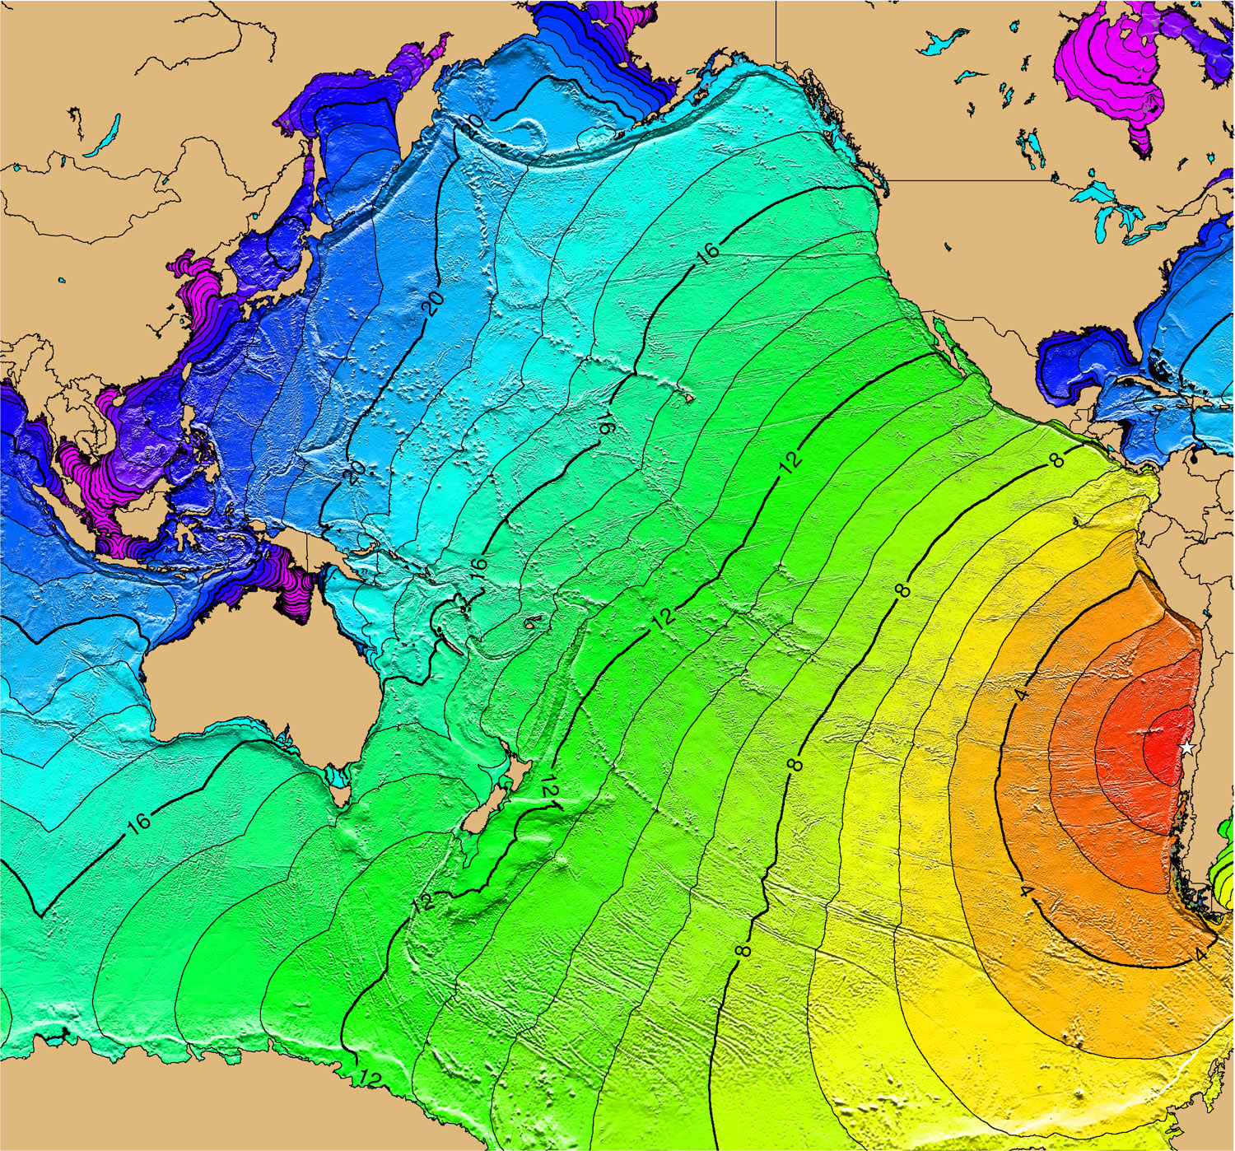
2010 Chilean Earthquake and Tsunami
Generated by a Mw 8.8 earthquake 115 km NE of Concepcion, Chile on February 27th, 2010.
CIRES
University of Colorado at Boulder
October 21st, 2013

Slide 15
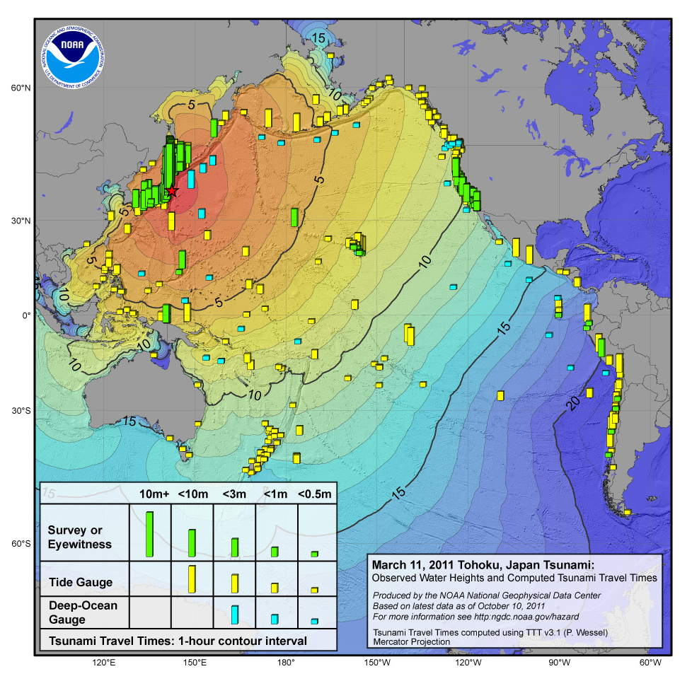
2011 Tohoku Tsunami
Tohoku tsunami generated by Mw 9.0 earthquake at 5:46 UTC on March 10th, 2011, approximately 130 km east of Sendai, Honshu, Japan.
  Caused over 19,000 casualties in northeastern Japan and affected more than 57 cities (Ando et al. 2011) → high casualty number is said to have partially resulted from false-confidence provided by tsunami walls around many of the cities.
  The tsunami inundated ~217 sq. miles of Japan.
  Tsunami also caused significant damaged to the U.S. west coast (1 casualty in California).
CIRES
University of Colorado at Boulder
October 21st, 2013

Slide 16
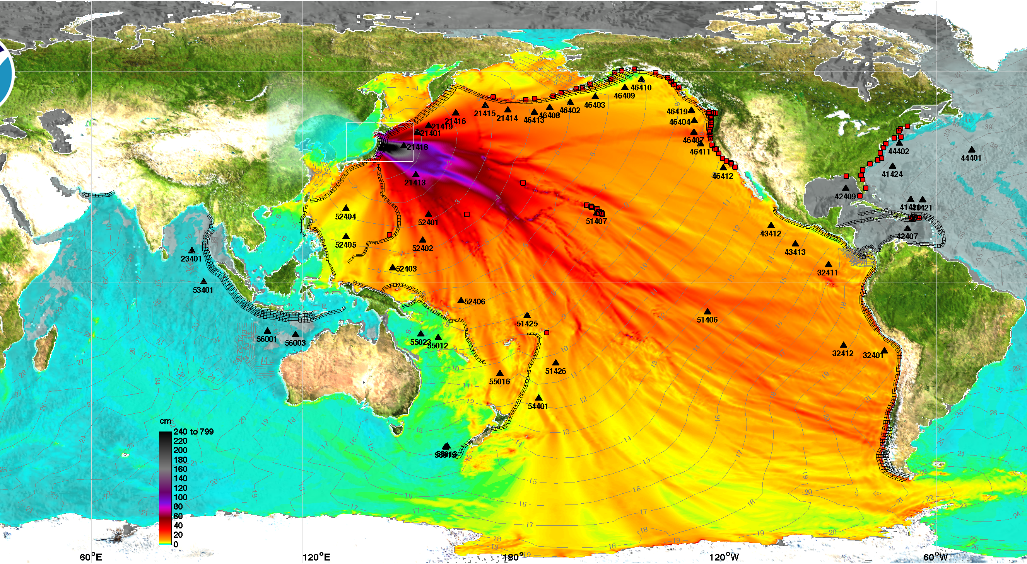
2011 Tohoku Tsunami
CIRES
University of Colorado at Boulder
October 21st, 2013

Slide 17
Early Warning and Detection of Tsunami
Three different methods of detecting tsunamis in the open ocean will be covered:
  Detection Using Satellite Altimeters
  Detection in Ocean Surface Roughness Measurements
  Detection Using Other Satellites/Observations
CIRES
University of Colorado at Boulder
October 21st, 2013

Slide 18
Tsunami Detection by Satellite Altimetry
In recent years, tsunami detection has been demonstrated in the open ocean using measurements from satellite altimeters.
  Detection using sea surface height measurements:
    1992 Nicaragua Tsunami (Okal et al. 1999)
    1995 Chile Tsunami (Okal et al. 1999)
    2004 Sumatra-Andaman Tsunami (e.g. Smith et al., 2005; Song et al., 2005; Ablain et al., 2006; Hirata et al., 2006; Geist et al., 2007; Gower, 2007; Hayashi, 2008; Hoechner et al., 2008)
    2010 Chile Tsunami (Hamlington et al. 2010)
    2011 Tohoku Tsunami (Hamlington et al., 2012).
  Detection using sea surface roughness measurements (more on this later)
    2004 Sumatra-Andaman Tsunami (Godin et al. 2004)
    2010 Chile Tsunami (Hamlington et al. 2010)
CIRES
University of Colorado at Boulder
October 21st, 2013

Slide 19
Can Satellite Altimeters Help With Early Warning and Detection of Tsunamis?
  “Unfortunately, satellite altimetry bears little promise of useful contribution to future tsunami warning systems, as it requires intensive and time- consuming data processing, and above all, the presence of a satellite at the right place at the right time.” (Okal, 2011).
  Statement has frequently been made that there is only a small chance of observing a tsunami with along-track measurement system of satellite altimetry.
    May be true for smaller-scale events, but does not hold true for larger events.
  Relevant questions:
  Not if, but how soon after the tsunamigenic event will a satellite altimeter sample the tsunami?
  How can satellite altimeter measurements be used for improving tsunami early warning and detection?
CIRES
University of Colorado at Boulder
October 21st, 2013

Slide 20
Early Warning with Satellite Altimeters
Important to emphasize that that satellite altimetry could not have directly helped for the warning of coastal populations of Indonesia (2004), Chile (2010), or Japan (2011).
  Time between earthquake and arrival of tsunami was measured in minutes rather than hours.
  Quickest and best warning for coastal populations in such close proximity to the location where the tsunami was the earthquake itself.
  Here, we focus on improving far-field tsunami detection and warning (time-lag between tsunami generation and arrival on the order of hours) and understanding how satellite altimetry measurements can help model projections/estimates.
CIRES
University of Colorado at Boulder
October 21st, 2013

Slide 21
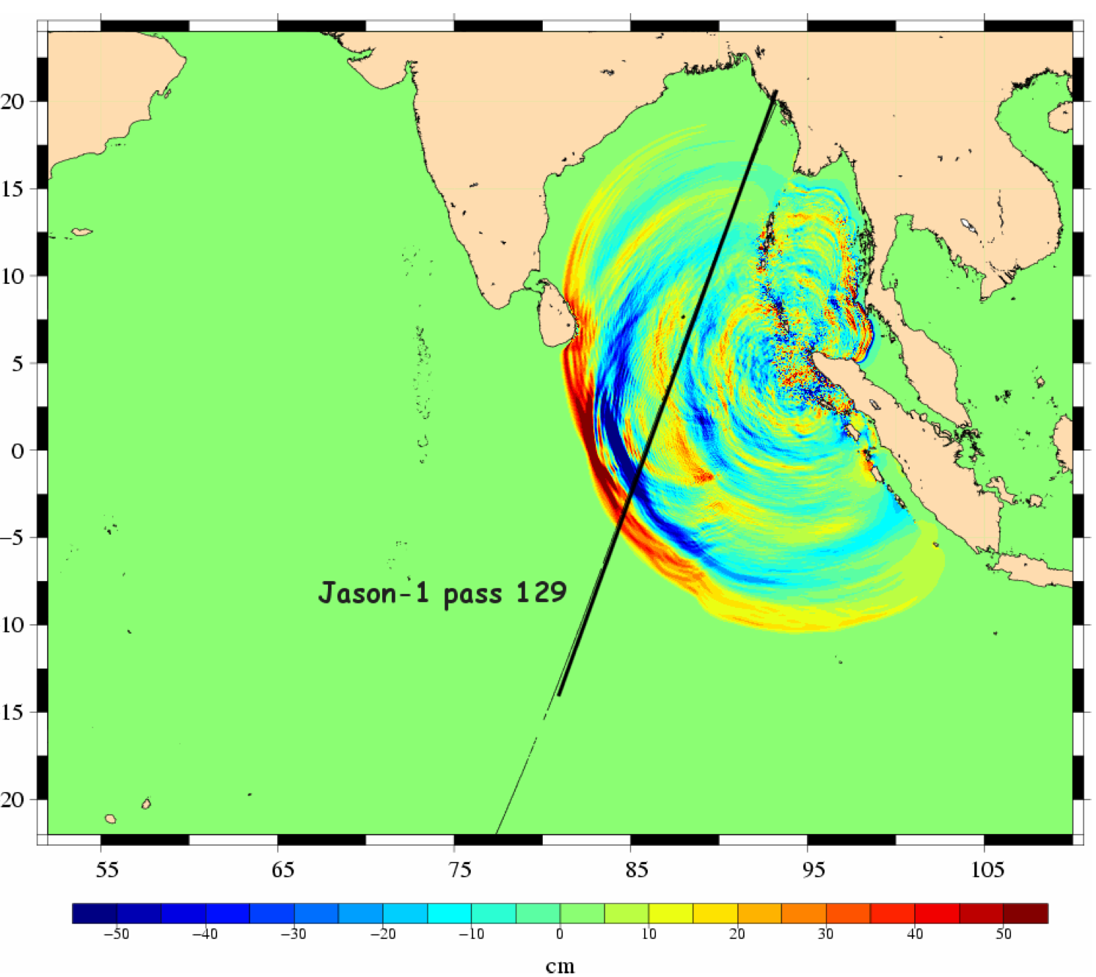
Satellite Altimeter Coverage of 2004 Sumatra-Andaman Tsunami
Jason-1 was the first to encounter the tsunami wave field, 1:53 hours after the earthquake.
  Tsunami wave heights from model are shown along with Jason-1 pass 129 ground track (Ablain et al, 2006).
CIRES
University of Colorado at Boulder
October 21st, 2013

Slide 22
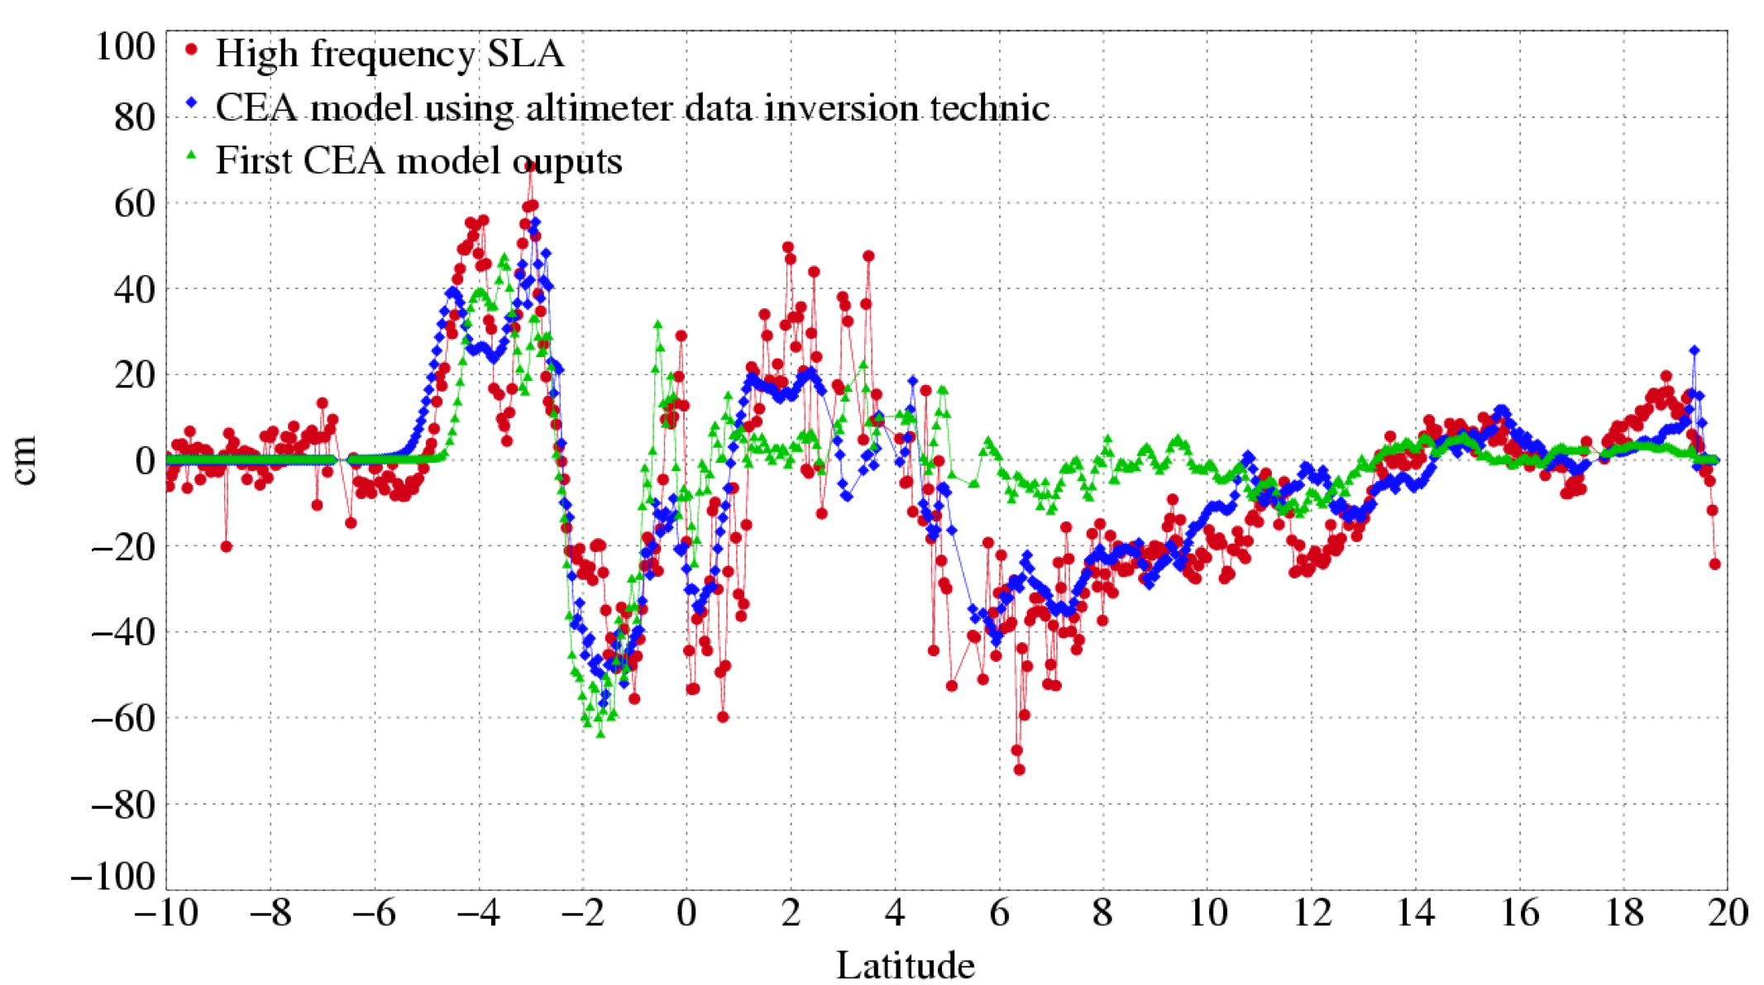
Satellite Altimeter Coverage of 2004 Sumatra-Andaman Tsunami
Jason-1
CIRES
University of Colorado at Boulder
October 21st, 2013

Slide 23
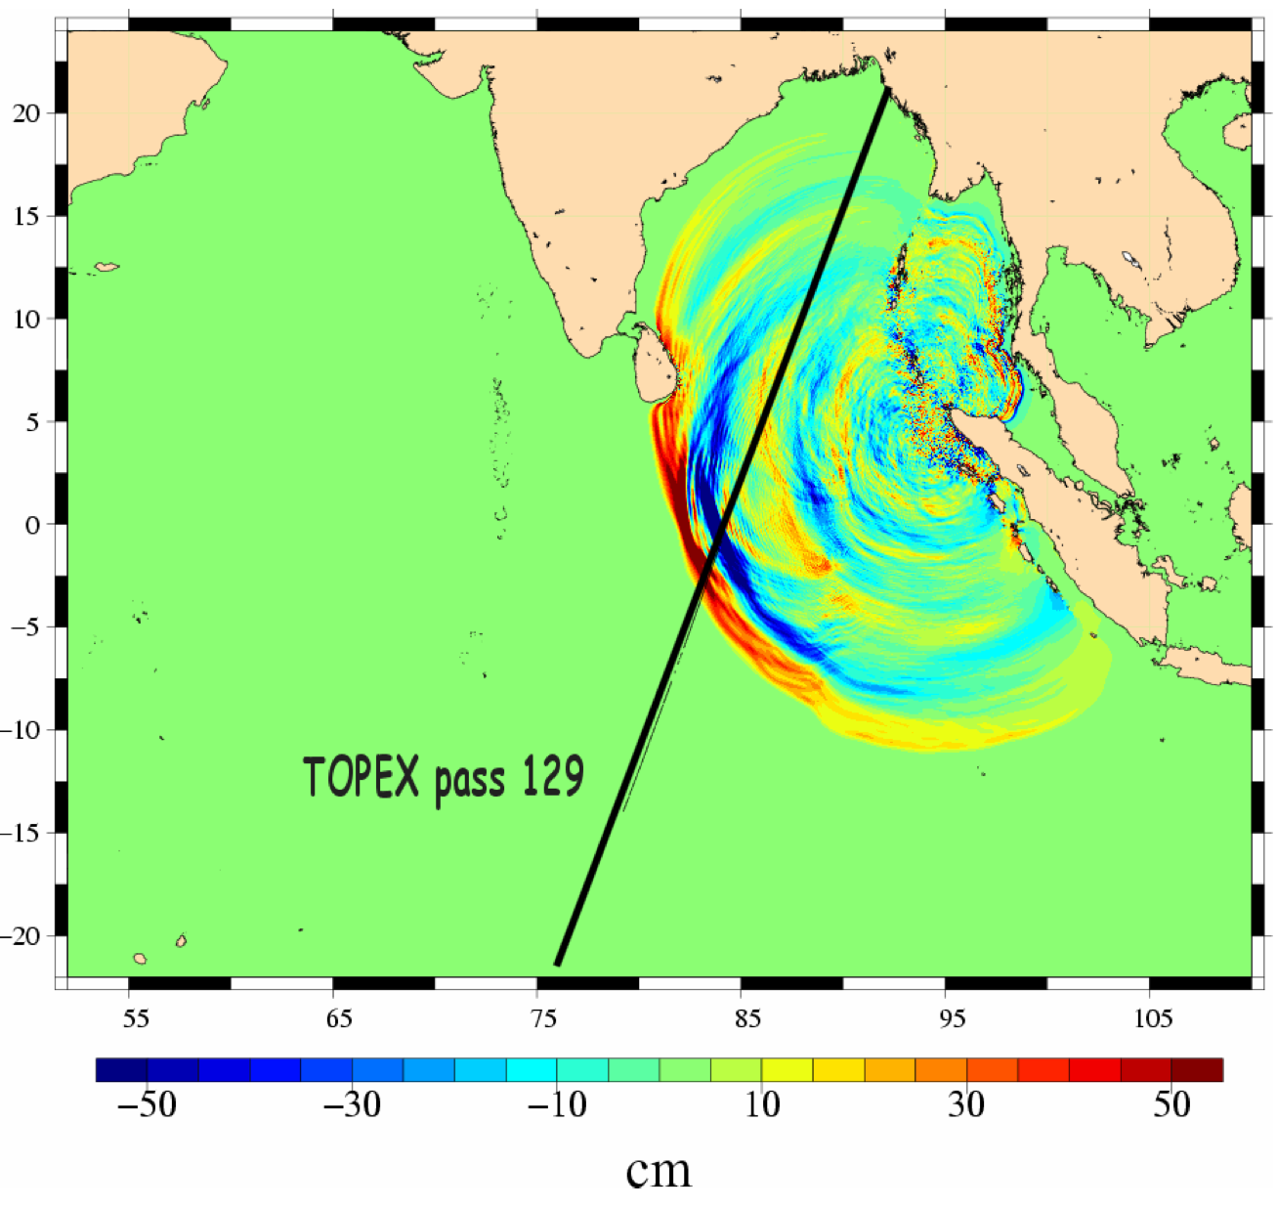
Satellite Altimeter Coverage of 2004 Sumatra-Andaman Tsunami
  TOPEX encountered the tsunami wave field on pass 129, 1:58 hours after the earthquake (Ablain et al, 2006).
CIRES
University of Colorado at Boulder
October 21st, 2013

Slide 24
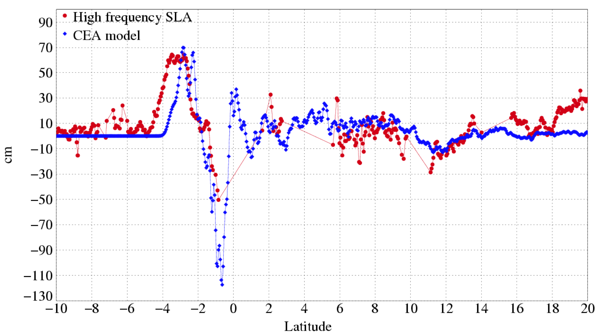
Satellite Altimeter Coverage of 2004 Sumatra-Andaman Tsunami
TOPEX
CIRES
University of Colorado at Boulder
October 21st, 2013

Slide 25
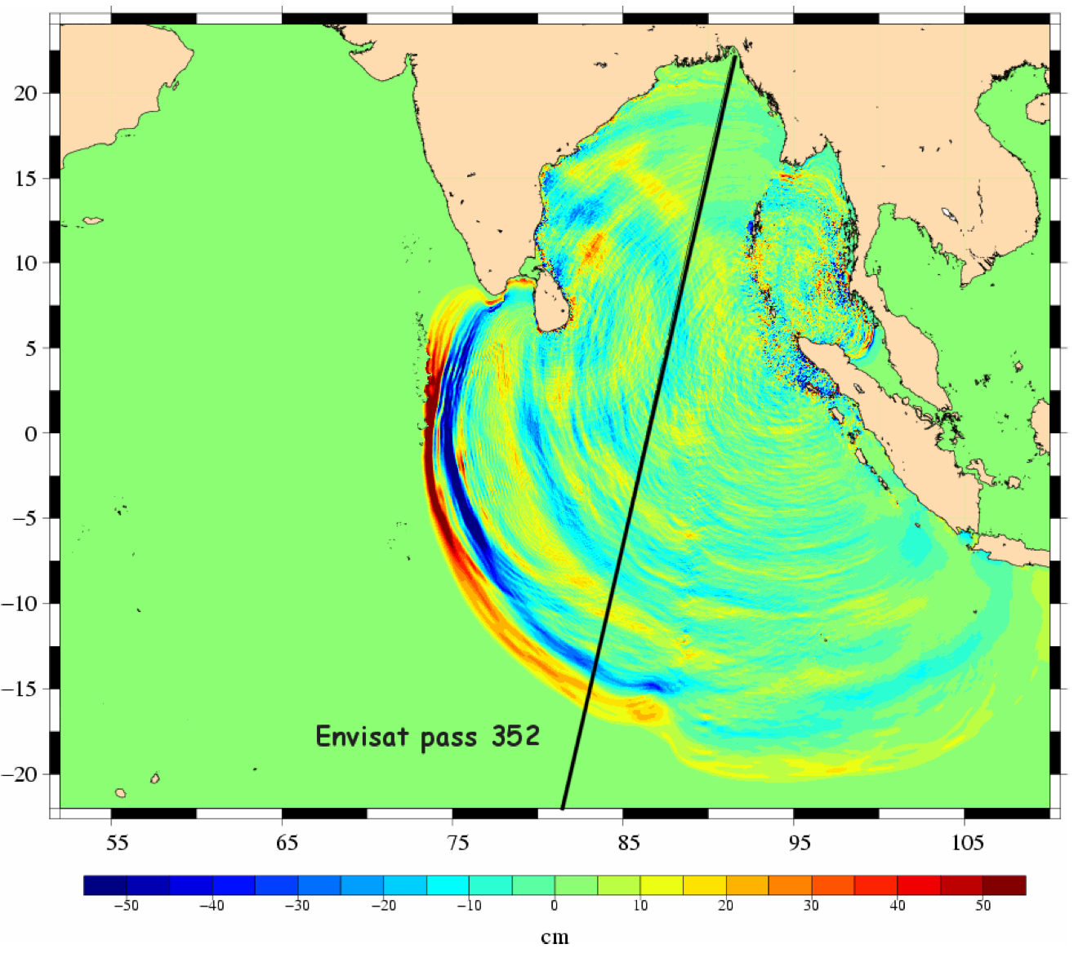
Satellite Altimeter Coverage of 2004 Sumatra-Andaman Tsunami
  Envisat encountered the tsunami wave field on pass 352, 3:15 hours after the earthquake (Ablain et al, 2006).
CIRES
University of Colorado at Boulder
October 21st, 2013

Slide 26
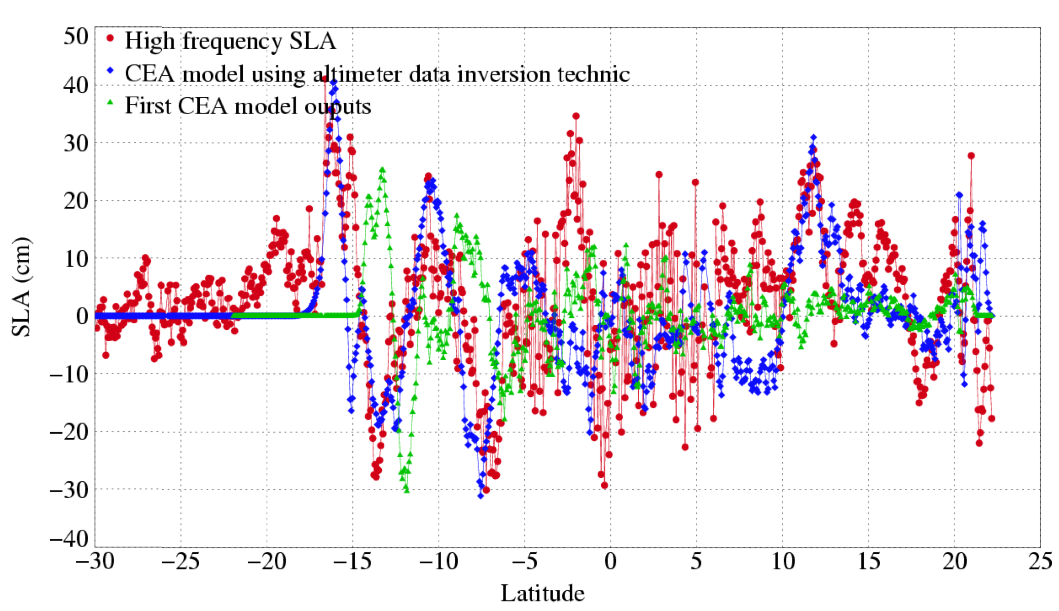
Satellite Altimeter Coverage of 2004 Sumatra-Andaman Tsunami
Envisat
CIRES
University of Colorado at Boulder
October 21st, 2013

Slide 27
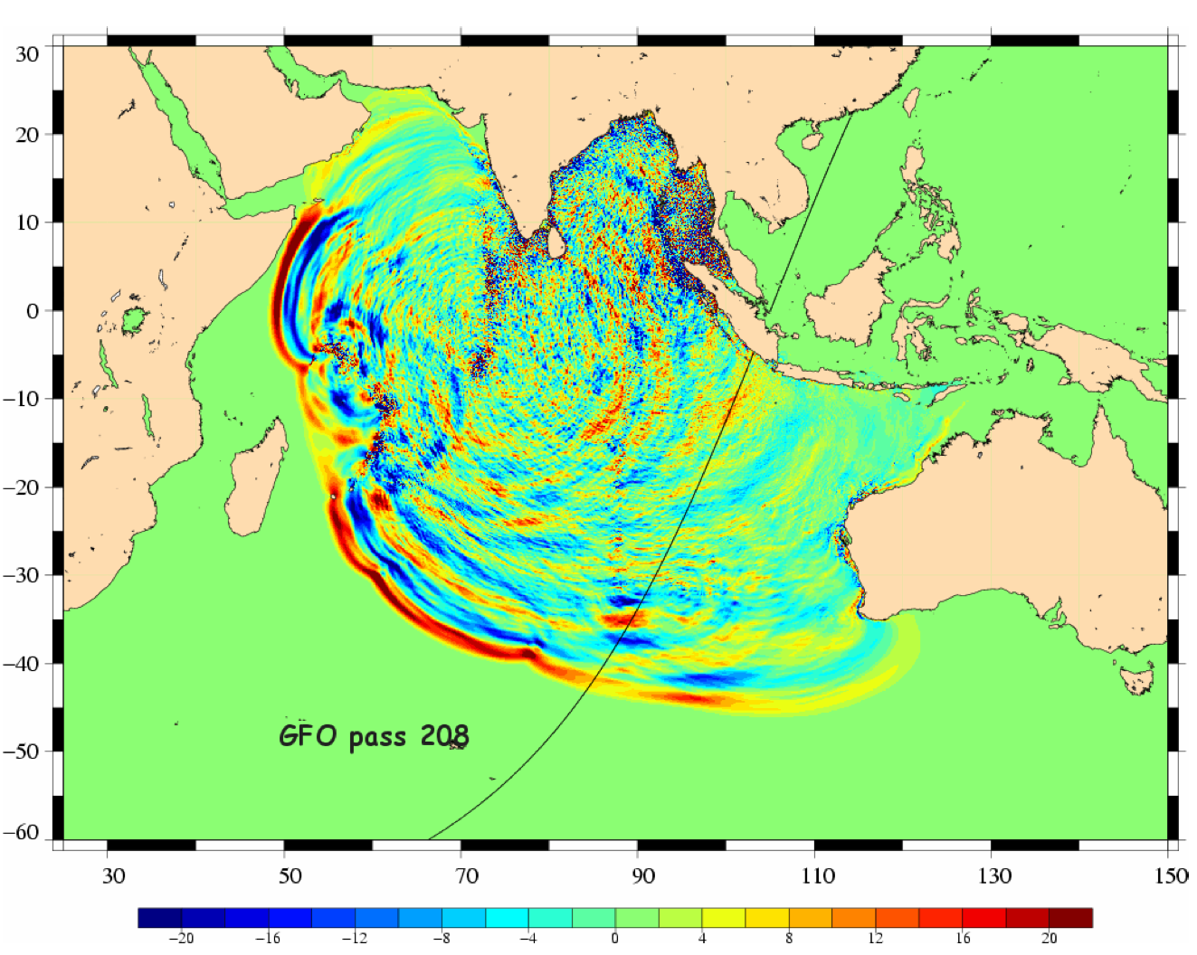
Satellite Altimeter Coverage of 2004 Sumatra-Andaman Tsunami
  Finally, GFO encountered the tsunami on passes 208 and 210, 7 and 9 hours after the earthquake (Ablain et al, 2006).
CIRES
University of Colorado at Boulder
October 21st, 2013

Slide 28
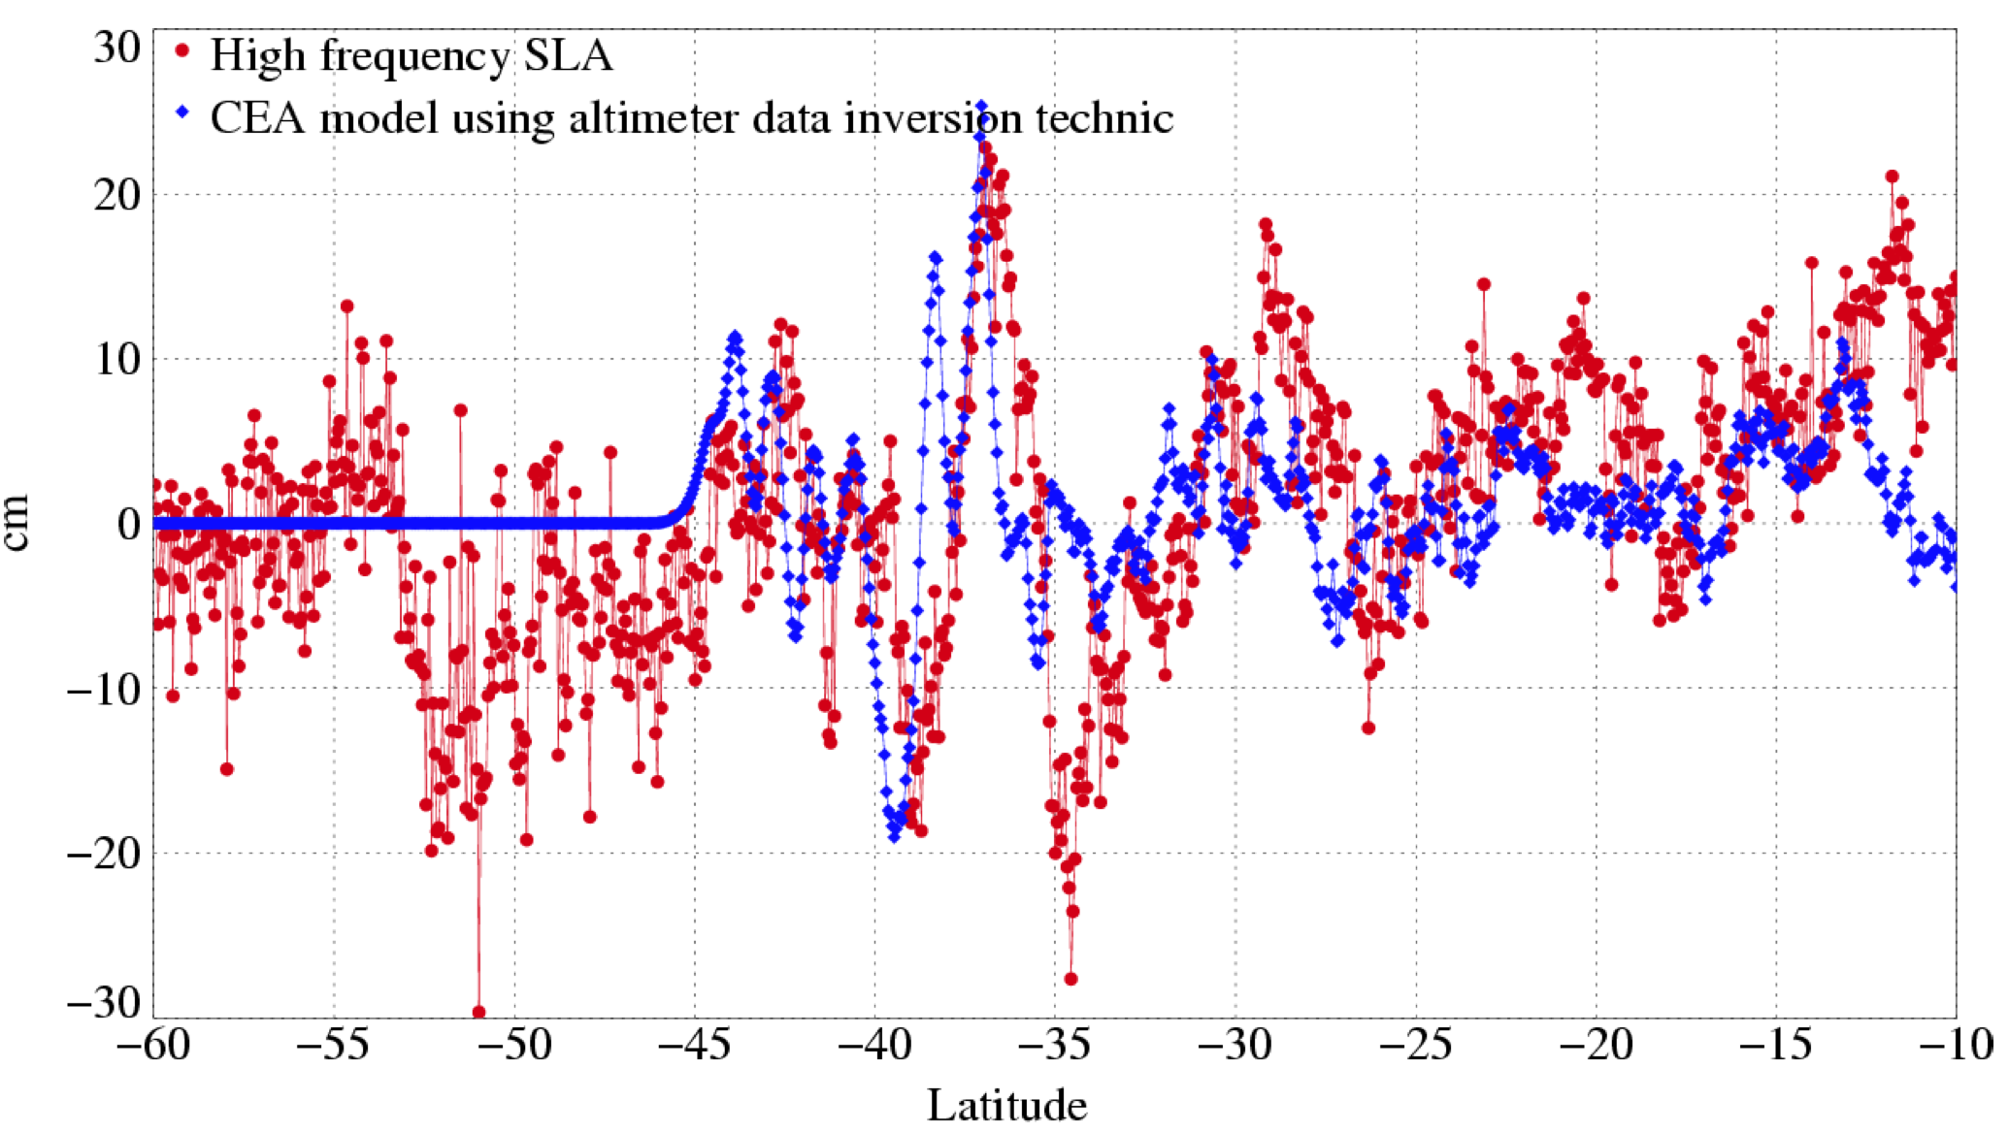
Satellite Altimeter Coverage of 2004 Sumatra-Andaman Tsunami
GFO
CIRES
University of Colorado at Boulder
October 21st, 2013

Slide 29
Satellite Altimeter Coverage of 2010 Chilean Tsunami
  The second tsunami we studied was the 2010 Chilean tsunami – significantly weaker than the 2004 Sumatra-Andaman tsunami.
  Jason-1 and Jason-2 passes over the 2010 Chilean tsunami.
    First sampling of the tsunami occurred by Jason-1 on pass 139 approximately 3 hours after the generation of the tsunami.
CIRES
University of Colorado at Boulder
October 21st, 2013

Slide 30
Satellite Altimeter Coverage of 2010 Chilean Tsunami
  (A) SSH data for pass 139 (~3 hours) of Jason-1, with tsunami cycle (red), and cycles before and after tsunami (blue and green).
  (B) Filtered SSH data (blue) for pass 139 with MOST model (red) overlaid.
    SSH data is filtered by removing a smoothed average of the passes from the cycles before and after the tsunami (Gower, 2005; Ablain et al., 2006).
CIRES
University of Colorado at Boulder
October 21st, 2013

Slide 31
Satellite Altimeter Coverage of 2010 Chilean Tsunami
  (A) SSH data for pass 141 (~6 hours) of Jason-1, with tsunami cycle (red), and cycles before and after tsunami (blue and green).
  (B) Filtered SSH data (blue) for pass 141 with MOST model (red) overlaid.
CIRES
University of Colorado at Boulder
October 21st, 2013

Slide 32
Satellite Altimeter Coverage of 2010 Chilean Tsunami
  (A) SSH data for pass 143 (~8 hours) of Jason-1, with tsunami cycle (red), and cycles before and after tsunami (blue and green).
  (B) Filtered SSH data (blue) for pass 143 with MOST model (red) overlaid.
CIRES
University of Colorado at Boulder
October 21st, 2013

Slide 33
Satellite Altimeter Coverage of 2010 Chilean Tsunami
  (A) SSH data for pass 13 (~4 hours) of Jason-2, with tsunami cycle (red), and cycles before and after tsunami (blue and green).
  (B) Filtered SSH data (blue) for pass 13 with MOST model (red) overlaid.
CIRES
University of Colorado at Boulder
October 21st, 2013

Slide 34
Satellite Altimeter Coverage of 2010 Chilean Tsunami
  (A) SSH data for pass 15 (~6 hours) of Jason-2, with tsunami cycle (red), and cycles before and after tsunami (blue and green).
  (B) Filtered SSH data (blue) for pass 15 with MOST model (red) overlaid.
CIRES
University of Colorado at Boulder
October 21st, 2013

Slide 35
Comparison to MOST Model
CIRES
University of Colorado at Boulder
October 21st, 2013

Slide 36
2011 Tohoku Tsunami
Finally, we will studied the SSH signature of the 2011 Tohoku Tsunami.
After studying the tsunami-induced SSH variations from the 2004 Sumatra-Andaman and 2010 Chilean tsunami, we tried to answer the question:
  How can satellite altimetry be used to improve tsunami early detection and warning?
  → We used satellite altimeter measurements of the 2011 Tohoku tsunami, and a variety of data products to determine how quickly tsunami observations could be collected, processed and made available for use in a warning system .
CIRES
University of Colorado at Boulder
October 21st, 2013

Slide 37
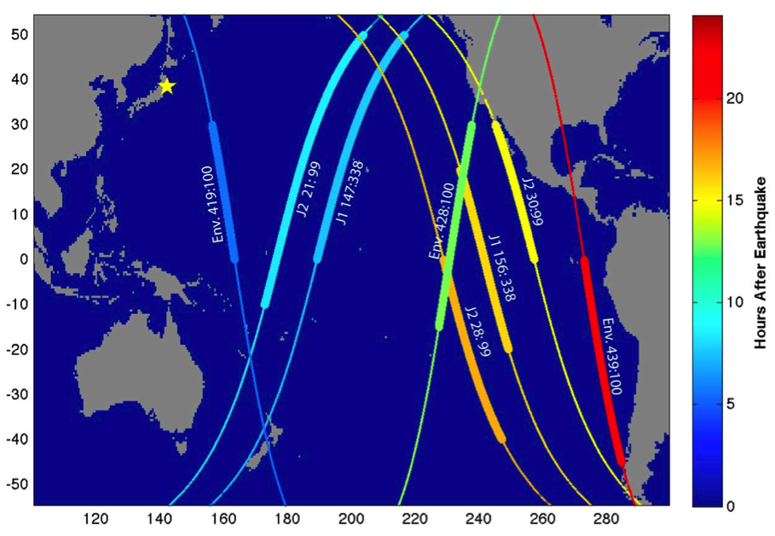
Satellite Altimeter Coverage of 2011 Tohoku Tsunami
Envisat:
Pass 419 of cycle 100 (5.5 hours)
Pass 428 of cycle 100 (13 hours)
Pass 439 of cycle 100 (22 hours)
Jason-1:
Pass 147 of cycle 338 (7.5 hours)
Pass 156 of cycle 338 (16 hours)
Jason-2:
Pass 21 of cycle 99 (8.5 hours)
Pass 28 of cycle 99 (15 hours)
Pass 30 of cycle 99 (17 hours)
CIRES
University of Colorado at Boulder
October 21st, 2013

Slide 38
Satellite Altimeter Coverage of 2011 Tohoku Tsunami
Envisat:
Pass 419 of cycle 100 (5.5 hours)
Pass 428 of cycle 100 (13 hours)
Pass 439 of cycle 100 (22 hours)
Jason-1:
Pass 147 of cycle 338 (7.5 hours)
Pass 156 of cycle 338 (16 hours)
Jason-2:
Pass 21 of cycle 99 (8.5 hours)
Pass 28 of cycle 99 (15 hours)
Pass 30 of cycle 99 (17 hours)
CIRES
University of Colorado at Boulder
October 21st, 2013

Slide 39
Data
Jason-1 and Jason-2 Near Real Time SSH anomaly data was obtained from the Physical Oceanography Distributed Archive Center (PO.DAAC) at NASA JPL.
  For Envisat and for historical Jason-1 data used in randomization tests, SSH measurements were obtained from the Radar Altimeter Database System (RADS).
  At time of study, Jason-1 and Envisat NRT SSH data had average latency of roughly 7 hours, with Jason-2 having latency closer to 4 hours.
  Data is filtered by removing smoothed average of previous two cycles along same pass (Gower 2007; Hamlington et al. 2011).
For comparison and to verify time and location of tsunami leading edge, we used the Method of Splitting Tsunami (MOST) model SSH data produced by NOAA Center for Tsunami Research (Titov et al. 2005).
  2-D SSH data from MOST were interpolated at times and locations of each altimeter ground-track and compared to NRT SSH data.
CIRES
University of Colorado at Boulder
October 21st, 2013

Slide 40
Model vs. NRT Data: Envisat
CIRES
University of Colorado at Boulder
October 21st, 2013

Slide 41
Model vs. NRT Data: Jason-1
CIRES
University of Colorado at Boulder
October 21st, 2013

Slide 42
Model vs. NRT Data: Jason-2
Creating a sea level climate data record with sufficient duration, consistency and quality that can be used to accurately determine climate variability and change is a challenge.
CIRES
University of Colorado at Boulder
October 21st, 2013

Slide 43
Historical Randomization Tests
Using historical data, it is possible to determine if the correlation and amplitude between observations and model data for a given pass are exceptional (containing tsunami signal).
  Using the Envisat pass as an example the test is completed as follows:
  Pass 419 (tsunami pass) from every previous Envisat cycle is collected using RADS, and the correlation and RMS amplitude ratio between the MOST model and filtered SSH data is computed.
  MOST model is adjusted +/- 15 minutes, leading to 31 data points for each cycle.
  Locations with high correlation, and RMS amplitude ratio of ~1, suggest the presence of a tsunami.
CIRES
University of Colorado at Boulder
October 21st, 2013

Slide 44
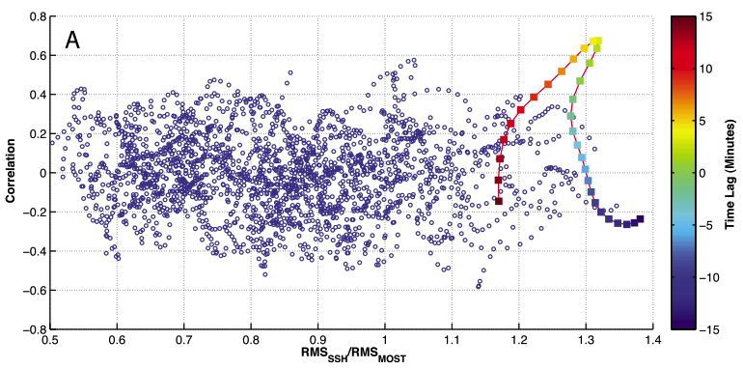
Historical Randomization Tests: Envisat
CIRES
University of Colorado at Boulder
October 21st, 2013

Slide 45
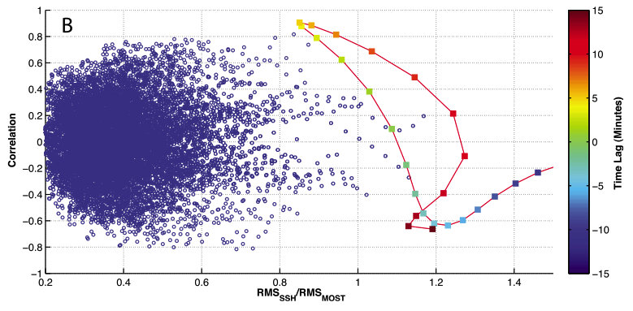
Historical Randomization Tests: Jason-1
CIRES
University of Colorado at Boulder
October 21st, 2013

Slide 46
Historical Randomization Tests: Jason-2
CIRES
University of Colorado at Boulder
October 21st, 2013

Slide 47
NRT Tsunami Monitoring Using Satellite Altimetry
Deep-Ocean Assessment and Report of Tsunamis (DART) buoys are generally used to detect tsunamis shortly after generation.
  Located primarily around coastlines, only a couple in interior of Pacific Ocean.
Recent advances in processing of altimeter data have opened up the possibility of using satellite altimeters to improve assessments of the propagating tsunami.
  Latencies could be reduced further by using less accurate orbit altitude estimates or the addition of ground terminals for reception of telemetry from satellites.
For Tohoku tsunami:
  Envisat first measured tsunami 5.5 hours after earthquake → with current latencies, could have improved warnings and predictions in Central and South America.
  A Jason-2 pass within 5.5 hours of earthquake → with current latencies, could have improved warnings and predictions for Hawaii.
CIRES
University of Colorado at Boulder
October 21st, 2013

Slide 48
How soon after tsunami should we expect satellite altimeter sampling?
Using a simple randomization test and setting the start time of the Tohoku tsunami at random times in the past, we can determine the expected time for a satellite altimeter overflight.
16
14
12
10
8
6
4
2
0
Envisat: 4.2 Hours
14
12
10
8
6
4
2
0
Jason-1: 4.7 Hours
Envisat + Jason-1: 3.4 Hours
18
16
14
12
10
8
6
4
2
0
0 1 2 3 4 5 6 7 8 9
0 1 2 3 4 5 6 7 8 9
0 1 2 3 4 5 6 7 8 9
0 1 2 3 4 5 6 7 8 9
Hours after earthquake
Hours after earthquake
Hours after earthquake
CIRES
University of Colorado at Boulder
October 21st, 2013

Slide 49
Could satellite altimetry have improved early warning and detection of the 2011 Tohoku Tsunami (or any tsunami)?
MOST model results are computed very quickly from a set of pre-computed runs for locations where tsunamis have occurred in the past.
  Model is adjusted with DART buoy data, which is primarily located near coastlines.
  No observations in the open ocean are currently used to improve the model estimate.
Comparison between NRT altimetry data and initial MOST model can be made and altimetry passes coincident with the tsunami signal could be identified.
NRT satellite altimetry data containing the tsunami signal would then be used to refine and improve model estimates.
Additionally, satellite altimetry data could be used directly to confirm the presence and size of a tsunami in the open ocean.
We now have a software system in place at CCAR to retrieve and analyze JPL/PO.DAAC NRT Jason-2 altimeter data as soon as a potential tsunamigenic earthquake occurs.
CIRES
University of Colorado at Boulder
October 21st, 2013

Slide 50
Detection of Tsunami in Sea Surface Roughness
Although we have demonstrated tsunami detection in the open ocean using satellite altimeters, the usefulness of altimeters as the basis of a early detection and warning system is limited.
  Satellite must fly over the tsunami within a short time of its generation due to the great tsunami propagation speed.
  Tsunami signals in the open ocean are usually weak and difficult to separate from background ocean variability → filtering required.
Spatial coverage and temporal resolution of satellite altimeters are not ideal.
  Especially true with the recent loss of Jason-1 and Envisat.
  Altimeters provide measurements only along their ground-track and generally require on the order of 10 days to achieve near-global coverage.
Of the tsunami manifestations in the deep ocean, variations of sea surface roughness are one of the most promising for detecting tsunamis from space.
  Possible to observe tsunami using scanning sensors which have sampling swaths on the order of hundreds of kilometers normal to the satellite ground track.
CIRES
University of Colorado at Boulder
October 21st, 2013

Slide 51
Tsunami Shadows
Tsunami-induced variations in sea surface roughness in the open ocean were first observed originating from a tsunami approaching Oahu in 1994 (Walker, 1996; Dudley and Lee, 1998).
  Referred to as “tsunami shadows” and have the appearance of darker strips on the ocean surface along a tsunami front.
  Walker (1996) was the first to suggest these shadows could be the result of a change in the roughness of the ocean surface.
  Formation of the shadows as areas with different RMS surface slope have been theoretically explained as a result of the air-sea interaction – specifically tsunami-induced perturbations in the wind velocity close to the ocean surface (Godin, 2003, 2004, 2009).
CIRES
University of Colorado at Boulder
October 21st, 2013

Slide 52
Tsunami Shadows
CIRES
University of Colorado at Boulder
October 21st, 2013

Slide 53
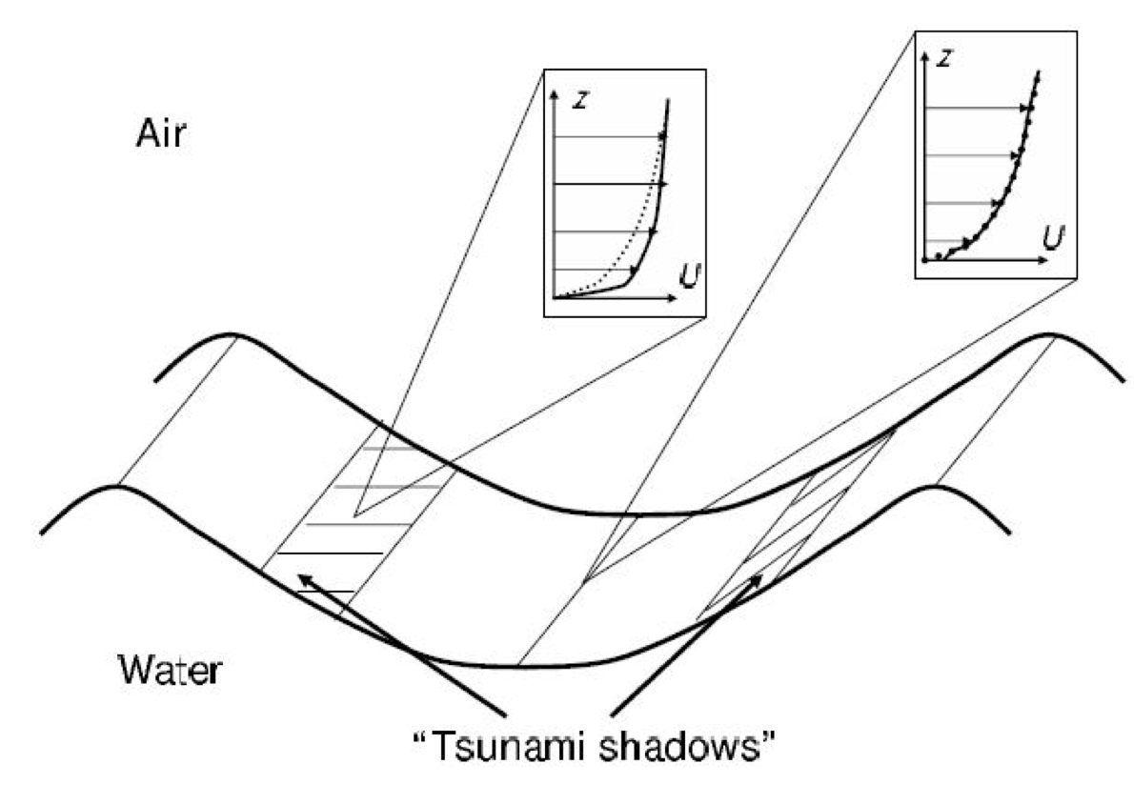
Tsunami Shadows
Tsunami shadows are parallel to the wave front and occur in between troughs and crests where the wind perturbation is maximal.
  Perturbed (solid lines) and unperturbed (dotted lines) wind velocity is shown as a function of height above the ocean (Godin, 2004).
CIRES
University of Colorado at Boulder
October 21st, 2013

Slide 54
Tsunami Shadows
The effective wind speed induced by a passing tsunami depends on the tsunami parameters, and, to a first approximation, differs from the background wind speed by a factor:
Where κ is the von Karman constant, u* is the friction velocity, H is the height of the background logarithmic boundary layer, a is the SSH change due to the tsunami, c is the tsunami phase speed.
Z₀ is the roughness length, and T is the tsunami period.
→ Most importantly, tsunami-induced changes in roughness depend on the size of the tsunami and the background wind speed.
CIRES
University of Colorado at Boulder
October 21st, 2013

Slide 55
Tsunami Shadows
Tsunami induced relative change in wind velocity, M, shown as a function of the tsunami wave period for various values of the background wind speeds at a height 10 m above the ocean surface. Tsunami amplitude is assumed to be 0.3 m.
CIRES
University of Colorado at Boulder
October 21st, 2013

Slide 56
Tsunami Shadows
Amplitude of the tsunami-induced variations in radar backscattering strength, shown as a function of the background wind speeds with a variety of amplitudes. Tsunami period is assumed to be 40 m.
  Variations in radar backscattering strength resulting from tsunami-induced wind variations are found using the Modified Chelton-Wentz algorithm (Witter and Chelton, 1991), by comparing the backscatter values which correspond to the background and effective wind speeds.
CIRES
University of Colorado at Boulder
October 21st, 2013

Slide 57
Sea Surface Roughness Detection: 2004 Sumatra-Andaman Tsunami
Satellite altimeters provide concurrent measurements of sea surface height and radar backscattering strength (referred to as sea surface roughness from now on).
  Considerable uncertainty remains regarding the magnitude of tsunami-induced roughness variations and the ability to detect these changes against the background of potentially stronger roughness variations due to other geophysical processes.
  Ideal for detecting and analyzing tsunami-induced roughness changes, since tsunami location and leading edge of the tsunami can be more easily seen in SSH.
  The Sumatra-Andaman tsunami was the first for which detailed concurrent measurements of SSH and surface roughness were available in the deep water.
  Measurements of the tsunami were made from Jason-1, TOPEX/Poseidon, Envisat and GFO (Smith et al., 2005), Ablain et al., 2006, Gower et al., 2005, 2007).
CIRES
University of Colorado at Boulder
October 21st, 2013

Slide 58
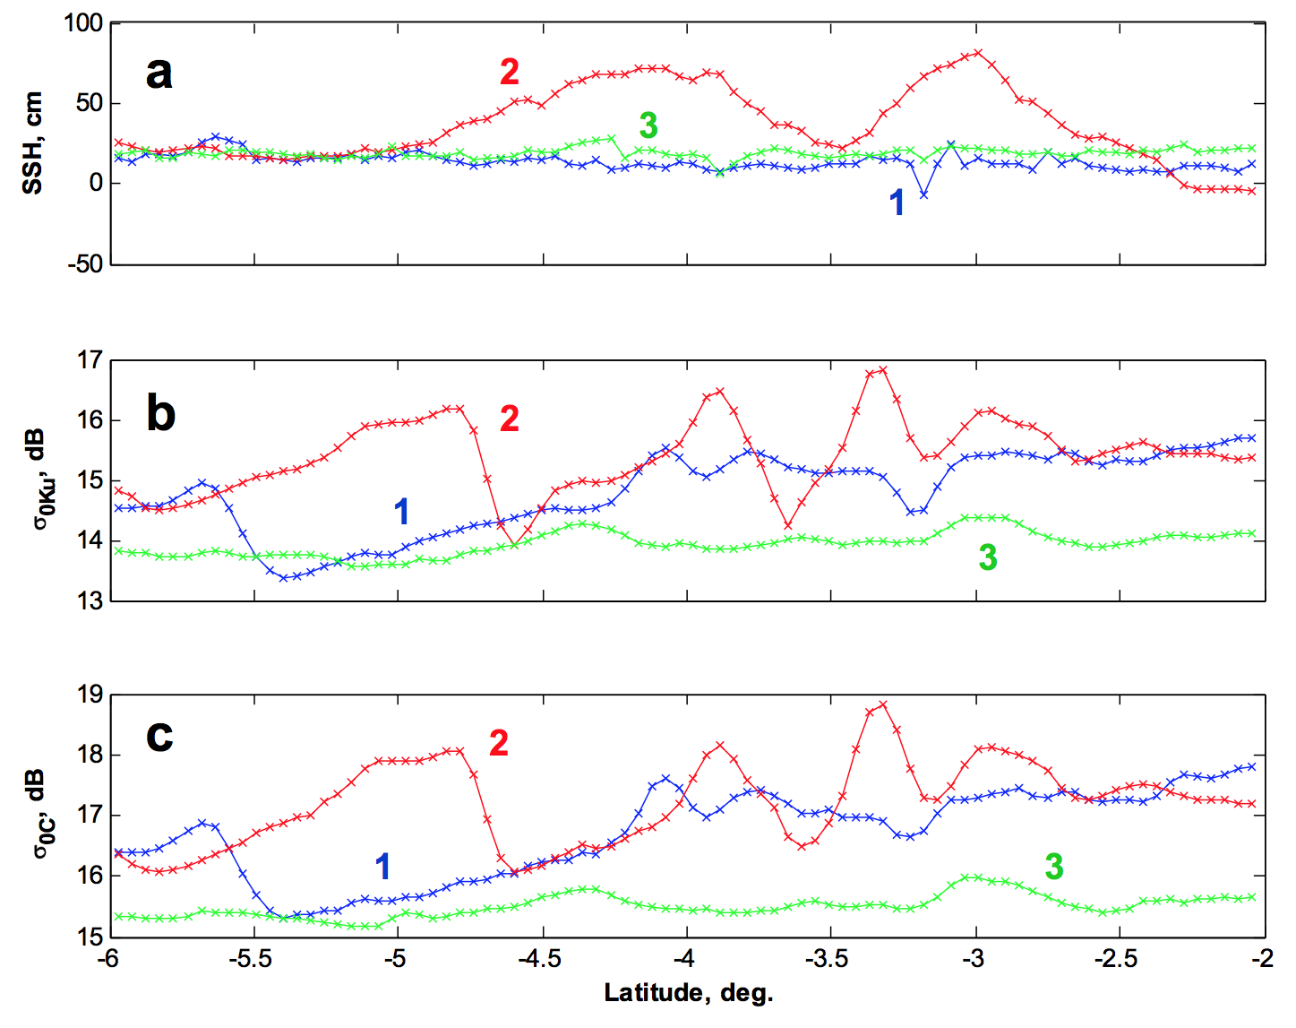
Sea Surface Roughness Detection: 2004 Sumatra-Andaman Tsunami
Jason-1 data for pass 129 obtained for cycle 108 (blue), cycle 109 (red, tsunami), and cycle 110 (green). (a) SSH, (b) Ku-band radar backscattering strength, (c) C-band radar backscattering strength.
With background wind speeds of 2-4 m/s at the time of the Jason-1 overflight of the tsunami, SSHa of 0.6 m, period of 35-45 min (Gower, 2007), we obtain values of +/- 1 dB for the maximum and minimum of the radar backscattering strength variation.
  This is consistent with the radar backscattering variations shown in (b) and (c).
CIRES
University of Colorado at Boulder
October 21st, 2013

Slide 59
Randomization Tests: 2004 Sumatra-Andaman Tsunami
Sea surface roughness is influenced by diverse phenomena in the ocean and atmosphere including wind gusts, currents, internal gravity waves and oceanographic fronts.
  Resulting radar backscattering strength variability can far exceed the expected tsunami induced variations.
  To determine whether backscatter variations observed during a tsunami event were indeed caused by a tsunami, data with and without the tsunami present must be compared.
Statistical randomization tests were performed to compare data with and without the tsunami present. 1000 3.2-degree windows were randomly selected from the area of the ocean through which the tsunami passed.
  Mean σ₀ values were subtracted in each window to create the σ₀ anomaly.
  RMS values and the number of zero crossings were calculated for the σ₀ anomaly in each window and compared to the respective value in the 3.2-degree window containing the leading edge of the tsunami.
  The RMS σ₀ anomaly characterizes the strength of the surface roughness variations, while the number of zero crossings gives a measure of the spatial scale of these variations.
CIRES
University of Colorado at Boulder
October 21st, 2013

Slide 60
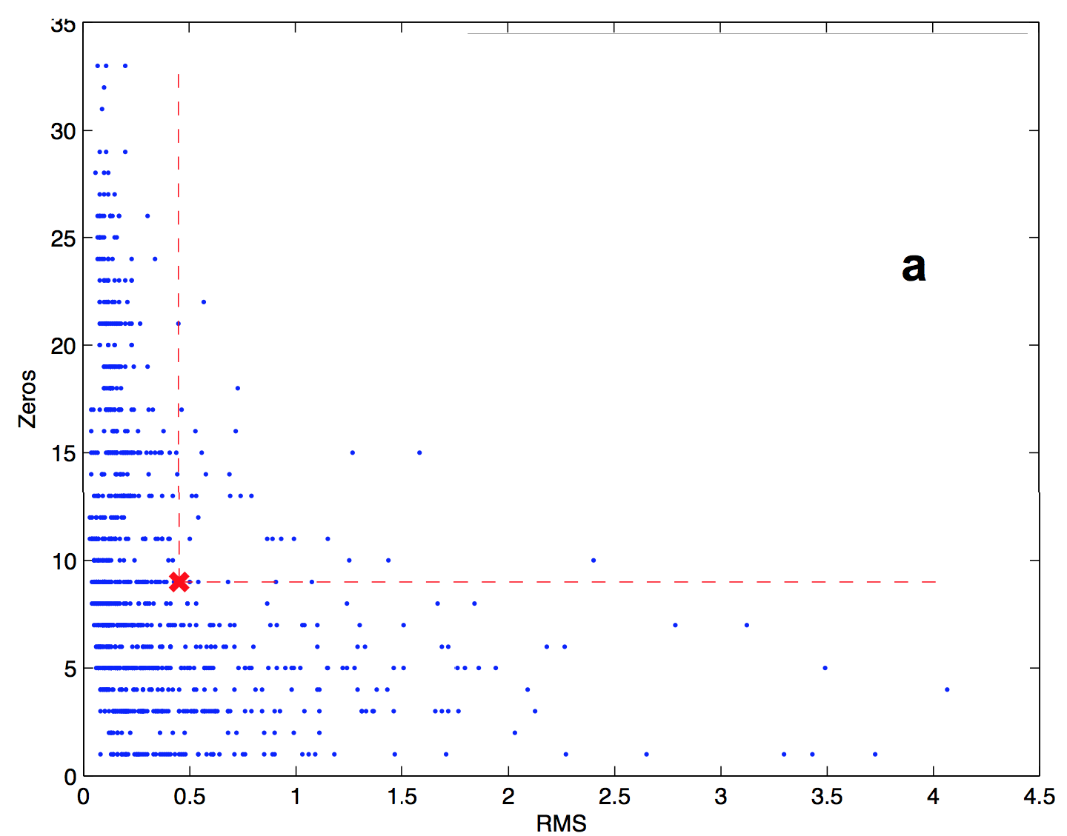
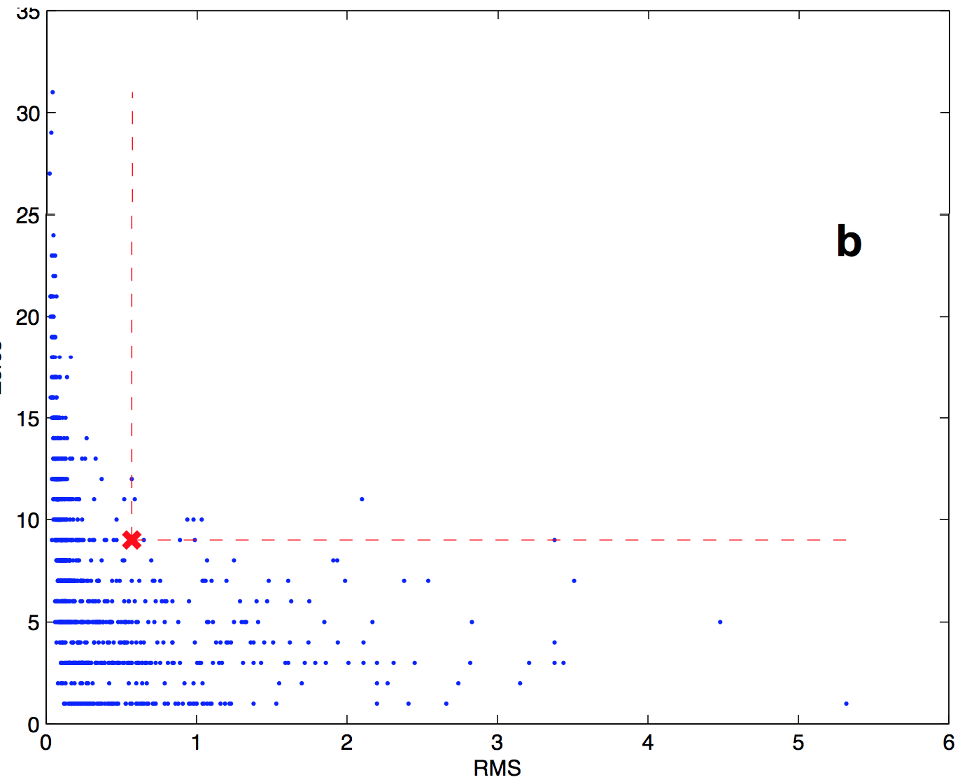
Randomization Tests: 2004 Sumatra-Andaman Tsunami
Ku-band: 3.15%
C-band: 0.93%
CIRES
University of Colorado at Boulder
October 21st, 2013

Slide 61
Sea Surface Roughness Detection: 2010 Chilean Tsunami
While the tsunami was identified in the radar backscattering strength for the 2004 Sumatra-Andaman tsunami, the size and strength of the tsunami was exceptional.
  Can detection be achieved for a weaker but still significant tsunami event like the 2010 Chilean tsunami?
With wind speeds between 7 and 14 m/s during the time of the tsunami, wave periods ranging from 30 to 60 minutes, a wave amplitude of roughly 0.2 m, σ₀ anomaly values are theoretically predicted to be between 0.1 and 0.2 dB.
  For Jason-1, pass 143 during the tsunami, σ₀ anomaly values of 0.20 dB for the Ku-band and 0.12 for the C-band were measured.
  Much smaller than the values obtained from the 2004 Sumatra-Andaman tsunami → resulting from higher background wind speed and lower tsunami amplitude.
CIRES
University of Colorado at Boulder
October 21st, 2013

Slide 62
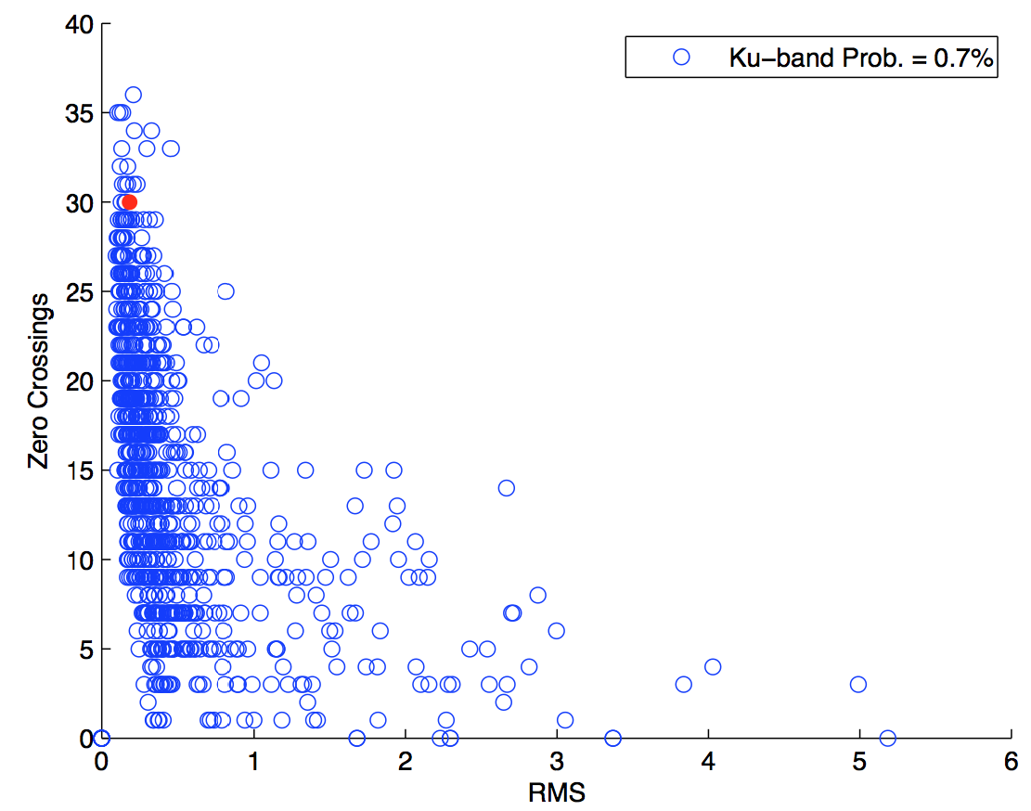
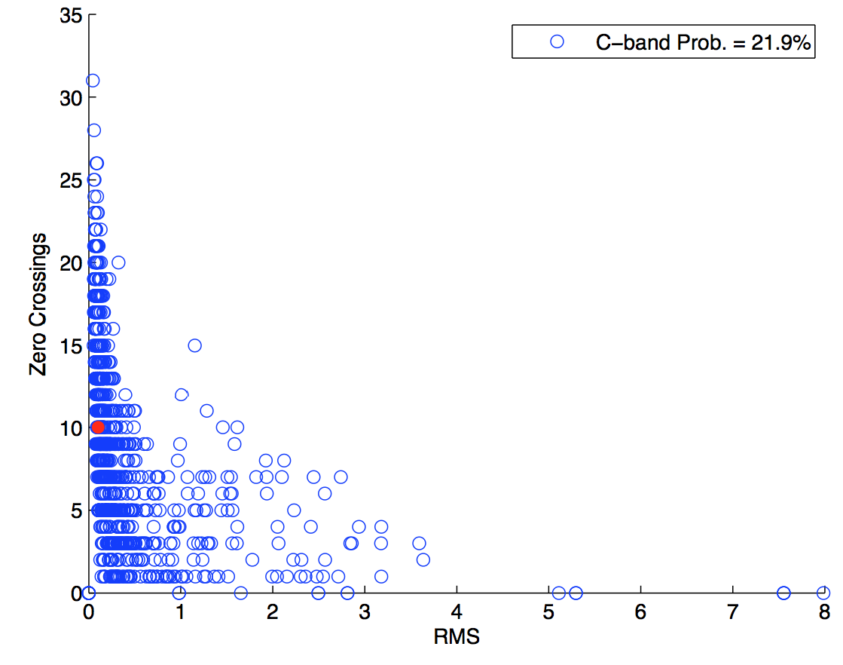
Sea Surface Roughness Detection: 2010 Chilean Tsunami
CIRES
University of Colorado at Boulder
October 21st, 2013

Slide 63
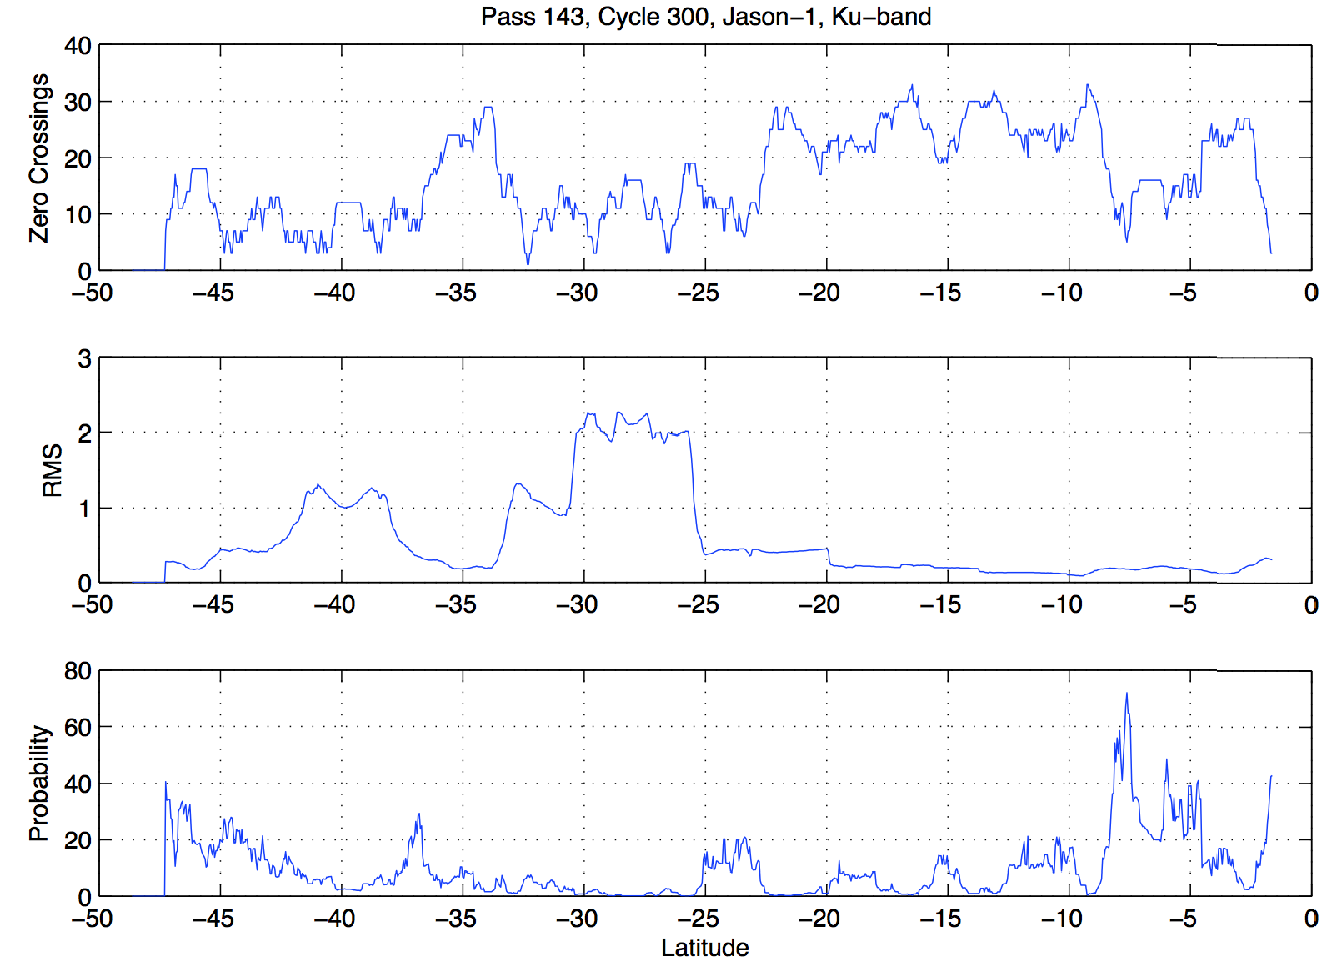
Sea Surface Roughness Detection: 2010 Chilean Tsunami
CIRES
University of Colorado at Boulder
October 21st, 2013

Slide 64
Sea Surface Roughness Detection: 2011 Tohoku Tsunami
CIRES
University of Colorado at Boulder
October 21st, 2013

Slide 65
Sea Surface Roughness Detection of Tsunami from Other Satellites
CIRES
University of Colorado at Boulder
October 21st, 2013

Slide 66
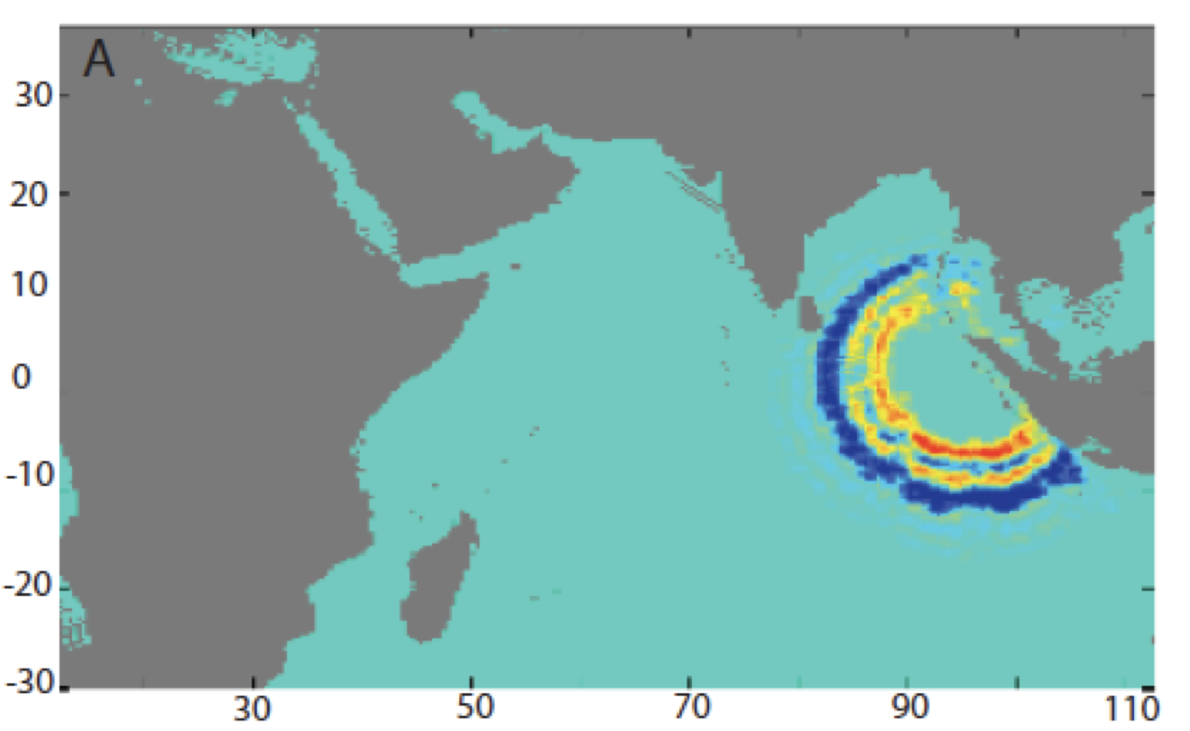
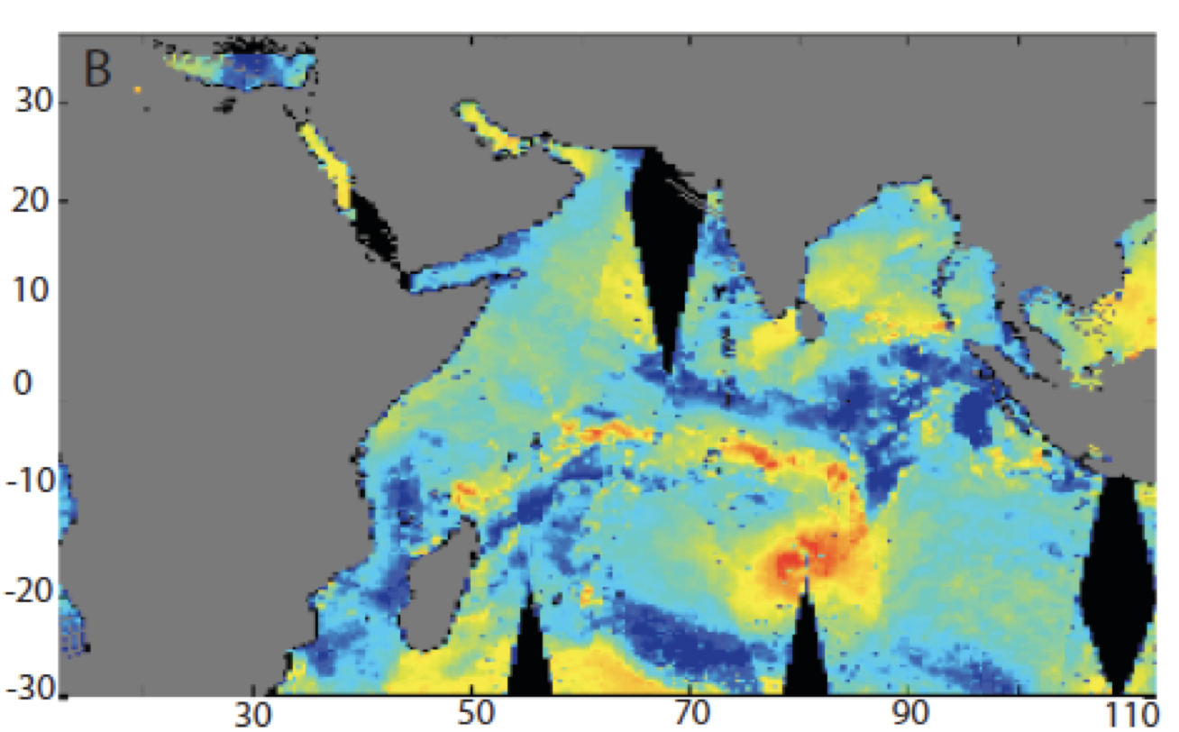
Sea Surface Roughness Detection of Tsunami
Using the model presented in Godin et al. (2004; 2009), the 2-D field of radar backscatter strength is computed for (A) a constant background wind of 3 m/s, and (B) a background wind field obtained from QUIKSCAT on December 26, 2004. SSH data has been obtained from model output at the time of the Jason-1 overflight of the 2004 Sumatra-Andaman tsunami.
CIRES
University of Colorado at Boulder
October 21st, 2013

Slide 67
Tsunami Detection in the Ionosphere
In several recent studies, GPS measurements of the total electron content (TEC) have been used to show variations consistent with atmospheric internal gravity waves caused by ocean tsunamis (e.g. Galvan et al., 2011).
  Observed fluctuations in the TEC correlated in time, space, and wave properties of the 2009 Samoan and 2010 Chilean tsunamis.
  Similar results were obtained for the 2011 Tohoku tsunami.
  Advantage – much better coverage using GPS satellites.
  Disadvantages – 1) unclear how the behavior of the tsunami in response to ocean bathymetry is translated to the TEC signal. 2) Tsunami-induced variations of the TEC are ~1% of the background TEC variability.
CIRES
University of Colorado at Boulder
October 21st, 2013

Slide 68
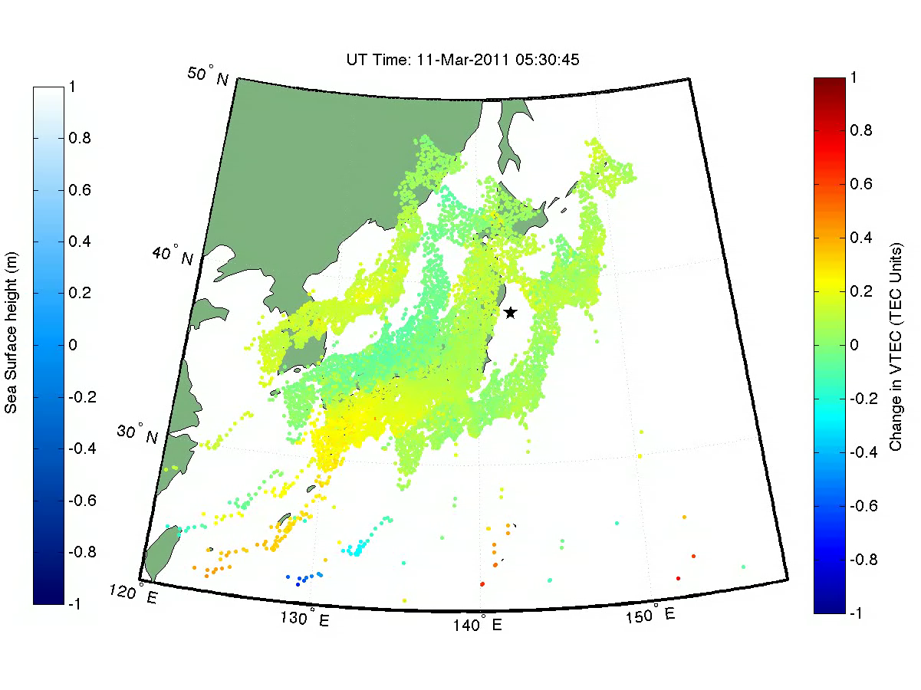
Tsunami Detection in the Ionosphere
CIRES
University of Colorado at Boulder
October 21st, 2013

Slide 69
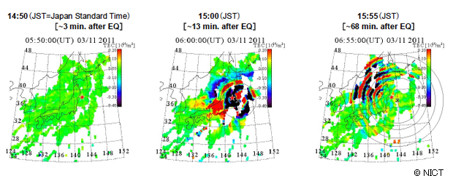
Tsunami Detection in the Ionosphere
CIRES
University of Colorado at Boulder
October 21st, 2013

Slide 70
Summary and Conclusions
At this time, satellite altimetry cannot provide improved warning for locations in the near-field of the tsunami.
  Far-field events can still be large and result in significant damage to property and potential loss of life.
Satellite altimetry should not be dismissed when considering the early warning and detection of tsunamis → relatively easy to extract tsunami signal in SSH.
  Open ocean observations of the tsunami provide the opportunity for additional model refinement.
  Satellite altimeters cover areas of the ocean where no DART buoy is present.
  Along-track measurements provide a larger, cross-sectional view of a propagating tsunami giving information that cannot be obtained from DART buoys.
  Results depend heavily on data latencies and satellite altimeter availability at the time of the tsunami.
  SWOT has the potential to make detection of a tsunami far easier.
CIRES
University of Colorado at Boulder
October 21st, 2013

