Slide 1

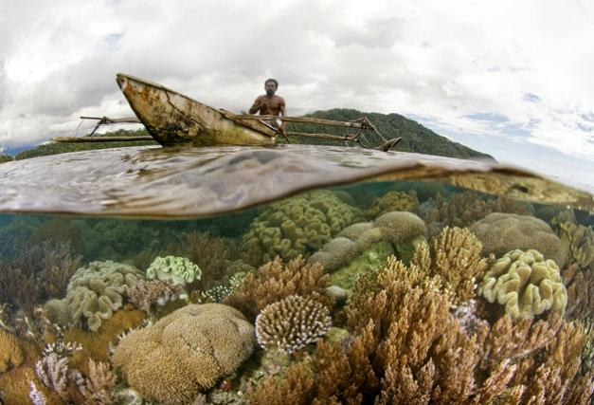
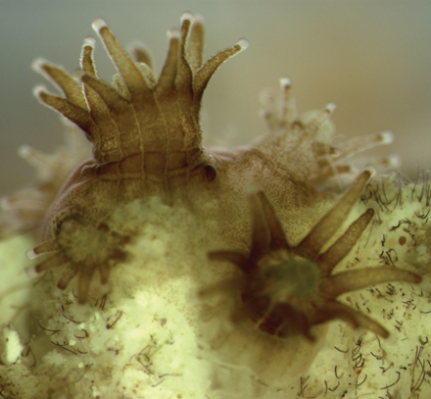
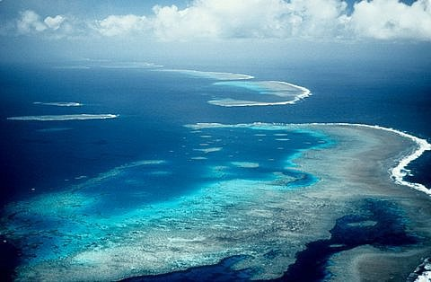

Ocean Acidification and Its Impacts on Coral Reefs
Joanie Kleypas
National Center for Atmospheric Research
Climate & Global Dynamics

Slide 2
Background
Effects of OA on Reef Organisms
Effects of OA on Reefs
Records
Future State of Coral Reefs
Notes:
Everything is what it is because it got that way
D’Arcy Wentworth Thompson “On Growth and Form” 1917
What escapes the eye, however, is a much more insidious kind of extinction: the extinction of ecological interactions
Daniel H Janzen, Natural History 83, 48 (1974)

Slide 3
Background
Effects of OA on Reef Organisms
Effects of OA on Reefs
Records
Future State of Coral Reefs
Notes:
Everything is what it is because it got that way
D’Arcy Wentworth Thompson “On Growth and Form” 1917
What escapes the eye, however, is a much more insidious kind of extinction: the extinction of ecological interactions
Daniel H Janzen, Natural History 83, 48 (1974)

Slide 4

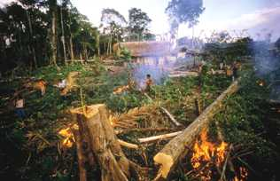
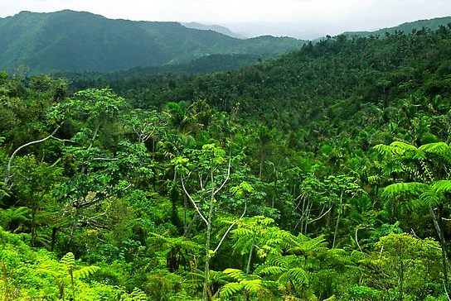
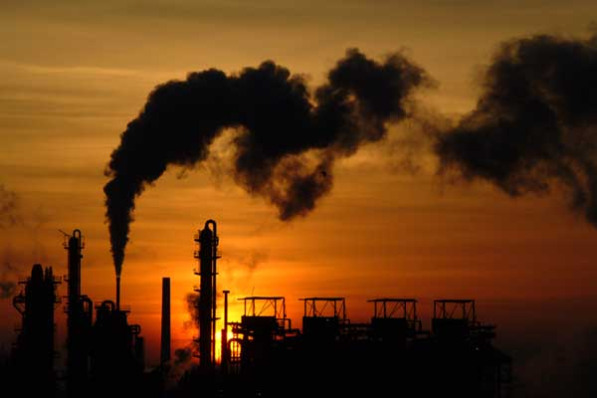
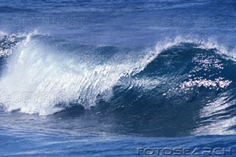
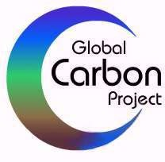
The CO2 we put in the atmosphere
Where it ends up
4.2 Pg y⁻¹
1.5 Pg C y⁻¹
46%
2.6 Pg y⁻¹
29%
7.5 Pg C y⁻¹
2.3 Pg y⁻¹
25%
Years 2000-2007
Slide modified from GCP - Global Carbon Budget Team
Canadell et al. 2007, PNAS (updated)

Slide 5
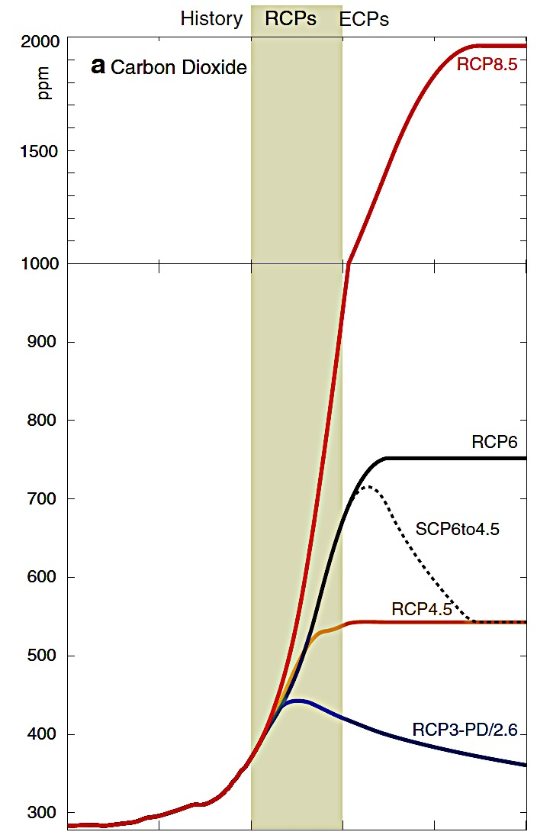
Projections of atmospheric CO2
RCP8.5
“Where we’re headed”
CO2
Atmos
ppm
We are here
RCP2.6
“What we hope for”
1800 1900 2000 2100
Year
Meinshausen et al. 2011 Climatic Change
Notes:
Representative carbon pathways and Extended carbon pathways

Slide 6
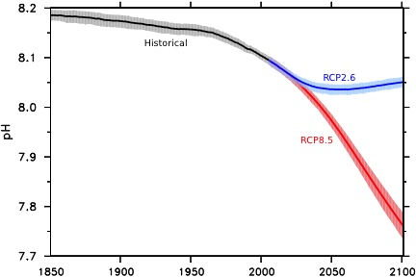
Projections of Surface Ocean pH
RCP2.6
pH change = −0.13
“What we hope for”
We are here
pH
ocean
RCP8.5
pH change = −0.42
“Where we’re headed”
Year
Figure courtesy of Jim Orr
Notes:
Note that how you define a Region of Greatest Risk will differ depending on your criteria
IF you feel that the ABSOLUTE change in pH is the most important factor, dissolution of Calcium Carbonate is the most important threshold, then

Slide 7
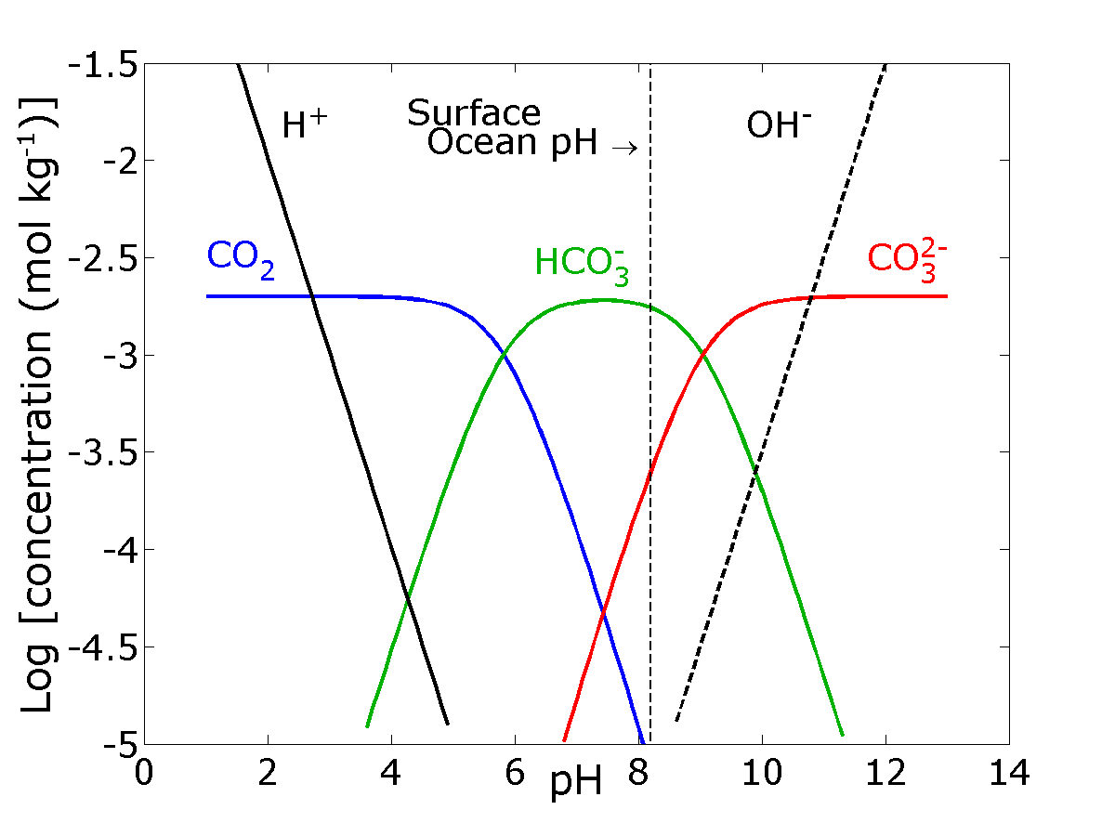
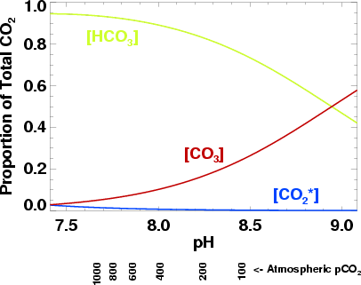
Multiple Changes in the CO₂ System
2x
1x
[HCO₃–]
[CO₃^{2–}]
[CO₂*]

Slide 8
Multiple Changes in the CO₂ System
Changes in CO₂-system
2x
1x
CO_{2(aq)}
HCO₃⁻
[HCO₃–]
CO₃²⁻
pH
[CO₃^{2–}]
[CO₂*]

Slide 9
The Chemistry
(CO₂ + H₂O)
CO₂(aq)
H₂CO₃
HCO₃– + H⁺
CO₃^{2–} + H⁺
Dissolved
carbon dioxide
Carbonic
acid
Bicarbonate
Carbonate
CO_{2(aq)}
HCO₃⁻
CO₃²⁻
pH

Slide 10
The Chemistry
CO₂
(CO₂ + H₂O)
CO₂(aq)
H₂CO₃
HCO₃– + H⁺
CO₃^{2–} + H⁺
Dissolved
carbon dioxide
Carbonic
acid
Bicarbonate
Carbonate
CO_{2(aq)}
HCO₃⁻
CO₃²⁻
pH

Slide 11
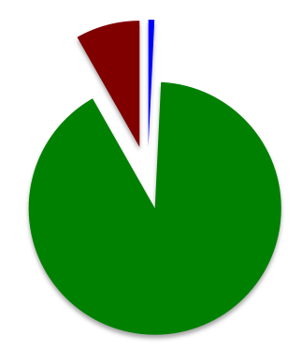
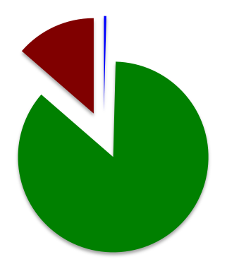
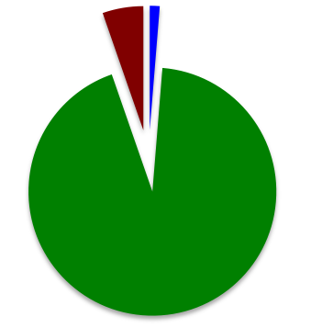
The Chemistry
(CO₂ + H₂O)
CO₂(aq)
H₂CO₃
HCO₃– + H⁺
CO₃^{2–} + H⁺
CO_{2(aq)}
HCO₃⁻
CO₃²⁻
pH
CO₂ = 560 μatm
CO₂ = 280 μatm
CO₂ = 940 μatm
Ω_{arag}= [CO₃²⁻][Ca²⁺]
K_{sparag}
Total CO₂
(aka TCO₂, DIC)

Slide 12
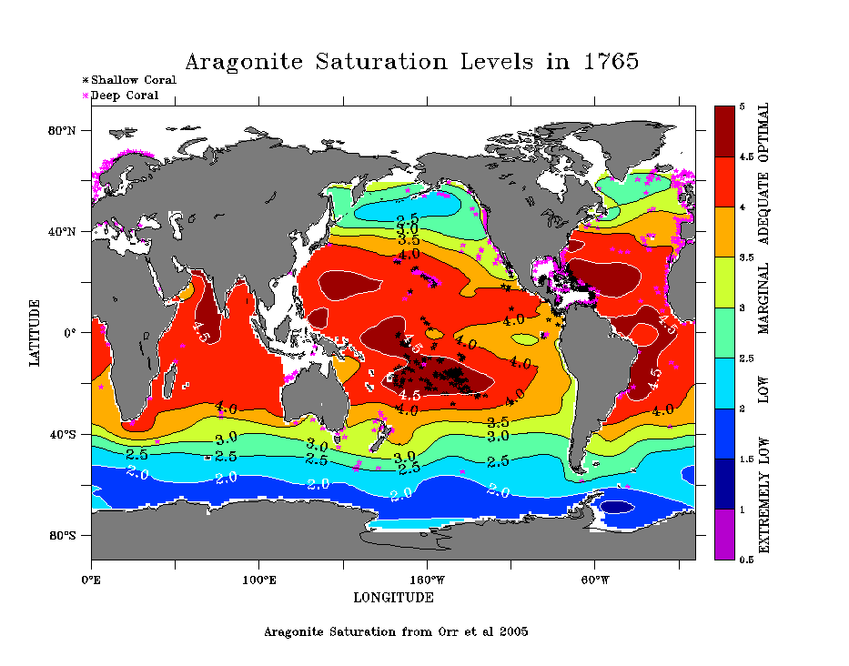
Aragonite Saturation Levels in
5
4.5
4
3.5
3
2.5
2
1.5
1
0.5
After Feely et al (2009) with modeled saturation Levels from Orr et al. 2005
Notes:
This is a time-lapse of modeled data showing changes in aragonite saturation state from the preindustrial through the end of this century.
Note the black stars designate coral reefs and the purple stars designate cold-water coral banks, many of which live near the depth of the saturation horizon.
When one views this time-lapse, it’s pretty shocking to see how rapidly the saturation state decreases – there are even areas where the surface waters become undersaturated.
The next thing you might ask is; WHEN DID THIS HAPPEN IN THE PAST? AND WHAT HAPPENED TO MARINE LIFE DURING THAT TIME?

Slide 13
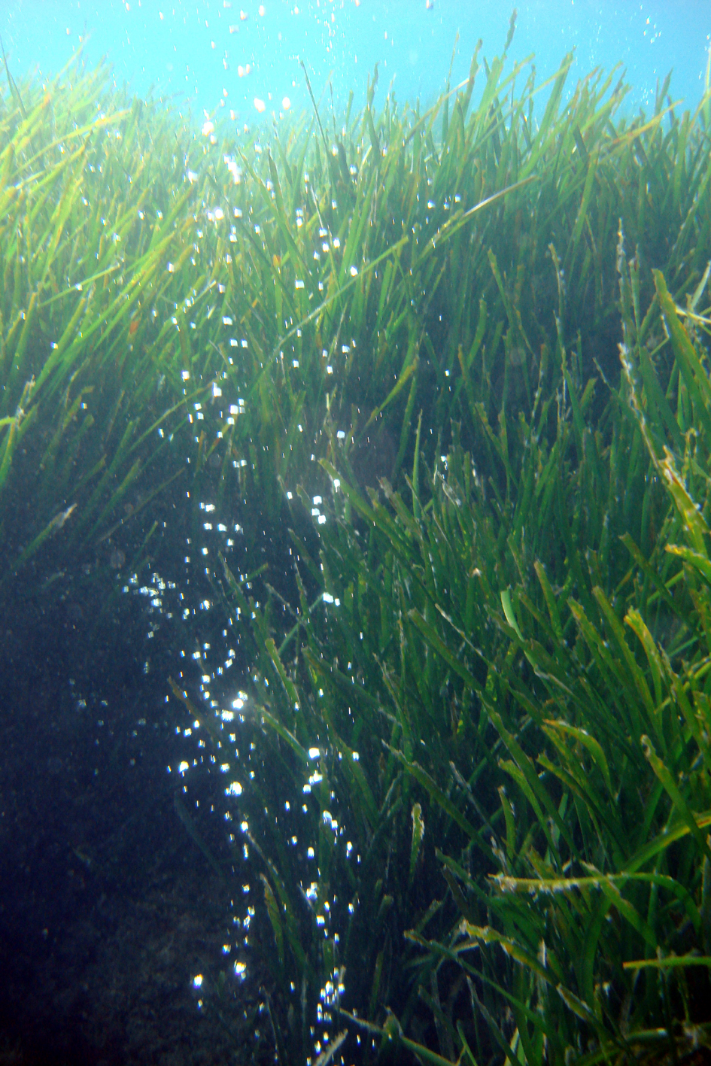
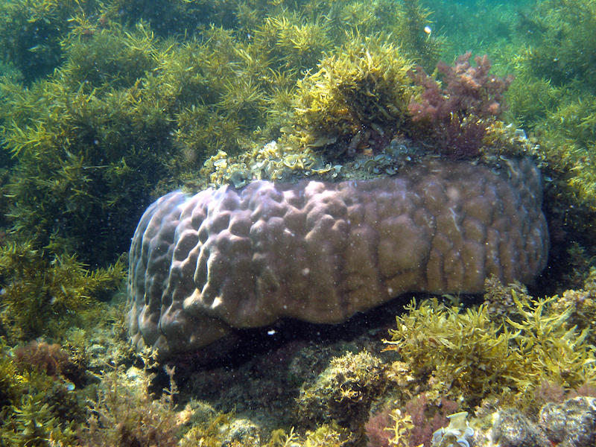
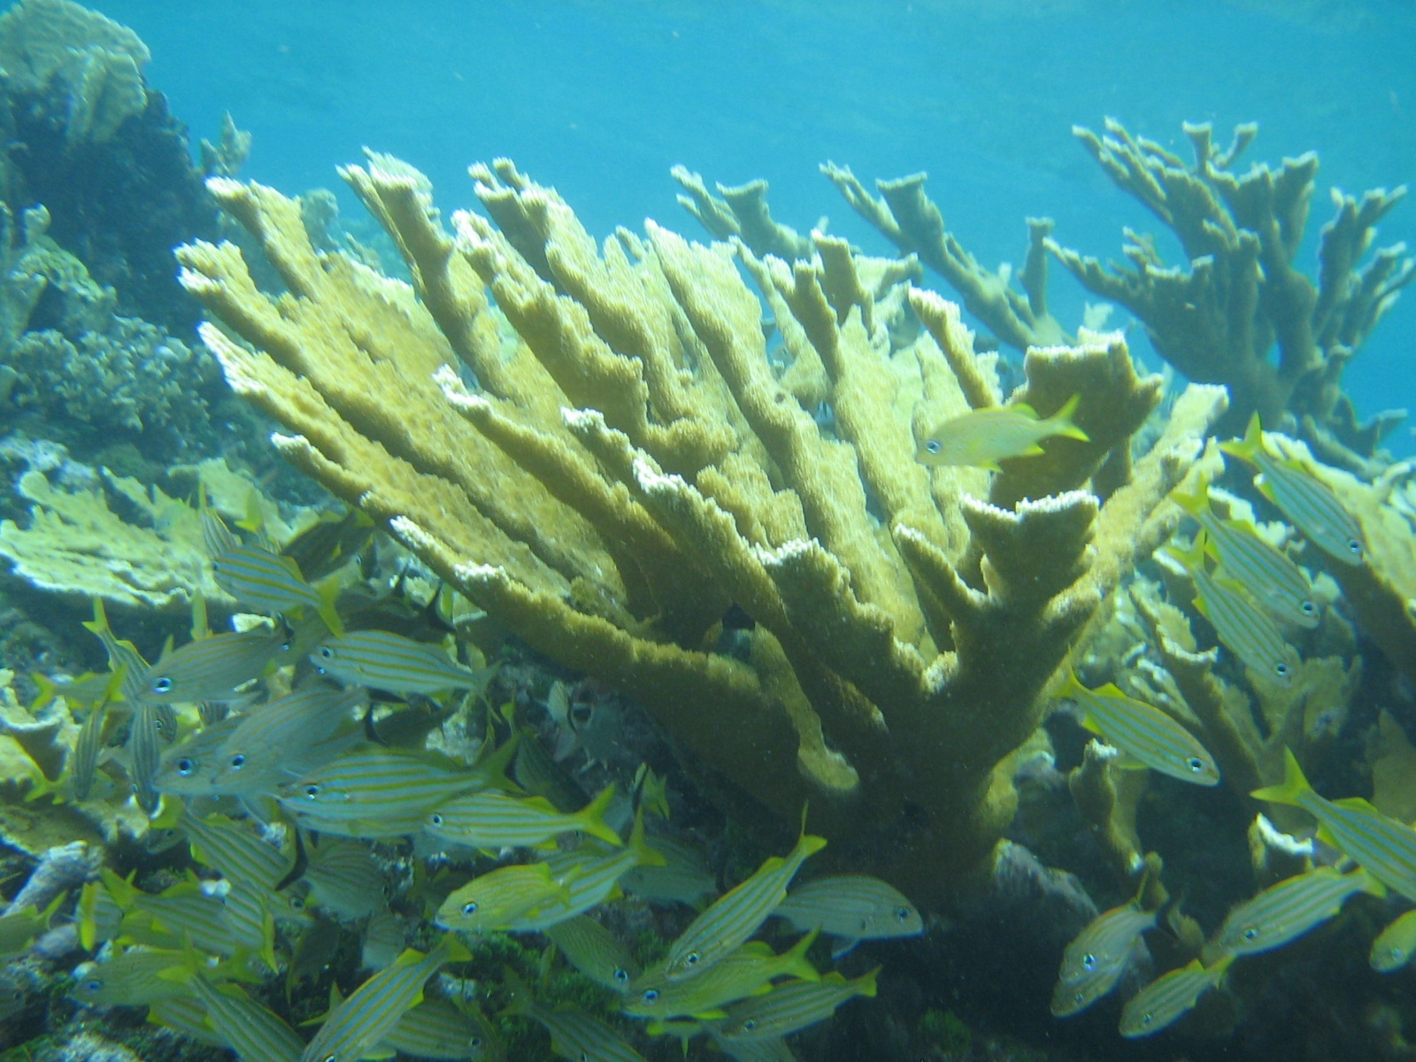
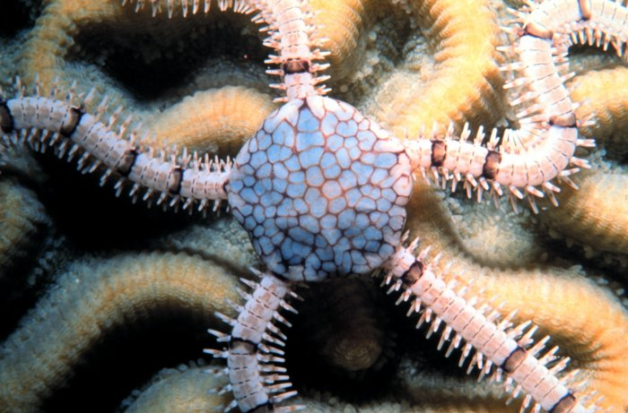
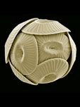
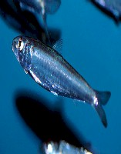
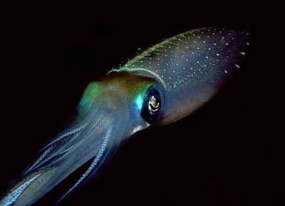
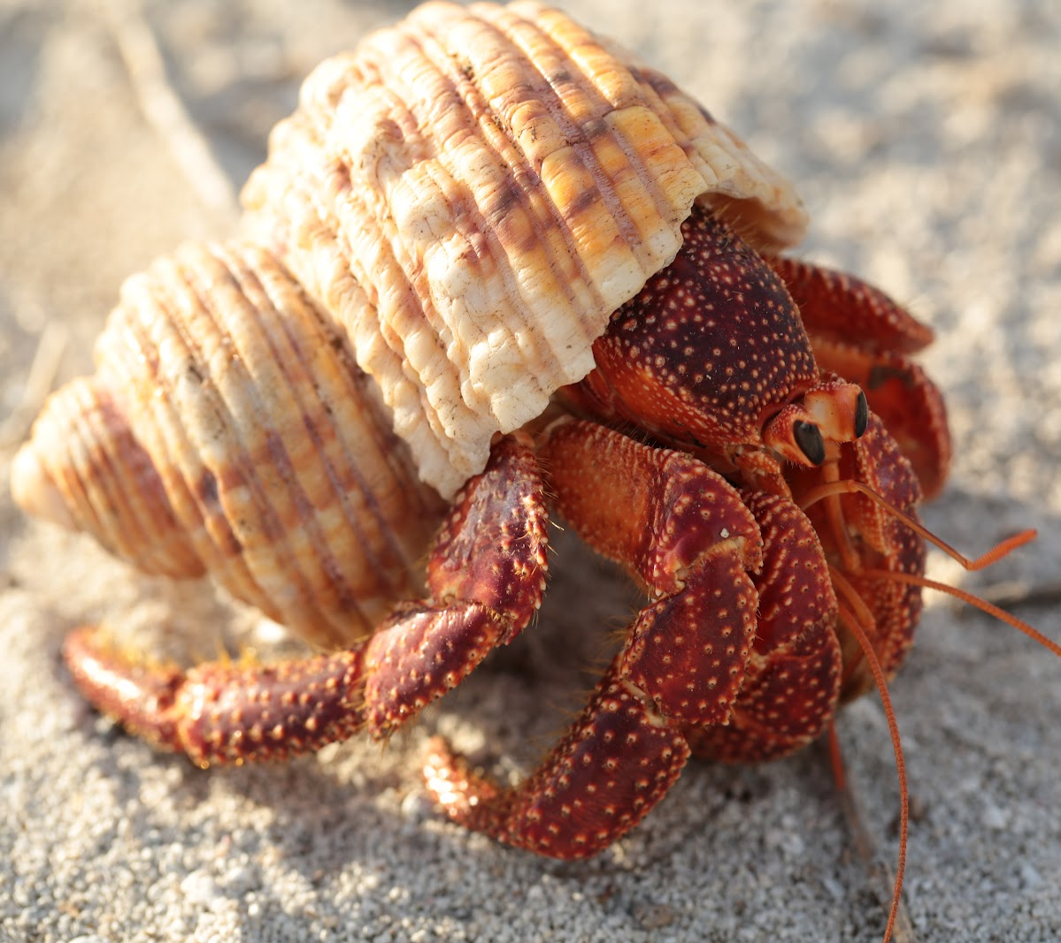
A suite of chemical shifts
O
C
CO_{2(aq)}
O
H
O
O
HCO₃⁻
O
O
O
CO₃²⁻
H⁺
pH
Notes:
This table shows how the concentrations of the various species changes from the preindustrial to the industrial period.
As CO2 increases, Total CO2 increases as well, but the carbonate ion decreases. That directly affects something we call the saturation state of calcium carbonate minerals – here we show the saturation state for aragonite.

Slide 14
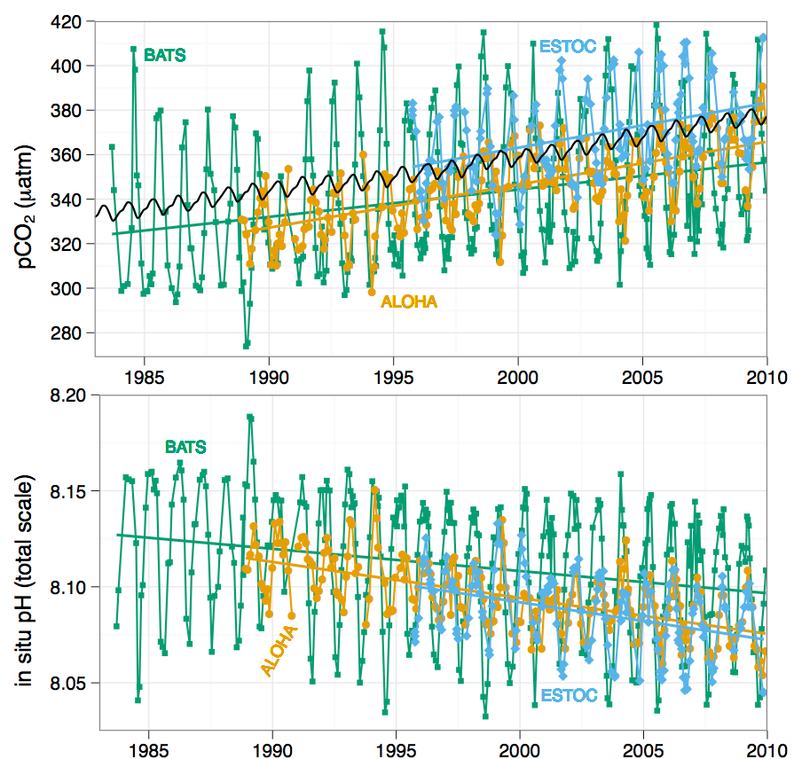
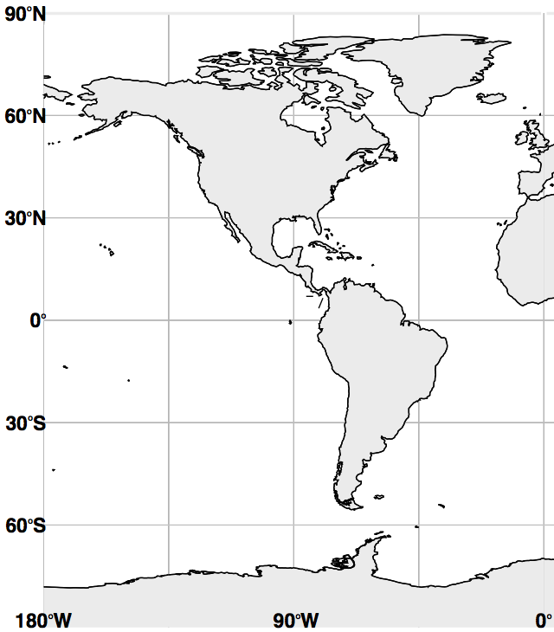
The Chemistry
ALOHA BATS ESTOC
CO₂
pH
Jim Orr, 2010

Slide 15
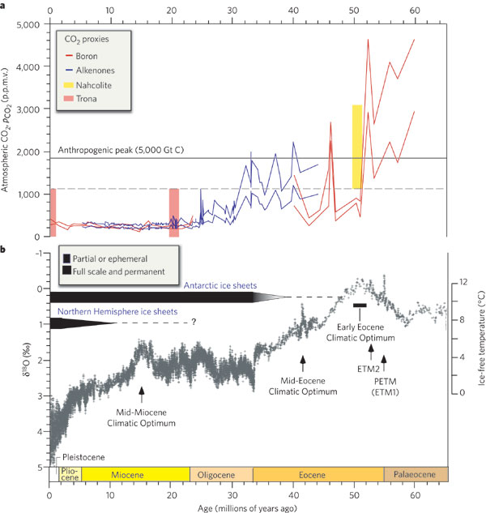
Paleocene-Eocene Thermal Maximum (PETM)
55 my ago
Atm pCO₂ (ppmv)
Temperature (°C)
0 10 20 30 40 50 60
Millions of Years
Zachos et al. 2008 Nature
Notes:
From Zachos et al 2008, Nature
a, Cenozoic p_{CO2} 0 to 65 Ma. Data are a compilation of marine (see ref. 5 for original sources) and lacustrine24 proxy records. Dashed horizontal line = maximum p_{CO2} for Neogene (Miocene to present) and minimum p_{CO2} for early Eocene (1,125 p.p.m.v.). Vertical distance between the upper and lower coloured lines shows the range of uncertainty for the alkenone and boron proxies.
b, Climate for the same period (0 to 65 million y). Climate curve is a stacked deep-sea benthic foraminiferal oxygen-isotope curve based on records from DSDP and ODP sites6, updated with high-resolution records for mid-Eocene to mid-Miocene25, 26, 27. Raw data were smoothed with 5-point running mean. The ¹⁸O temperature scale, on the right axis, was computed on the assumption of an ice-free ocean; it therefore applies only to the time preceding the onset of large-scale glaciation on Antarctica (35 Ma).
Figure shows 2-million-year-long Early Eocene Climatic Optimum and the more transient Mid-Eocene Climatic Optimum, and the very short-lived early Eocene hyperthermals such as the PETM (also known as Eocene Thermal Maximum 1, ETM1) and Eocene Thermal Maximum 2 (ETM2; also known as ELMO).

Slide 16
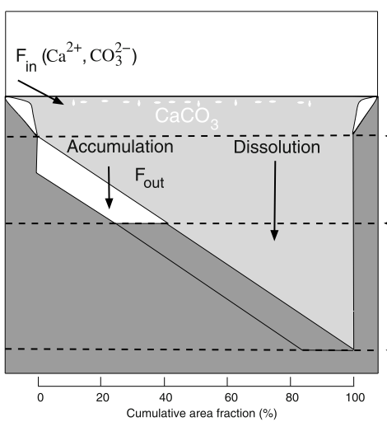
Evidence for Ocean Acidification in the Past
CCD
CCD
Modified from Zeebe 2003
Geochem. Geophys. Geosys.

Slide 17
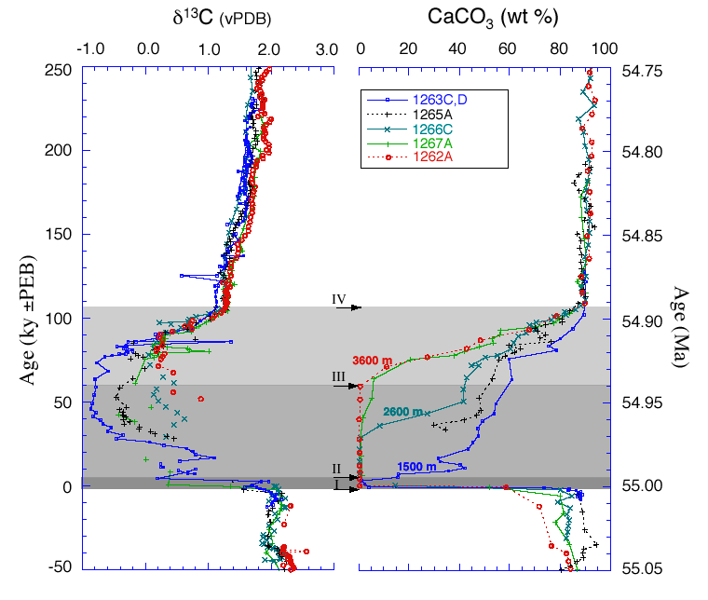
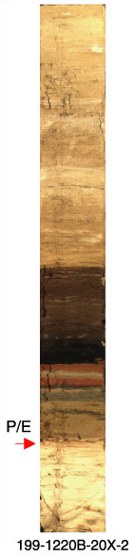
PETM – deep-sea dissolution event
Proc. Ocean Drilling Program #199, 2001
Zachos et al. 2005 Science
Notes:
As far as we know, the last time there was a rapid increase in atmospheric CO2 like the one we’re experiencing now, was 55 MY ago, at the Paleocene-Eocene Thermal Maximum.
Jerry Dickens’ work:
At this time, there was a spike in isotopically light carbon that indicated a sudden release of either a lot of CO2, such as through vulcanism, or a big release in methane, such as from frozen methane clathrates on the sea floor.
There was significant global warming as well.
These data are from deep-sea cores, such as the one shown on the right. The other thing that happened during this period was a dramatic shoaling of that calcium carbonate compensation depth – apparently the oceans became more acidic and the deep-sea carbonates began to dissolve. There were also significant changes in some of the benthic organisms, although I don’t think anyone classifies this as a significant extinction event.
It’s not a perfect analogue.
There is also evidence that it took thousands of years for the system to recover, as evidenced by the return of calcium carbonate in the sediments.

Slide 18
What Happened in the PETM?
Physical changes:
Increase in ocean temperature 5-8ºC
Shoaling of the CCD up to 2 km
Biological responses:
Dramatic reorganization of marine and terrestrial ecosystems
  Marine: 35-50% of deep-water benthic foraminifera went extinct (Thomas 1998)
  high species turnover of plankton (Gibbs et al 2006; Raffi et al 2009)
  Land: mammalian radiation
  reorganization of terrestrial plant communities (Wing et al. 2005)
Notes:
During the PETM, benthic foraminifera at middle bathyal and greater depths suffered extinction of 30-50% of species during a few thousand years. Extinction was less severe at neritic to upper bathyal depths, where temporary changes in faunal composition prevailed.
Preextinction deep-sea faunas were cosmopolitan and diverse, and contained heavily calcified species. Immediate postextinction faunas were more variable geographically, exhibited low diversity, and were dominated by thin-walled calcareous or agglutinated taxa, possibly because CaCO3 dissolution increased globally from neritic to abyssal depths just before the extinction. These assemblages were dominated either by long-lived taxa such as Nuttallides truempyi or by buliminid taxa, the latter accompanied by agglutinants in some areas.Faunas dominated by N. truempyi were common in the South Atlantic and at lower bathyal through upper abyssal depth in the Indian Ocean, and might indicate oligotrophic conditions as well as increased corrosiveness. Buliminid-dominated faunas might indicate high rates of deposition of organic matter or low-oxygen conditions. Such faunas were common globally along continental margins, and locally co-occurred with sedimentologic or planktonic faunal indicators of high productivity. In the bathyal central Pacific, however, buliminid-dominated faunas co-occurred with planktonic faunas suggesting oligotrophy, and they could reflect low-oxygen conditions resulting from sluggish ocean circulation, oxidation of dissociated methane hydrates, or warming of bathyal-abyssal waters caused by a change in deep-sea circulation. Alternatively, they could indicate that the fraction of organic matter reaching the seafloor increased as a result of decreased oceanic oxygenation. The latest Paleocene benthic extinction thus was complex, and factors such as changes in deep-sea circulation, increased CaCO3 corrosiveness, increased temperatures, decreased oxygenation, and changes in the patterns of high productivity may have contributed to its severity.

Slide 19
Multiple Effects on Marine Life
Changes in CO₂-system
Direct Effects
Increase in photosynthesis
Decrease in calcification
Chemical speciation
Physiology
Sound transmission
CO_{2(aq)}
HCO₃⁻
CO₃²⁻
pH
Indirect Effects
Food webs
Biogeochemistry
Animal
behavior
Ecosystem Engineering

Slide 20
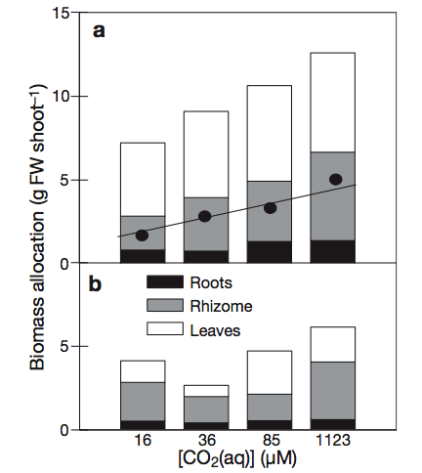
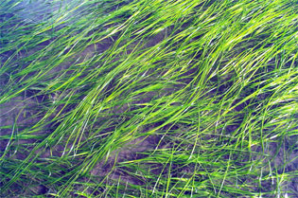
Zostera marina
CO_{2(aq)}
HCO₃⁻
Increased Biomass in Seagrasses
Photo credit: NOAA
Light replete
Light limited
Palacios & Zimmerman (2007) MEPS
Notes:
From: Palacios SL and RC Zimmerman. 2007. Response of eelgrass Zostera marina to CO2 enrichment: possible impacts of climate change and potential for remediation of coastal habitats. MEPS 344: 1-13.
“Fig. 4. Zostera marina. Biomass allocation (g FW shootﾐ1) among roots, rhizomes and leaves after 1 yr growth under CO2 enrichment, plotted as a function of CO2(aq) concentration for (a) light-replete and (b) light-limited treatments. Mean rhizome biomass (d) with fitted line shown for light-replete treatments (r2= 0.99, p < 0.01)”
Seagrasses are rooted plants, marine angiosperms (cotyledons) that are related to freshwater plants
But see also:
Sven Beer, Mats Bjork, Frida Hellblom and Lennart Axelsson
Inorganic carbon utilization in marine angiosperms (seagrasses)
Abstract: The mechanisms by which marine angiosperms, or seagrasses, utilize external inorganic carbon (Ci) include, in addition to uptake of CO2 formed spontaneously from HCO3–: (i) extracellular carbonic anhydrasemediated conversion of HCO3– to CO2 at normal seawater pH, or in acid zones created by H+ extrusion, and (ii) H+-driven utilization (direct uptake?) of HCO3–. The latter mechanism was recently indicated for Zostera marina, Halophila stipulaceaand Ruppia maritima, and manifested itself as a sensitivity of photosynthesis to buffers, as well as a relative insensitivity to acetazolamide under buffer-free conditions, especially at high pH.Seagrasses have until recently been viewed as having Ci utilization systems that are less ‘efficient’ than macroalgae, and this has, for example, led to the thought that future rises in atmospheric and thus dissolved CO2 would have a stronger effect on seagrasses than on macroalgae. However, most of the experiments leading to such conclusions were carried out in the laboratory on detached leaves, and buffers were used to keep HCO3–/CO2 ratios stable during Ci additions. The revelation that seagrass photosynthesis is sensitive to buffers as well as to physical perturbations, has led to new experiments in which initial pH values are set by appropriate HCO3–/CO32–ratios, and/or O2 measurements on leaf pieces are replaced with pulse amplitude-modulated fluorometry on whole, attached leaves, often in situ. Under such conditions, the photosynthetic responses of seagrasses to Ci match those obtained for macroalgae. Thus, the paradigm of ‘inefficient’ Ci utilization by seagrasses as compared with macroalgae may no longer be valid. Consequently, it seems that the generally observed high productivity of seagrass beds may have its background in very efficient, H+-driven, means of HCO3– utilization.Keywords: inorganic carbon, marine angiosperms, photosynthesis, seagrasses. Functional Plant Biology 29 (3) 349 - 354 Full text doi:10.1071/PP01185

Slide 21
CO_{2(aq)}
HCO₃⁻
Effects on the Nitrogen Cycle
Hutchins et al. 2009 Oceanography
Notes:
Beman et al. PNAS 2011
As NO3- is assimilated by phytoplankton and eventually remineralized to NH4+, ocean acidification would substantially reduce the proportion converted back to NO3- by nitrification, ultimately depleting upper water column NO3- over time.
Substantial shift in the chemical form of nitrogen from NO3-supported production to NH4+ favored production
Smaller organisms that are more competitive for NH4+ would be favored over organisms that prefer NO3- (such as diatoms)
NH3= ammonia
NH4+ = ammonium –
pH low NH3 + H20 -> NH4+ + OH-
pH high <-

Slide 22
CO_{2(aq)}
HCO₃⁻
Effects on the Nitrogen Cycle
Hutchins et al. 2009 Oceanography
Notes:
Beman et al. PNAS 2011
As NO3- is assimilated by phytoplankton and eventually remineralized to NH4+, ocean acidification would substantially reduce the proportion converted back to NO3- by nitrification, ultimately depleting upper water column NO3- over time.
Substantial shift in the chemical form of nitrogen from NO3-supported production to NH4+ favored production
Smaller organisms that are more competitive for NH4+ would be favored over organisms that prefer NO3- (such as diatoms)
NH3= ammonia
NH4+ = ammonium –
pH low NH3 + H20 -> NH4+ + OH-
pH high <-

Slide 23
CO_{2(aq)}
HCO₃⁻
Effects on the Nitrogen Cycle
Hutchins et al. 2009 Oceanography
Notes:
Beman et al. PNAS 2011
As NO3- is assimilated by phytoplankton and eventually remineralized to NH4+, ocean acidification would substantially reduce the proportion converted back to NO3- by nitrification, ultimately depleting upper water column NO3- over time.
Substantial shift in the chemical form of nitrogen from NO3-supported production to NH4+ favored production
Smaller organisms that are more competitive for NH4+ would be favored over organisms that prefer NO3- (such as diatoms)
NH3= ammonia
NH4+ = ammonium –
pH low NH3 + H20 -> NH4+ + OH-
pH high <-

Slide 24
CO_{2(aq)}
HCO₃⁻
Effects on the Nitrogen Cycle
Losers:
Diatoms
less
Winners:
  Picophytoplankton
more
Hutchins et al. 2009 Oceanography
Notes:
Beman et al. PNAS 2011
As NO3- is assimilated by phytoplankton and eventually remineralized to NH4+, ocean acidification would substantially reduce the proportion converted back to NO3- by nitrification, ultimately depleting upper water column NO3- over time.
Substantial shift in the chemical form of nitrogen from NO3-supported production to NH4+ favored production
Smaller organisms that are more competitive for NH4+ would be favored over organisms that prefer NO3- (such as diatoms)
NH3= ammonia
NH4+ = ammonium –
pH low NH3 + H20 -> NH4+ + OH-
pH high <-

Slide 25
Background
Effects of OA on Reef Organisms
Effects of OA on Reefs
Records
Future State of Coral Reefs
Notes:
Everything is what it is because it got that way
D’Arcy Wentworth Thompson “On Growth and Form” 1917
What escapes the eye, however, is a much more insidious kind of extinction: the extinction of ecological interactions
Daniel H Janzen, Natural History 83, 48 (1974)

Slide 26
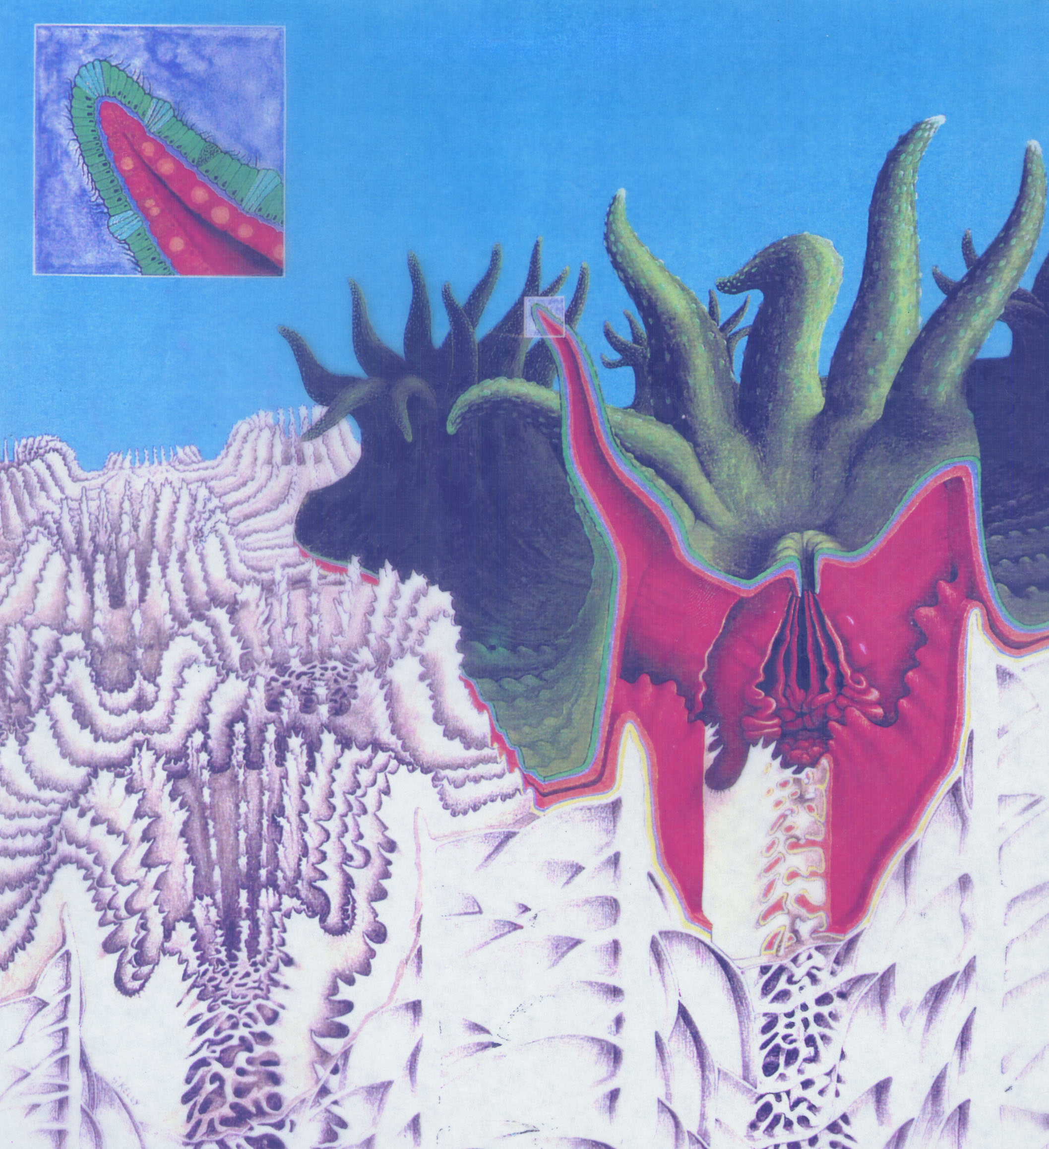
corals
Effects on Coral Reef Builders
Photosynthesis/
Respiration
Food Supply
Calcification/
Dissolution
Reproduction
Settlement &
Recruitment
Notes:
Calcification/dissolution (30-40 studies)
Effects coral and coralline algae functioning or recruitment
Effects reef-building
Photosynthesis of coral symbionts or coralline algae (~10 studies)
Effects on non-calcareous algae (<10 studies)
Other studies
Coral bleaching thresholds (1 study)
Coral reef fish chemosensory ability (2 studies)

Slide 27
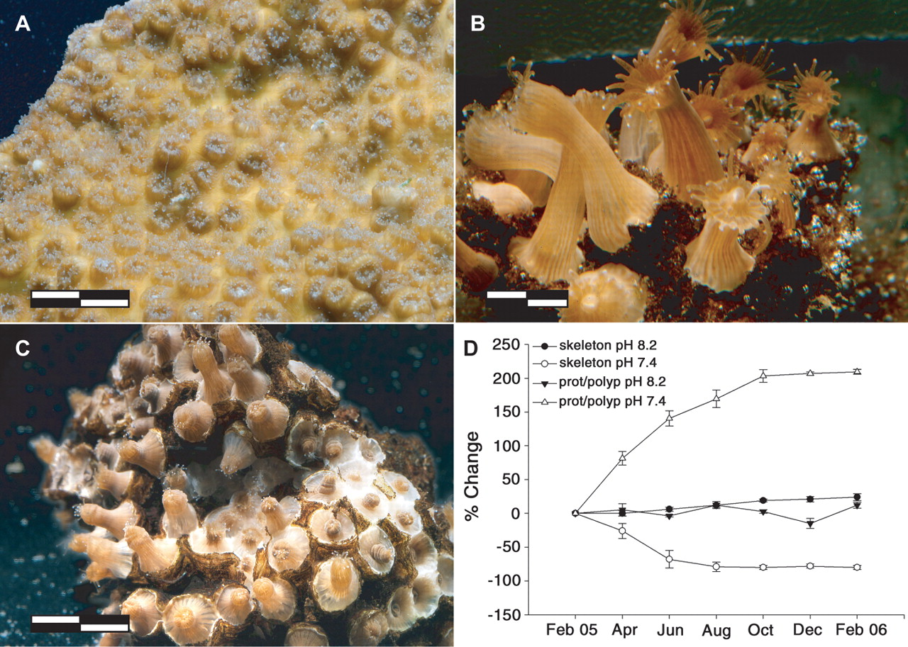
corals
Ocean acidification affects coral calcification
Normal pH:
Coral skeleton is normal
Low pH:
Coral skeleton has dissolved away
Coral polyps are “anemone-like”
Fine & Tchernov, Science 315, 1811 (2007)

Slide 28
corals
Ocean acidification affects coral calcification
Chan & Connolly (2011) Meta-analysis
Compared findings of 25 CO2 manipulation experiments on corals
Almost all studies showed a decline in calcification as Ω_{Arag} decreased
Average decline is 15% for every unit decrease in Ω_{Arag}
Chan & Connolly 2011 Global Biogeochem Cycles
Notes:
Fig. 1 Overall effects of ocean acidification on coral calcification.
Calcification is denoted as a percentage decrease from baseline calcification (calcification at OArag of 3.517) per unit decrease in OArag.
Thus, all lines intersect the point (OArag = 3.517, calcification = 100%).
The thin black lines show the calcification responses for individual studies.
The endpoints of these lines indicate the range of OArag values spanned in each study.
The thick black line represents the combined (mean) calcification response across all studies, and the dashed lines represent upper and lower 95% confidence intervals for this combined response (that is, they represent the uncertainty around the mean response, not the overall among-study variability).

Slide 29
corals
Ocean acidification affects coral calcification
Chan & Connolly (2011) Meta-analysis
Acid addition
Carbonate manipulation method
CO2 bubbling
Buoyant wt
Calcification measurement *
Alk. anomaly
Slow
Species growth rate
Fast
Chan & Connolly 2011 Global Biogeochem Cycles
Notes:
Fig. 2 Methodological and biological variation in effects of ocean acidification on coral calcification.
Bars indicate the mean decrease in calcification per unit decrease in OArag for each subset of studies.
Whiskers indicate 95% confidence intervals on the mean response.
AA, acid addition studies;
CO2, CO2 bubbling studies;
BW, buoyant weighting studies;
TA, alkalinity anomaly technique studies;
Slow, studies using slow-growing species;
Fast, studies using fast-growing species.
The slopes are significantly different only using calcification measurement method (indicated with an asterisk).
NOTE they did not look at other conditions such as light saturation, which as shown later, can also be a factor as well

Slide 30
corals
Corals elevate pH at the site of calcification
pH of calcifying fluid
Calculated
based on
δ¹¹B
pH of ambient water
McCulloch et al. 2012 Nature Climate Change
Notes:
Regressions for the temperate shallow water coral C. caespitosa (this study) and tropical species of Porites, Acropora, and Stylophora (Hönisch et al., 2004; Krief et al., 2010; Reynaud et al., 2004) that define the relationship between seawater pH and the biological pH component (ΔpH) imparted during calcification.
ΔpH is calculated as the difference between pHbiol, based on the δ11B-derived pH using Klochko et al's fractionation factor (α = 1.0272), and measured pHsw.
The resultant regressions define the species pH calibrations and can be used to iteratively calculate ΔpH and ambient seawater pH.
Measurement errors for pHsw are shown at 1 SD, and errors for ΔpH are calculated as the combined fractional errors (at 1 SD) for measured pHsw and pHbiol.

Slide 31
corals
Mechanisms of calcification in a coral
Astrangia
Cohen & Holcomb 2009, Oceanography
Notes:
Figure 4: Aragonite crystals accreted by corals reared over a range of aragonite saturation states display systematic changes in crystal morphology (A-D) that can be quantified using the crystal aspect ratio (the ratio of crystal length to width).
In (E), coral crystal aspect ratio (Y axis) is plotted against aragonite saturation state of the seawater in which the corals were reared.
The saturation state of the corals’ calcifying fluid (2Y axis) is estimated by applying the relationship between aspect ratio and fluid saturation state derived from the experimental aragonites.

Slide 32
corals
Mechanisms of calcification in a coral
Astrangia
Cohen & Holcomb 2009, Oceanography
Notes:
Figure 5: The number of protons pumped by corals during calcification under a range of seawater saturation states (ocean acidification scenarios) is estimated using
CO2Sys and
the predicted saturation state of the calcifying fluid achieved by the corals in each treatment.
The calcifying fluid is assumed to be seawater with an initial alkalinity of 2470 µmol/kg in equilibrium with the specified pCO2 (400, 740 or 1340 µatm).
The fluid is isolated from the surrounding seawater, proton pumping elevates the alkalinity and saturation state within the calcifying space while CO2 diffuses through the calicoblastic epithelium to maintain equilibrium pCO2.
The number of protons pumped to reach a calcifying fluid saturation state estimated from the crystal morphology (Figure 4) is the same in each treatment (4.5 µmoles/ml) (shaded bar) suggesting that the corals in this experiment did not divert more energy to this task.
Calculations were made using a Matlab implementation of CO2Sys using constants of Mehrbach et al, 1973 refit by Dickson and Millero, 1987 for carbonate, Dickson (1990) for sulfate; input conditions are as follows: S=30, T=25, atmospheric pressure = 1atm, silicate, phosphate, ammonia, HS=0, Ca and B concentrations are based on salinity

Slide 33
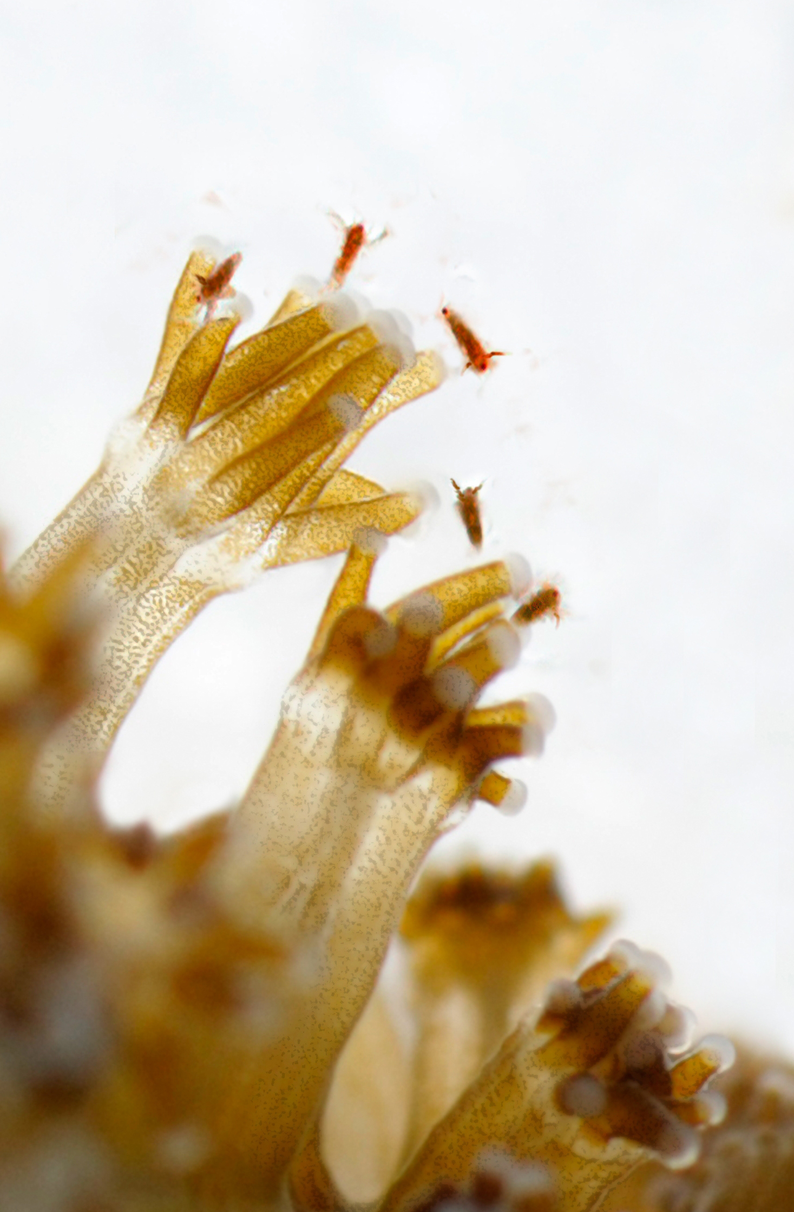
corals
Corals need energy to calcify
Food
Calcification rates of well-fed corals are not as strongly impacted by ocean acidification
Drenkard et al. 2013 Coral Reefs
Notes:
Our results suggest that calcification rates of nutritionally replete juvenile corals will decline as OA intensifies over the course of this century. Critically, however, such corals could maintain higher rates of skeletal growth and CaCO3 production under OA than those in nutritionally limited environments.

Slide 34
corals
Corals need energy to calcify
- Light
Light Calcification
% change due to OA
Dark Calcification
Gross Photosynth.
Suggett et al. 2012 Coral Reefs
Notes:
Gray bars – when light is limiting
White bars, when light is NOT limiting - Enhanced photosynthesis appears to help with calcification during the DAY
But has no effect on dark calcification

Slide 35
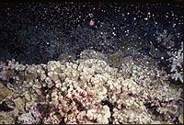
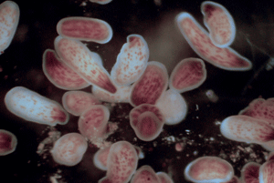
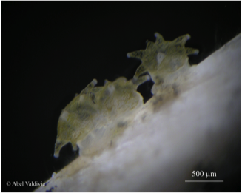
corals
Effects on coral reproduction & recruitment
Gamete production & fertilization
John Gorman photo
Larvae & Larval settlement
Dominique Barthélémy
Post-settlement growth & survival
Rebecca Albright photo

Slide 36
corals
Effects on coral reproduction & recruitment
Gamete production & fertilization
Fecundity a big factor in connectivity in supply side dynamics
No clear direct effects of OA
John Gorman photo
Larvae & Larval settlement
OA does appear to affect substrates
Dominique Barthélémy
Post-settlement growth & survival
OA affects both in some species
Rebecca Albright photo

Slide 37
Reduced settlement on coralline algae
corals
Acropora millepora & Acropora tenuis
Crustose coralline algae were pre-exposed to four treatment pH conditions for 6 weeks
Coral larvae were then introduced
Coral larvae were not affected by pH
… but fewer coral larvae settled at lower pH
% Metamorphosis
pH
Webster et al. 2013 Global Change Biol.
Notes:
Photographs of Hydrolithon onkodes:
freshly mounted crustose coralline algae (CCA) on a glass tile with underwater epoxy to avoid exposure of dead CCA skeleton and
with newly settled corals on the CCA surface following exposure to pH 7.7 for 6 weeks.
Note the new algal growth on the epoxy around the top right of the image. Scale bar = 0.5 cm, arrows indicate newly settled recruits.

Slide 38
Reduced settlement on coralline algae
corals
Acropora millepora
Doropoulos & Diaz-Pulido 2013 Mar. Ecol. Prog. Ser.
Notes:
Doropoulos and Diaz-Pulido 2013, MEPS found that high CO2 affects settlement of coral recruits (Acropora selago) on three species of coralline algae (Porolithon on codes, Sporoithon sp., and Titanoderma sp), esp. Titanoderma -- reasons? chemical cues of the algae are affected, or effects on associated microbial community
Doropoulos et al. 2012 Ecology Letters found that OA affected settlement of Acropora millepora and CCA by 45%, esp. Titanoderma spp.., Hydrolithon spp.
Doropoulos et al. 2012 Ecology found that OA caused reduced growth of coral recruits, which prolonged their vulnerability to grazing and disturbance (incidental grazing mortality). "size-escape thresholds"

Slide 39
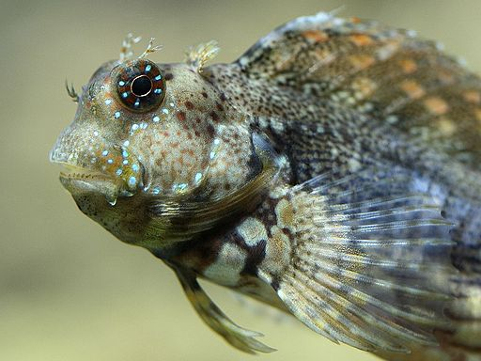
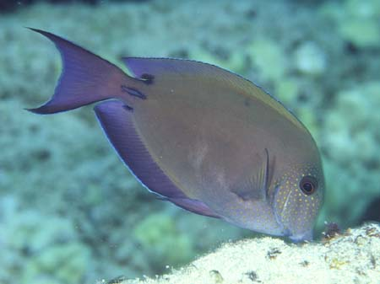
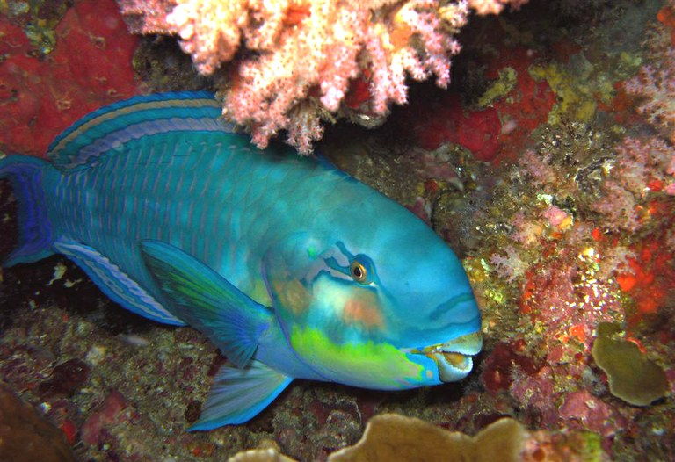
corals
Reduced survival of recruits after settlement
Acropora selago
Bulls in a China Closet
Doropoulos & Diaz-Pulido 2013 Mar. Ecol. Prog. Ser.
Notes:
Doropoulos et al. 2012 Ecology found that OA caused reduced growth of coral recruits, which prolonged their vulnerability to grazing and disturbance (incidental grazing mortality). "size-escape thresholds”
Greater mortality following settlement, despite having reached the size-escape threshold, was weaker skeletons made them more vulnerable to being scraped off.

Slide 40
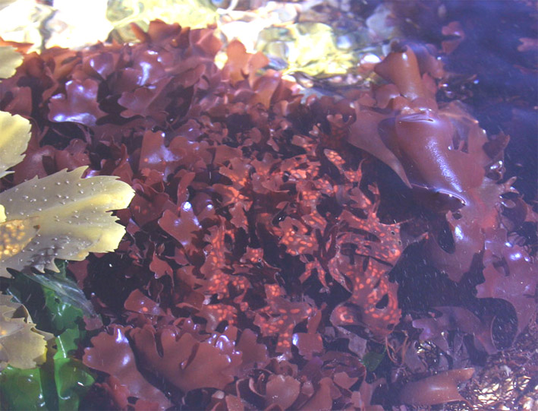
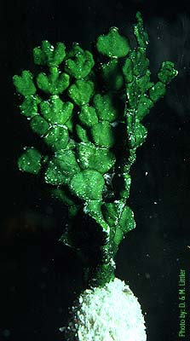
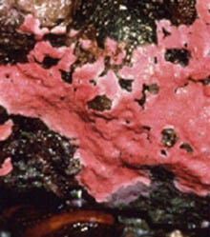
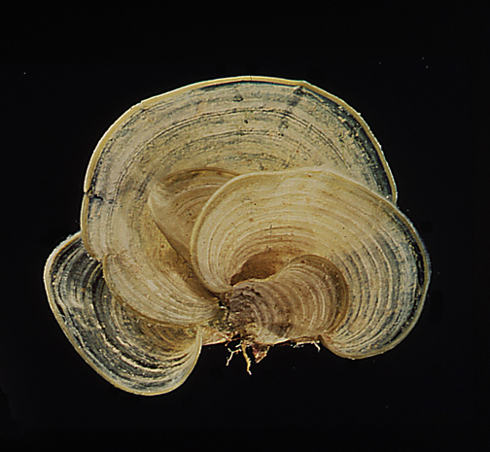
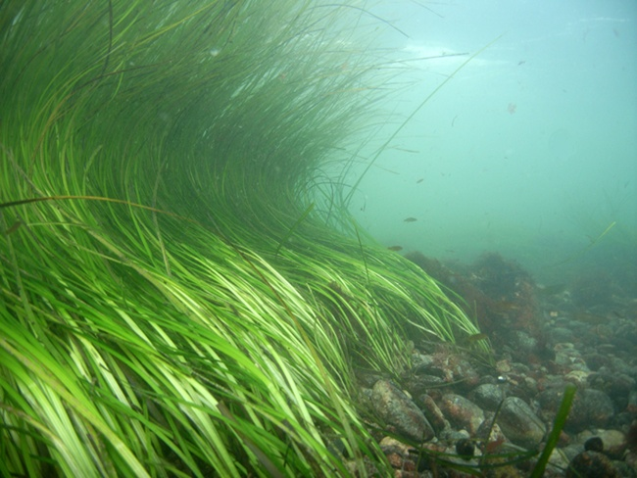

corals
Effects on other reef organisms
Macroalgae
Calcifying macroalgae
Seagrasses
Nancy Sefton
Fish
Notes:
Halimeda (Sinutok et al.) OA and warming inhibits calcification (3-fold reduction at 1000 uatm & 32C)
Coralline algae (Johnson et al.) – Palmyra Atoll – “consistent negative impact of OA on calcified algae and positive impact on fleshy algae, irrespective of ecosystem. Calcified algae either did not grow or lost relative CaCO3 in CO2 treatments, whereas fleshy algae grew faster, had higher pigment concentrations”

Slide 41
Background
Effects of OA on Reef Organisms
Effects of OA on Reefs
Records
Future State of Coral Reefs
Notes:
Everything is what it is because it got that way
D’Arcy Wentworth Thompson “On Growth and Form” 1917
What escapes the eye, however, is a much more insidious kind of extinction: the extinction of ecological interactions
Daniel H Janzen, Natural History 83, 48 (1974)

Slide 42
Natural ocean acidification
CO2 vents off Papua New Guinea
Reefs
WINNERS:
  Seagrasses
  Macroalgae
  Massive Porites
  LOSERS:
    Other hard corals
    Soft corals
    Sponges
    Coralline algae
    Gastropods
Decreased biodiversity
Ecosystem elimination
Milne Bay
Fabricius et al. 2011 Nature Climate Change

Slide 43
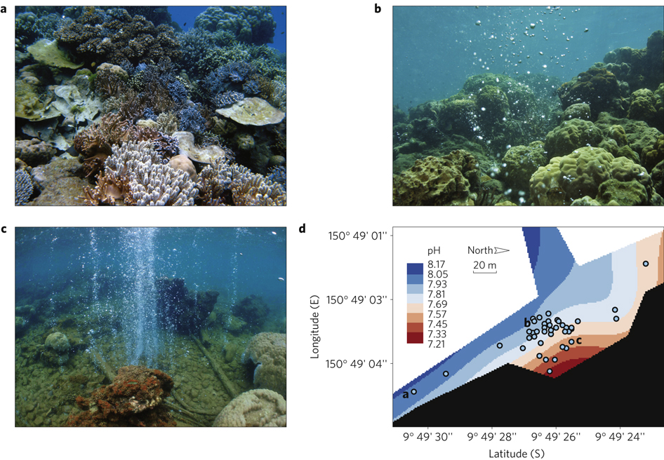
Natural ocean acidification
CO2 vents off Papua New Guinea
Reefs
pH = 7.93-8.05
pH = 7.81-7.93
pH = 7.45-7.57
Fabricius et al. 2011 Nature Climate Change
Notes:
As Sarah and Denise will show in their talks to follow, ocean acidification presents a number of challenges to marine life, and we expect to see many impacts on marine organisms and ecosystems, including those of our productive coastal waters.
Here I provide a very visual example of the kind of changes we expect.
This is a reef region located near a NATURAL carbon dioxide seep.
The bubbles in the photos are carbon dioxide gas from subsurface volcanic activity
The lower right hand panel is a map showing the pH changes around that seep.
Blue colors are high pH and are closer to natural conditions.
Brown values are low pH close to the carbon dioxide seep.
The top left photo shows the state of the reef in waters that are far away from the carbon dioxide bubbling - Note the high biodiversity at this site
The top right photo shows a site closer to the seep. It is dominated by one coral species and one that we know is one is better than most corals at withstanding environmental change. The decrease in biodiversity is obvious in this photo.
The lower left photo shows a site even closer to the seep. The ecosystem is basically gone.
We expect to see these kinds of changes on coral reefs in the future.
And other ecosystems are likely to experience a similar magnitude of change.

Slide 44
Natural ocean acidification
CO2 vents off Japan
Reefs
WINNERS:
  Soft corals
  LOSERS:
    Hard corals
Decreased biodiversity
Inoue et al. 2013 Nature Climate Change

Slide 45
Natural ocean acidification sites are not perfect analogs
Reefs
Problems due to connectivity with outside areas
Immigration from areas NOT experiencing OA
Lack of isolation hinders adaptation
Notes:
As Sarah and Denise will show in their talks to follow, ocean acidification presents a number of challenges to marine life, and we expect to see many impacts on marine organisms and ecosystems, including those of our productive coastal waters.
Here I provide a very visual example of the kind of changes we expect.
This is a reef region located near a NATURAL carbon dioxide seep.
The bubbles in the photos are carbon dioxide gas from subsurface volcanic activity
The lower right hand panel is a map showing the pH changes around that seep.
Blue colors are high pH and are closer to natural conditions.
Brown values are low pH close to the carbon dioxide seep.
The top left photo shows the state of the reef in waters that are far away from the carbon dioxide bubbling - Note the high biodiversity at this site
The top right photo shows a site closer to the seep. It is dominated by one coral species and one that we know is one is better than most corals at withstanding environmental change. The decrease in biodiversity is obvious in this photo.
The lower left photo shows a site even closer to the seep. The ecosystem is basically gone.
We expect to see these kinds of changes on coral reefs in the future.
And other ecosystems are likely to experience a similar magnitude of change.

Slide 46
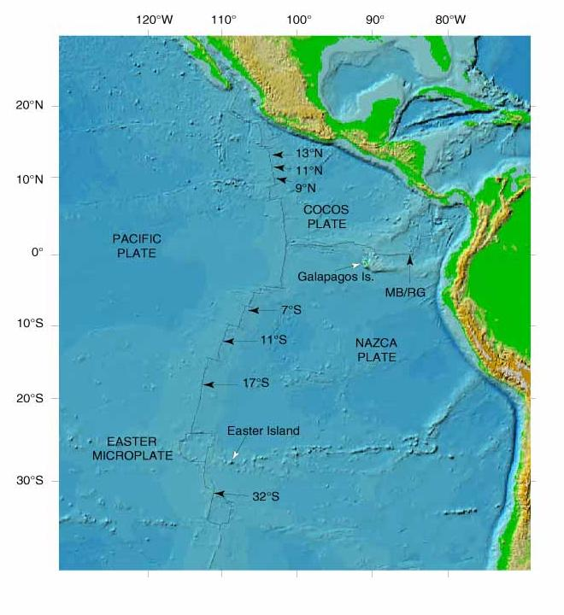
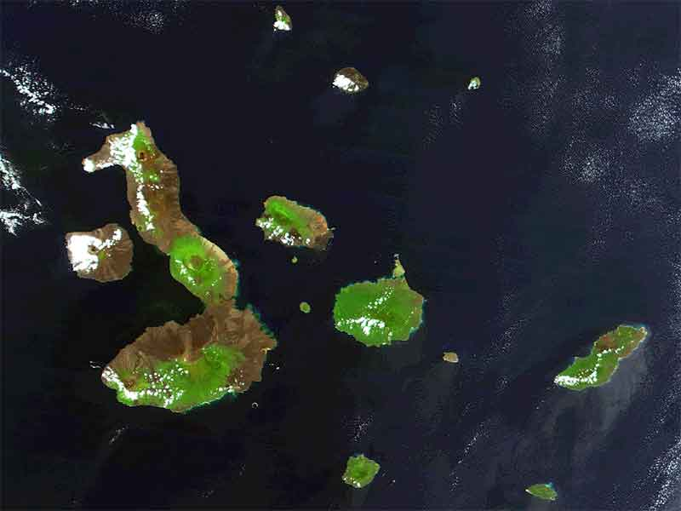
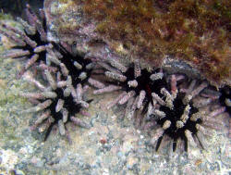
Natural ocean acidification
Galápagos Coral Reefs
reefs
Galapagos example
Eucidaris sp.
Notes:
Common name: Slate-pencil sea urchin
Dramatic erosion rates documented by Glynn, Eakin, and others following the 1982-83 ENSO.
Why such high erosion rates?
Sea urchin grazing is a major physical erosion process
Framework was reduced to sediments and other processes removed the sediments
These reefs are also poorly cemented: could this have been a factor in the high erosion (dissolution?) rates?
If so, will future reefs experience higher erosion rates?

Slide 47




Natural ocean acidification
Galápagos Coral Reefs
reefs
Manzello et al. (2008) PNAS

Slide 48




reefs
Bioerosion
will rates increase?
Changes in euendoliths at 750 vs 400 ppm CO₂
Deeper penetration of euendoliths
48% increase in carbonate dissolution rates
Tribollet et al. 2009
Global Biogeochem. Cycles
Grazers
Macroborers
Microborers
Notes:
Tribollet et al 2009. EFFECTS OF ELEVATED PCO2 ON DISSOLUTION OF CORAL CARBONATES BY MICROBIAL EUENDOLITHS Global Biogeochem Cycles
Eight-month old blocks of the coral Porites lobata colonized by natural Hawaiian euendolithic and epilithic communities were experimentally exposed to 2 different aqueous pCO2 treatments, 400 ppmv and 750 ppmv, for 3 months. The chlorophyte Ostreobium quekettii dominated communities at the start and at the end of the experiment (65%-90%). There were no significant differences in the relative abundance of euendolithic species, nor any differences in bioeroded area at the surface of blocks (27%) between pCO2 treatments. The depth of penetration of filaments of O. quekettii was however significantly higher under 750 ppmv (1.4 mm) than 400 ppmv (1 mm). Consequently, rates of carbonate dissolution measured under elevated pCO2 were 48% higher than under ambient pCO2 (0.46 kg CaCO3 dissolved m-2 y-1 versus 0.31 kg m-2 y-1). Thus, biogenic dissolution of carbonates by euendoliths in coral reefs may be a dominant mechanism of carbonate dissolution in a more acidic ocean.

Slide 49
reefs
Bioerosion
will rates increase?
Sponge: Cliona orientalis
Coral: Porites
Changes in bioerosion rates by Year 2100:
RCP % Increase in bioerosion
at year 2100
4.5 8.6
6 15.8
8.5 30.9
.
Wisshak et al. 2012 PlosOne
Notes:
Max Wisshak study
Duckworth & Peterson 2012 Mar. Biol
- Also showed that sponge erosion of scallop shells increased dramatically with decreasing pH

Slide 50

Future Calcification
- Combined T & Ω effects WITH bleaching -
reefs
Reef CaCO₃ Budget
most reefs will shift to a state of net dissolution state this century
“Coral reefs may start dissolving when atmospheric CO₂ doubles”
Gross Calcification (% of Preindustrial Rate)
Silverman et al. (2009) GRL
Notes:
Silverman et al (2009) Coral reefs may start dissolving when atmospheric CO2 doubles, GRL, 36, L05606, doi:10.1029/2008GL036282
Figure 3. Global coral reef distribution and their TGgross relative to their pre-industrial rate (280 ppm) in percent calculated with equation (6) employing modeled sea surface Warag and temperature values from Cao and Caldeira [2008], taking into account the change in live coral cover due to bleaching for each reef location at pCO2 stabilization levels of 380, 450 and 560 ppm. Live coral cover in all reefs was reduced by 50% cumulatively from an initial value of 50% when the SST at the reef location exceeded 1C over its maximum monthly average summer SST at the 280 ppm stabilization level.

Slide 51
reefs
Reef CaCO₃ Budget
most reefs will shift to a state of net dissolution state this century
Threshold Range
Ω_{A} = 3.0 to 3.2
pCO₂ = 520 to 600 ppm
Year = 2055−2075
Calcification/Dissolution
Tipping Point?
SLIDE FROM KIM YATES, USGS
Notes:
There are only a few other studies that have quantified dissolution thresholds. However, the results of these studies are beginning to merge on a few key points. The red line on this graph shows seawater saturation state for the tropics out to 2100 using data from Kleypas et al. 1999. The circles represent aragonite saturation state dissolution thresholds from four different studies. The black circle is from our data (black) and represents mostly Caribbean reefs. The green circle is a study done by Silverman et al. 2009 using a model for seawater carbonate chemistry on 9000 reef locations world-wide. The blue circle is a study done by Kayanne et al. 2008 on community calcification on the Shiraho Reef flat in Japan. The purple circle is the point at which dissolution began in the Biosphere 2 studies of Langdon et al. 2003. These data indicate that dissolution thresholds range between approximately 520 to 600 ppm pCO2, aragonite saturation states between ~ 3.0 to 3.2. These conditions are predicted to occur between the years 2055 and 2075. Interestingly, Langdon et al., indicate a reduction in community calcification rates of ~40% at pCO2 of 560 atm. In the Biosphere 2 experiments. We have 4 independent studies that are now pointing to a very specific timeframe of concern for reefs.

Slide 52

reefs
Loss of architectural complexity
Rugosity =
molded distance
= 2.5
shortest distance
A
B
Photo: Wolcott Henry, Marine Photobank

Slide 53


reefs
Loss of architectural complexity
2.5
Changes in Architectural Complexity of Caribbean Reefs
1969-2008
1.5
1.2
Alvarez-Filip et al. (2009) Proc. Roy. Soc. London B
Photos: Wolcott Henry, Marine Photobank
Notes:
A recent, nice study in the Caribbean compared rugosity measurements taken over the last 40 years, from reef sites all over the Caribbean.

Slide 54
reefs
Loss of architectural complexity
2.5
Changes in Architectural Complexity of Caribbean Reefs
1969-2008
3.0
2.5
2.0
1.5
1.0
1.5
Rugosity
1.2
Alvarez-Filip et al. (2009) Proc. Roy. Soc. London B
Photos: Wolcott Henry, Marine Photobank
Notes:
What they found was that there has been a progress loss of architectural complexity over that time.
This is what we expect to see in the future. As we lose live coral cover, and decrease reef building, we can expect to see this worsen

Slide 55
Background
Effects of OA on Reef Organisms
Effects of OA on Reefs
Records
Future State of Coral Reefs
Notes:
Everything is what it is because it got that way
D’Arcy Wentworth Thompson “On Growth and Form” 1917
What escapes the eye, however, is a much more insidious kind of extinction: the extinction of ecological interactions
Daniel H Janzen, Natural History 83, 48 (1974)

Slide 56

Community composition affects chemistry
Ω_{Arag}

Slide 57




Community composition affects chemistry
Algae and coral both affect the seawater chemistry
Total Alk
Moorea Reef Flat
Total CO₂
Ω_{arag}
Kleypas, Anthony, Gattuso 2012 GCB
Notes:
Advantages: could be linked to other engineering plans
Disadvantages:
high in nutrients
Release CO2 back to the atmosphere
Limited to small areas, because of the volume of water needed.
blog.wired.com/sterling/ 2007/12/index.html

Slide 58
Community composition affects chemistry
Seagrasses draw down CO2 during photosynthesis and thus counteract ocean acidification
Manzello et al. 2012 PlosOne
Notes:
Advantages: could be linked to other engineering plans
Disadvantages:
high in nutrients
Release CO2 back to the atmosphere
Limited to small areas, because of the volume of water needed.
blog.wired.com/sterling/ 2007/12/index.html

Slide 59
Seagrasses are better than macroalgae
Unsworth et al. 2012 Env. Res. Lett.
Notes:
Advantages: could be linked to other engineering plans
Disadvantages:
high in nutrients
Release CO2 back to the atmosphere
Limited to small areas, because of the volume of water needed.
blog.wired.com/sterling/ 2007/12/index.html

Slide 60
future
Where will they be?
Preview of work by Lauren Freeman, Scripps

Slide 61
future
Where will they be?
Models
1) Community Earth System Model (CESM) to provide climate and BGC data
2) Maxent – a bioclimate envelope model
Steps
1) “Trained” the model using CESM “present day” bioclimate envelopes – these variables were best at predicting “present day” reef distributions
  Cumulative Temperature Stress
  Phosphate maximum
  Current speed maximum
  Salinity minimum
  Aragonite Saturation State minimum
  PAR minimum
2) Determined the bioclimate envelopes for “future” conditions

Slide 62

future
Reef Bioclimate Envelope
All Reefs
2000
2050
2100

Slide 63

future
Reef Bioclimate Envelope
Caribbean
2000
2050

Slide 64

future
Reef Bioclimate Envelope
Pacific Reefs
Pacific Ocean
2000
2050

Slide 65

future
Reef Bioclimate Envelope
Indian Ocean
2000
2050

Slide 66
Fate of Coral Reef Ecosystems
future
Ocean acidification will impact corals and coral reef ecosystems
Reef building will decline, but it is unclear how that will affect coral reefs.
Reef ecosystem response may be tempered by increases in marine algae and seagrasses.
Reef bioclimate envelopes will shift – but it varies with ocean basin
Sterling Zumbrunn

