Slide 1


Connections Between
Oceanic Weather and
Atmospheric Climate
Frank Bryan
Oceanography Section
National Center for Atmospheric Research
Contributions from:
DOE/LLNL Grand Challenge Team (LLNL, LANL, ORNL, Scripps, NCAR)
NSF PetaApps Team (COLA, RSMAS, UW, NCAR)
Special Thank to:
John Dennis (NCAR/CISL)
Bob Tomas (NCAR/CGD)

Slide 2
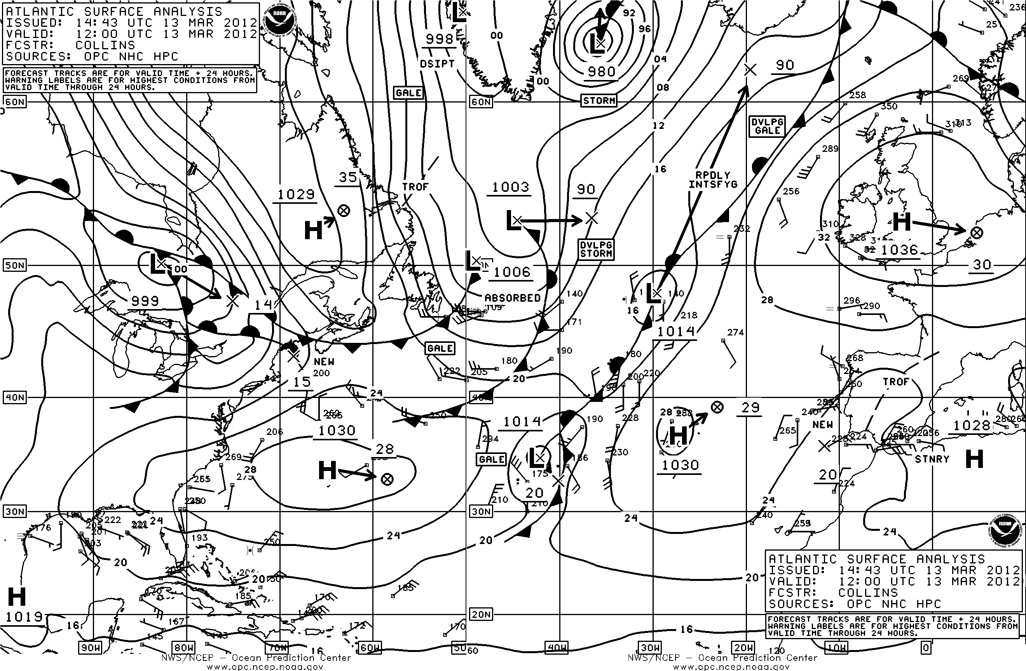
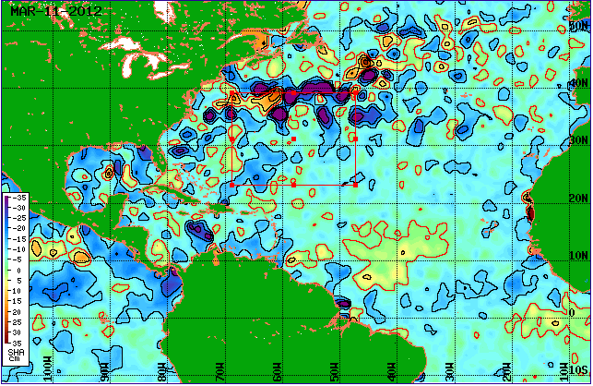
The Synoptic Scale:
Atmosphere vs. Ocean
Mean Sea Level Pressure: O(1000 km)
Troposphere
Sea Surface Height Anomaly: O(100 km)
Open Ocean
Notes:
The fluids are governed by the same dynamics and give rise to “weather”

Slide 3
What Role Do Ocean Eddies Play in Mid-Latitude Ocean-Atmosphere Interaction?
Does the atmosphere “see” the ocean synoptic or frontal scales?
  Over what altitude/range does any influence extend?
What are the relative roles of ocean dynamics and atmospheric forcing in generating SST variability?
  Through what mechanisms?
  Scale dependence?
How does natural variability of the climate system differ when both ocean and atmosphere have “weather”?

Slide 4
Community Climate System Model
 | Low Resolution Eddy-Parameterized | High Resolution Eddy-Resolving
Ocean Grid / Resolution | Dipole ~1.0° / 60L (42L) | Tripole 0.1° / 42L
Ocean Tracer Horiz. Subgrid Closure | Gent-McWilliams w/ diagnostic κ | Biharmonic κ∝Δ³
Ocean Momentum Subgridscale Closure | Anisotropic harmonic viscosity | Biharmonic ν∝Δ³
Ocean Topography | Full Cell (ETOPO5) | Partial Cell (ETOPO2)
Atmos. Resolution | 0.5° / 26L | 0.5° / 26L
Ocean-Atmosphere Coupling Interval | 6 hours | 6 hours
Control Experiment Initial Condition | CCSM3 T85x1 Present Day Control | CCSM3 T85x1 Present Day Control
Control Experiment Length | 167 years | 167 years
McClean et al (2011) Kirtman et al (2012, submitted)

Slide 5
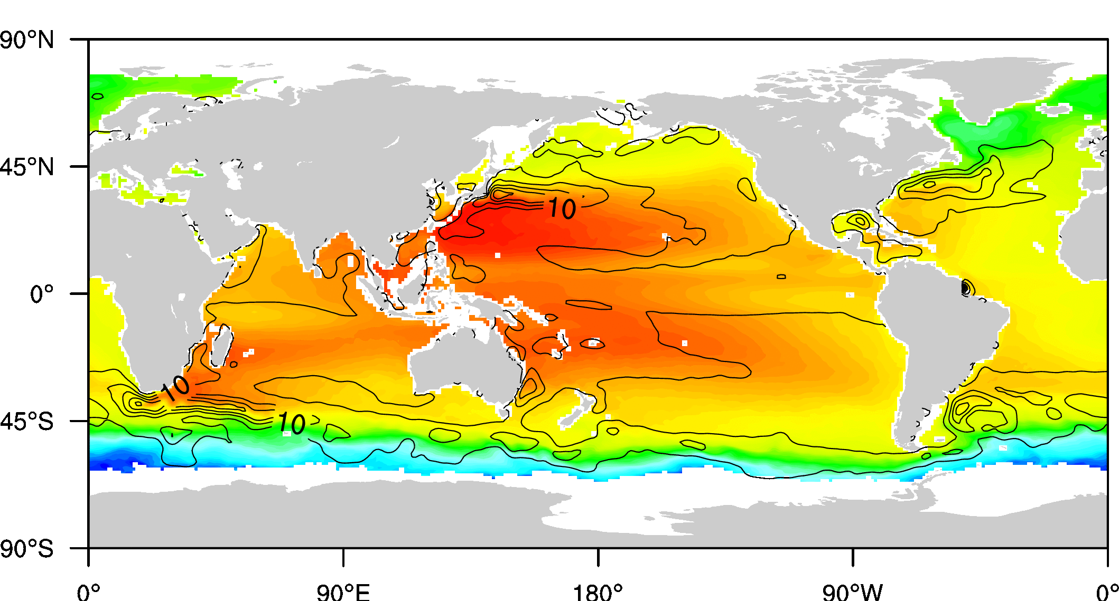
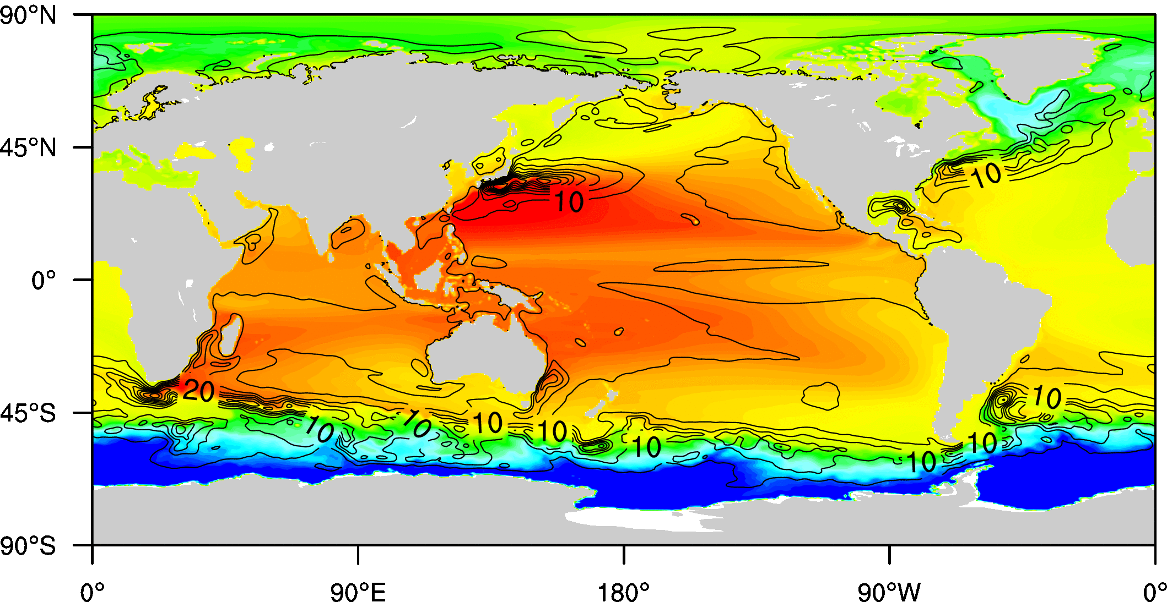
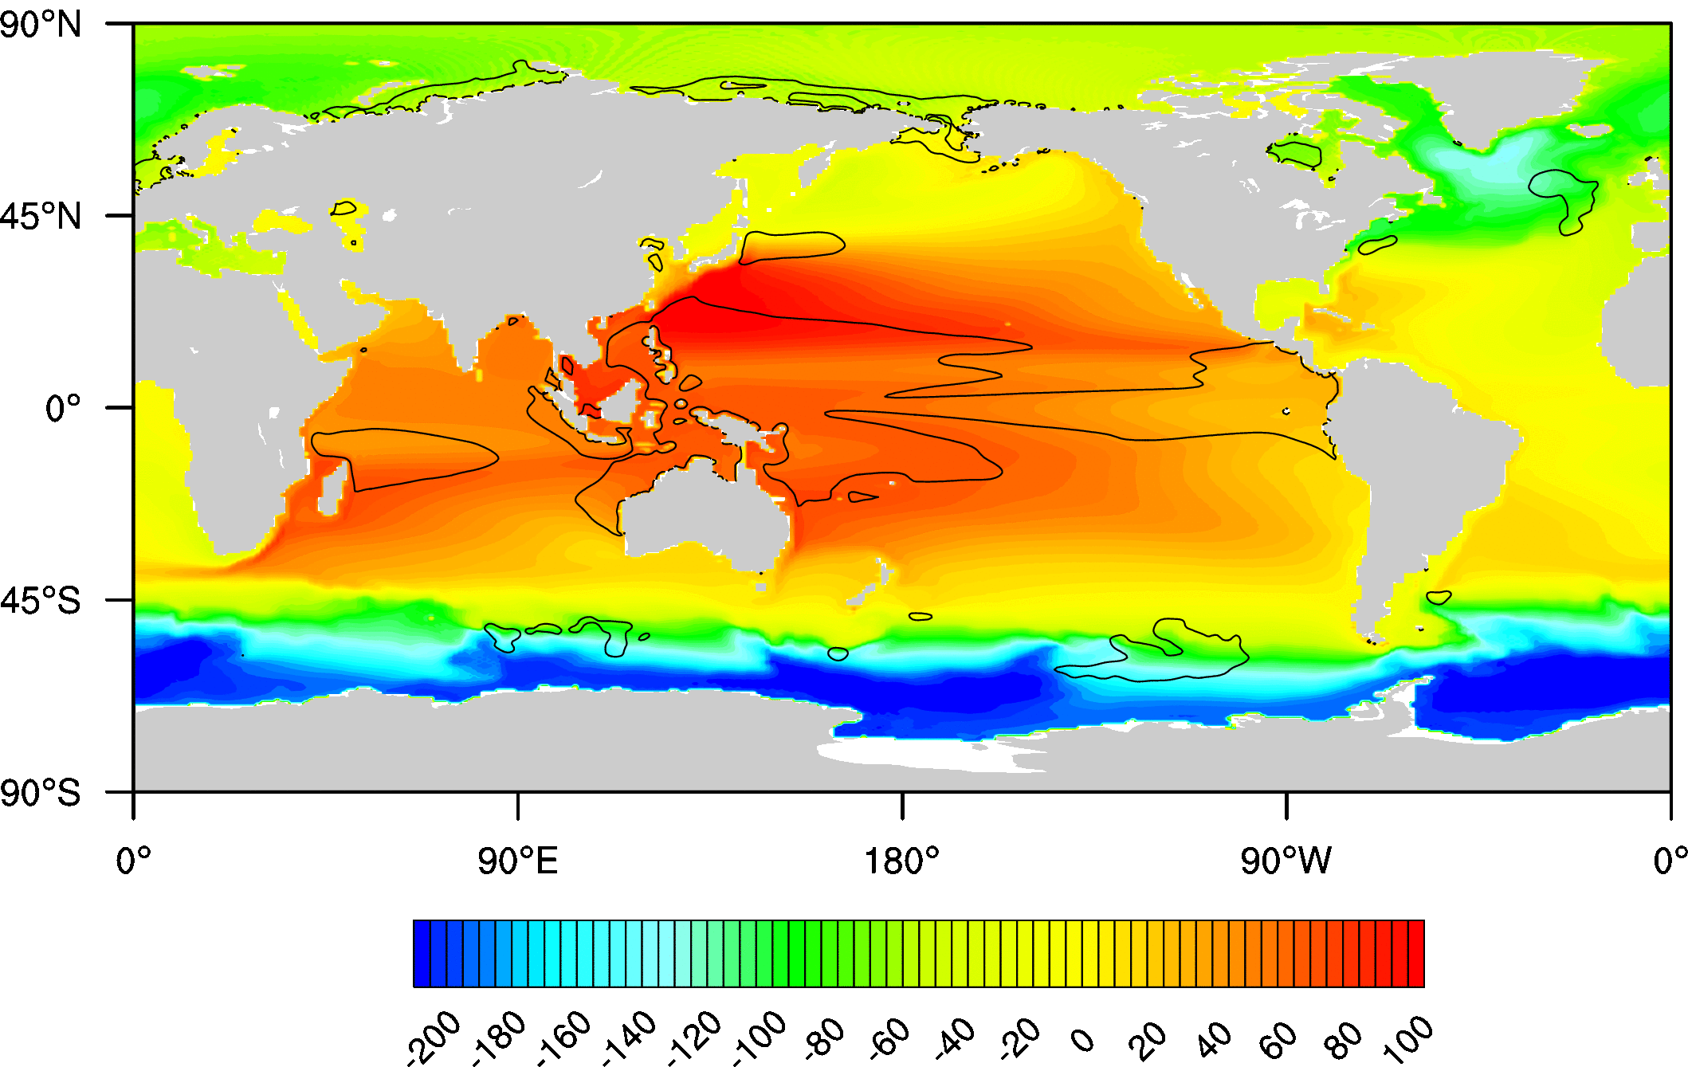
SSH Mean and Variability in Simulations and Observations
Altimeter Observations
HR
LR

Slide 6
Coupling of Low Level Winds and SST
Basin Scale
Frontal Scale
High Winds ➔
High latent and sensible heat flux, entrainment➔
Cool SST
High SST➔
High Winds
Mantua (1998)
Chelton and Xie (2010)

Slide 7
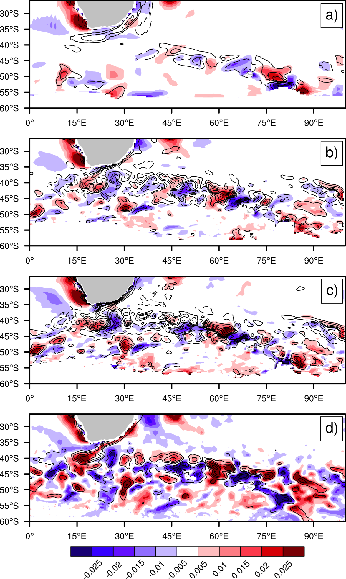
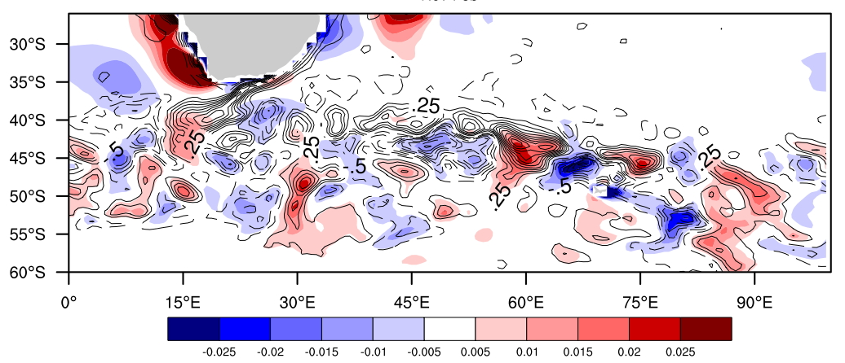
0.5atm/1.0ocn
Seasonal Mean
Wind Stress (color)
Vs.
High-Pass SST( contour)
10°x6°
0.5atm/0.1ocn
0.25atm/0.1ocn
0.5 CAM5
Observ

Slide 8
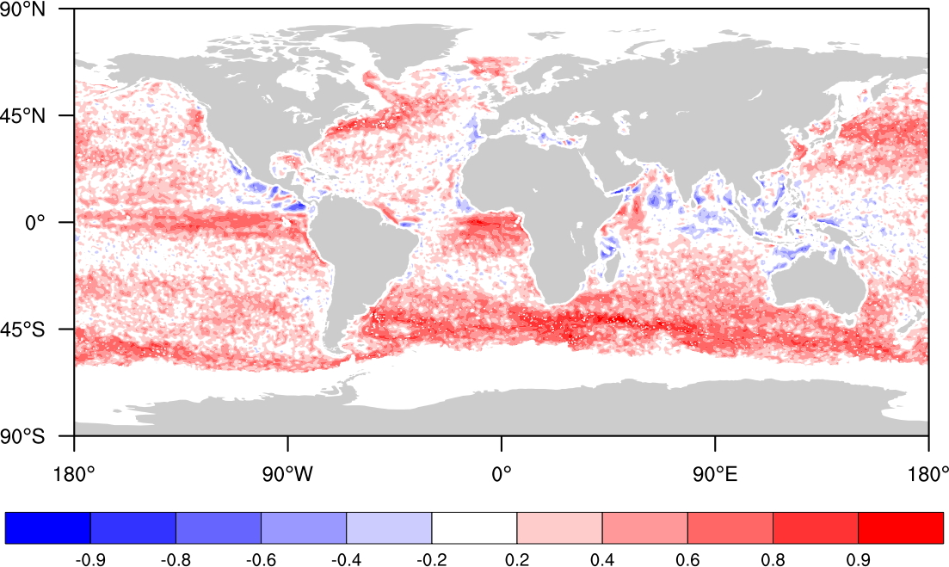
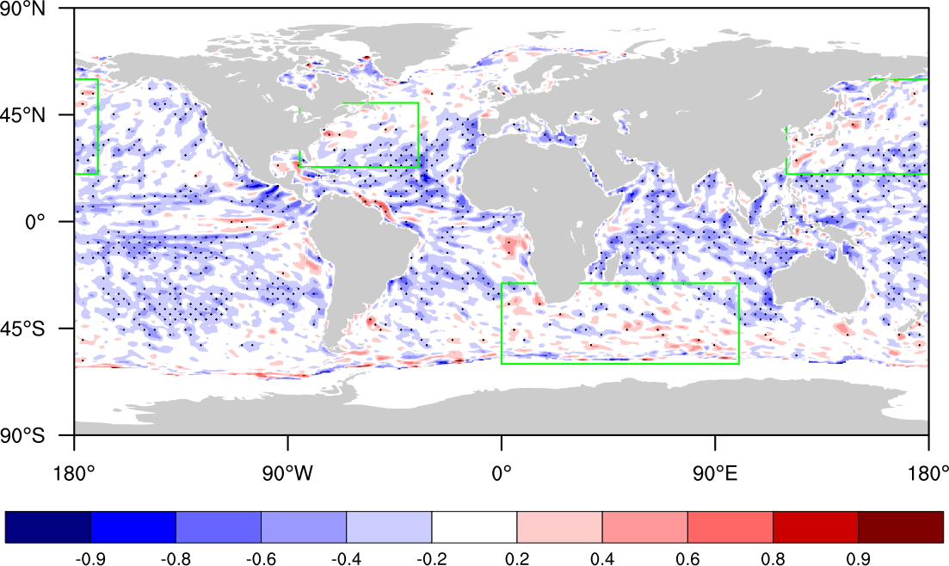
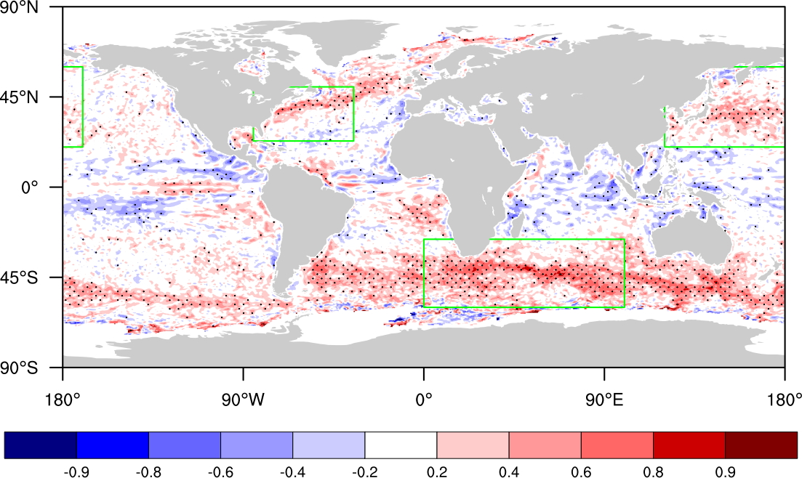
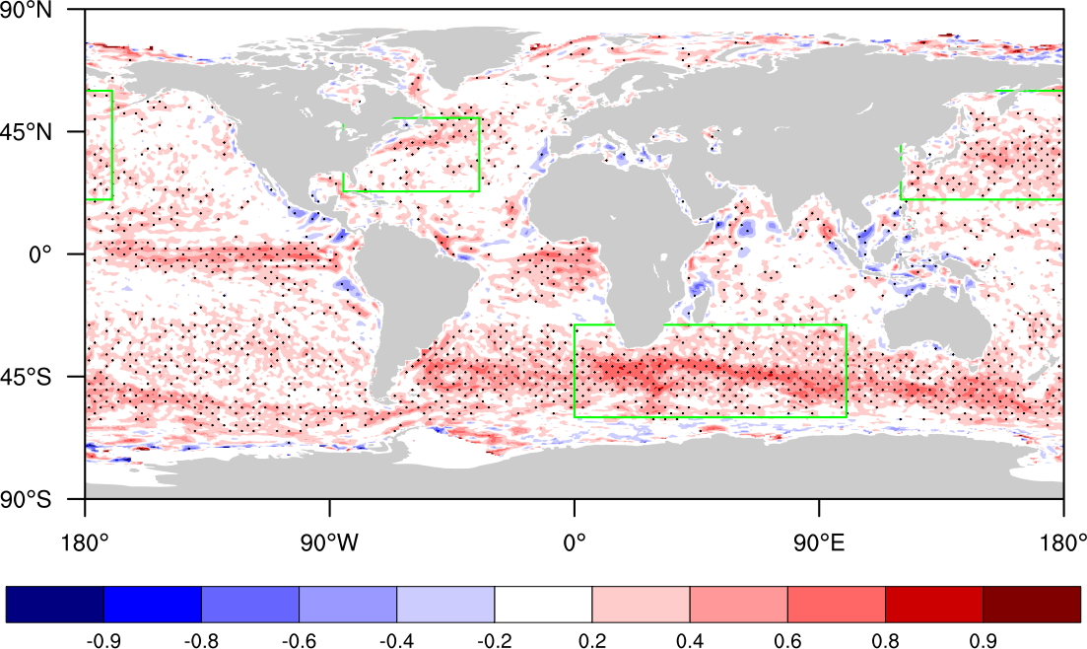
Correlation High-Pass SST w/ |U_{srf}|
QuickScat + AMSR
CCSM 0.5° atm / 1° ocn
CCSM 0.5° atm / 0.1° ocn
CAM5 0.5° w/ 0.25° Observ. SST

Slide 9
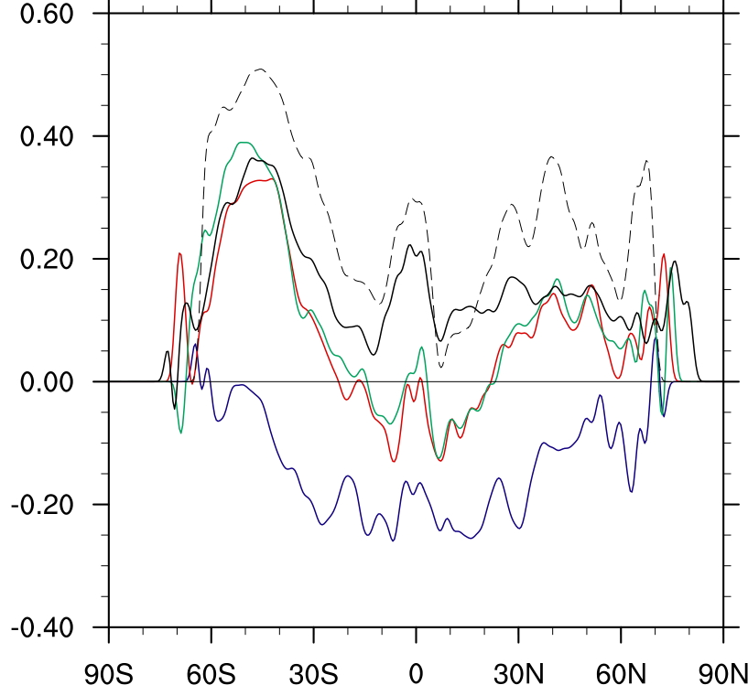
Zonal Avg. Correlation High-Pass SST w/ |U_{srf}|
Obs
0.5° CAM5
0.25° atm / 0.1° ocn
0.5° atm / 0.1° ocn
0.5° atm / 1° ocn

Slide 10
A Vertical Mixing Mechanism
Wallace et al (1989)
Warm SST➔
Destabilize PBL➔
Mix Momentum Down➔
Accelerate Surface Wind
Curl (τ) ~ crosswind grad(SST)
div (τ) ~ downwind grad(SST)
Chelton and Xie (2010)

Slide 11
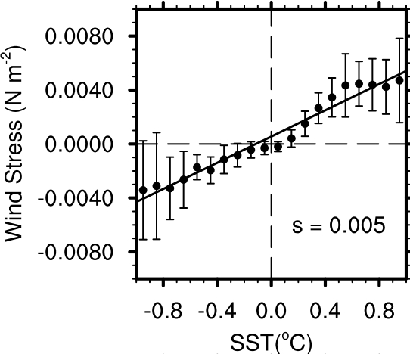
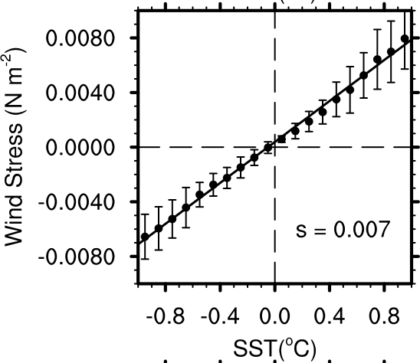
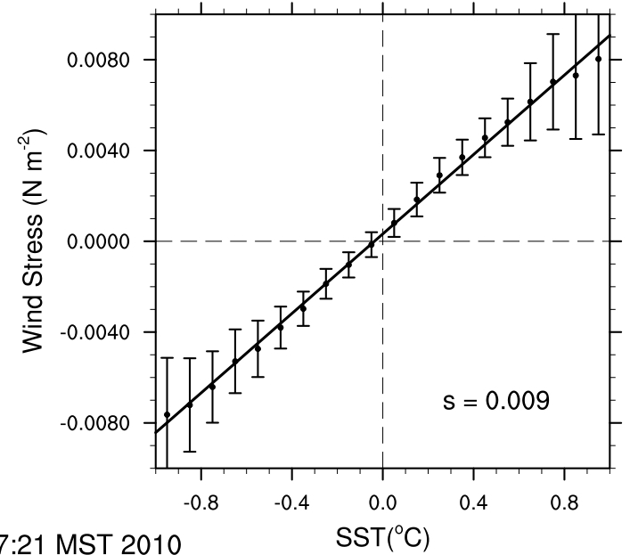
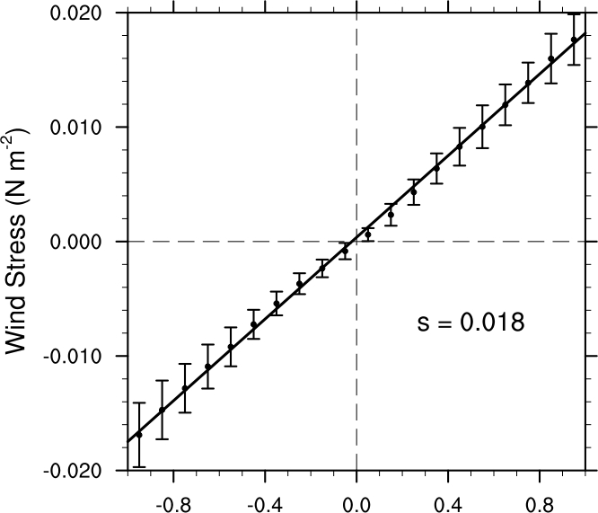
Regional SST vs Stress Regressions
0.5 atm/ 1.0 ocn
0.5 atm/ 0.1 ocn
0.5 CAM5
Observ
 | Region | 0.5A/1.0O | 0.5A/0.1O | 0.25A/1.0O | 0.5A CAM5 | QS/AMSR
|τ| vs. SST | KE | 0.007 | 0.008 | 0.006 | 0.007 | 0.010
 | ARC | 0.005 | 0.007 | 0.008 | 0.009 | 0.018
 | GS | 0.006 | 0.004 | 0.005 | 0.005 | 0.009
div(τ) vs Downwind grad(SST) | KE | -0.16 | 0.83 | 0.75 | 0.84 | 0.64
 | ARC | 1.02 | 1.03 | 0.99 | 1.08 | 1.62
 | GS | 0.39 | 0.60 | 0.50 | 0.61 | 0.62
curl(τ) vs Crosswind grad(SST) | KE | -0.51 | 0.50 | 0.53 | 0.64 | 0.42
 | ARC | 0.75 | 0.82 | 0.84 | 0.77 | 1.33
 | GS | -0.37 | 0.29 | 0.33 | 0.37 | 0.38

Slide 12
NDJF
MJJA
Tropospheric
Response along 40°S
Cld Frac
SST
SLP
H_{BL}

Slide 13
Pressure Adjustment Mechanism
Lindzen and Nigam (1987) Minobe, Takatama (2008,2010)
For linearized momentum balance in PBL:
Convergence ~ Laplacian pressure

Slide 14
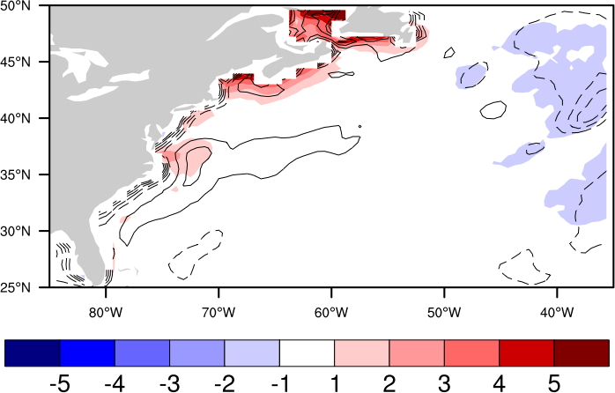
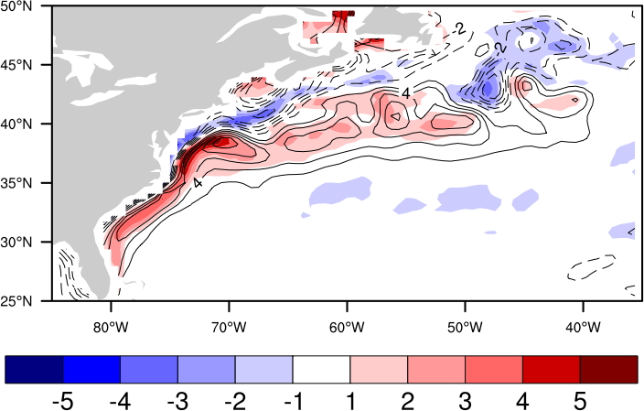
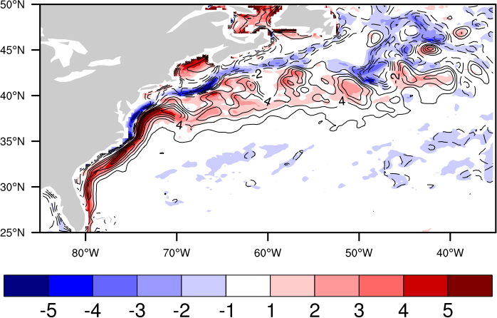
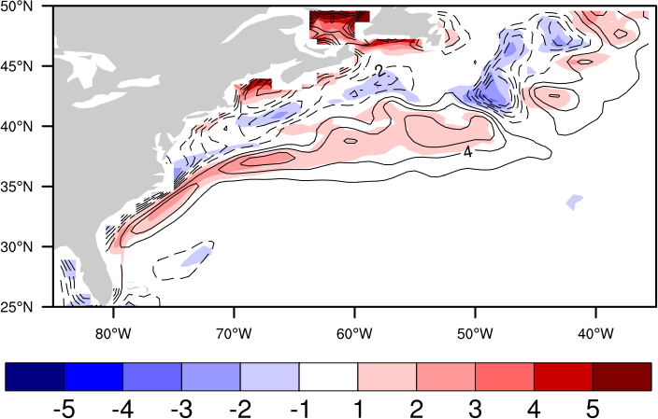
Winter Mean
Laplacian Pressure (color) vs. Convergence (contours)
0.5A/1.0O
0.5A/0.1O
0.25A/0.1O
0.5 CAM5

Slide 15
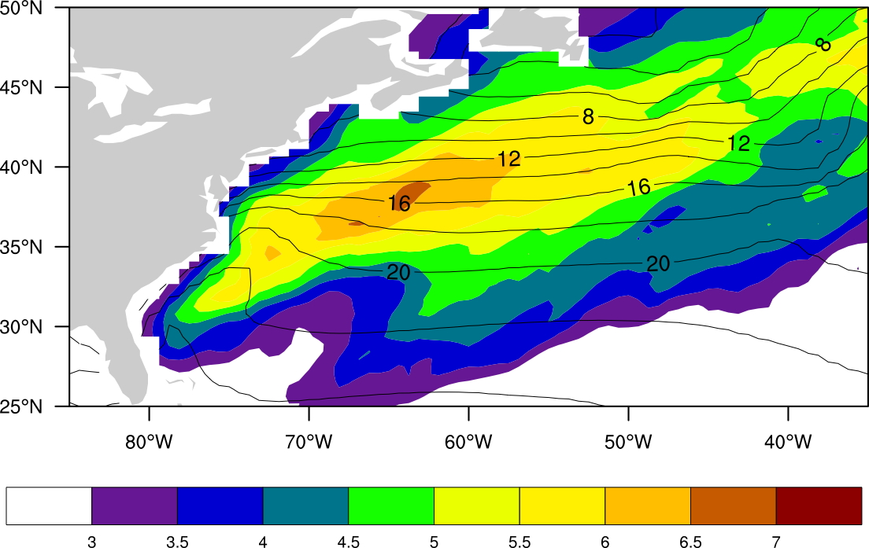
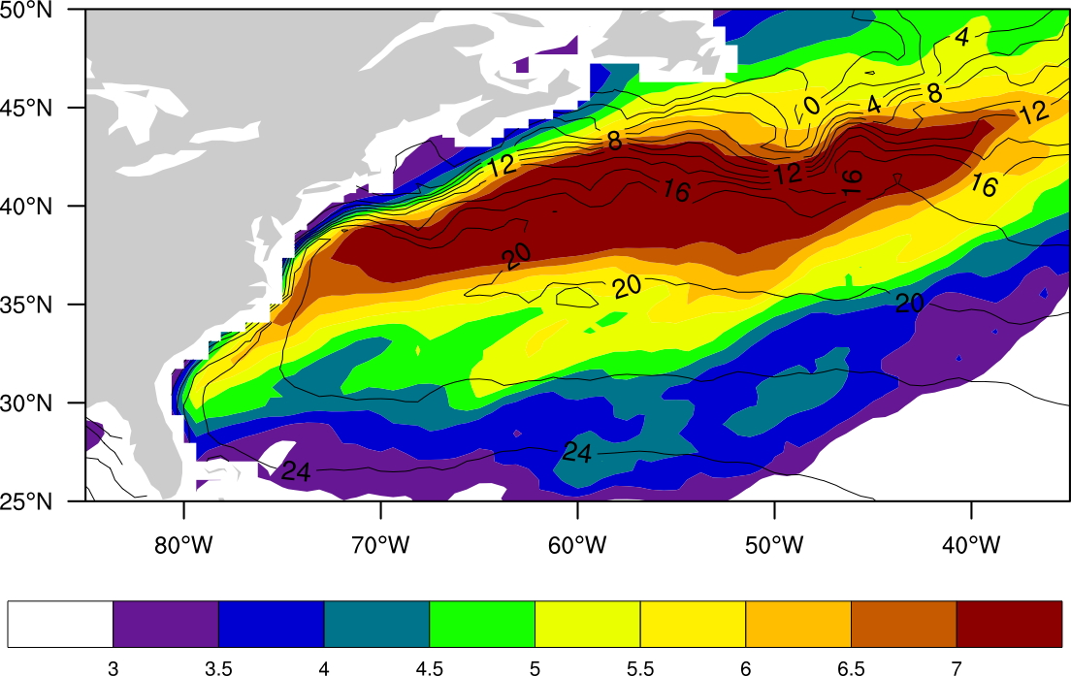
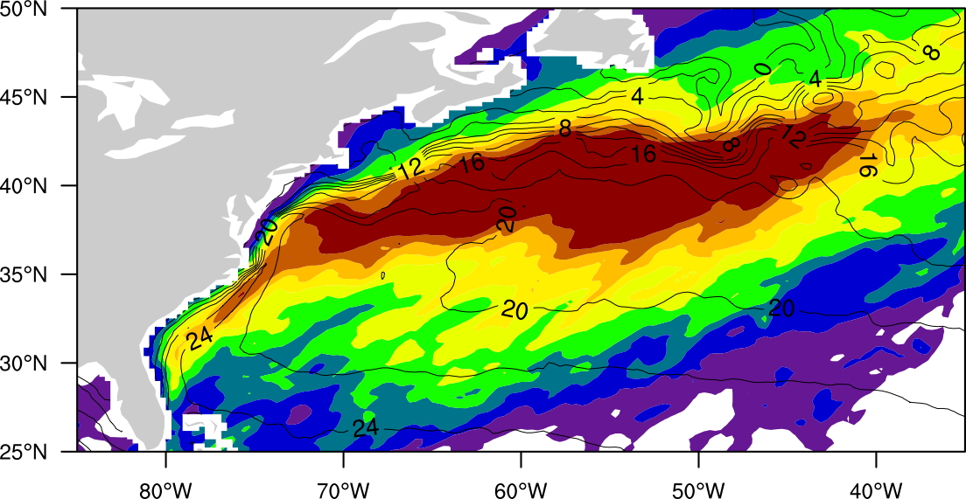
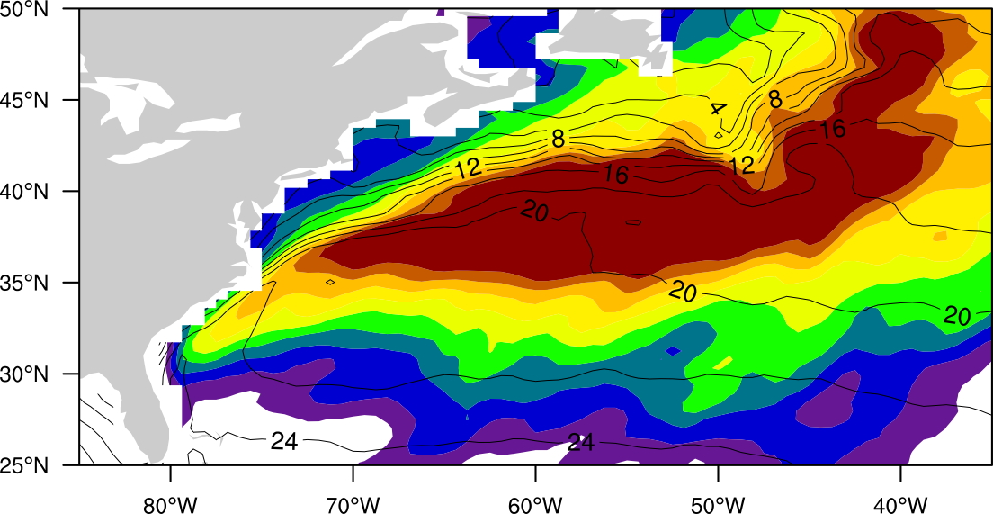
Winter Mean Precipitation
0.5A/1.0O
0.5A/0.1O
0.25A/0.1O
0.5 CAM5

Slide 16
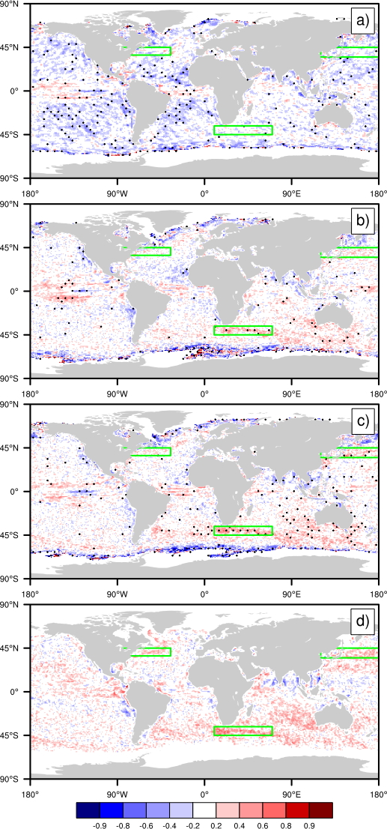
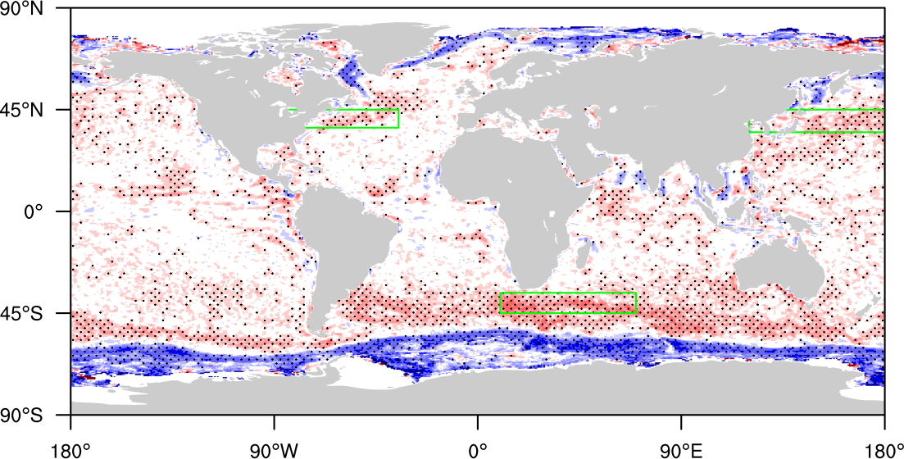
Planetary Scale Impact on Energy Balance:
Correlation High-Pass SST vs.
All Sky Albedo
0.5A/1.0O
0.5A/0.1O
0.25A/0.1O
0.5 CAM5
Observ

Slide 17
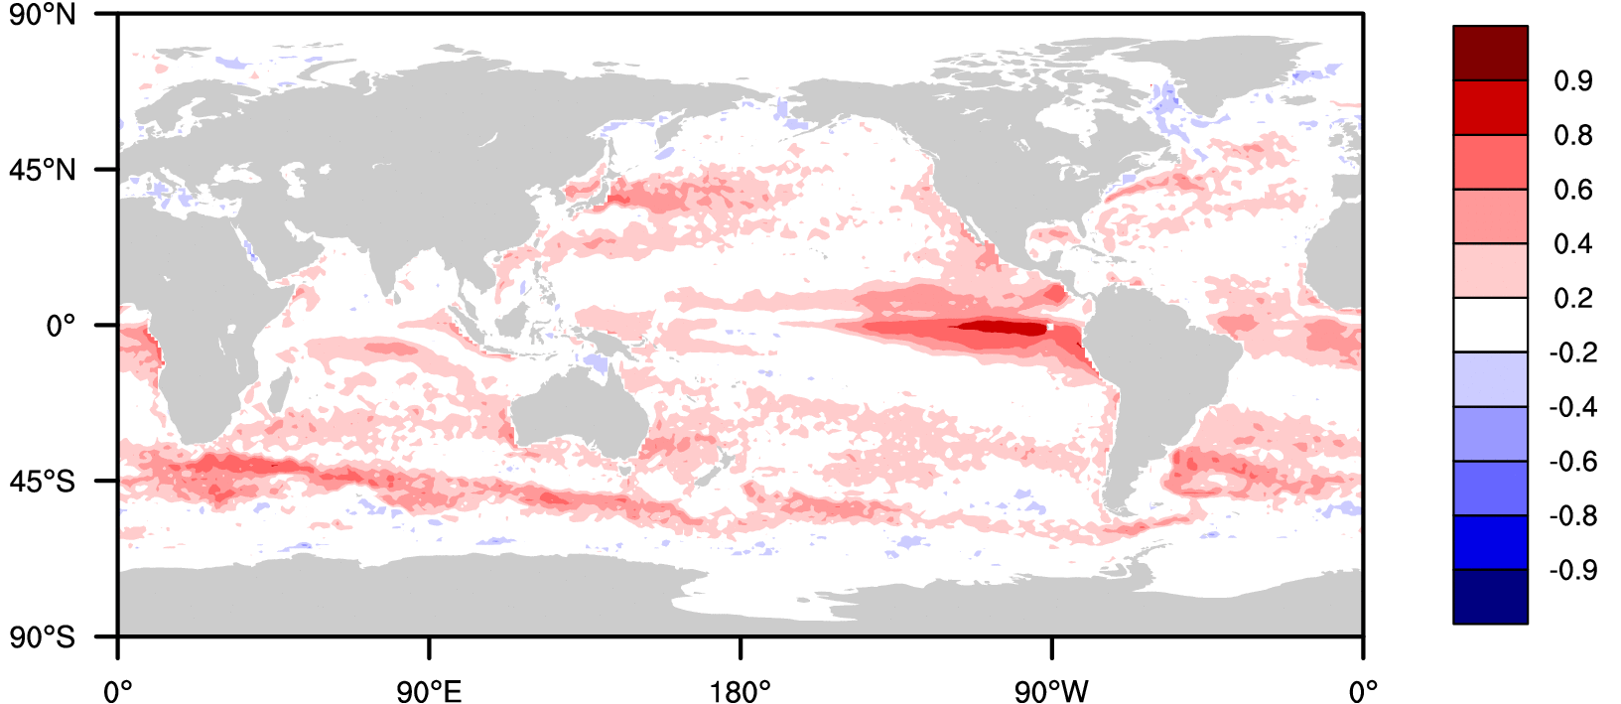
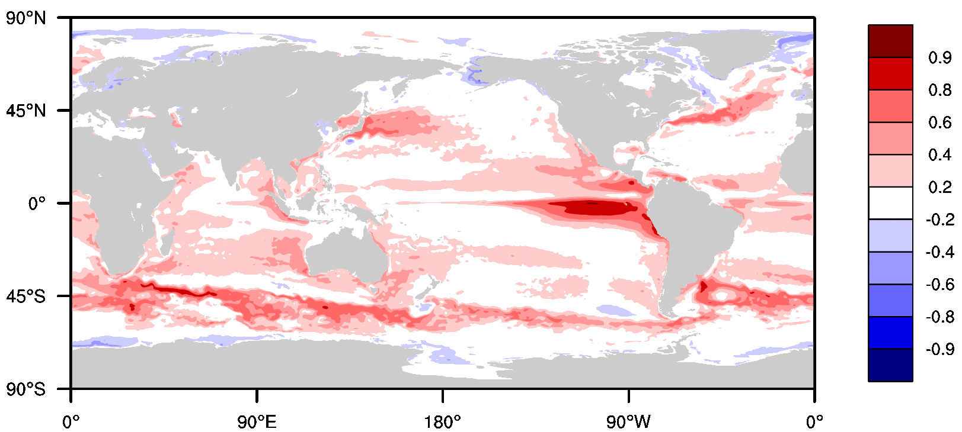
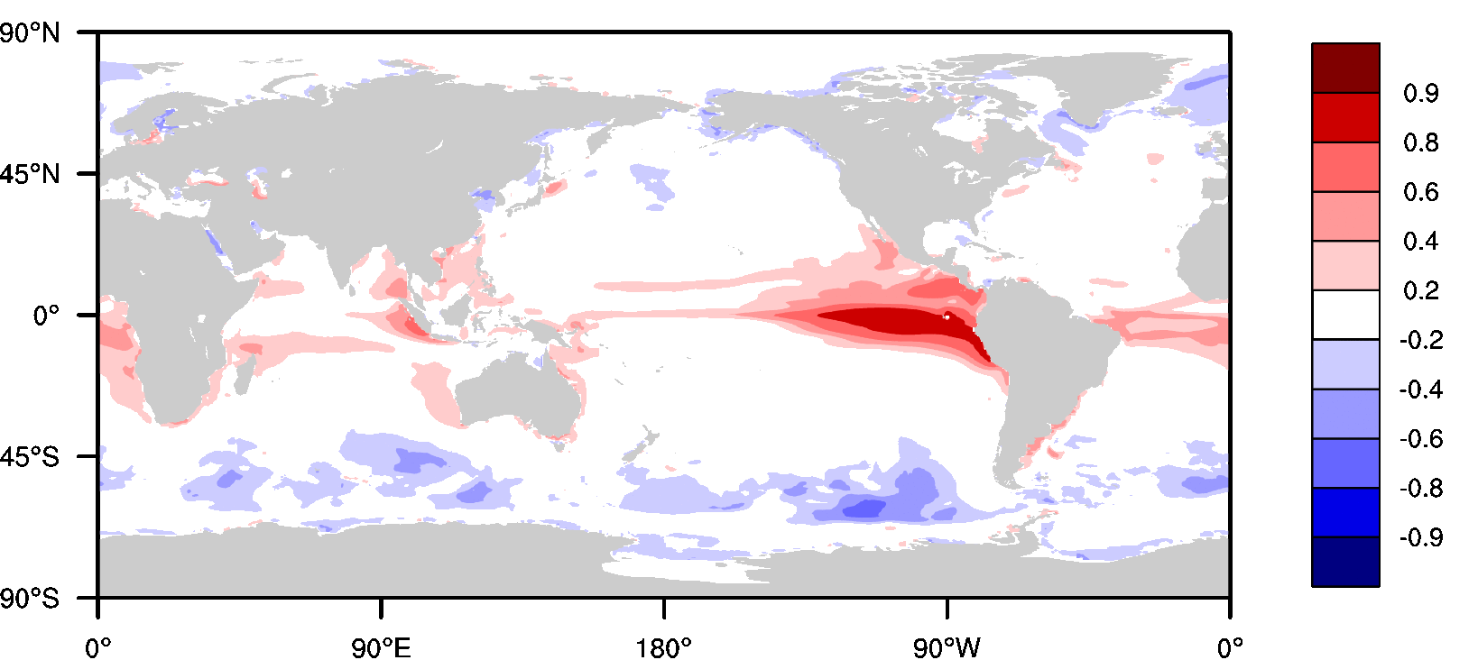
Correlation of Surface Turbulent Heat Flux and SSH
OBS
(JOFURO+AVISO)
HR
LR

Slide 18
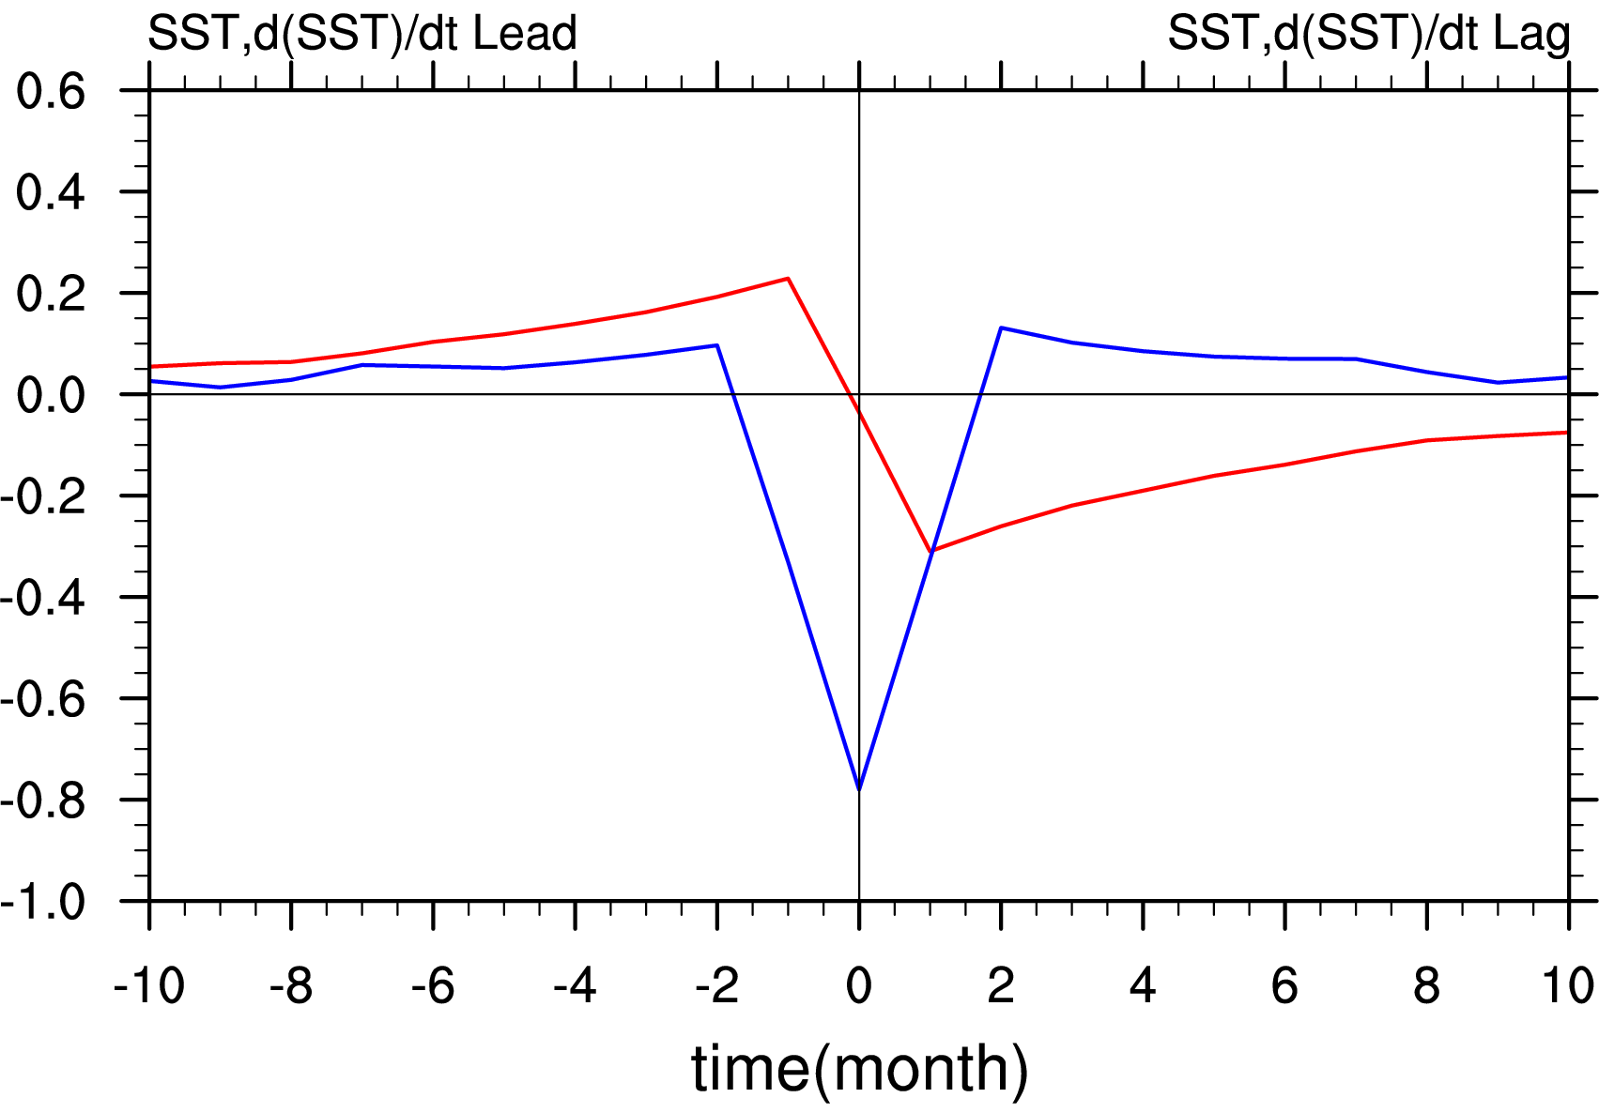
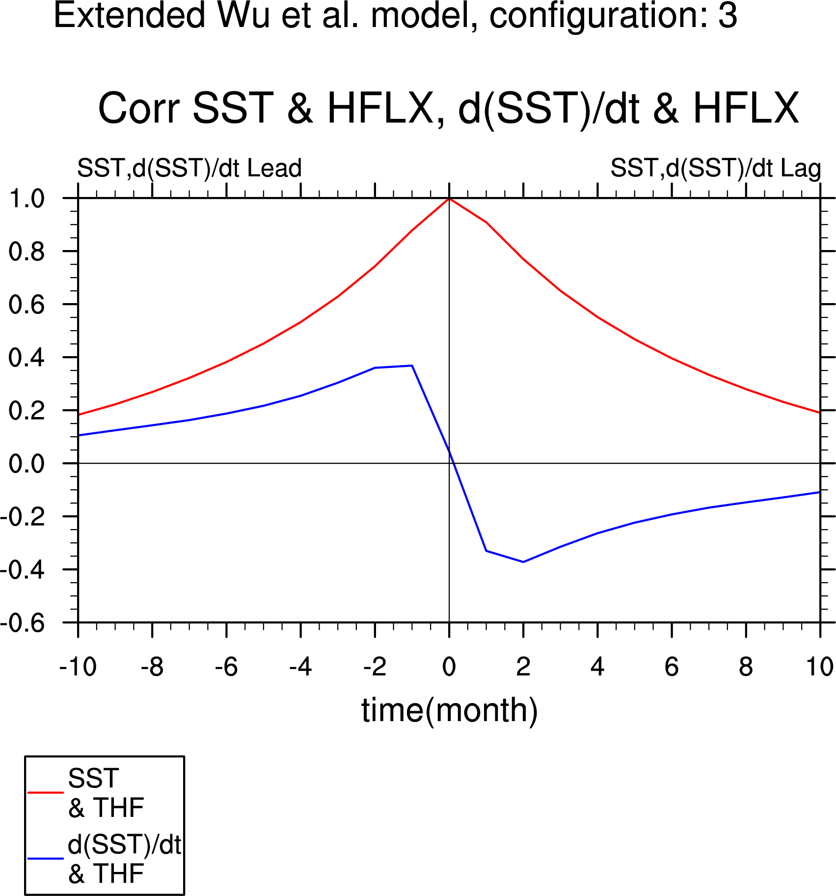
A Simple Stochastic EB Model for Mid-latitude SST Anomalies
Barsugli and Battisti (1998)
Atmospheric
Weather Noise
Lagged Correlation
d(SST)/dt w/ HF
SST w/ HF
β ~ α/20, ϒ_{a} ~ 6 day⁻¹, ϒ_{o} ~ 3 years⁻¹: Wu et al (2006)
Notes:
Correlation analysis to attribute sources of coupled atmosphere-ocean variability
Can use a simple stochastic model of the coupled ocean atmosphere system to determine the signatures of
Beta = alpha/20
Gamma_a ~ 1/6 day
Gamma_o ~ 1/3 years

Slide 19
An Alternative Model: Oceanic Driven Variability
Wu et al (2006)
Oceanic
Weather Noise
SST w/ HF
d(SST)/dt w/ HF
Notes:
Correlation analysis to attribute sources of coupled atmosphere-ocean variability
Can use a simple stochastic model of the coupled ocean atmosphere system to determine the signatures of
Beta = alpha/20
Gamma_a ~ 1/6 day
Gamma_o ~ 1/3 years

Slide 20
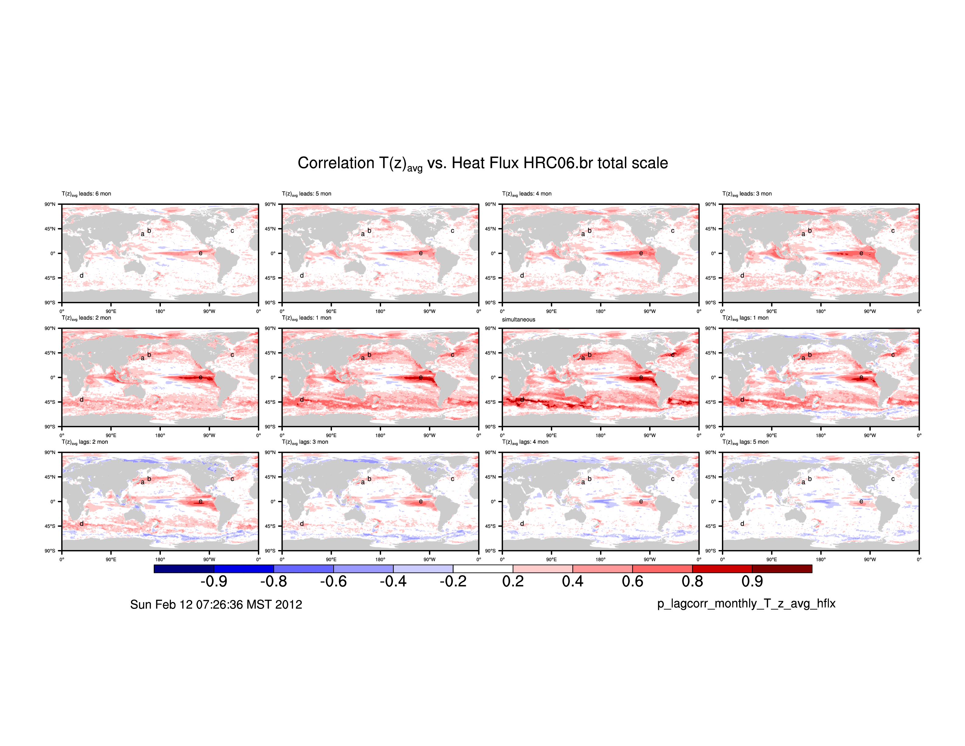
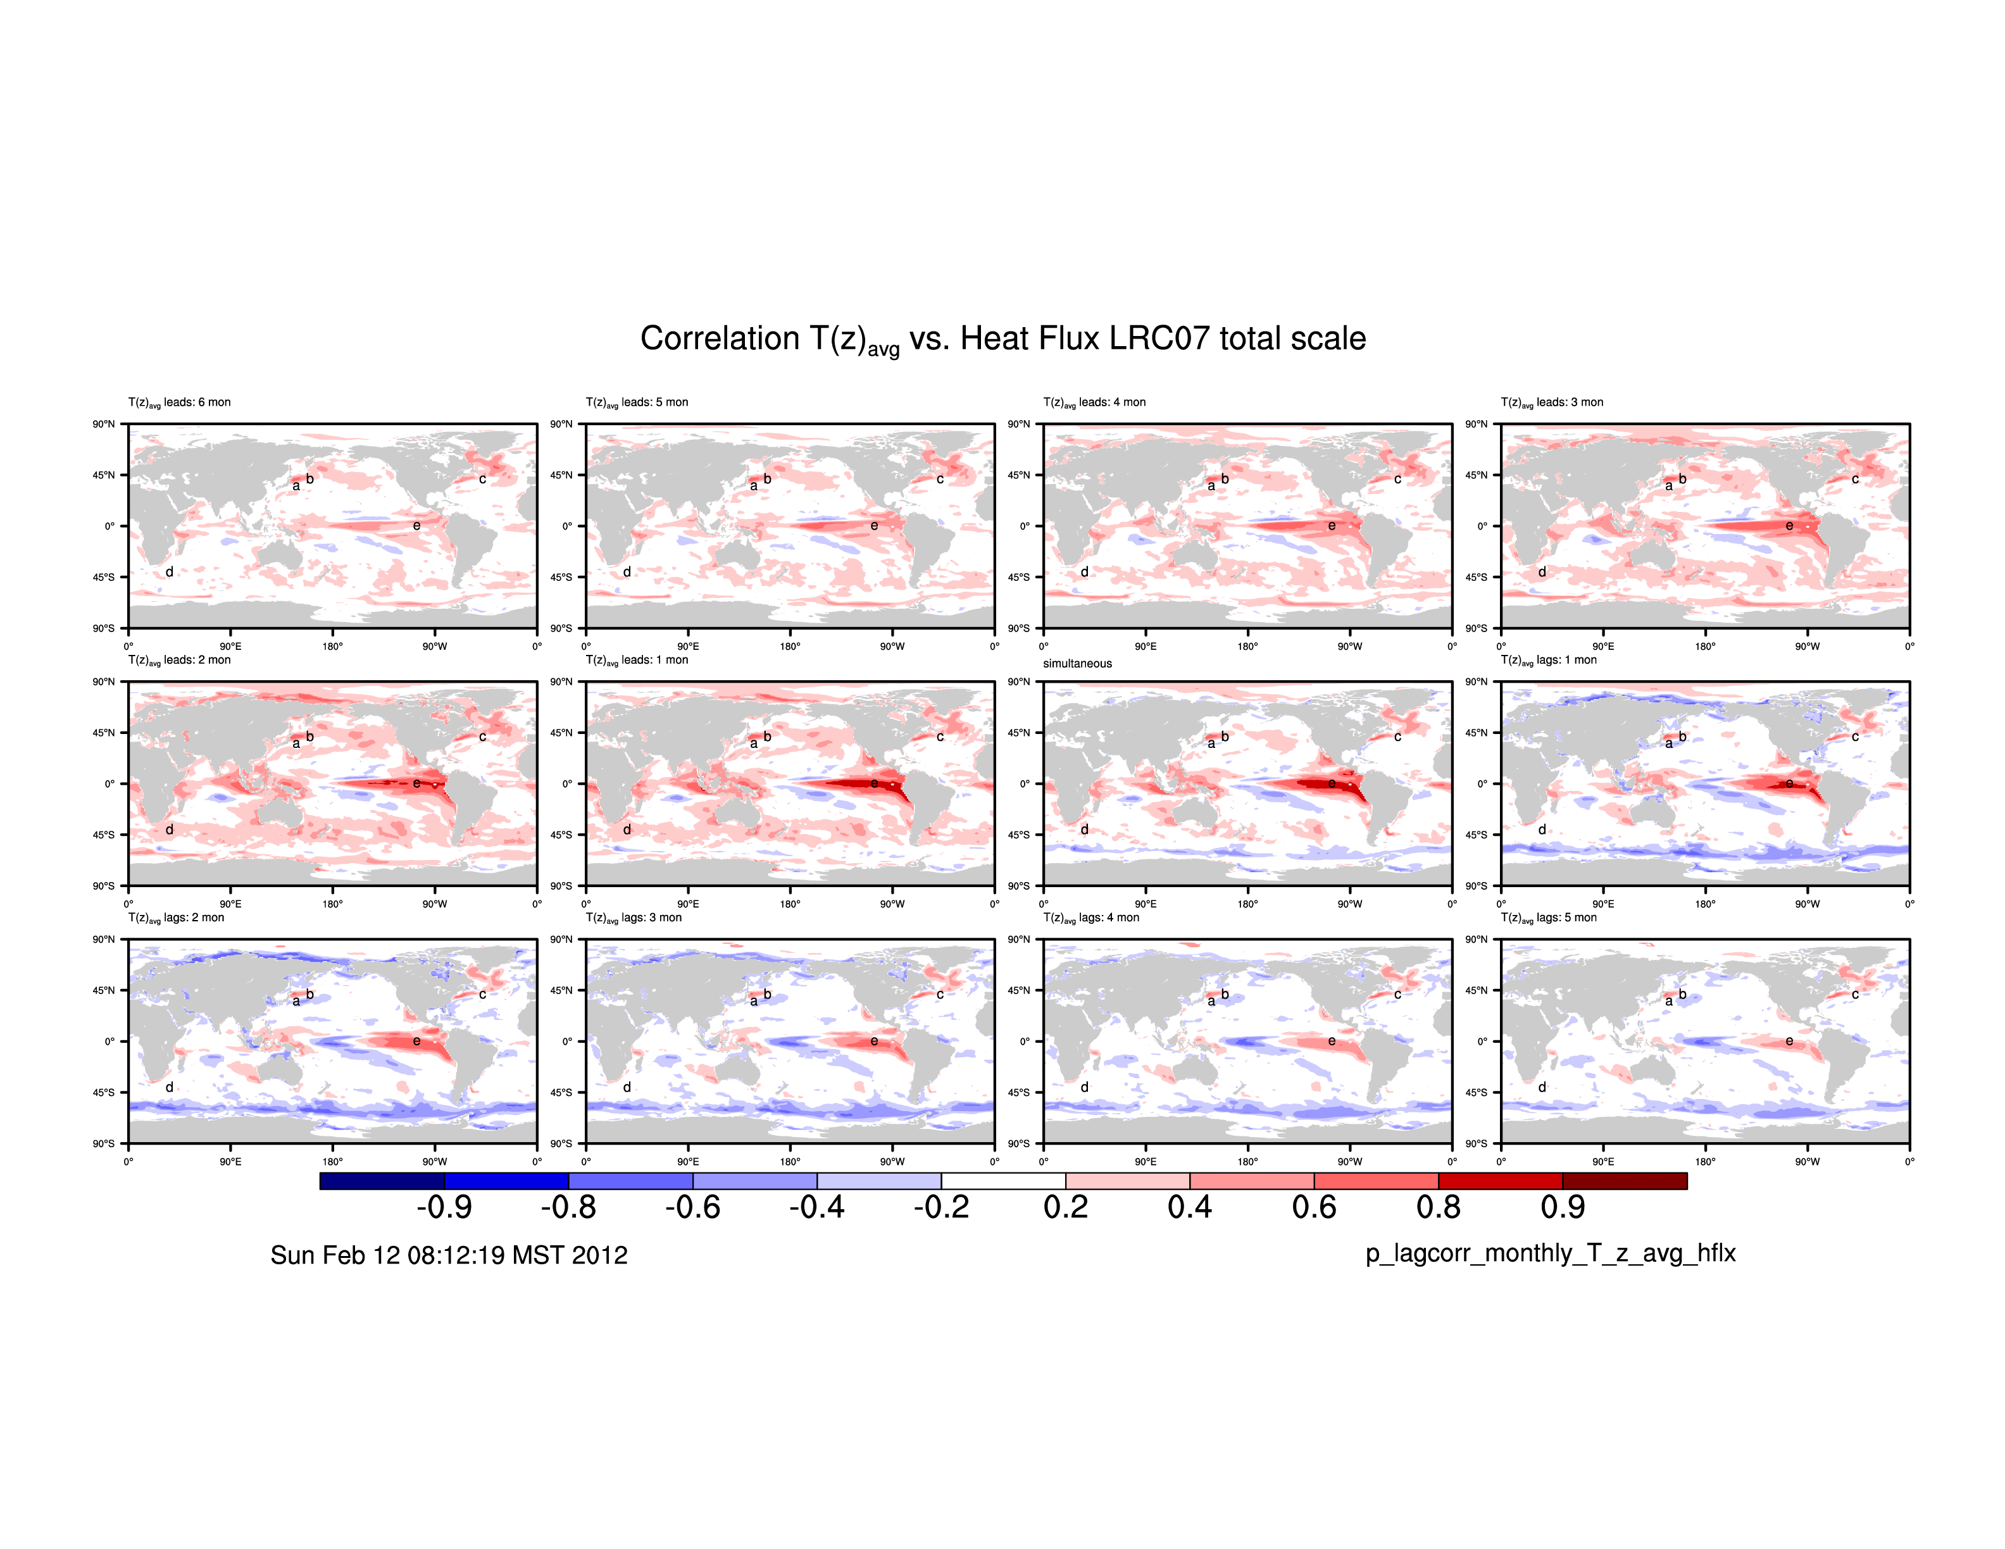
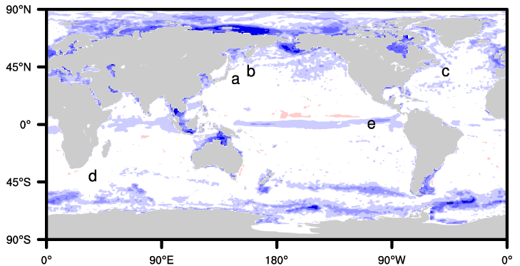
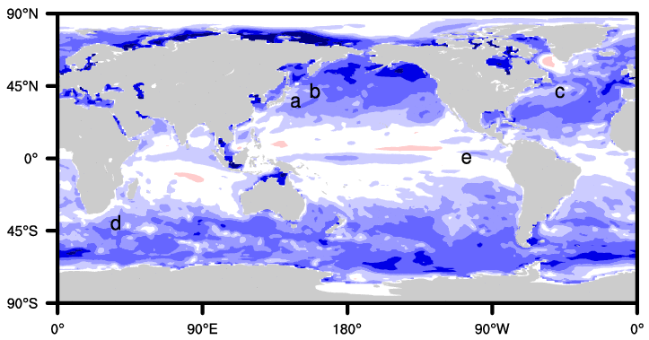
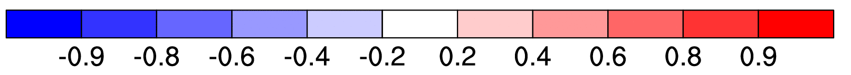
Correlations between HC & THF, d(HC)/dt & THF in Coupled Simulations
HR
LR
HC & HF
d(HC)/dt &
HF
Ocean Weather
Atmosphere Weather
Notes:
In mid-latitude, corr. between HC and HF are + and extensive in the HR
Highest correlations are found in the vicinity of WBC’s and frontal zones.
In same regions in LR simulation, there are + correlations but they are less extensive and weaker.
In mid-latitudes, the correlations between d(HC)/dt and HF are negative and extensive in the LR simulation.
Highest correlations are away from the vicinity of WBC’s and frontal zones.
In same regions in HR simulation, correlations are neutral or weakly negative and far less extensive.
+ HC,HF corr. In HR imply ocean forcing atmosphere through air-sea DT
- dHC/dt corr. In LR imply atmosphere forcing ocean through ocean heat balance
HF & HC repeated HR has +correlations in mid-latitudes, absent or muted in LR
HF & dHC/dt LR has –correlations in mid-latitudes, absent or muted in HR

Slide 21
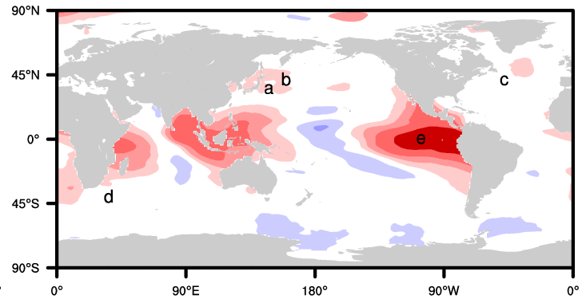
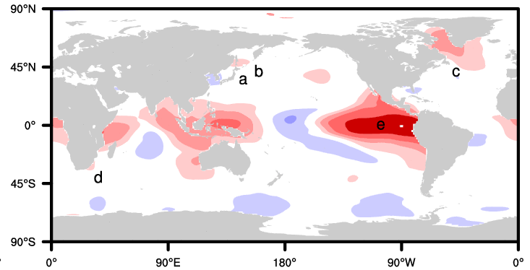
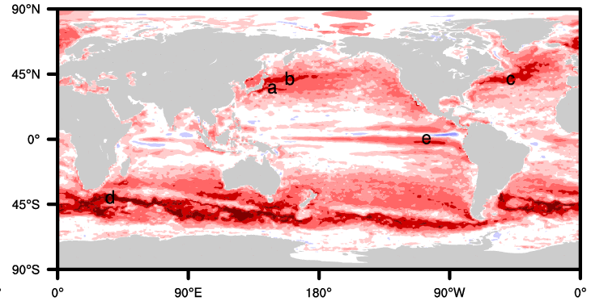
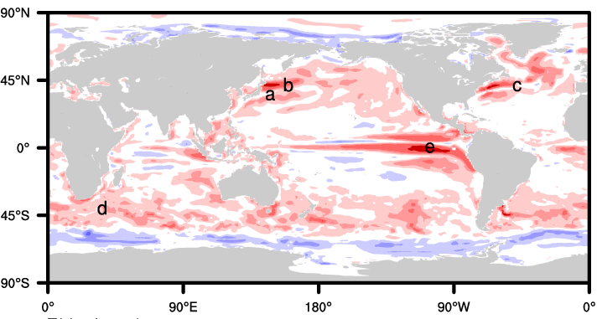
Scale Dependence of HC & HF Correlations
HR
LR
Total
Large > 10º
Small < 10º
Notes:
Now looking in processes in HR and LR simulations and HR and LR results will be presented in columns
Examine the scale dependence of the simultaneous correlation between heat content and total heat flux in the simulations
The large scale correlation maps are very similar across ocean model resolutions and larger values are mostly confined to the topics.
The small scale correlations are mostly positive in mid-latitudes in both simulations, but are more extensive and stronger in the simulation done using the HR ocean component
When all scales are used to calculate the correlation, the influence of the small scales is still clear.
Patterns and magnitude of correlations in larger scales very similar across ocean model res. and dominated by tropical features
HR and LR corr. in smaller scales both + in mid-latitudes, but much stronger in HR
Much more HC and HF variance in HR compared to LR; Covariance (not shown) HR >> LR
Small scales behind correlations in mid-latitudes, all scales

Slide 22
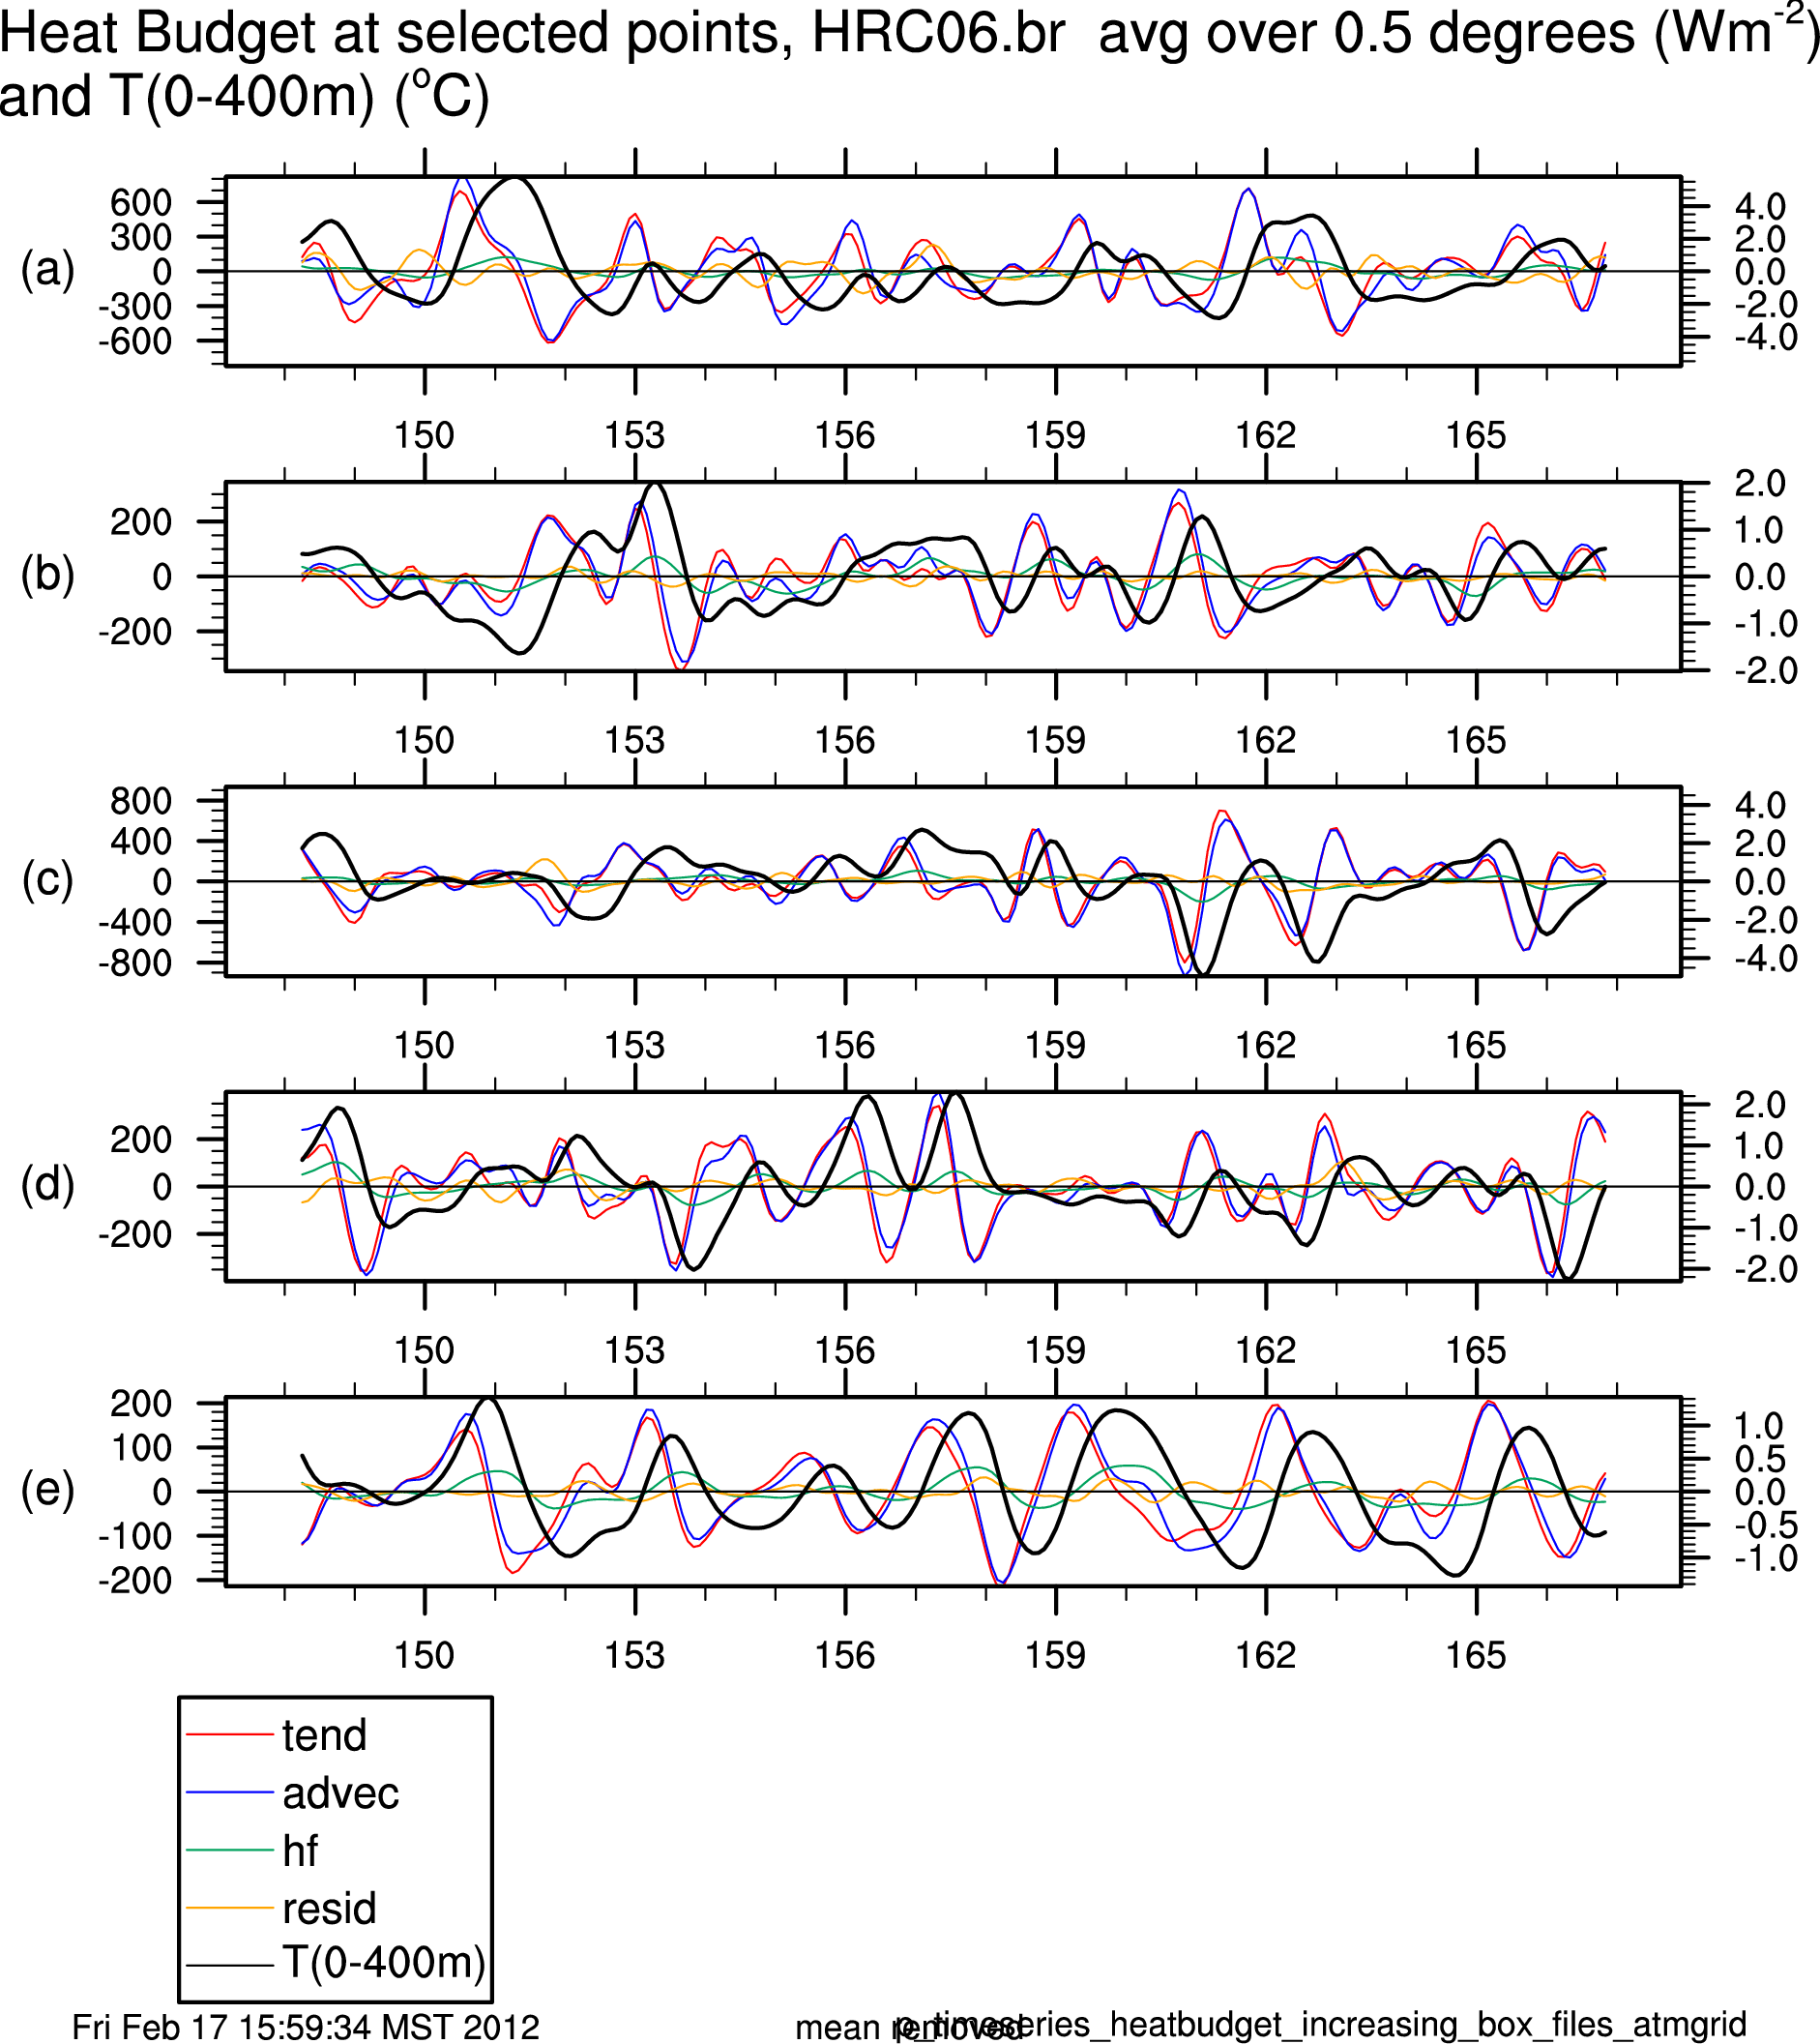
Point-wise HR Heat Budget
(Anomalies wrt Mean Seasonal Cycle)
∂HC ⁄∂t = -C_{p}ρ_{o 400m}∫⁰ ∇⋅uTdz - HF + R
Wm⁻²
ºC
T_{0-400m} - temp
(a) Kuroshio
tend ~ advec; both >> HF
HF and T anomalies are in phase
(d) Agulhas
(e) Equatorial East Pacific
Notes:
At all locations, tend ~ adv; both >> hf
Ocean dynamics (advection) creates a tend, produces temp anomalies that are in phase with hf
Familiar relationships in E. Eq. Pac. but at small scales and with HR ocean, similar relationships seen in mid-latitude WBC and other frontal regions

Slide 23
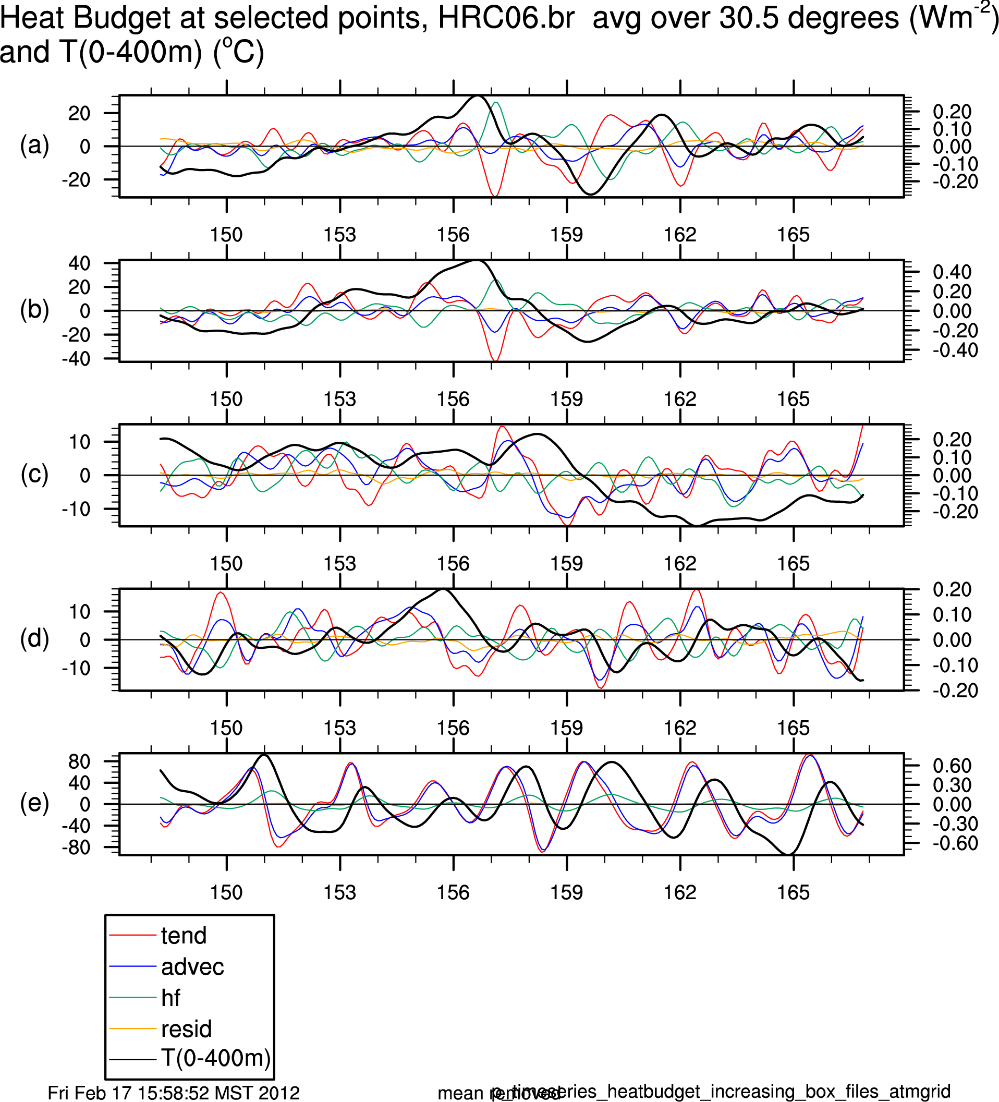
HR Heat Budget ~ 30º x 30° Boxes
∂HC ⁄∂t = -C_{p}ρ_{o 400m}∫⁰ ∇⋅uTdz - HF + R
Y-scales ~ factor 20 (2) less in mid-latitudes (tropics) compared to small scales
Wm⁻²
ºC
(a) Kuroshio
T_{0-400m} - temp
(d) Agulhas
Mid-latitudes HF plays greater role in balance but advec still leading term
(e) Equatorial East Pacific
Notes:
At larger scales, picture in E Eq Pacific does not change much
In mid-latitudes: tend and adv do not balance as well as at smaller scales
HF plays more important role with regional diffs; as scale -> global, adv -> 0 and HF ~ tend
HF not in phase with temp
HF often 180º out phase with tend: atmos driven fluxes forcing ocean temp response and/or atmosphere damping ocean temp anomalies

Slide 24
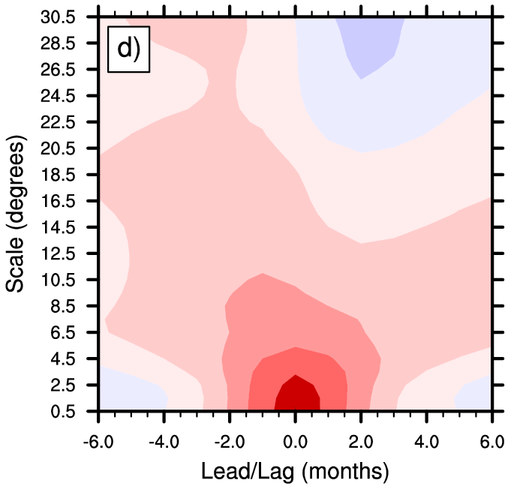
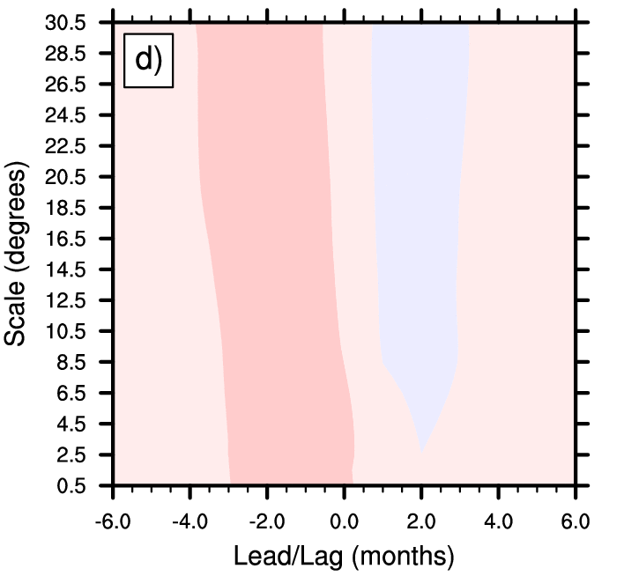
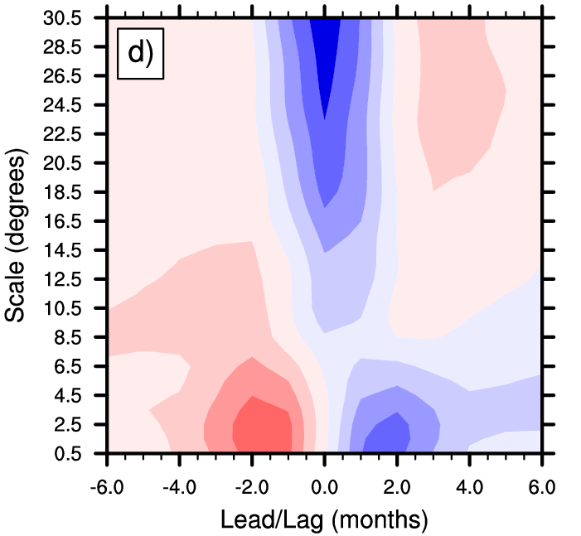
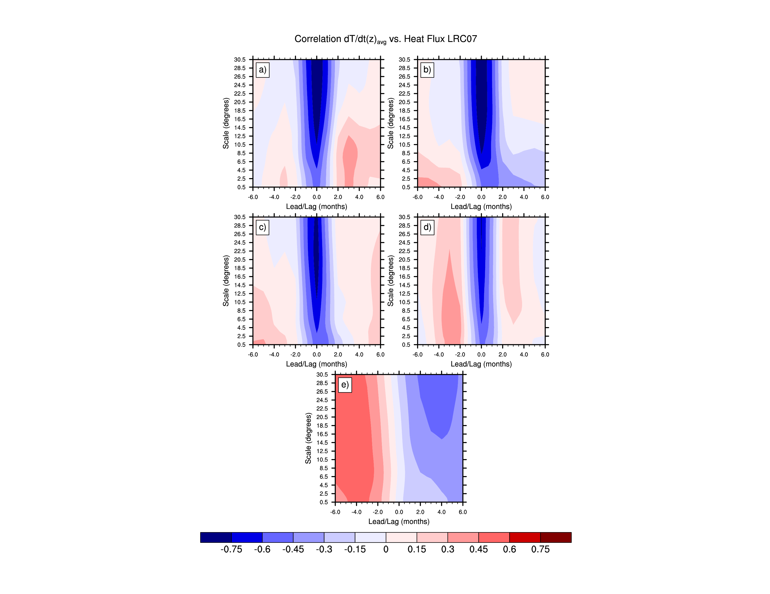
Scale Dependence of Lagged Correlation
HR
LR
(Agulhas Region)
HC and HF
HC leads
HC lags
d(HC)/dt & HF
Ocean Weather
Atmosphere Weather
Notes:
Explain the plot
In E. Eq. Pac., the HC and HF corr. very similar across ocean component resolution. It is max. at 0 lag or when HC leads by ~1 mon. and time scale > 1 year
In the HR simulation in the mid-latitudes, at small scales, the HC and HF corr. is also max at 0 lag. Time scale depends on region
In the HR and LR simulations in mid-latitudes at larger scales, corr. > 0 when HC leads, corr. < 0 when HF leads and ~0 at 0 lag. Consistent with HC anomies being created and/or damped by fluxes. Time scale depends on region. Transition between small and large ~5º in Kuroshio, little larger in Agulhas
In LR simulation, Kuroshio region at scales <15º negative corr., max at ~2mon. HF lead, consistent with atmos. driving HC anomaly and/or HC lag, consistent with atmos. damping HC anomaly

Slide 25
Transition Scale:
Ocean Dominance to Atmosphere Dominance
HC vs. HFLX
|d(HC)/dt| vs. HFLX

Slide 26
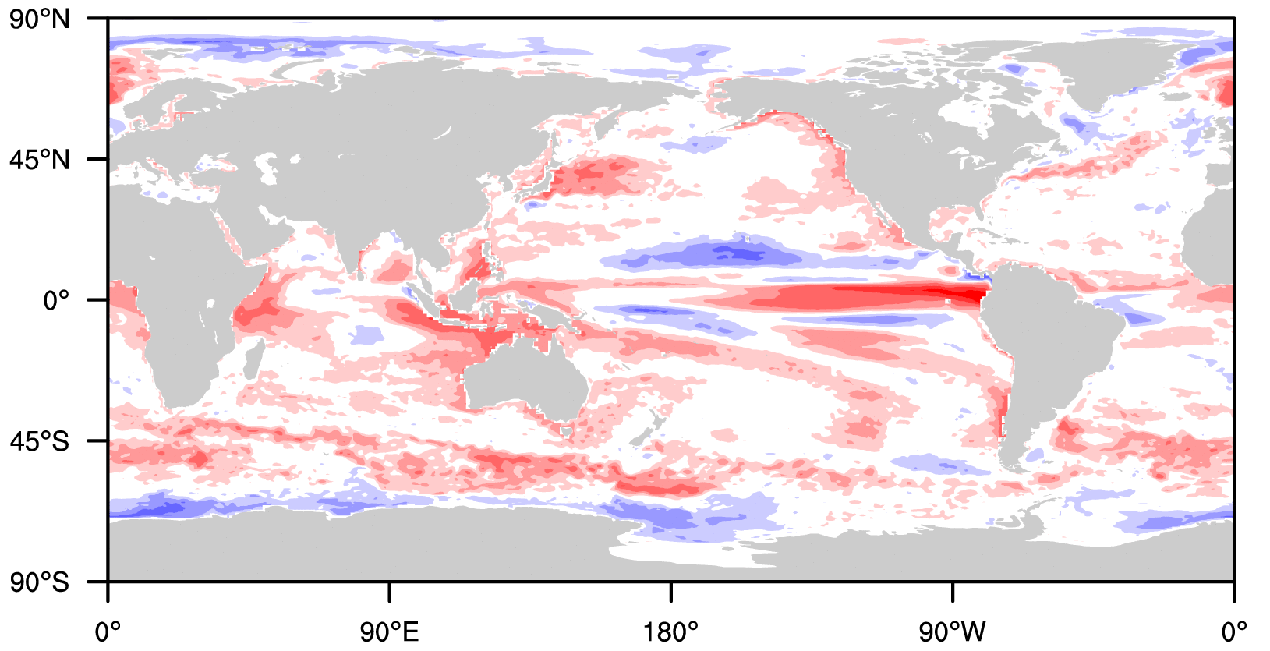
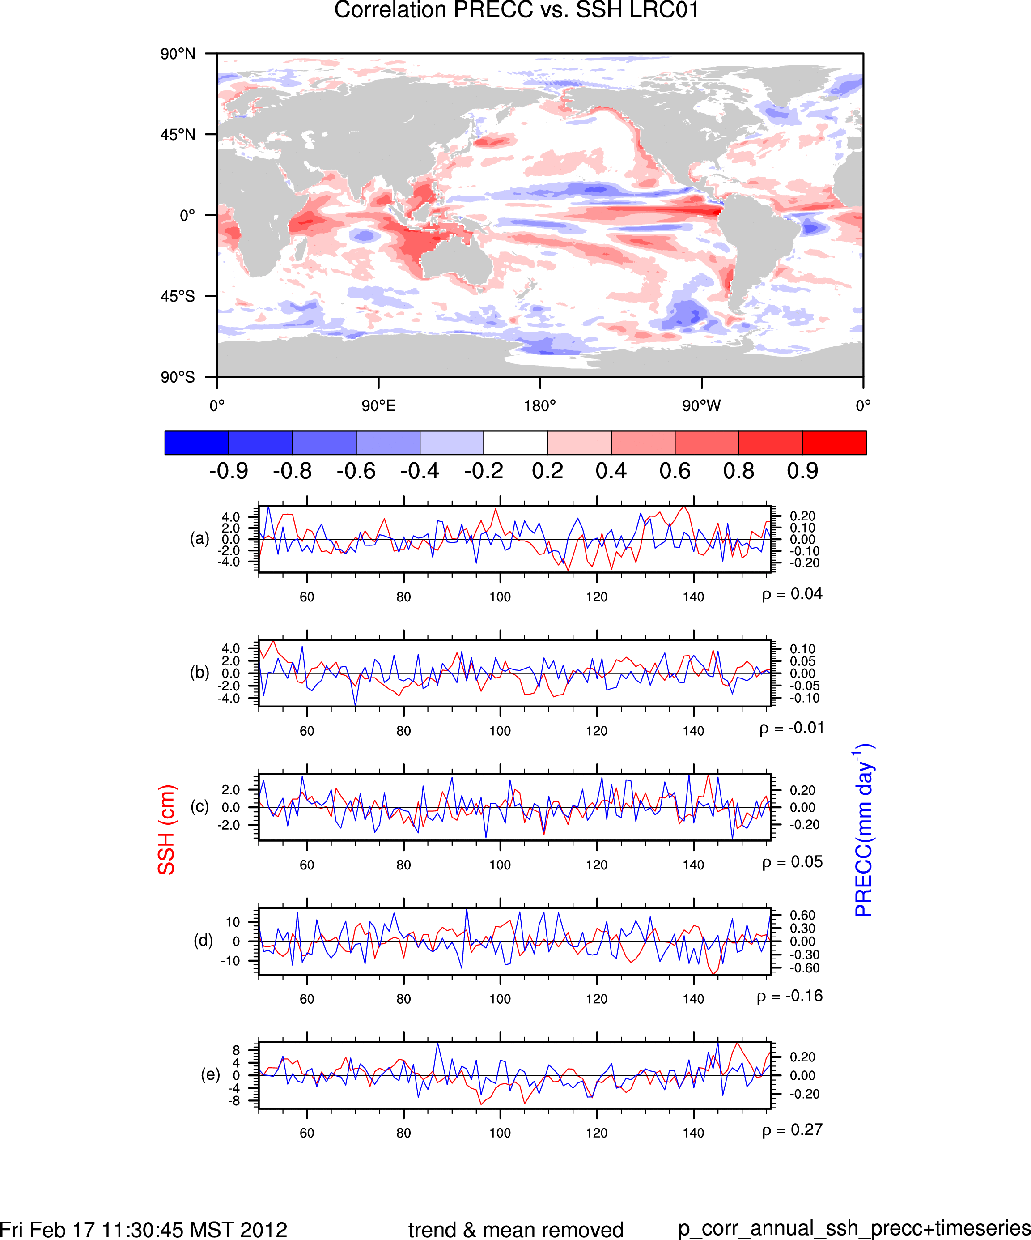
Does Intrinsic Ocean Variability Influence the Free Troposphere?
Correlation Annual SSH and Convective Precipitation
HR
LR
Notes:
There are positive corr. between SSH and convective precip. in vicintiy of WBC’s, ACC and mid-latitude ocean fronts
This connection may allow ocean variability to impact not just the lower atmosphere in vicinity of ocean/atmosphere interface, but throughout the troposphere.
Changes in convective heating have potential to alter atmospheric circulation patterns

Slide 27
Conclusions
Lower atmosphere significantly modified by the SST expression of ocean fronts and eddies
Resulting low-level convergence/divergence can force motions in the free troposphere and have a signature in clouds and precipitation
Advective generation of mid-latitude heat content anomalies on scales below ~1000km results in a much stronger simultaneous correlation between upper ocean heat content and surface heat fluxes emerges in the HR model
While anomalies of this scale could be resolved by the LR model grid, the model lacks the dynamics to generate them.
The traditional view of seasonal to interannual SST variability being driven by atmospheric weather remains valid for larger scales in the HR model.

Slide 28
Future Directions and Questions
Does the enhanced variability in surface heat fluxes at regional scales arising from ocean dynamics impact the free troposphere and larger scale / low-frequency climate? By what mechanisms?
How do mesoscale eddies impact the persistence of upper ocean heat content anomalies? What does this imply for seasonal, interannual, or decadal prediction?
Do new modes of climate variability emerge when both the atmospheric and ocean are chaotic?
Stability of the AMOC – what role do eddies play in the response of the AMOC to external forcing?

