Slide 1
Characterizing Turbulence at a Prospective Tidal Energy Site: Observational Data Analysis
Katherine McCaffrey
PhD Candidate, Fox-Kemper Research Group
Department of Atmospheric and Oceanic Sciences
Cooperative Institute for Research in Environmental Sciences
Thank you to my advisor and collaborators:
Baylor Fox-Kemper, Dept. of Geological Sciences, Brown University, CIRES
Peter Hamlington, Dept. of Mechanical Engineering, CU Boulder
Jim Thomson, Applied Physical Laboratory, Univ. of Washington

Slide 2
Outline
Introduction to Tidal Energy
Introduction to the Problem
Anisotropy, Coherence, and Intermittency
Observations and Metrics
Parameterization Results
Preliminary Statistical Model Results
Notes:
Model results if there’s time

Slide 3
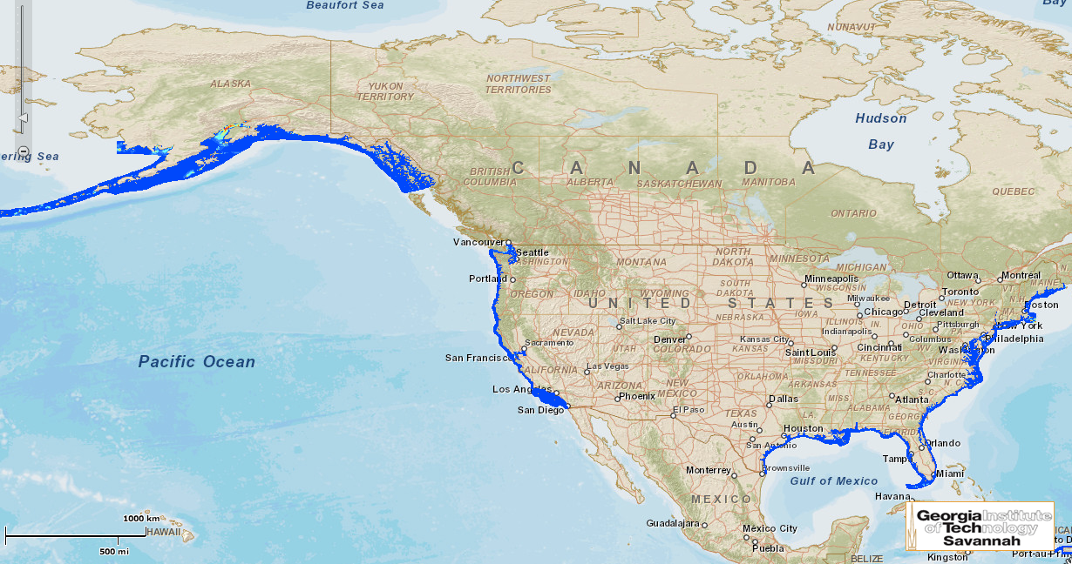
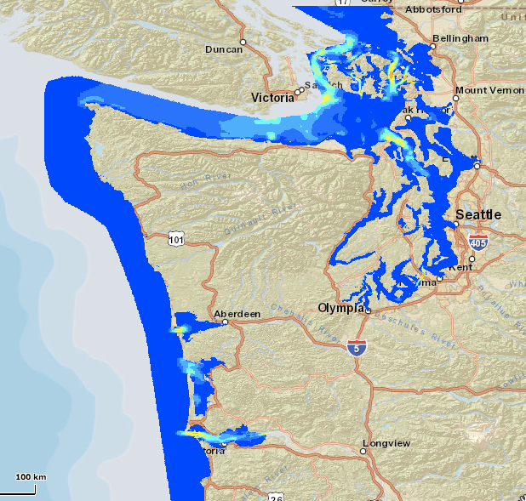
Tidal Energy Resource
Clean, renewable, predictable energy source; close to population centers
DOE Resource Assessment: potential 250 TWh/year electricity generation (~6% of US usage)
http://www.tidalstreampower.gatech.edu/
Notes:
Only 6% of total, but that can be concentrated where the people are

Slide 4
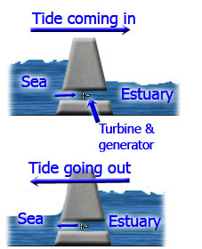
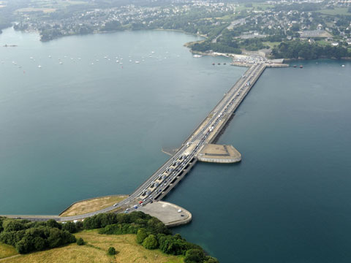
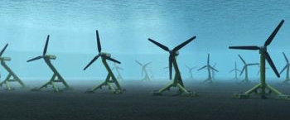
Tidal Energy Conversion Technology
Barrages - use pressure differences on either side of a dam
In-Stream Turbine – in the flow, invisible from surface
Rance, France – first and largest tidal barrage in the world: 240 MW
http://www.darvill.clara.net/altenerg/tidal.htm
http://www.theecologist.org/News/news_analysis/67808how_france_eclipsed_the_uk_with_brittany_tidal_success_story.html
http://www.infoniac.com/environment/world-s-biggest-tidal-turbine-to-be-built-in-scotland.html
Notes:
Barrages change tidal cycle and cause transportation issues – bad for tidal ecosystem
In stream – can’t SEE, but ships aren’t affected, ecosystem isn’t changed (at least not nearly as much as barrage… still area of research)

Slide 5
Where are we now?
Bay of Fundy – successes and setbacks
European Marine Energy Centre, Orkney, Scotland test center
Thorough site characterizations at Admiralty Inlet and Nodule Point, Puget Sound, WA
Notes:
Bay of Fundy – turbine plan 18 months, out after 6. Too strong, too turbulent… UNEXPECTED conditions
Highlights need for test sites for turbines as well as more thorough site characterization prior to installment

Slide 6
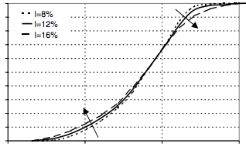
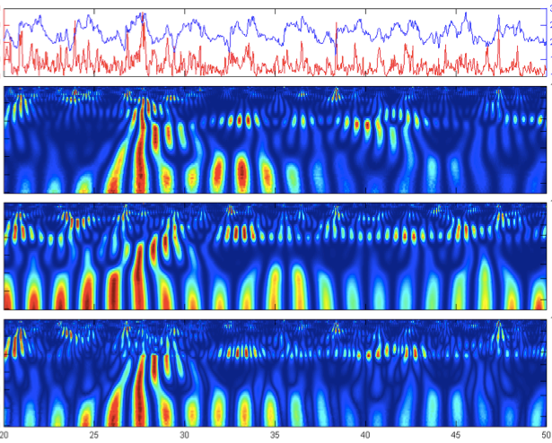
Learning from Wind
Turbulence effects on power production: turbulence intensity
Power
Red – CTKE
Blue – Dynamic Pressure
Wind speed
Kaiser et al 2007
Local CTKE Excitation
Turbulence effects on turbine mechanics (loads and subsequent gear box failures): coherent turbulent kinetic energy
Local Dynamic Pressure Response
Local Relative Energy Flux
Time (seconds)
Kelley et al 2005
Notes:
It is hard to gather many observations in the water, to know what even needs to be measured, so we learn from the wind industry what the important parameters are:
Turbulence intensity’s known effect no power production. EXPLAIN POWER CURVE.
Coherent turbulent kinetic energy’s effect on turbine loads (shown here are dynamic pressure and relative energy flux. EXPLAIN WAVELET MAP.

Slide 7
Goals
Take the knowledge and experiences of the wind energy industry to further the development of tidal energy, focusing on turbulence.
Do a thorough physical description of the turbulence that will affect a tidal turbine
Site classification for decision-making
Describe realistic turbulence with metrics that can be used to improve models
Turbulent in-flow generators: National Renewable Energy Laboratory’s TurbSim/pyTurbSim
Tidal Array scale: ROMS
Turbine scale: LES

Slide 8
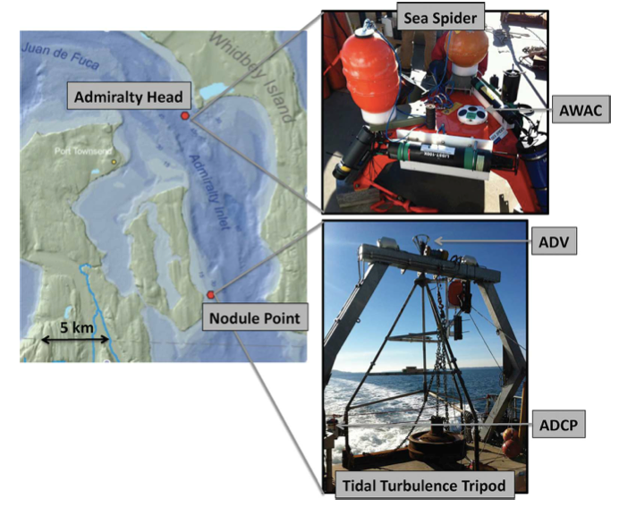
Nodule Point, Puget Sound, WA
Latitude | N 48 01.924’
Longitude | W 122 39.689’
Depth | 22m
Dates | Feb 17-21, 2011
Sampling Frequency | 32 Hz
Noise | 0.02 m/s
Proposed Hub Height | 4.7m
Hub Height Max. Velocity | 1.8 m/s
Thomson et al, 2012
Notes:
Two observational campaigns
Describe ADCP – can’t calculate higher order statistics because of the inherent noise from beam spread.
Describe ADV – higher resolution, but only one height.
Velocities at NP: max of 1.8 m/s, 0.8 m/s slack tides shown.

Slide 9
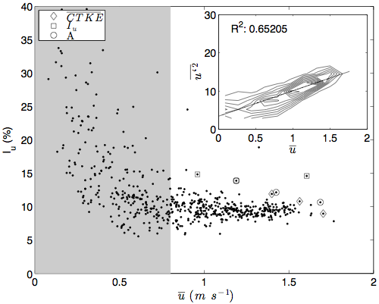
Turbulence Metrics
Turbulence Intensity:
Coherent Turbulent Kinetic Energy:
StDev u (m/s)
I_{u} (%)
Mean u (m/s)
Notes:
Iu is purely statistical, and therefore saying nothing about the physical turbulence
CTKE is instantaneous – not REALLY “coherent” but it does get closer to the correlations through the cross terms of the Reynolds Stresses

Slide 10
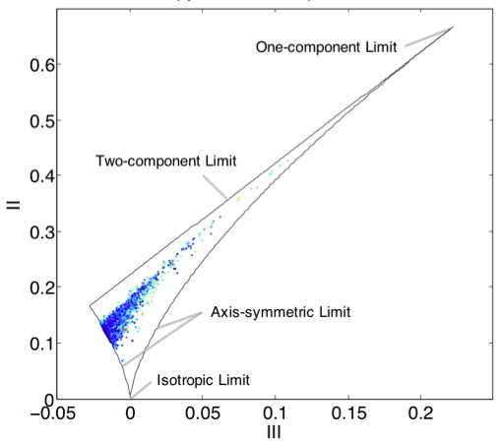
Turbulence Metrics
One component limit
Anisotropy Tensor
Invariants:
CTKE-like, but built from invariants: Anisotropy Magnitude
Independent of chosen coordinate system
Two component limit
All real flows fall somewhere in this triangle
Three component limit
Notes:
CTKE and Iu change depending on chosen principle axes
Use metric well-founded in turbulence theory, and the invariants that are universal.
Lumley Triangle has physical description of 1, 2 and 3 comp turbulence

Slide 11
Physical Turbulence
What physical features are there to turbulence?
Size – how big? The size of the turbine? Larger? Smaller?
Frequency – how often do these “events” happen?
Shape – flat, pancake-like? 3-d
How do we measure these?
Coherence – how long is the flow correlated?
Intermittency – how “random” is the flow?
Anisotropy – how many velocity components contribute to the fluctuating velocity?

Slide 12
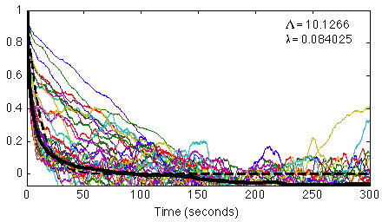
Coherence
Temporal Autocorrelation
Integral Scale
Taylor Scale
Λ=10.13 sec
λ=0.08 sec
R(τ) (%)
τ (seconds)
Notes:
Integral scale – how long is it correlated?
Taylor scale – how long until it’s no longer correlated?

Slide 13
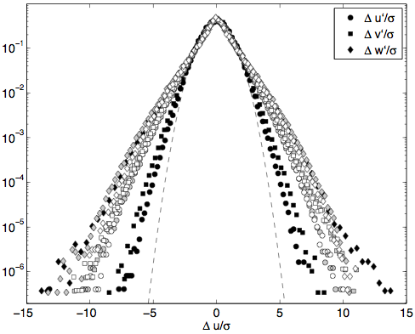
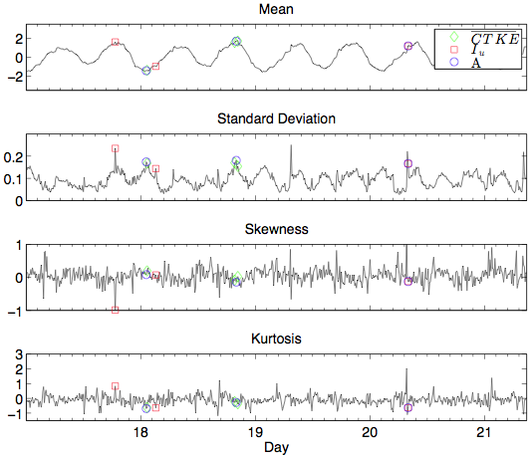
Intermittency
Intermittency manifests itself in departures from a normal distribution in the probability density function of velocity differences.
Mean
Standard Deviation
Probability
Skewness
Kurtosis
Δu/σ
Pdfs of the velocity perturbation differences, ∆u’ (circles), ∆v’ (squares), and ∆w’ (diamonds), with Gaussian curves for reference (dashed). Black shapes have a time step of ∆t = 1 (~3 cm), gray are ∆t = 115 (~3 m), and white are ∆t = 230 (~6 m).
Higher order moments support the lack of Gaussianity in the pdfs.

Slide 14
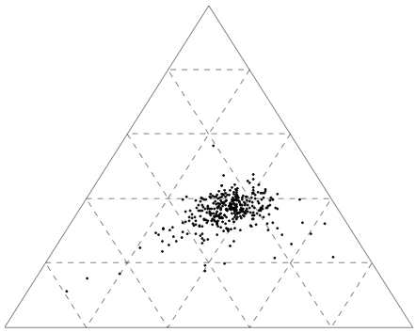
Anisotropy
Improvement to the anisotropy analysis: For eigenvalues, λ_{i}, of the anisotropy tensor, a_{ij}, ordered from greatest to least, the barycentric coordinates are defined by:
Three component limit
C_{1c} : one-component limit –
linear
C_{2c} : two-component limit –
planar
C_{3c} : three-component limit –
isotropic
One component limit
Two component limit
Banerjee et al 2007

Slide 15
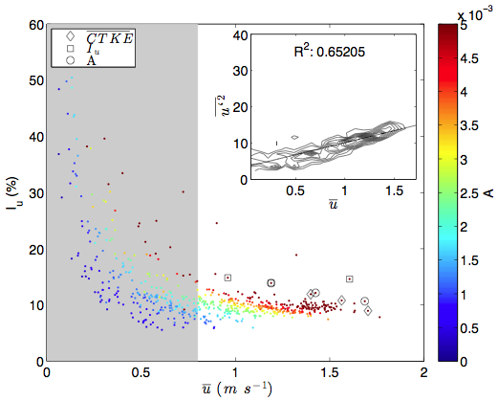
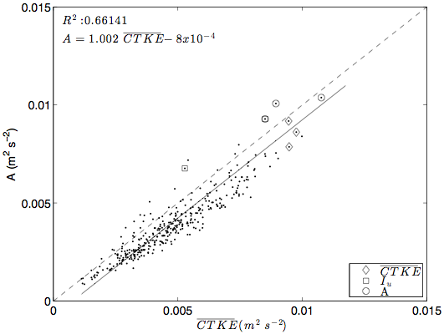
Parameterization
How do we represent how “turbulent” a location is?
Often turbulence intensity is all that is used
What about intermittency, coherence, and anisotropy?
I_{u} (%)
A (m²/s²)
A (m²/s²)
Mean u (m/s)
CTKE (m²/s²)
Notes:
Mean u doesn’t tell us everything for Iu…. What about A? Color by A add information about the anisotropy. Not directly correlated with Iu,
A was made to be like CTKE, and they are closely correlated, so use A instead of CTKE.

Slide 16
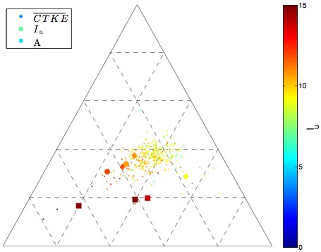
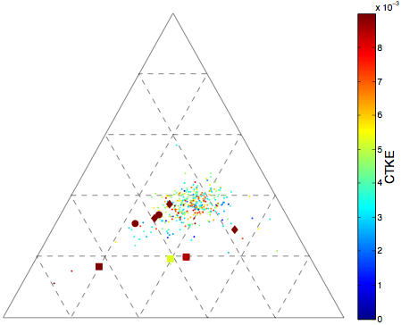
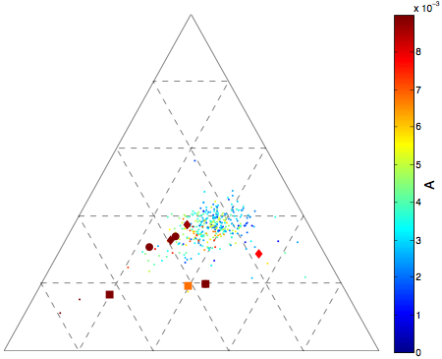
Parameterization: Shape
Three
The highest instance of each parameter (large shapes) is close(r) to the one-component limit.
I_{u} (%)
One
Two
CTKE (m²/s²)
I_{u} only measures one component (u)
A (m²/s²)
A is better than CTKE
Notes:
Big shapes are the highest for each parameter – notice they’re closer to 1 comp.
CTKE is completely scattered.
Iu only measures one component by definition, so it is skewed.
A is better then CTKE.
REMAKE THESE FIGURES!!!!!!!!!!!!!

Slide 17
Parameterization: Size
 | λ | Λ
I_{u} | 0.596 | 0.450
CTKE | 0.680 | 0.017
A | 0.884 | 0.317
A (m²/s²)
λ (seconds)
The anisotropy magnitude, A, captures the the behavior of CTKE (and therefore loads?), intermittency in the pdf, the shape from the barycentric map, and the coherence of the correlation function.

Slide 18
Conclusions
A new, tensor-invariant metric for physically describing turbulence, the anisotropy magnitude, is introduced
Turbulence intensity does not parameterize intermittency, coherence, or anisotropy as well as other easy-to-measure metrics such as CTKE and A.
The anisotropy magnitude does the best job at representing intermittency, coherence, and anisotropy.
If A is similar to CTKE, does it have the same strong correlation to turbine loads?
How well does the coherence function in pyTurbSim represent the observations in terms of A?

Slide 19
Next step…
How do the statistics calculated from the model output compare to those from the observations?
How well do the models do at generating realistic turbulence?
The NREL pyTurbSim model (Jonkman & Kilcher) creates stochastic turbulence.
The NCAR LES model (Sullivan et al.) includes more realistic ocean physics.
J. Jonkman, L. Kilcher, TurbSim user’s guide: Version 1.06. 00, Golden, CO: National Renewable Energy Laboratory (2012).
P. P. Sullivan, J. C. McWilliams, C.-H. Moeng, A subgrid-scale model for large-eddy simulation of planetary boundary-layer flows, Boundary Layer Meteorology 71 (1994) 247–276.

Slide 20
Introduction to pyTurbSim
Stochastic turbulence generator
Inputs:
Background mean flow profile
Spectral density curve
Turbulence intensity and Reynolds stresses
Method:
Inverse fast Fourier transform
Optional additional spatial coherence function
Outputs:
Three-component velocity time series
Model Input
Latitude | 48N
Depth (RefHt) | 22m
U_{ref} | 1.8 m/s
Sampling Frequency (timestep) | 10 Hz
Hub Height | 4.7m
___________________ u’w’ | .0011 m²/s²
__________________ u’v’ | .0009 m²/s²
_____________________ v’w’ | .0004 m²/s²
Turb Model | TIDAL
Profile Type | H2L (log)

Slide 22
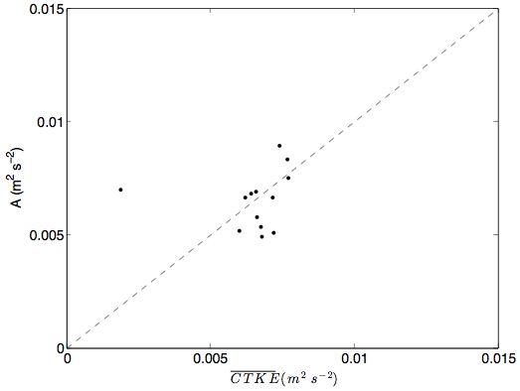
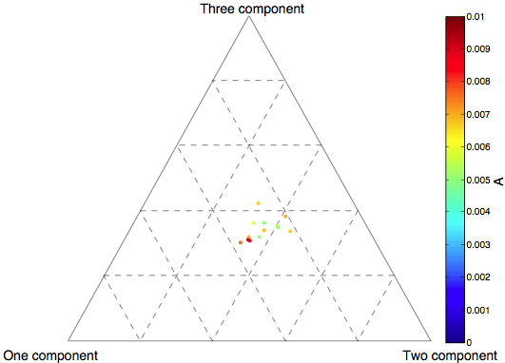
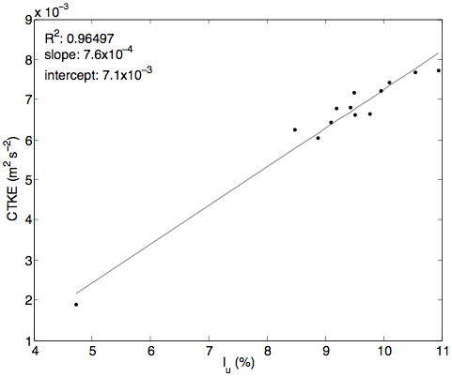
Preliminary Results
Baseline statistics, before coherence is added
A (m²/s²)
CTKE (m²/s²)
A (m²/s²)
CTKE (m²/s²)
I_{u} (%)

Slide 23
Thank you!
Stay tuned for model results at the Boulder Fluid Seminar December 10th!

